Slide 1
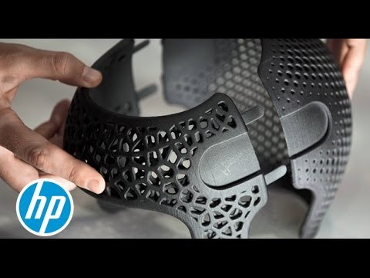
Documentation on 3d printing (Future is in your choice )
Prepared by :
Rajendra Prasad Sarala
Design Engineer
SH RK DREAMS PVT LTD.,

Slide 2
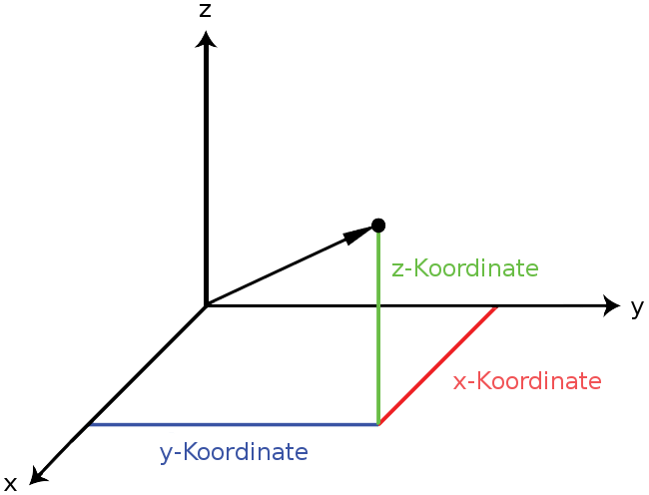
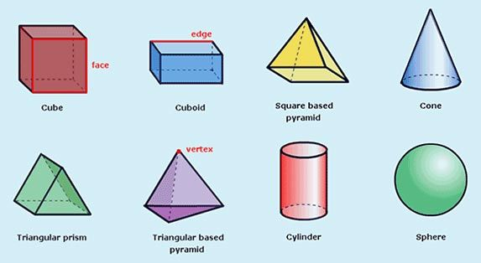
3D – (THREE DIMENSIONAL)
In computers, 3-D (three dimensions or three-dimensional) describes an image that provides the perception of depth.
When 3-D images are made interactive so that users feel involved with the scene, the experience is called virtual reality.
You usually need a special plug-in viewer for your Web browser to view and interact with 3-D images. Virtual reality experiences may also require additional equipment.

Slide 3
3D PRINTING : (The Impossible Is Possible)
It is a manufacturing process which builds real, solid objects from digital models found in computer files.
In any various process in which material is joined solidified under computer control create a three-dimensional object.
There are many different technologies, like stereolithography (STL) or Fused Deposit Modelling (FDM).
3D printed models created with CAD result in reduced errors and can be corrected before printing, allowing verification in the design of the object before it is printed.
Through the printer produced High Resolution of output.
3D printing will only make the printing of objects faster, less expensive and more reliable than traditional manufacturing.
Currently in market so many no.of 3d Printer company’s there. Based on customer requirements 3d printers available.
It can print any unstructured design also.

Slide 4
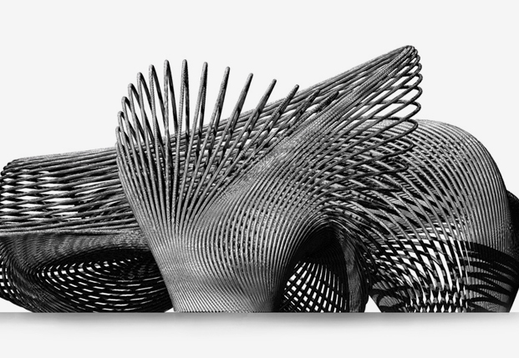
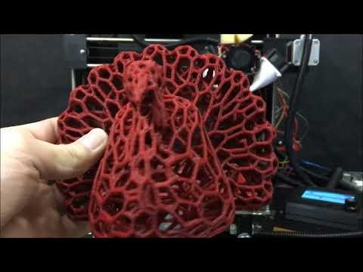
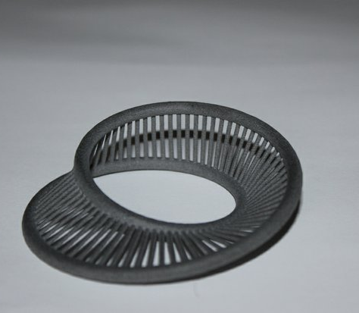
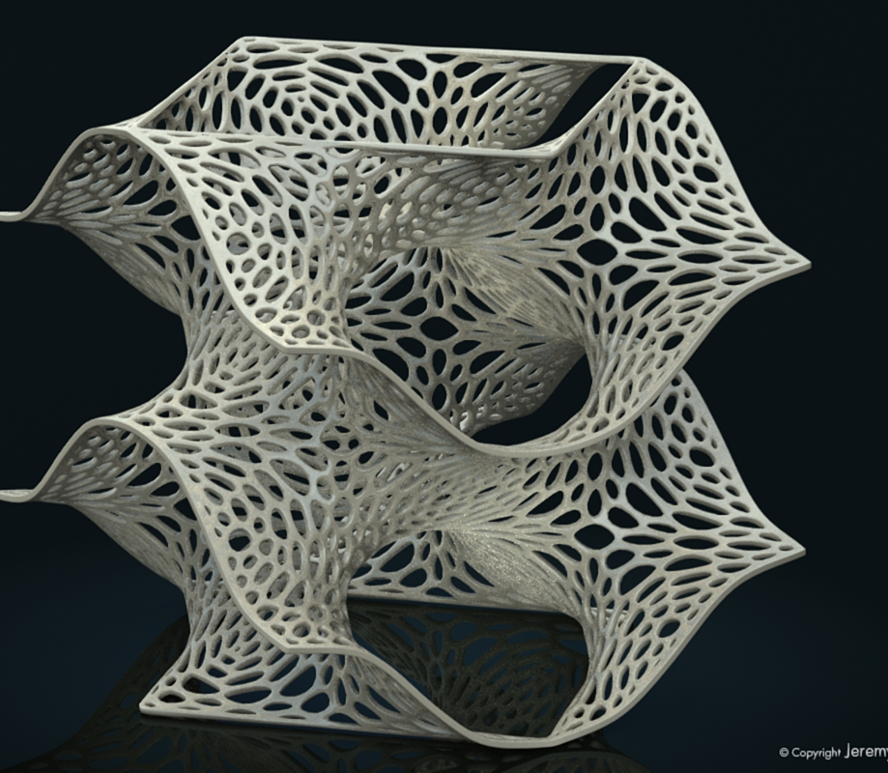
UNSTRCTURED MODELS :
These models cannot manufacture through CNC machines. Only possible in 3d printing.

Slide 5
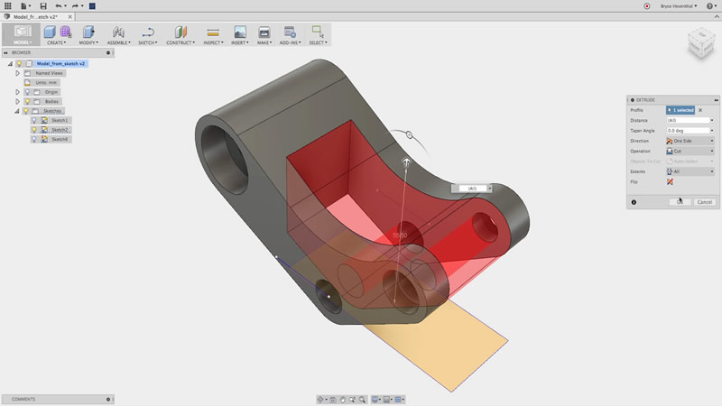
3D MODELING SOFTWARES:
AUTO CAD
CATIA
PRO-E
3DS-MAX
SOLID WORKS
FUSION 360
INVENTOR
BLENDER
SKETCHUP Etc.,

Slide 6

3D PRINTING SUPPORTED FILE FORMATS:
STL FORMAT -STL files are a standard file type that interfaces between Computer Aided Design (CAD) software and 3D printers
OBJ FORMAT - OBJ is an open file format that represents 3D geometry.
HOW TO CONNECT TO PRINTER :
Based on printer specifications. Most of the printers supports.
Usb , Sd card
USB Stick, Ethernet.
Power Cable, Wi-Fi.

Slide 7
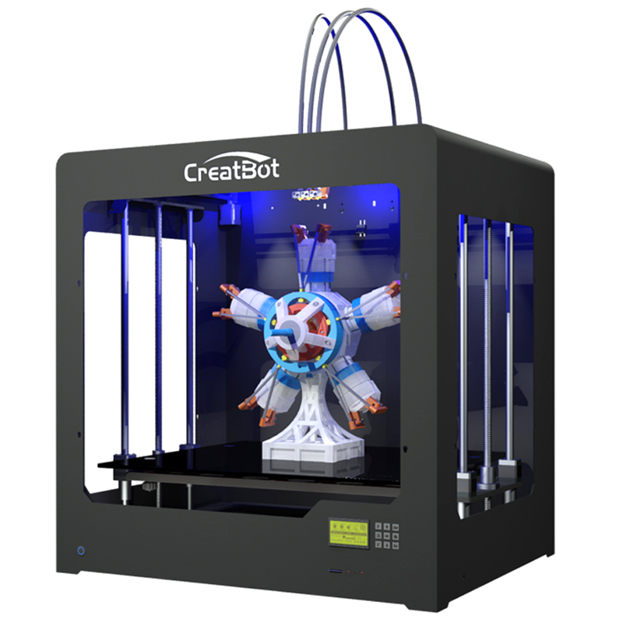
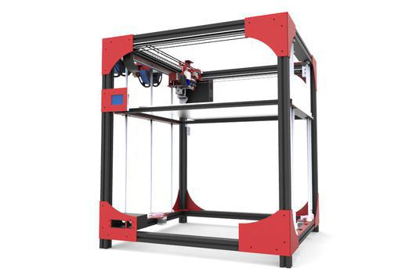
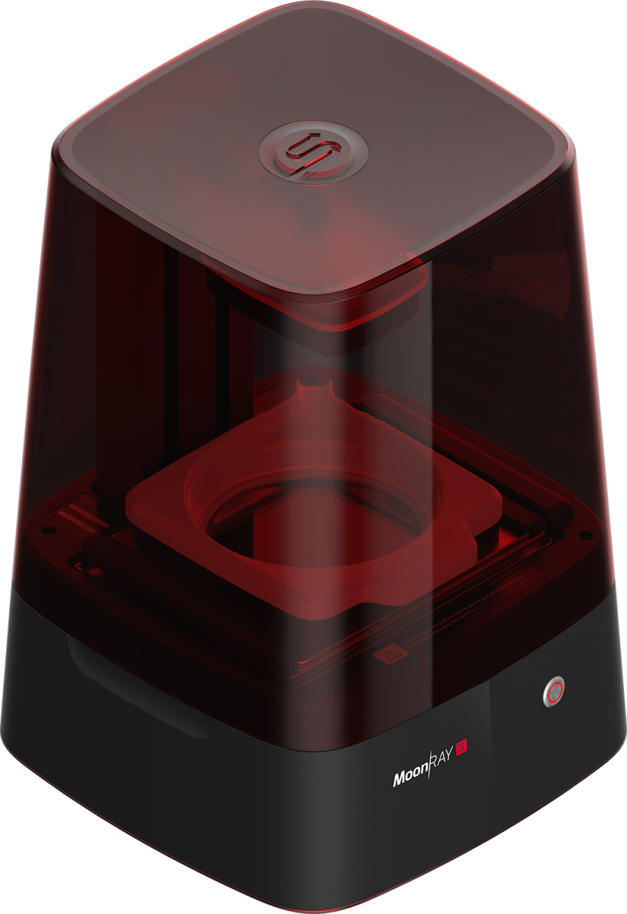
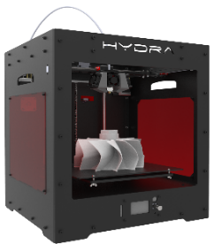
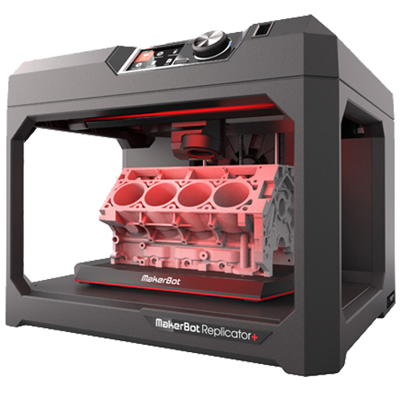
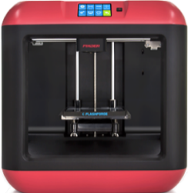
SOME OF 3D PRINTER MODELS :
MODIX BIG 60
MOONRAY DLP WIRELESS -SPRINT RAY
CreatBot-DG-3D
Flashforge Finder
MakerBot Replicator
Hydra Pro

Slide 8
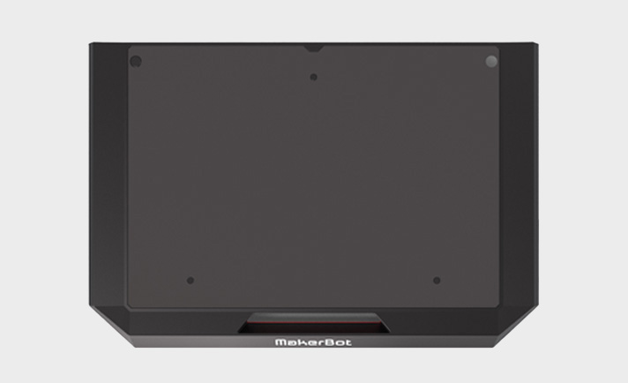
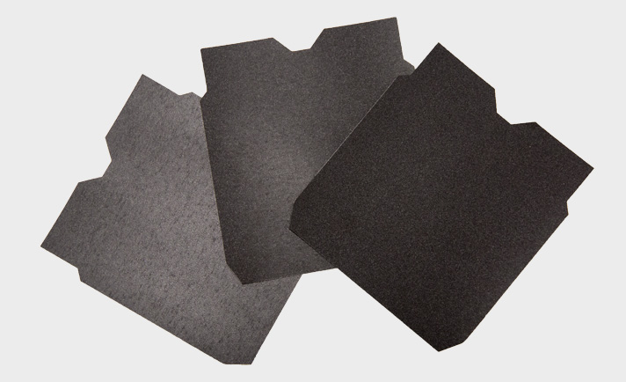
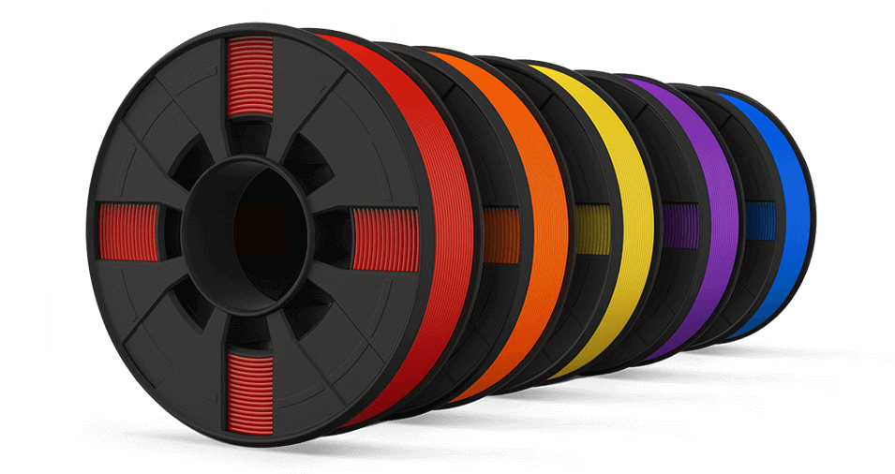
HOW IT WORKS:
Build plate :
It is base plate in 3d printer Surface print in this plate.
It is flexible.
Easily remove the product after print.
G-Stage Surface:
G-stage surface is placed downside of build plate.
It’s move the base plate up and down for print layer.
Filament:
This is material for 3d printing.
This filament will be fixed in the back of the printer.
Filament minimum dia is 1.75 mm , Maxim 2.75mm

Slide 9
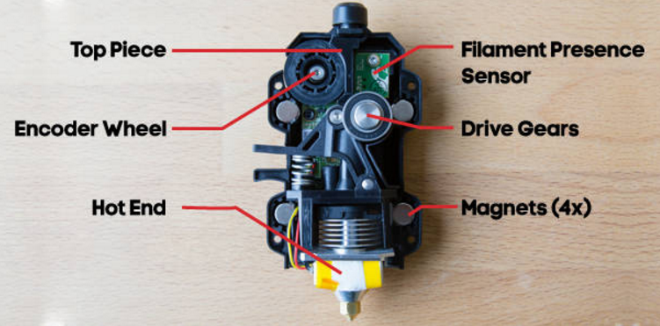
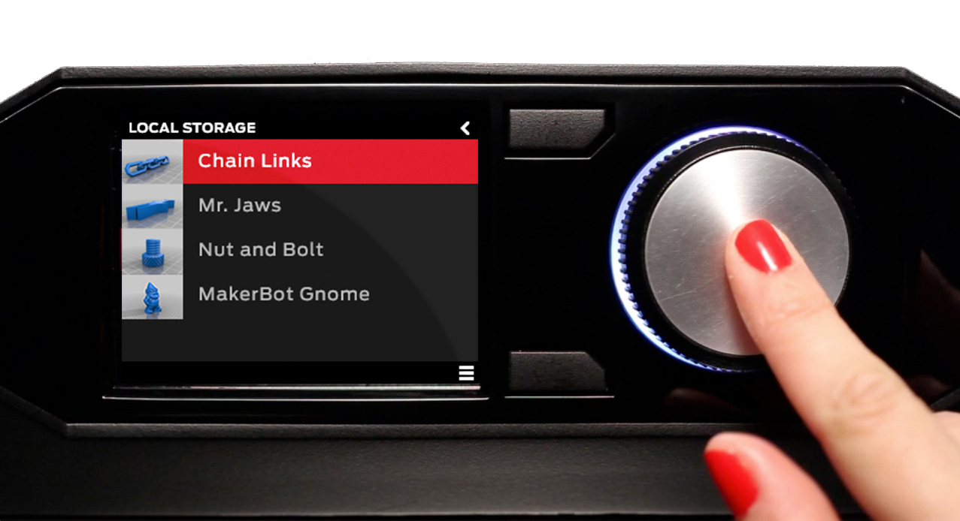
Extruder:
Extruder attached to the carriage.
Extruder connect to magnet snap.
Nozzle having heat Temperature 215º C
Control Panel:
Operate the Sd card and select the 3d model.
Setting up temperature and extruder magnet snap.
Always maintain speed average then only product get good finish.

Slide 10
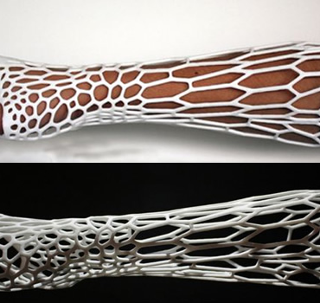
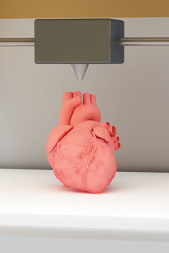
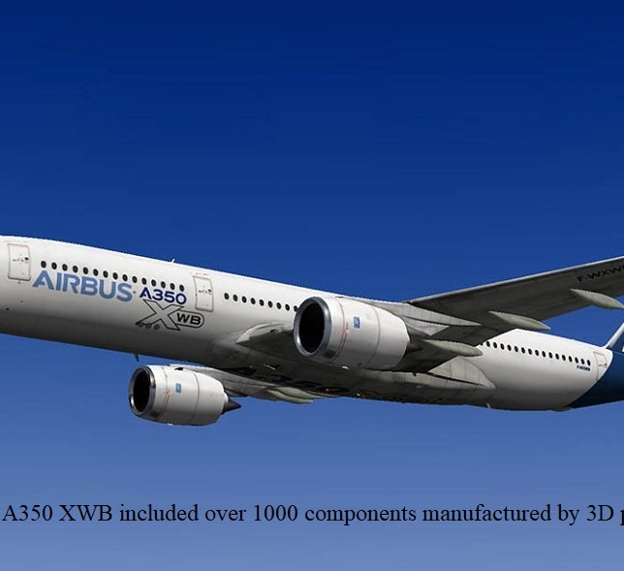
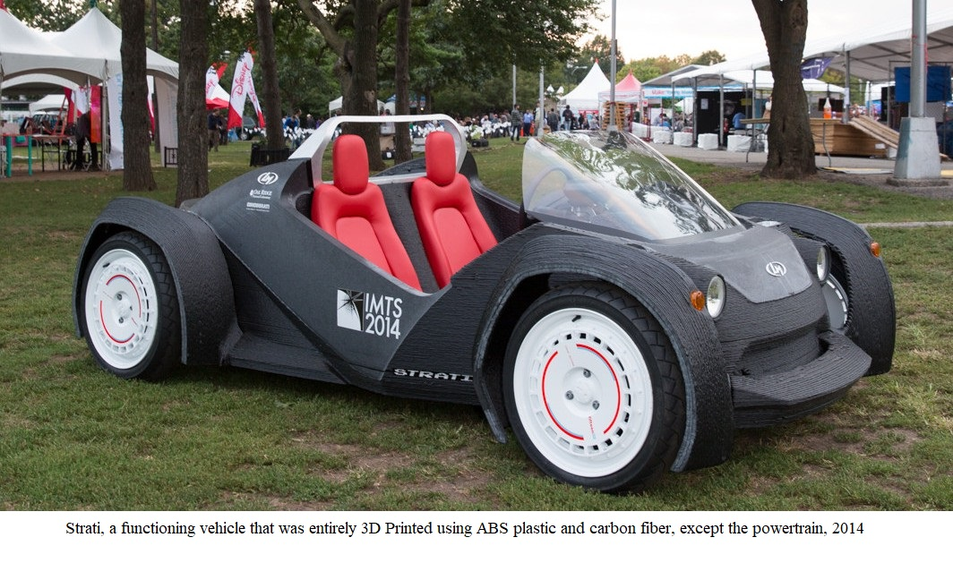
3D PRINTERS APPLICATIONS :
It cover various sector from Education to industry
Healthcare
Aerospace
Automobiles
Manufacturing
Clothing
Construction
Electronic Gadgets

Slide 11
3D PRINTING MATERIALS :
ABS (Acrylonitrile Butadiene Styrene) – (Cost Per Kg - (20-50$))
PLA (Polylactic Acid) - (Cost Per Kg - (20-50$))
PVA (Polyvinyl Alcohol) - (Cost Per Kg – (>100$))
NYLON (PA- Polyamide) – (Cost Per Kg - (18$))
HDPE (High - density polyethylene) - (Cost Per Kg - (30$))
T-Glase/PETT (PETT - Polyethylene terephthalate) - (Cost Per Kg - (30$))
Wood Filament - (Cost Per Kg - (60-100$))
Metal Filament - (Cost Per Kg - (75-120$))
Carbon Fiber Mix - (Cost Per Kg - (50-120$))
Flexible Filament - (Cost Per Kg - (50-120$))
Conductive Filament – (Cost per 100g reel – ($70))

Slide 12
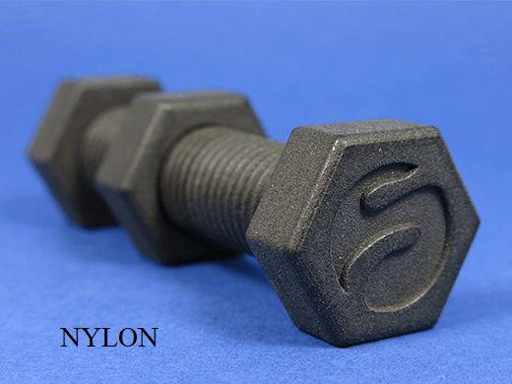
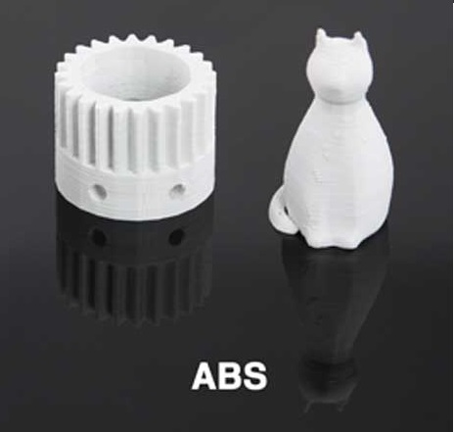
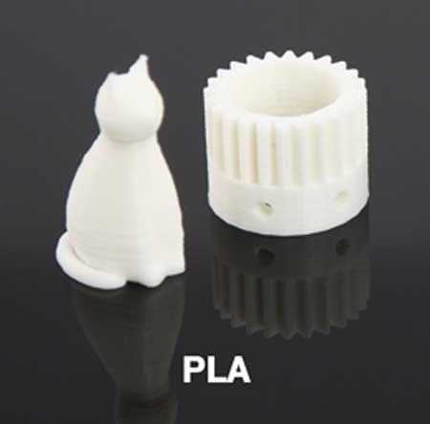
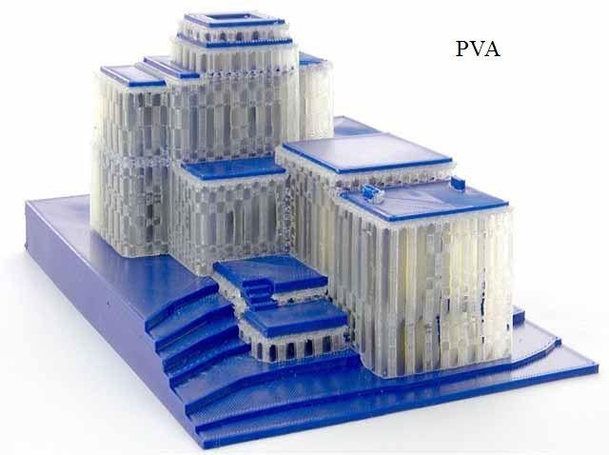
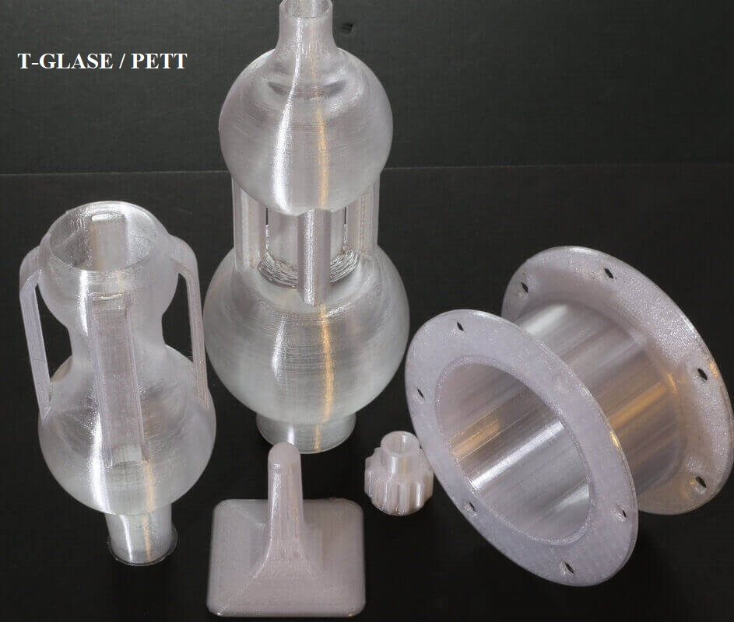
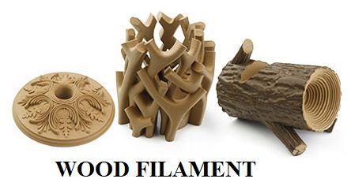
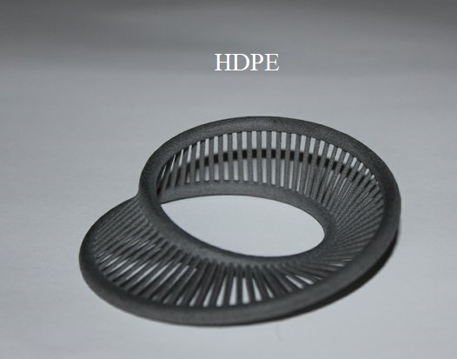
3D PRINTING MATERIALS

Slide 13
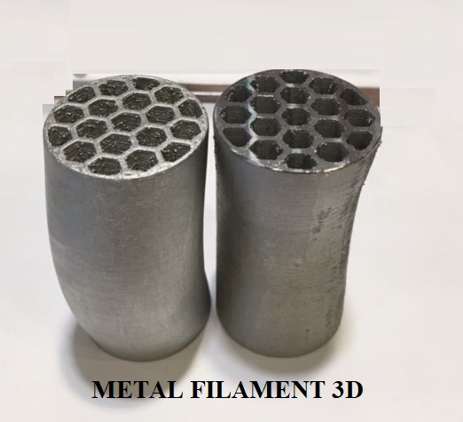
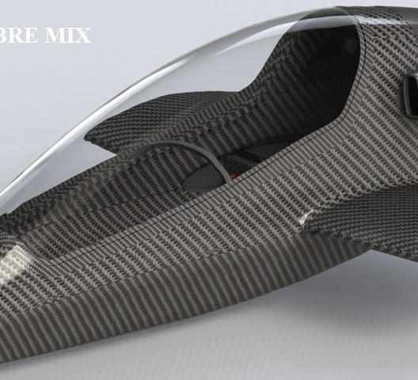
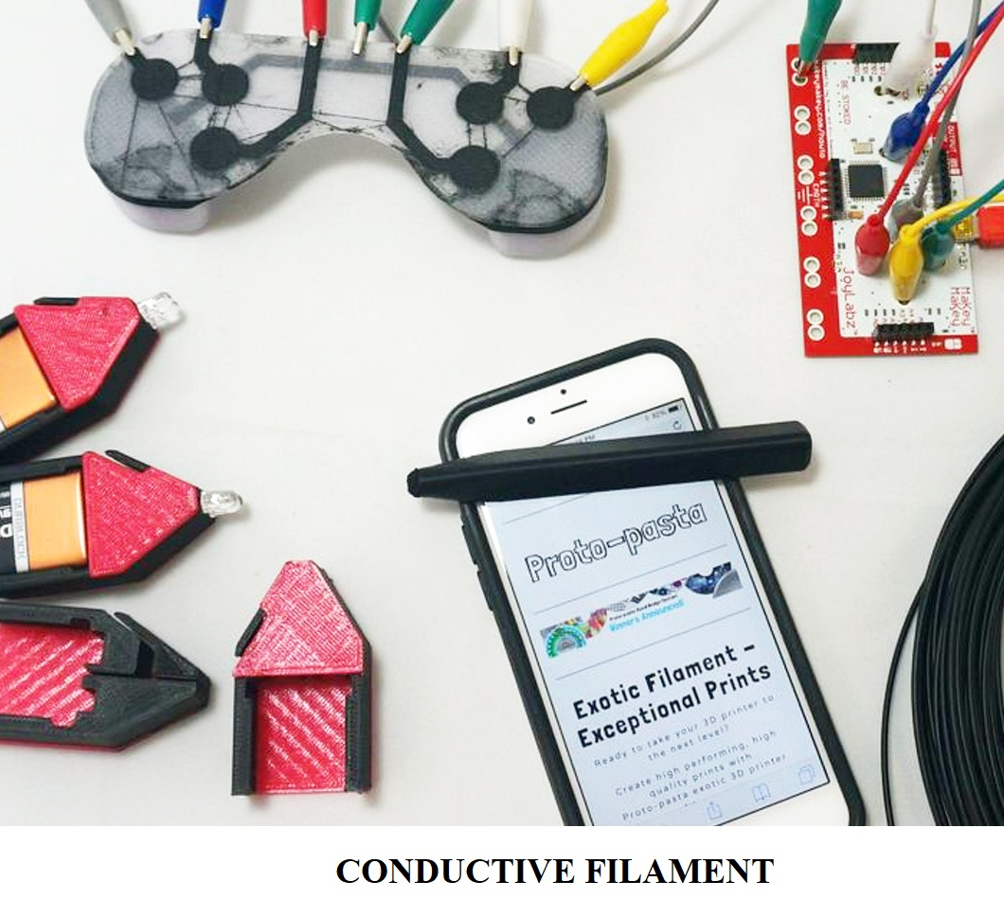
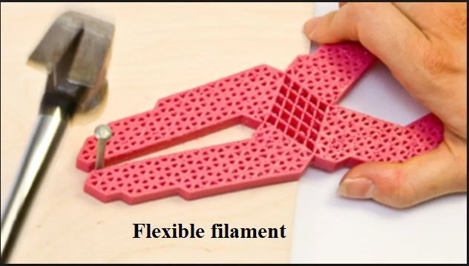
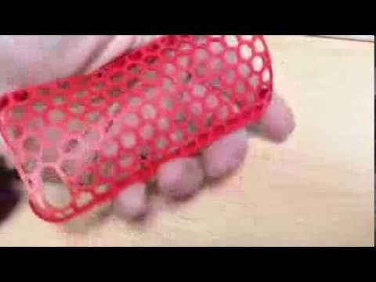
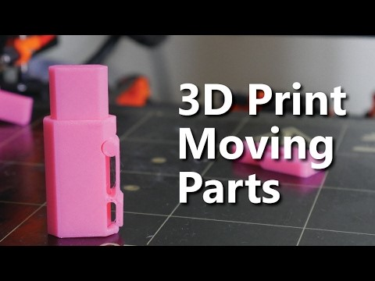
Material SAMPLES

Slide 14
Material Properties :
ABS :
ABS comes the closest to the material of real production models, it’s primarily used for fully functional applications including snap-fits, end-use components and prototypes for form, fit functional testing.
ABS is roughly twice the cost of producing polystyrene, it is considered superior for its hardness, gloss , toughness and electrical insulation properties.
PLA :
PLA has a wide range of applications, ranging from medicine, due to bio-compatible properties to packing, electronics etc.,
PLA can be manufactured with the addition of various types of fillers. The thermal properties of polylactide show that it can also be used as a raw material to produce various types of insulation barriers.

Slide 15
Continue..
PVA :
PVA is partially crystalline upon formation and is characterized by properties such as chemical resistance, water solubility, and biodegradability
Major advantages of this physical structure are its high filtering efficiency, its ability to be reused after cleaning (non-medical uses only), and its impressive retention and wicking properties.
NYLON :
Nylon is a synthetic thermoplastic linear polyamide, nylon is used for a variety of applications to include clothing reinforcement in rubber material like car tires, for use as a rope or thread, and for a number of injection molded parts for vehicle and mechanical equipment.
It is exceptionally strong relatively resistant to abrasions and moisture absorptivity, long lasting, resistant to chemicals, elastic and easy to wash.

Slide 16
Continue..
HDPE :
High-density polyethylene (HDPE) or polyethylene high-density (PEHD) is a polyethylene thermoplastic made from petroleum.
HDPE is a rigid, tough plastic that offers good chemical resistance and low moisture absorption. HDPE is stronger and more rigid than LDPE.
Plastic refers to a group of synthetic or semi-synthetic materials that have been engineered to achieve specific properties.
T-GLASE / PETT :
As a raw material, PET is globally recognized as a safe, non-toxic, strong, lightweight, flexible material that is 100% recyclable.
In fact, it’s the most widely recycled plastic in the world! Virtually all municipal recycling programs in the US accept PET packaging, with recycling of thermoformed PET containers on the rise.

Slide 17
Continue..
WOOD FILAMENT :
Wood 3D printer filament is typically made from recycled wood fibers and polymer binders which will extrude just like any other plastic filament. A number of various plastic filaments that resemble wood are currently available now.
Similar to other composite filaments, wood filaments are made from standard PLA infused with very finely powdered wood materials. The material fused with PLA may be wood dust, cork, bamboo, or other powdered wood derivatives. Most wood filaments in the market today consist of around 60 to 70% PLA and 30 to 40% wood fibers.
METAL FILAMENT :
3D printing filament is created using a process of heating, extruding and cooling plastic to transform nurdles into the finished product. Unlike a 3D printer the filament is pulled rather than pushed through the nozzle to create the filament, the diameter of the filament is defined by the process that takes place after the plastic has been heated rather than the diameter of the extruder nozzle.
The diameter is often measured by a laser as part of a quality control mechanism to ensure correct diameter of the filament. The filament is then fed through a warm water tank which cools the filament which gives the filament its round shape.

Slide 18
Continue..
CARBON FIBRE MIX :
Carbon fiber is a wonder substance that when combined with resin to form a composite, results in a very strong and light material. It’s been used in many exotic applications that have grown a powerful reputation for the material.
Carbon fibers are created in long strands on spools, and then often woven into sheets that are applied with resin to form the strong carbon fiber shapes, as shown at top. This is why many carbon fiber objects have a very regular pattern on their surfaces.
FLEXIBLE FILAMENT:
Flexible filaments are made of Thermoplastic Elastomers (TPE) which are a blend of hard plastic and rubber. As the name suggests, this material is elastic in nature allowing the plastic to be stretched and flexed easily.
CONDUCTIVE FILAMENT:
Another application of conductive Graphene PLA Filament is in the creation of electrically conductive circuitry for use in electronics.
Traditionally, 3D printing enthusiasts needed to add circuitry to their creation after it was printed in plastic, using copper wire; by offering conductive filament, you can print Graphene wiring simultaneously with your build process.

Slide 19
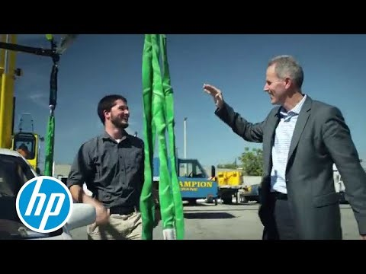
STRENGHT ABILITY:
Strength is not always easy to define—much depends on what you intend to do with an object after you print it. Are you bending it? Hanging something from it? Does it need to withstand impact or heat? Different materials support different combinations of toughness and tensile strength.
Most 3D-printing enthusiasts know the strength of common materials including ABS, PLA and nylon. We've prepared technical specifications on ABS and PLA here. TriMech offers a summary of common tensile strengths, including:
MATERIAL | TENSILE STRENGTH
ABS | 33 MPa (4700 psi)
NYLON | 48 MPa (7000 psi)
PLA | 50 MPa(7250 psi)
PC | 68 MPa (9800 psi)
PEI | 81 MPa (11735 psi)

Slide 20
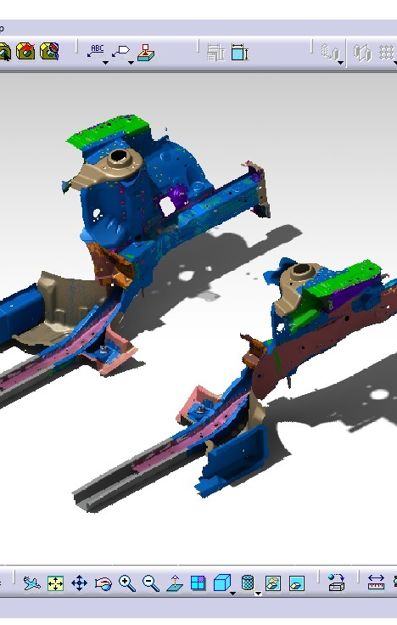
Modelling:
3D printable models may be created with a computer-aided design (CAD) package, via a 3D scanner, or by a plain digital camera and photogrammetry software.
The manual modelling process of preparing geometric data for 3D computer graphics is similar to plastic arts such as sculpting.
3D scanning is a process of collecting digital data on the shape and appearance of a real object, creating a digital model based on it.

Slide 21
3D PRINTER APPLICATIONS
In the current scenario, 3D printing or AM has been used in manufacturing, medical, industry and sociocultural sectors which facilitate 3D printing or AM to become successful commercial technology.
The earliest application of additive manufacturing was on the toolroom end of the manufacturing spectrum. For example, rapid prototyping was one of the earliest additive variants, and its mission was to reduce the lead time and cost of developing prototypes of new parts and devices, which was earlier only done with subtractive toolroom methods such as CNC milling, turning, and precision grinding.
3D printing has entered the world of clothing, with fashion designers experimenting with 3D-printed T-shirts, shoes, and dresses.
In commercial production Nike is using 3D printing to prototype and manufacture the 2012 Vapor Laser Talon football shoe for players of American football, and New Balance is 3D manufacturing custom-fit shoes for athletes.
3D printing has come to the point where companies are printing consumer grade eyewear with on-demand custom fit and styling (although they cannot print the lenses). On-demand customization of glasses is possible with rapid prototyping.

Slide 22
Continue..
In cars, trucks, and aircraft, AM is beginning to transform both
(1) Unibody and fuselage design and production
(2) Powertrain design and production.
In early 2014, Swedish supercar manufacturer Koenigsegg announced the One:1, a supercar that utilizes many components that were 3D printed. Urbee is the name of the first car in the world car mounted using the technology 3D printing (its bodywork and car windows were "printed").
In 2014, Local Motors debuted Strati, a functioning vehicle that was entirely 3D Printed using ABS plastic and carbon fiber, except the powertrain. In May 2015 Airbus announced that its new Airbus A350 XWB included over 1000 components manufactured by 3D printing.
In 2015, a Royal Air Force Eurofighter Typhoon fighter jet flew with printed parts. The United States Air Force has begun to work with 3D printers, and the Israeli Air Force has also purchased a 3D printer to print spare parts.

Slide 23
Continue..
In 2017, GE Aviation revealed that it had used design for additive manufacturing to create a helicopter engine with 16 parts instead of 900, with great potential impact on reducing the complexity of supply chains.
Doctors 3D-print 'living' body parts. Custom-made, living body parts have been 3D-printed in a significant advance for regenerative medicine, say scientists. The sections of bone, muscle and cartilage all functioned normally when implanted into animals.
House 3D printers use paste extrusion to build houses. It is a similar technology to the one that FFF (Fused filament fabrication) 3D printers use. Paste-type material, such as concrete or mud, is pushed through the house 3D printer’s nozzle in layers. 3D printing in the construction industry helps save time, effort and material.

Slide 24
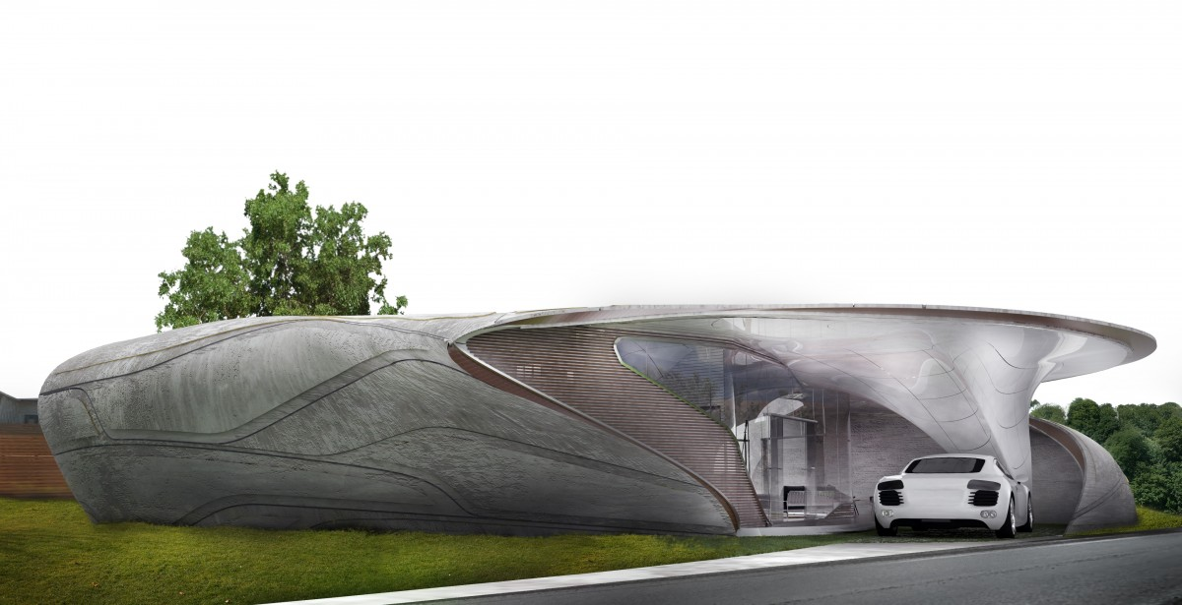
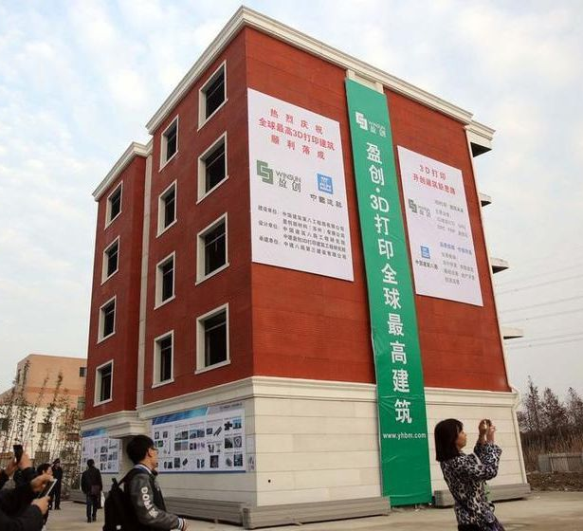
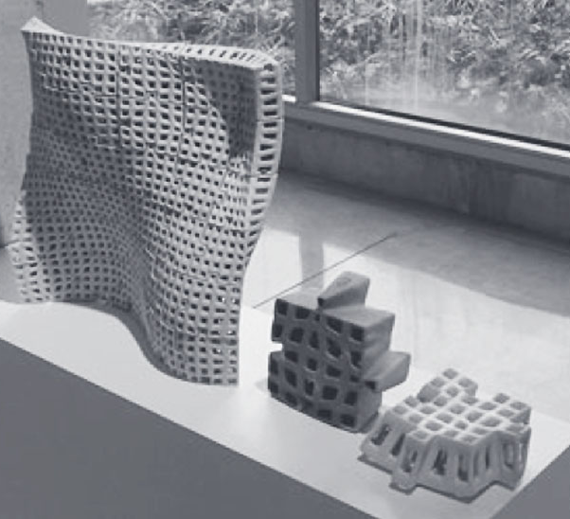
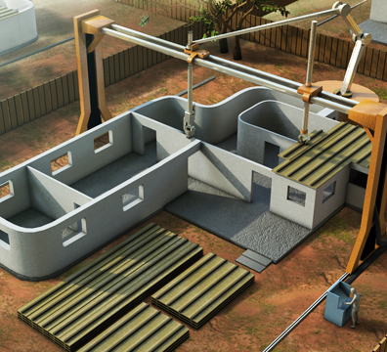
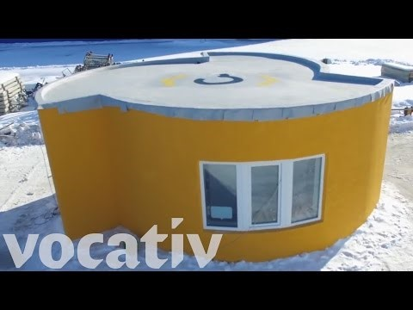
3D PRINTING HOUSE

Slide 25
BRANCH TECHNOLOGY (Architecture)
Branch Technology consists of a diverse team of architects, programmers, mechanical engineers, mathematicians and industrial designers focused on the common goal of revolutionizing the built environment.
Branch Technology passionate about translating the strength, beauty, and efficiency of nature into how to build.
Branch Technology an architectural fabricator specializing in large-scale 3D printing. We bring unprecedented design freedom and resource stewardship to the construction industry.
Branch Technology has combined 3D Printing, industrial robotics, and conventional building materials to enable a new way to build. This technology stack enables direct digital fabrication to provide you with cost effective design freedom.
With an inherently zero-waste process, Branch delivers products that offer improved materials strength, reduced energy use and job site efficiencies. Modular components are 3D printed in a factory environment, filled with conventional construction materials and later shipped to the job site for fast and simple assembly.

Slide 26
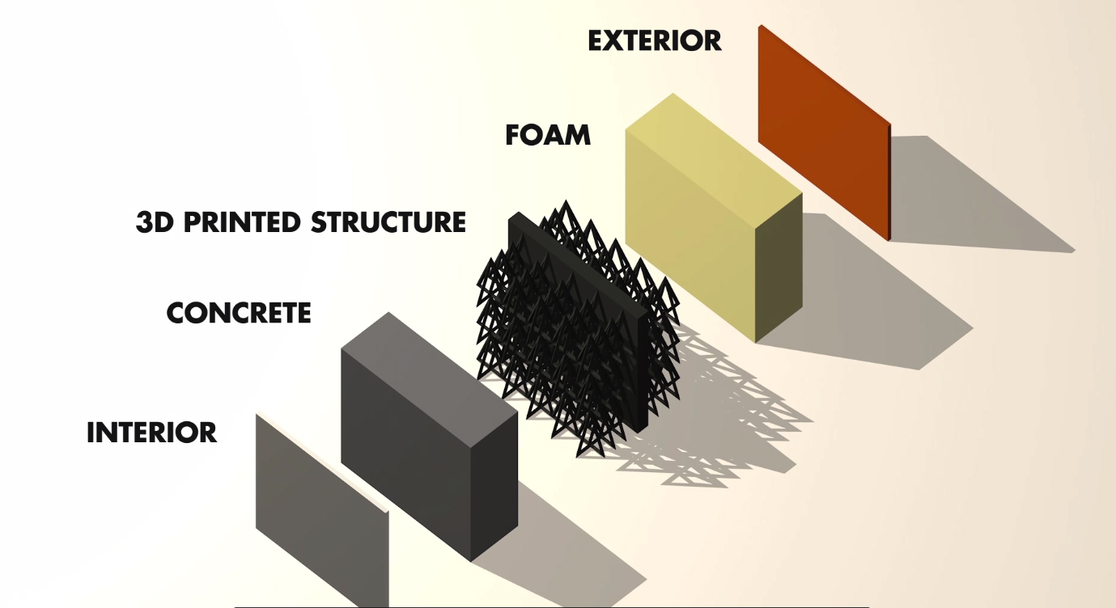
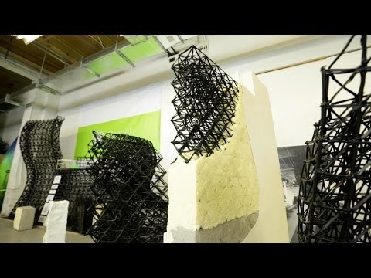
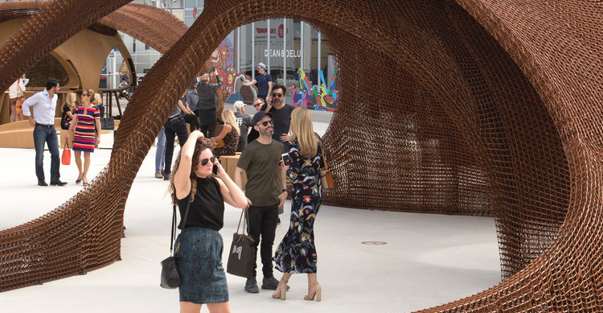
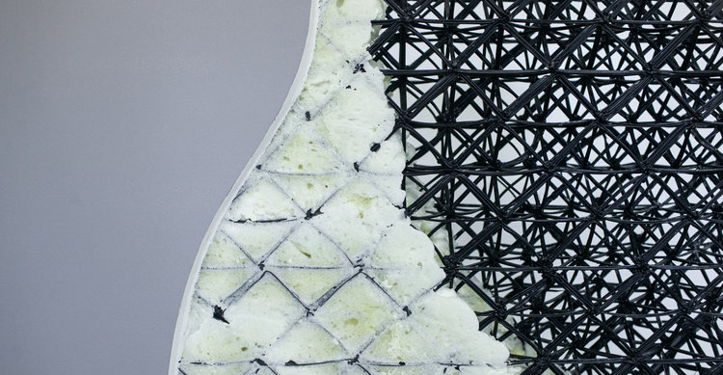
Branch Technology delivers products that democratize design for all — taking construction into a new era. C-FAB™ allows for virtually unlimited design freedom. The result is a lasting product that is as robust and beautiful as it is revolutionary.
The process starts with you. Send to model and see what you can create when you build like nature.
Branch is home of the world's largest freeform 3D printers. They offer a comprehensive solution to your project that includes engineering, manufacturing and installation. Through a design assist process, they will work with you to break down your design into modular parts that fit within our build envelope and allow for quick assembly on site.

Slide 27
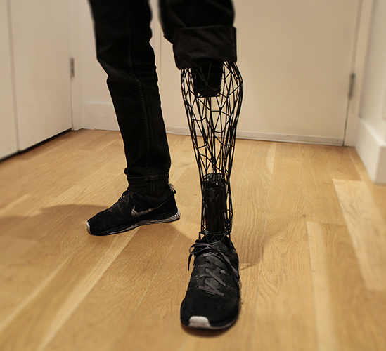
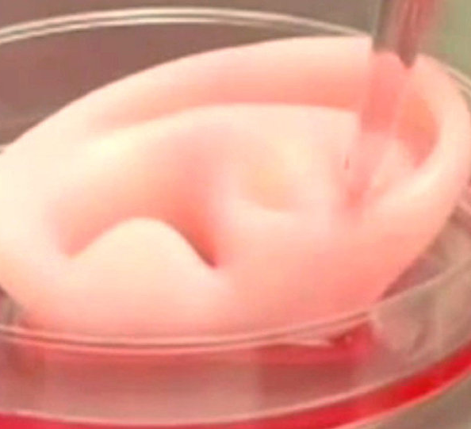
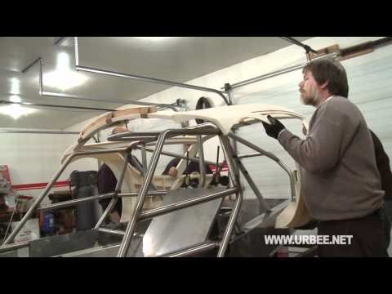

3D PRINTING MODELS IN SOCIETY

Slide 28

3D PRINTING BENEFITS :
We can download Mp3, Movies and Now times to download things also. For example your required laptop stand, mobile cases and toys etc., you can download from sites and print it.
Time and cost reduce on product.
From home you can create product and print.
Any customize object you can modify and based on requirement product can print.
Sites Are : Sketchfab.com
Thingiverse.com
      Myminifactory.com

Slide 29
CONCLUSION :
I have presented the concept of 3D printing technology in an encapsulated way including the comparison chart of cost and build time with the traditional manufacturing method for building parts.
Currently 3d revolution in market many fields like Aerospace, Electronics , Architecture, Cloths & Shoes, Medicines and Automobiles.
One can conclude that the 3D printing technology revolutionize and reshape the world as it is very exciting technology with huge potential also comprising the different technologies at one place, taking into account their economic benefits and social impact. Increase gradually day after day and significantly influence the human’s life, the economy and modern society.

Slide 30

ANY QUIRIES

Slide 31

THAN’Q’

