Slide 1
About OMICS Group
OMICS Group International is an amalgamation of Open Access publications and worldwide international science conferences and events. Established in the year 2007 with the sole aim of making the information on Sciences and technology ‘Open Access’, OMICS Group publishes 400 online open access scholarly journals in all aspects of Science, Engineering, Management and Technology journals. OMICS Group has been instrumental in taking the knowledge on Science & technology to the doorsteps of ordinary men and women. Research Scholars, Students, Libraries, Educational Institutions, Research centers and the industry are main stakeholders that benefitted greatly from this knowledge dissemination. OMICS Group also organizes 300 International conferences annually across the globe, where knowledge transfer takes place through debates, round table discussions, poster presentations, workshops, symposia and exhibitions.

Slide 2
About OMICS Group Conferences
OMICS Group International is a pioneer and leading science event organizer, which publishes around 400 open access journals and conducts over 300 Medical, Clinical, Engineering, Life Sciences, Pharma scientific conferences all over the globe annually with the support of more than 1000 scientific associations and 30,000 editorial board members and 3.5 million followers to its credit.
OMICS Group has organized 500 conferences, workshops and national symposiums across the major cities including San Francisco, Las Vegas, San Antonio, Omaha, Orlando, Raleigh, Santa Clara, Chicago, Philadelphia, Baltimore, United Kingdom, Valencia, Dubai, Beijing, Hyderabad, Bengaluru and Mumbai.

Slide 3

Keynote: Molecular Sensing Based on Optical Whispering-Gallery Mode Microsensors
Zhixiong “James” Guo
3rd International Conference and Exhibition on Biosensors & Bioelectronics August 11-13, 2014, San Antonio, Taxes, USA

Slide 4
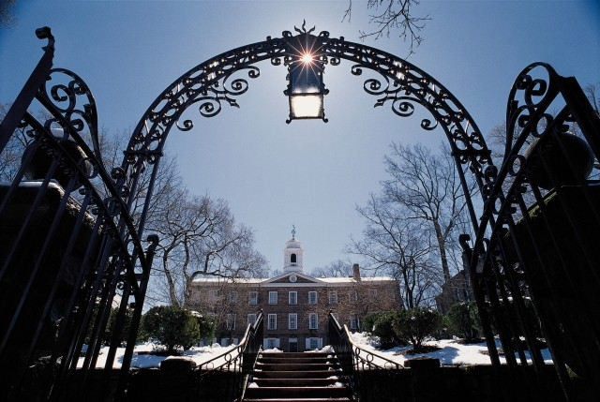

Rutgers ⎯ Jersey Roots, Global Reach
With more than 65,000 students on campuses in Camden, Newark, and New Brunswick, Rutgers is one of the nation’s major public institutions of higher education.
Chartered in 1766, Rutgers has a unique history as a colonial college, a land-grant institution, and a state university. In 1864, Rutgers prevailed over another major college in NJ to become the state’s land-grant college.
The Birthplace of College Football

Slide 5
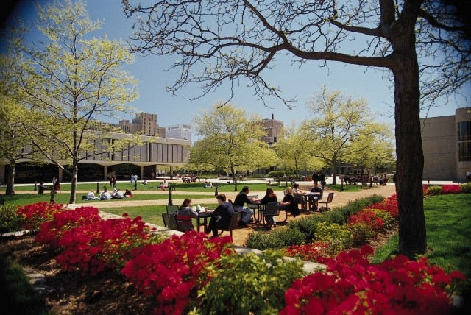

Major Campus – New Brunswick/Piscataway
Land: 2,688 acres
Students: > 50,000
< 40 miles to Times Square, NYC

Slide 6
Presentation Outline
Introduction
➢
➢
➢
What is whispering-gallery mode?
Lab fabrication of optical WGM devices Molecular sensing based on optical WGM
Physical and Mathematical Description
➢
➢
WGM sensor in a micro-opto-electro-fluidic system (MOEFS) Governing equations
---- Charge and fluid transport
---- Dynamics of adsorption and desorption
---- Maxwell’s equations
Results and Discussion
➢
➢
➢
➢
➢
Validation with experimental measurement Influence of applied electrical potential Dynamics of adsorption
Influence of resonance modes Sensor curves
Concluding remarks

Slide 7
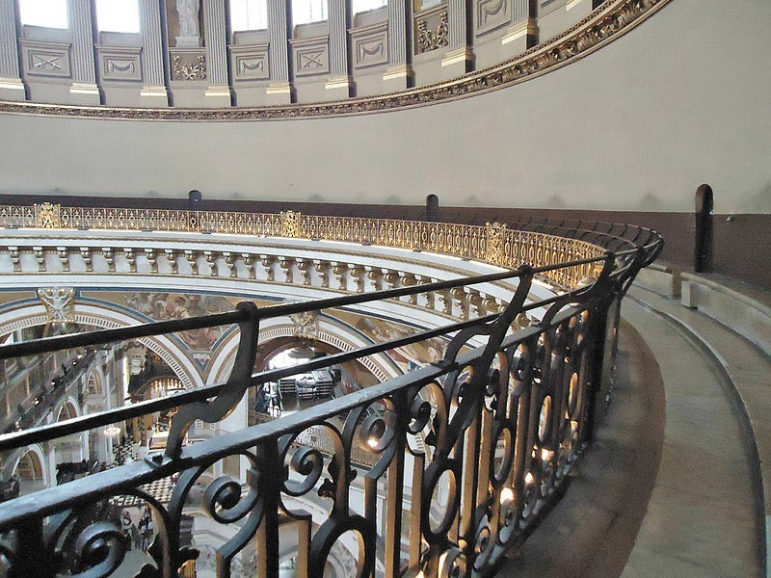
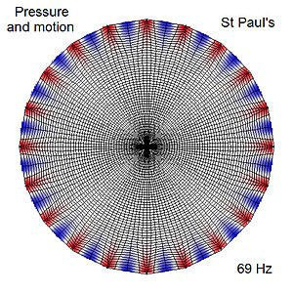
Whispering Gallery
Images from Wikipedia
Whispering gallery at St. Paul’s Cathedral Simulation of the whispering gallery at St. Paul’s Cathedral
The study of acoustic whispering gallery began in St. Paul’s Cathedral,
London
Lord Rayleigh was the first to describe how sound waves were reflected around the walls of the gallery due to its circular shape in 1878
The term 'whispering gallery' has been borrowed in the physical sciences to describe other forms of whispering-gallery waves such as light

Slide 8
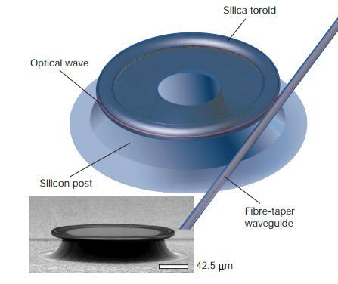
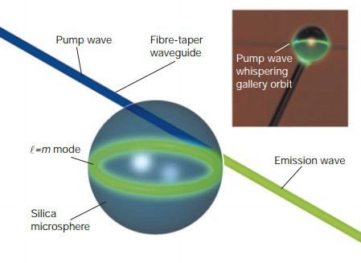
Optical Whispering Galleries
Sound waves have a wavelength on order of meters. Light, on the other hand, has a wavelength on the order of microns or less
Optical whispering-gallery mode (WGM) occurs in small dielectric circular shapes such as spheres, rings, or cylinders, with diameters on the micrometer scale
Optical WGM resonators are characterized as having extremely high Quality factors (Q- factors) and very small mode volumes
Such features them ideal for micro/nano photonic devices, such as lasers, filters, sensors, and quantum systems
Distinct researchers include Stephen Arnold at NYU-Poly, Kerry Vahala at Caltech, Russian scientist V.S. Ilchenko, French scientist Serge Haroche (Nobel Laureate in Physics, 2012), etc.
Images from Vahala 2003, Nature 424
Whispering gallery mode resonators

Slide 9
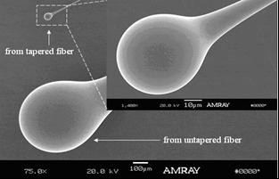
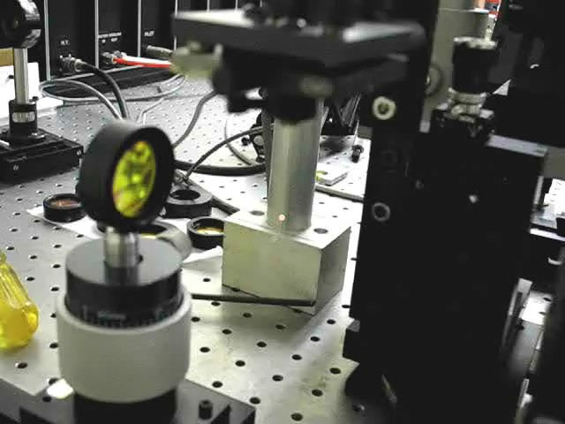
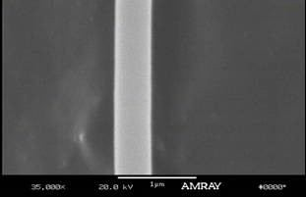
Fabrication of Microbeads & Tapers
Images from Ma, Rossmann & Guo, 2008,
J. Phys. D

Slide 10
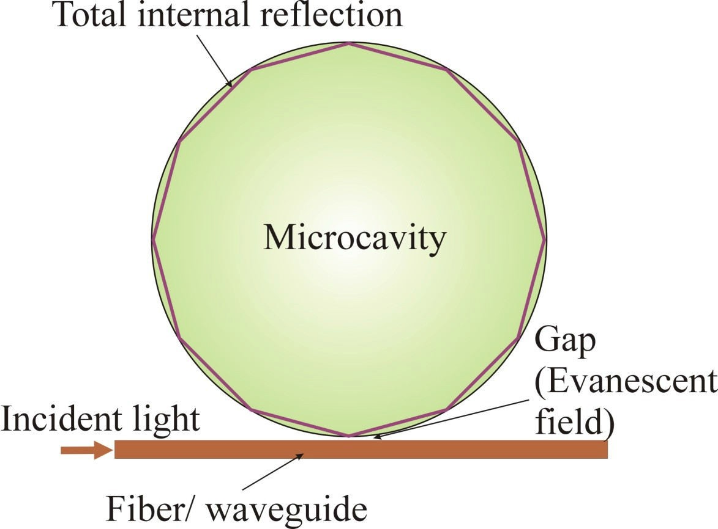
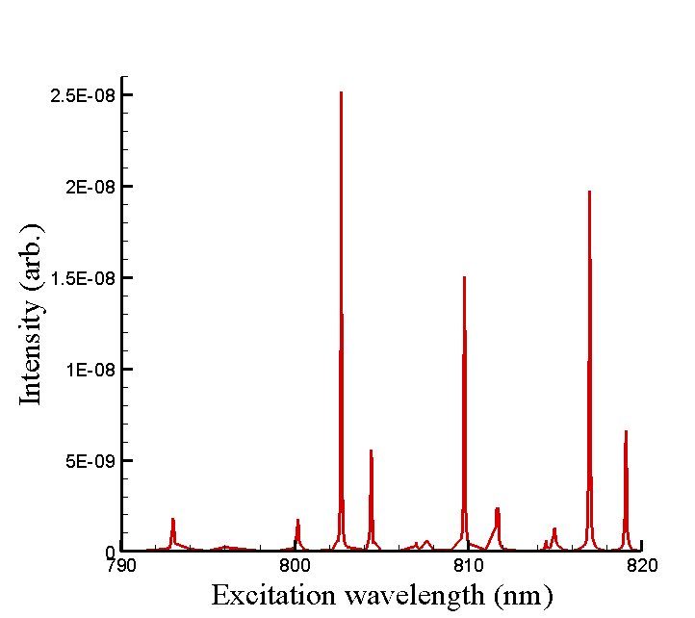
Generation of Optical WGM
WGM occurs when light, confined by total internal reflections, orbits near the surface of a dielectric medium of circular geometry and returns in phase after each revolution. The electromagnetic field can close on itself, giving rise to resonance.
Sensing Principle:
Δf / f = −(Δr / r + Δn / n)
Typical resonance spectrum

Slide 11
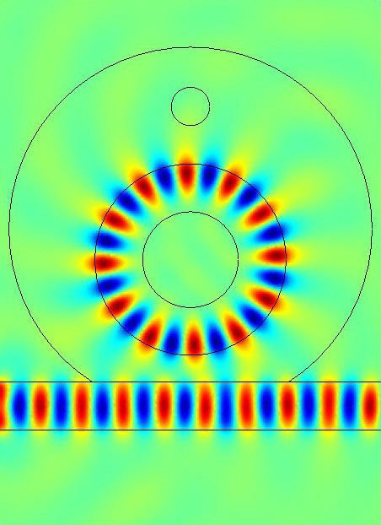
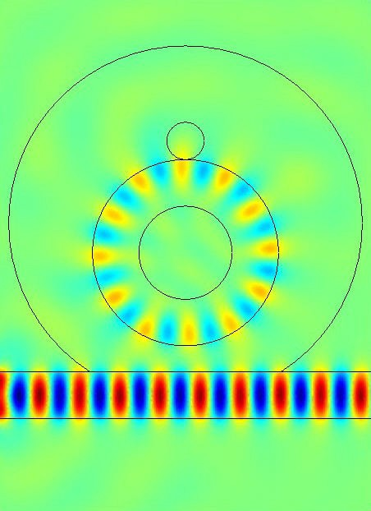
Example: Sensing of A Single Nano-Entity
Single Nano Particle
1.0
400 nm
Cavity of 2 µm in diameter
In contact
0.5
0
-0.5
-1.0
Waveguide
H. Quan & Z. Guo, Nanotechnology, 2007; or Haiyong Quang, Ph.D. Dissertation, Rutgers University, 2006.

Slide 12
Earlier Literature on Single Molecule Detection
• Science 10 August 2007: Vol. 317 no. 5839 pp. 783-787
Received for publication 11 May 2007
Label-Free, Single-Molecule Detection with Optical Microcavities
(Dr. Zhixiong Guo proposed such a similar ideal back in early 2005, See below)
NSF Proposal Number: CTS-0541585. Starting Date: August 15, 2005
Principal Investigator: Guo, Zhixiong
Proposal Title: SGER: Single Molecule-Radiation Interaction in Whispering Gallery
Mode Evanescent Field
• Nanotechnology 18 (2007) 375702 (5pp)
Received 9 May 2007. Published 22 August 2007
Simulation of single transparent molecule interaction with an optical microcavity.
Haiyong Quan and Zhixiong Guo
Results from
Haiyong Quan, Ph.D. Dissertation, Rutgers University, May 2006
Characterization of Optical Whispering Gallery Mode Resonance and Applications
• Nature Methods - 5, 591 - 596 (2008)
Whispering-gallery-mode biosensing: label-free detection down to single molecules. Frank Vollmer & Stephen Arnold

Slide 13
Earlier Literature on Layered Detection
• Appl. Phys. Lett. 80, 4057 (2002)
Protein detection by optical shift of a resonant microcavity.
F. Vollmer, D. Braun, A. Libchaber, M. Khoshsima, I. Teraoka, S. Arnold.
Optics Letters, Vol. 28, Issue 4, pp. 272-274 (2003)
Shift of whispering-gallery modes in microspheres by protein adsorption.
S. Arnold, M. Khoshsima, I. Teraoka, S. Holler, and F. Vollmer
Selected Topics in Quantum Electronics, IEEE J, vol.12 (1) , 2006
Polymer microring resonators for biochemical sensing applications
C.Y. Chao, W. Fung, L. J. Guo
Advanced Functional Materials, vol. 15 (11), pp. 1851-1859, 2005
Macroporous Silicon Microcavities for Macromolecule Detection
H. Ouyang, M. Christophersen, R. Viard, B. L. Miller and P. M. Fauchet
• JQSRT, vol. 93 (1-3), pp. 231–243, 2005
Simulation of whispering-gallery-mode resonance shifts for optical miniature biosensors
H. Quan and Z. Guo
and many others

Slide 14
Proposed MOEFS with a WGM Sensor
Ground/Anode
Anode/Gound
Analyte inlet port
Buffer inlet port
Outlet port
Channel
Enlarged simulation region
WGM sensor
Charged analyte flow direction
Total internal reflection
Channel
d
h
ө
w
Gap
Incident light
Optical waveguide
l

Slide 15
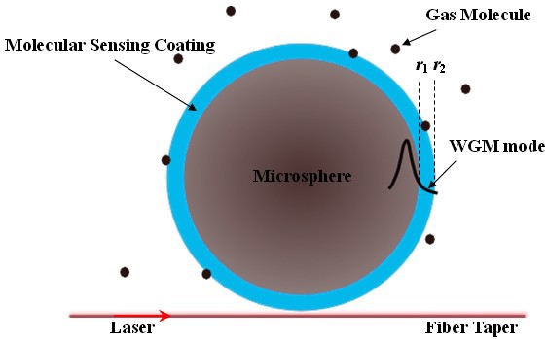
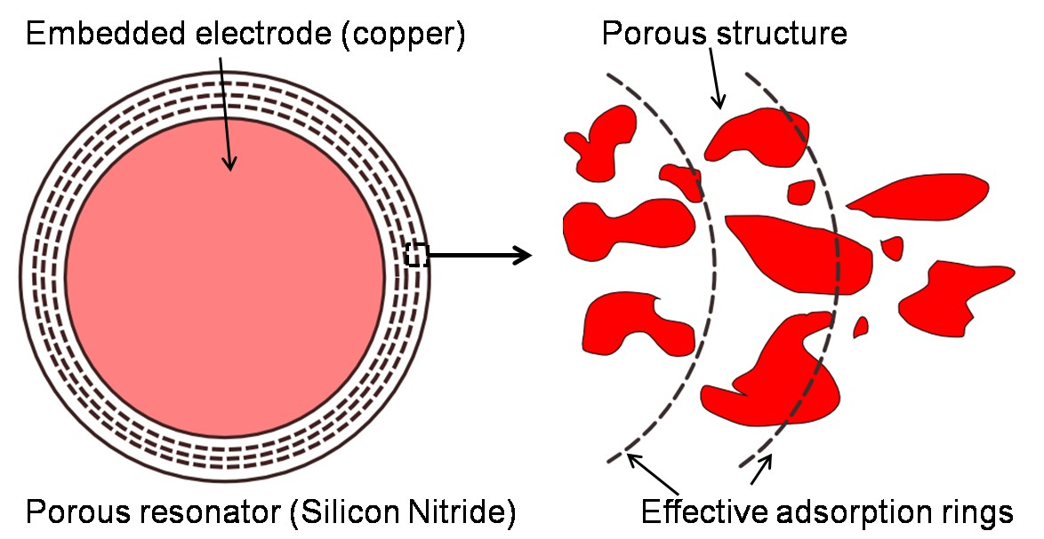
Adsorption and Sensing of Small Molecules
Molecules/Analytes
Molecular monolayer
Method I: Surface attachment of analytes Lei and Guo 2011, Biomicrofluidics
Method II: Filtration and trapping of analytes in porous layer
Lei and Guo 2012, Nanotech.

Slide 16


Governing Equations
Charge transportation equations
∂C
for the charged analyte, hydroxide ion and hydrogen ion.
i
+ K V ⋅ ∇C = ∇ ⋅ (z w FC ∇Φ) + K
D ∇²C ,
i = 1, 2,3
∂t
i ,c
i i i i i ,d i
i
Poisson equation for electrical potential
2
ρ_{E} = F (∑c_{i} z_{i} )
i
ε ∇ Φ = −τρ
f
E
Navier-Stokes equation with porous medium model
∇P υ ₂ ρ ξ
∂V
+ V ⋅ ∇V = − + ∇ V − ∇Φ+
τ
Γ
E
∂t
τρ
τρ
τ
Langmuir model for adsorption
∂C
s
⎛ C ⎞
= K
ads ⎜
1
⎟
(Θ − C ) − K C
∂t
⎝ ^{ξ} ⎠
s
des s

Slide 17
Governing Equations (cont.)
Time-dependent Maxwell’s equations
⎧ ∇⋅ E = ^{ρ} ; ∇× E = −μ ^{∂H}
⎧ 1
⎪
∇² E + ω ²ε E = 0
⎪⎪
ε ∂t
⎪ μ
c
⎨
⎨
⎪∇⋅ H = 0; ∇× H = J + ε ^{∂E}
^{⎪ 1} ∇² H + ω ²ε H = 0
⎩⎪
where
∂t
⎪⎩ μ
c
_{j}
2πc
ε_{c} = ε − i _{ω}
^{= ε}cr^{ε}0
ω =
λ
j=1,2 indicate the electrical conductivity of bulk solution and micro resonator, respectively .
In-plane TE waves
E(x, y,t) = E (x, y)e e^{iωt}
z z
H (x, y,t) = [H (x, y)e + H (x, y)e ]e^{iωt}
x x y y

Slide 18
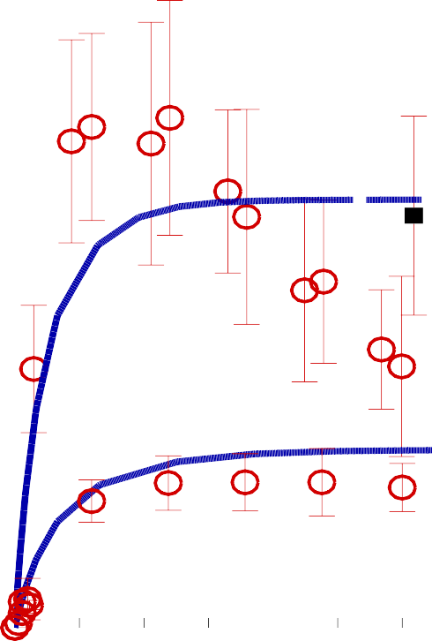
Validation with Experiment
Sample analyte: Bovine Serum Albumin (BSA) proteins that carry negative charges at neutral pH
0.8
On a hydrophilic surface, the electrostatic attraction between oppositely charged material is often the major driving force for adsorption of bio molecules. In a Si₃N₄/H₂O solution,
Relative coverage (C_{s}/θ)
0.6
Unaffect Experiment Simulation
the SiNH ⁺ species remains the charged
3
20 pM
one.
0.4
Langmuir approach is adopted to describe the protein adsorption process. The key assumptions are: (a) only a monolayer forms by adsorption; (b) the adsorbing surface is composed of discrete, identical, and non-interacting sites; (c) the adsorption process for each molecule is independent; and (d) there is no molecule-molecule interactions since the concentration is very low.
0.2
500 pM
0
0 200
400 600
Time (s)
Adsorption of BSA at two different concentrations onto a silica micro resonator at pH 6.6 in the absence of external electrical field (experimental results by Yeung et al. 2009, Colloids and surfaces B: Biointerfaces )

Slide 19
Results: Detection of BSA Proteins
16.7 V/cm 50pM
Frequency down shift (MHz)
80
The resonance frequency shifts versus the bulk BSA concentration for different applied voltage gradients at steady state
60
23.3 V/cm 10pM
400
350
40
23.3 V/cm
16.7 V/cm
6.67 V/cm
Frequency down shift (MHz)
300
20
Langmuir fitting
250
5000
10000 15000
Time (s)
200
150
Time trace of optical resonance frequency down shifts
induced by BSA adsorption, showing the Langmuir adsorption pattern
100
50
0
0
20 40 60
Concentration (pM)
80

Slide 20
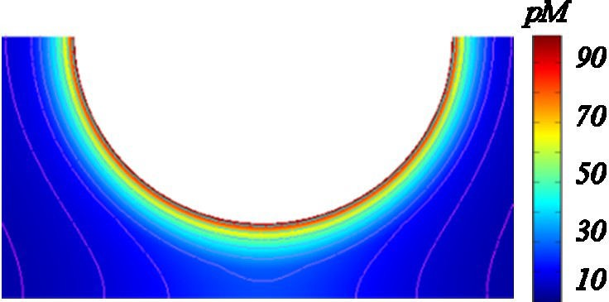
Results: Aminoglycoside Adsorption in Porous Layer
Sample molecules: Neomycin, an aminoglycoside antibiotic, that carries positive charges at neutral pH
Contour of analyte concentration in the porous resonator and the equipotential lines of the electrical potential field for the case with 10 pM feed and 17.7 V/cm
A grounding electrode is placed inside the resonator to attract the positively-charged neomycin molecules. The porous vicinity surrounding the electrode is the most concentrated region, which justifies the fact that, the applied electrical potential is a predominant driven mechanism over the convection and diffusion for the charged analyte transport.
Molecular concentration near the resonator can be enhanced by a magnitude of order, that is very useful for extremely low-concentration molecule detection.

Slide 21
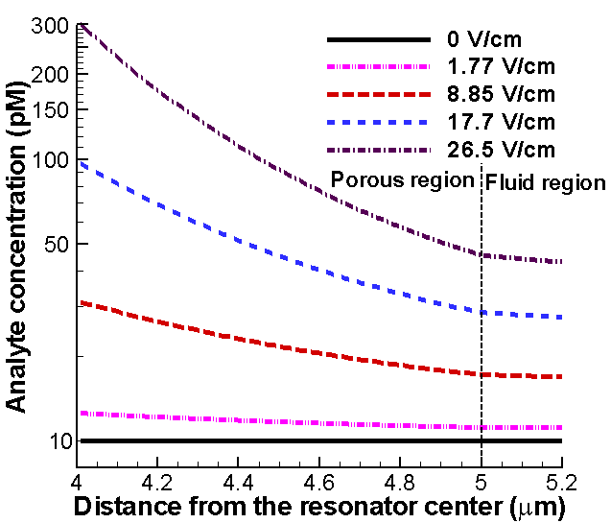
Influence of Electrical Potential on Adsorption
Averaged surface density (pg/cm²)
250
10 pM
50 pM
200
150
100
50
0
5 10 15 20 25
Electrical potential gradient (V/cm)
The aminoglycoside concentration profiles along the resonator radial direction with a feed concentration of 10 pM for various applied voltage gradients.
Influence of electrical potential on the surface density inside the porous resonator

Slide 22
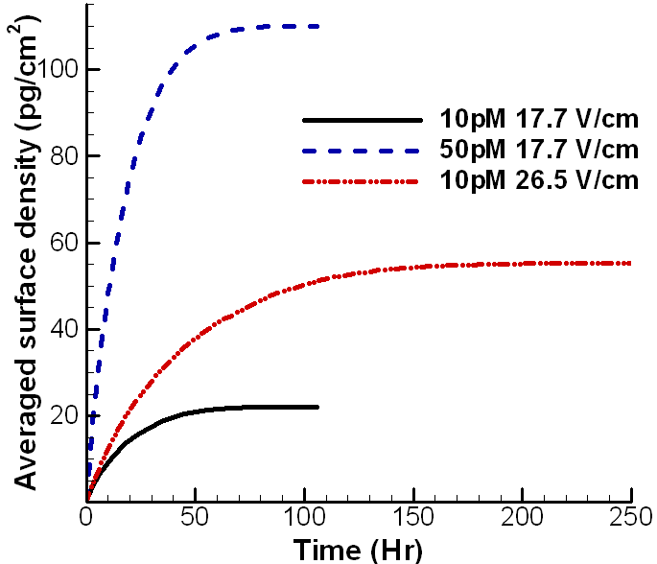
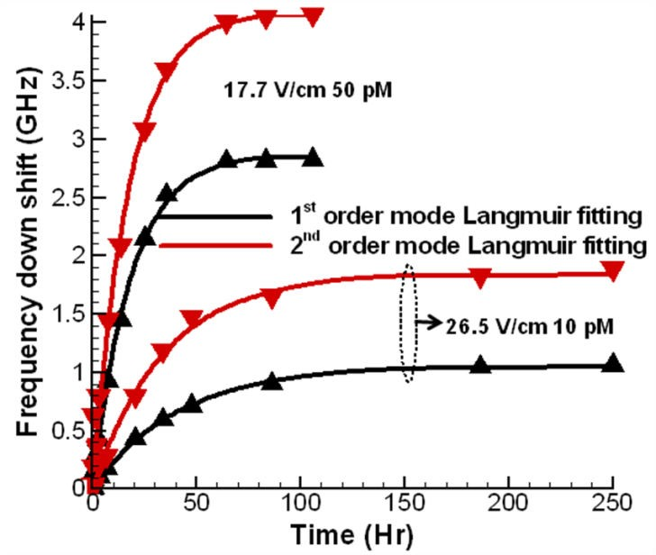
Time Trace of Adsorption and Induced WGM Shifts
The time trace of the adsorbed aminoglycosides on the resonator surface for three different operation cases.
The resonance frequency down shifts with Langmuir fitting for two different feeding and applied voltage conditions under the first-order and second-order modes, respectively.

Slide 23
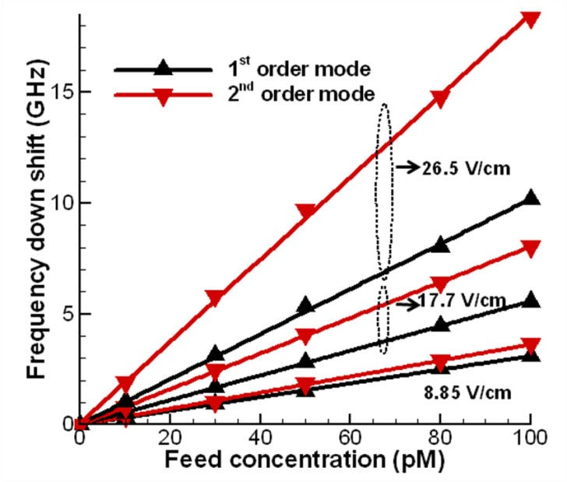
Mode Profile and Sensor Curves
₁3
3.5
4
4.5
5
5.5
90
0.8
80
Normalized energy
Concentration (pM)
0.6
70
1st order mode 2nd order mode Concentration
60
0.4
50
0.2
40
0₃
30
3.5 4 4.5 5 5.5
Distance from the resonator center (μm)
Energy distributions in the resonator radial direction for the first- and second-order modes and the amino concentration profile in and outside the resonator for the case of
17.7 V/cm applied voltage gradient and 10 pM feed concentration.
The optical sensor curves at steady-state aminoglycoside deposition.

Slide 24
Conclusions
A porous ring microresonator integrated in a microelectrofluidic system can function as both a filter and an optical whispering-gallery mode sensor.
The microelectrofluidic forces augment substantially the filtration capability of the system, which separates the target molecules from its solution and enriches the analyte deposition inside the porous resonator.
This alters the optical properties of the resonator and shifts the optical WGM resonance frequency, leading to label-free ultrasensitive detection of small molecules at picomolar concentration levels and below.
The second-order whispering-gallery mode signal is found to give greater resonance frequency shift than the commonly adopted first-order mode of other types of WGM sensors.
For large molecules such as proteins, they are detectable via direct surface attachment due to surface modification or electrostatic force.

Slide 25
Acknowledgment
Thank You!
This material is based upon work supported by NSF grants CBET-1067141 and CTS-0541585, and by the US Department of Agriculture under grant number 2008-01336.
Former graduate students who made great contributions: Dr. Haiyong Quan
Dr. Lei Huang
Dr. Qiulin Ma
Useful discussion with Dr. Guoying Chen, Research Chemist, at Eastern Regional Research Center, USDA Agricultural Research Service, is appreciated.

Slide 26
Let Us Meet Again
We welcome you all to our future conferences of OMICS Group International
Please Visit:
www.omicsgroup.com
www.conferenceseries.com
www.pharmaceuticalconferences.com

