Slide 1
About OMICS Group
OMICS Group International is an amalgamation of Open Access publications and worldwide international science conferences and events. Established in the year 2007 with the sole aim of making the information on Sciences and technology ‘Open Access’, OMICS Group publishes 400 online open access scholarly journals in all aspects of Science, Engineering, Management and Technology journals. OMICS Group has been instrumental in taking the knowledge on Science & technology to the doorsteps of ordinary men and women. Research Scholars, Students, Libraries, Educational Institutions, Research centers and the industry are main stakeholders that benefitted greatly from this knowledge dissemination. OMICS Group also organizes 300 International conferences annually across the globe, where knowledge transfer takes place through debates, round table discussions, poster presentations, workshops, symposia and exhibitions.

Slide 2
About OMICS Group Conferences
OMICS Group International is a pioneer and leading science event organizer, which publishes around 400 open access journals and conducts over 300 Medical, Clinical, Engineering, Life Sciences, Pharma scientific conferences all over the globe annually with the support of more than 1000 scientific associations and 30,000 editorial board members and 3.5 million followers to its credit.
OMICS Group has organized 500 conferences, workshops and national symposiums across the major cities including San Francisco, Las Vegas, San Antonio, Omaha, Orlando, Raleigh, Santa Clara, Chicago, Philadelphia, Baltimore, United Kingdom, Valencia, Dubai, Beijing, Hyderabad, Bengaluru and Mumbai.

Slide 3


A Microbial Fuel Cell-Based Detection System for the Heating Value of Sludge
Shaoan Cheng
shaoancheng@zju.edu.cn
State Key Laboratory Clean Energy Utilization
Zhejiang University
Aug. 11-13, 2014, San Antonio, USA

Slide 4
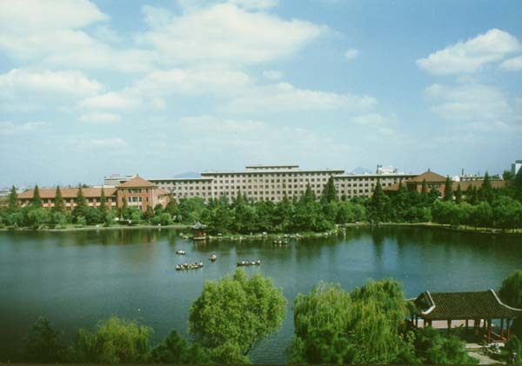
Contents
Background
Experiments and results
Conclusions

Slide 5
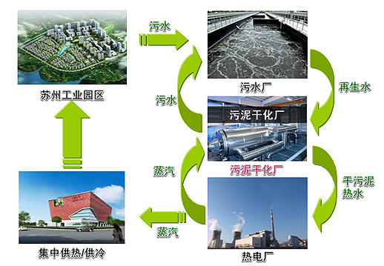
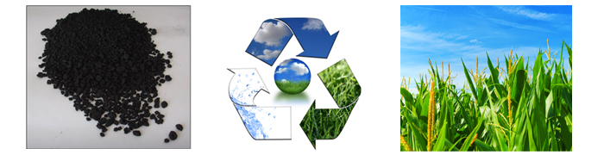
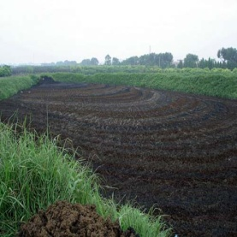
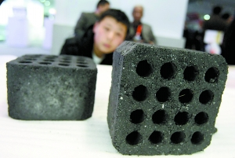
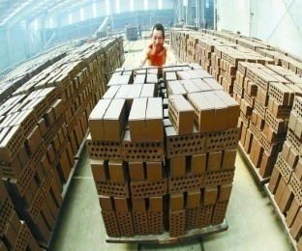

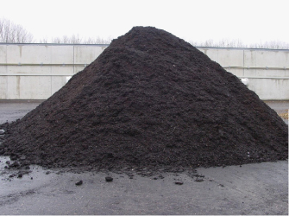
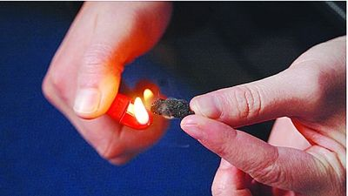
Sludge and utilization
fertilizer
wastewater
Drying process
Water
Organics
Inorganics
Building materials
River sidement
fuel

Slide 6
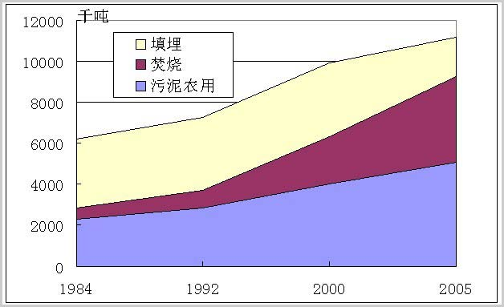
Sludge and utilization
Landfill
burn
fertile land
Amount increased >10%
Utilization depends on
heating value
It is highly needed to first and quickly know the heating value of sludge before used it

Slide 7
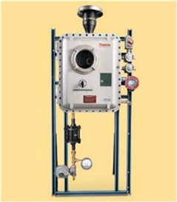
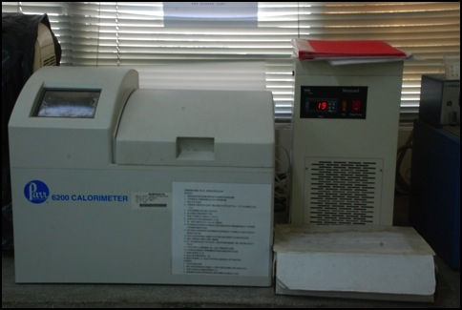
Present method for measuring
the heating value of sludge methods
Proximate analysis based multiple regression models
oxygen bomb
element analysis
industrial analysis
special apparatus
complicated measurement steps
long detection time.

Slide 8
New technology:microbial fuel cell
Heating value of sludge----TCOD of sludge
TCOD---SCOD
Microbial fuel cell----SCOD
？
Heating value of sludge----Microbial fuel cell

Slide 9
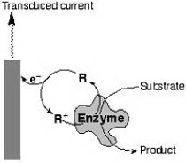
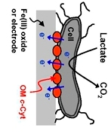

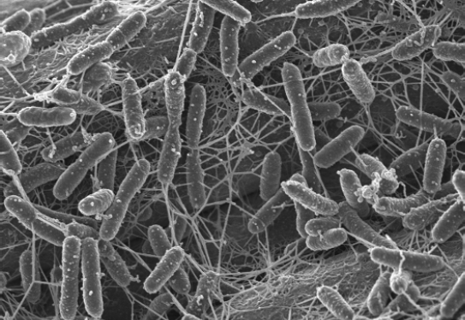
What’s microbial fuel cell
A MFC is a device that use bacteria to oxidize organic matter and produce electricity. The bacteria (attached to the anode) produce electrons that travel to the cathode (current).
Mediater
Direct
This is how a MFC works
e⁻
load
e⁻
Nanowire
Fuel (wastes)
O₂
bacteria
H⁺
Oxidation products (CO₂)
H₂O
Anode
Cathode
Proton Exchange membrane
Reference: Liu et al., Environ. Sci. Technol. 2004

Slide 10
Application : treat wastewater
and recovery energy
Fan
Waste water
Container
Clean water
Container
CO₂
CO₂
O₂
H⁺
e⁻
O²⁻
Bacteria
e⁻
O²⁻
H⁺
Organics
IN PUT
Anode
Cathode
OUT PUT
Notes:
10

Slide 11
Treating wastewater for recovery of energy
Fan
Waste water
Container
Microbial fuel cell
Clean water
Container
CO₂
CO₂
O₂
H⁺
e⁻
O²⁻
Bacteria
e⁻
H⁺
O²⁻
Organics
IN PUT
Anode
Cathode
OUT PUT
Notes:
11

Slide 12
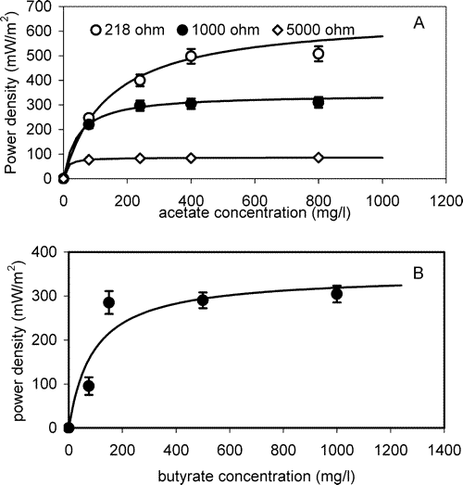
MFC:Power and COD removal
Power generation related to the COD, specially in low COD region
Hong et al, EST, 2005

Slide 13
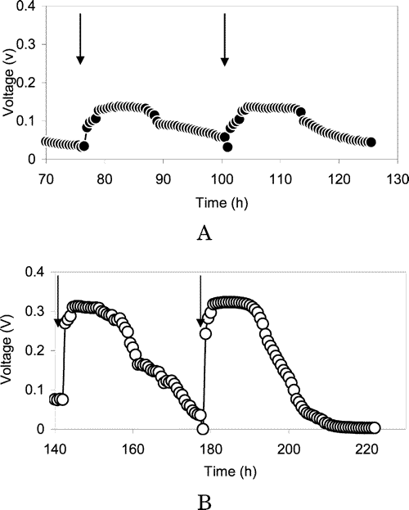
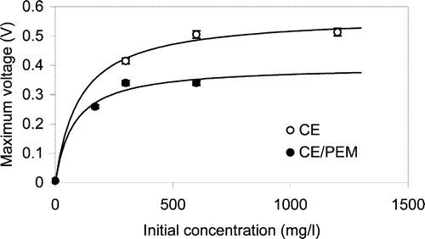
Voltage of MFC ---SCOD
Hong Liu, et al, Environ. Sci. Technol., 2004, 38 (14), pp 4040–4046

Slide 14
Experiments
Reference
R
Nickel foam air cathode
Glass fiber separator
Ti wire
Carbon brush anode
Sludge
four kinds of sludge with different heating values :1674，1838， 1762，1892 J/Kg；and COD: 3960，6040，4498，6247 mg/L, respectively。
Single chamber MFC

Slide 15
Experiments
Inoculation: activated sludge as inocula, batch mode, external resistance of 1000 Ω
Operation: when the voltage of the MFC was less than 10 mV, the reactor was refilled fresh sludge. The above process repeated until the voltage of MFC went to a constant value.
Optimization external reisitance: After start up, the reactors were conducted with ploarization and power density curves for obtaining optimization external resistance.
Performance: To explore the effect of concentration of sludge on the electricity generation and the relationship between the sludge concentration and the electricity generation, two kinds of sludges were diluted with phosphate buffer solution (PBS) as the ratios of sludge to PBS: 1:1、1:2、1:4、1:8。

Slide 16
Results---power generation and polarization
Power density and polarization
Electrode polarization
The electricity generation at different concentration of sludge mainly depends on the anode polarization.

Slide 17
Results---current generation at different concentrations for four sludges
A
B
1:1
1:2
1:4
1:8
C
D

Slide 18
The relationship between the current and heating value
linear relationship between the heating value and the current generated.
linear relationship between the heating value and the COD values

Slide 19
Conclusions
New detection system Based on the single chamber microbial fuel cell has sample structure, low cost and easy to be applied for fast measuring the Heating Value of sludge.
Heating value of sludge has good linear relationship with current production of MFC, therefore, measuring the current under the certain resistance can quickly estimate the heating value of sludge.

Slide 20
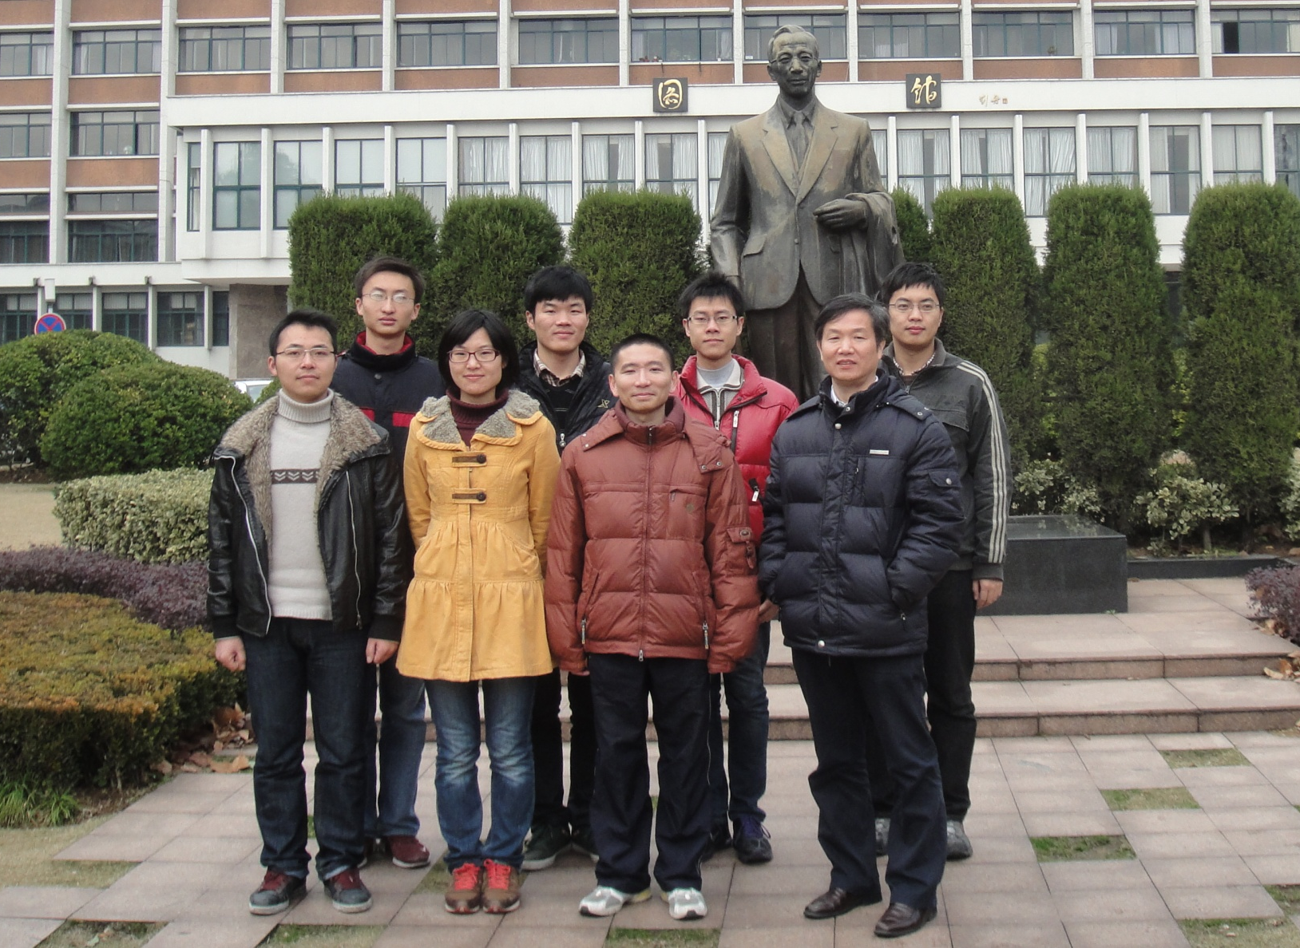

Slide 21



National natural science foundation
(No.21073163, No.51278448)
National High Technology Research
and Development of China (863)
No.2011AA060907, No. 2012AA051502
Natural science foundation of Zhejiang
No.Z4110186, No.2010C31014
No.2011010110018

Slide 22
Thank You !

Slide 23
Let Us Meet Again
We welcome you all to our future conferences of OMICS Group International
Please Visit:
www.omicsgroup.com
www.conferenceseries.com
www.pharmaceuticalconferences.com

