Slide 1



About OMICS Group
OMICS Group International is an amalgamation of Open Access publications and worldwide international science conferences and events. Established in the year 2007 with the sole aim of making the information on Sciences and technology ‘Open Access’, OMICS Group publishes 500 online open access scholarly journals in all aspects of Science, Engineering, Management and Technology journals. OMICS Group has been instrumental in taking the knowledge on Science & technology to the doorsteps of ordinary men and women. Research Scholars, Students, Libraries, Educational Institutions, Research centers and the industry are main stakeholders that benefitted greatly from this knowledge dissemination. OMICS International also organizes 500 International conferences annually across the globe, where knowledge transfer takes place through debates, round table discussions, poster presentations, workshops, symposia and exhibitions.

Slide 2
About OMICS International Conferences
About OMICS Group
OMICS International is a pioneer and leading science event organizer, which publishes around 500 open access journals and conducts over 300 Medical, Clinical, Engineering, Life Sciences, Pharma scientific conferences all over the globe annually with the support of more than 1000 scientific associations and 30,000 editorial board members and 3.5 million followers to its credit.
OMICS International has organized 500 conferences, workshops and national symposiums across the major cities including San Francisco, Las Vegas, San Antonio, Omaha, Orlando, Raleigh, Santa Clara, Chicago, Philadelphia, Baltimore, United Kingdom, Valencia, Dubai, Beijing, Hyderabad, Bengaluru and Mumbai.

Slide 3



METABOLOMIC STUDY OF THE ACUTE INFLAMMATORY RESPONSE IN A PORCINE MODEL OF COMBAT TRAUMA INJURY
Anna Karen Laserna†, Guihua Fang†, Yong Chiat Wong§, Jian Wu§, Yiyang Lai§, Rajaseger Ganapathy §,
Shabbir Moochhala§, Sam Fong Yau Li†
†Department of Chemistry, National University of Singapore
§Defence Medical & Environmental Research Institute, DSO National Laboratories

Slide 4
Trauma Injury
One of the leading causes of morbidity and mortality worldwide¹
Leading cause of death for people under 45²
Has significant personal, social & economic impact
1. R. Lozano, M. Naghavi, K. Foreman, S. Lim, K. Shibuya, et al., The Lancet, 2012, 380, 2095-2128.
2. E. G. Krug, G. K. Sharma and R. Lozano, American Journal of Public Health, 2000, 90, 523-526.

Slide 5

Profile of Combat Trauma
Higher risk of mortality³
Nature of wounding agents
Multiple wounding
Persistence of threat
Limited resources
Delayed access to definitive care
3. Champion, H. R.; Bellamy, R. F.; Roberts, C. P.; Leppaniemi, A., J Trauma Acute Care Surg, 2003, 54 (5), S13-S19.

Slide 6
Profile of Combat Trauma
Prevalence of penetrating trauma in combat injuries

Slide 7

Secondary Complications
After Injury
Complex network of changes⁴
Can affect organs far from site
of injury
They can be:
  Normal physiological changes that proceeds uncontrolled⁵
  Pathological changes
4. S. Sevitt, Injury, 1972, 4, 151-156.
5. S. Sevitt, The Lancet, 1966, 288, 1203-1210.

Slide 8
Traumatic Hemorrhagic
Shock (THS)
Loss of blood - Deficiency of O₂ reaching the organs leads to shock
Triggers severe metabolic derangements & the complex inflammatory response
Can lead to the development of Systemic Inflammatory Response Syndrome (SIRS)

Slide 9
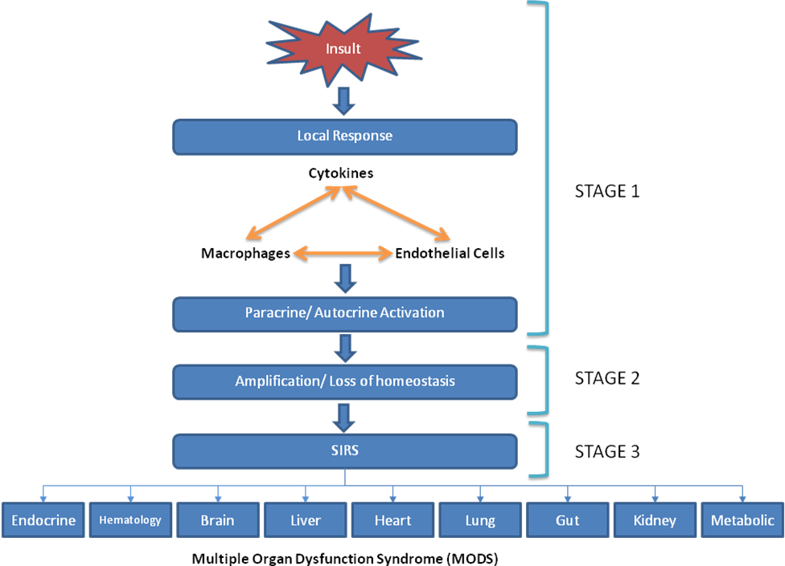
Inflammatory Response
Controlled inflammatory response
Inflammatory response out of control
Systemic Inflammatory Response Syndrome (SIRS)
Multiple organ dysfunction syndrome (MODS).
Davies, M. G.; Hagen, P. O., British Journal of Surgery, 1997, 84 (7), 920-935.

Slide 10
Metabolomics
GENOMICS
TRANSCRIPTOMICS
PROTEOMICS
METABOLOMICS
PHENOTYPE
Genes
mRNAs
Proteins
Metabolites
~ 20,000
> 10⁶
> 10⁷
~7,800
Metabolomics
Comprehensive analysis of all metabolites⁵
Closer to the phenotype as compared to the other “Omics” levels
5. Fiehn, O., Plant Mol. Biol. 2002, 48 (1-2), 155-171.

Slide 11
Common Analytical
Platforms
Metabolomics
MS-based
Flow injection or Direct injection MS
Coupled to liquid chromatography
(LC-MS)
NMR
Coupled to gas chromatography
(GC-MS)
Coupled to capillary electrophoresis
(CE-MS)
MULTI-PLATFORM APPROACH
No single instrument to cover the whole metabolome
Use of complementary platforms to maximize metabolite coverage

Slide 12
LC-MS and NMR in Metabolomics
NMR
LC-MS
Advantages
Minimal sample preparation
Simple analysis
Specificity
Disadvantages
Low sensitivity
Overlapping signals for complex mixtures
Advantages
High sensitivity
High selectivity
Disadvantages
Some metabolites may not be ionized effectively into MS vacuum

Slide 13
Objectives
Use NMR and LC-MS to obtain a comprehensive profile of the metabolic changes in a simulation of combat trauma injury in a porcine model
Correlate metabolite changes with cytokines and reported protein markers of organ-specific injury
  Identify potential biomarkers of Systemic Inflammatory Response Syndrome (SIRS) and organ-specific injury
  Identify metabolites that can modulate inflammatory response

Slide 14
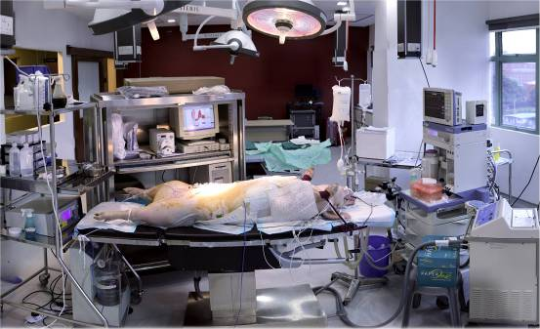
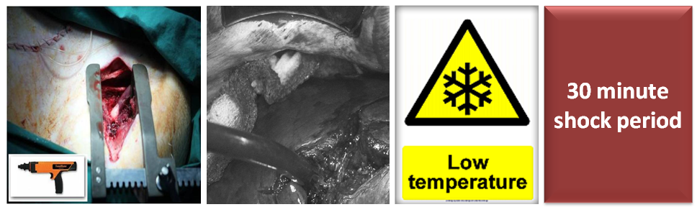
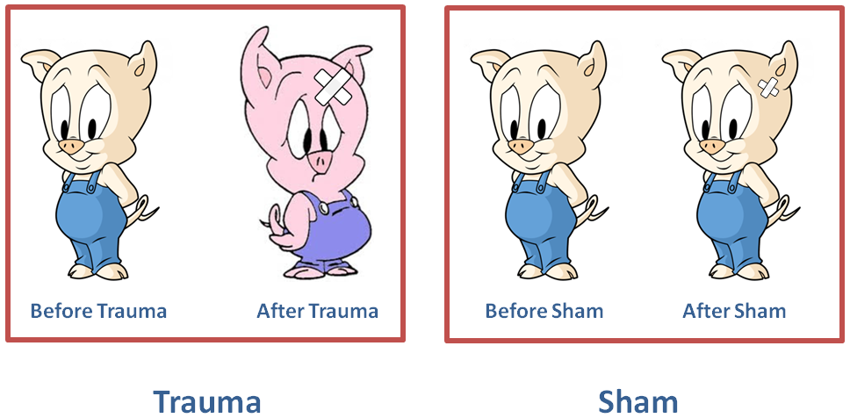
Injury Protocol
Blood Sampling
(Before Trauma/ Sham)
Induce anaesthesia, intubation & instrumentation
Combat Injury Simulation Phase
Blood Sampling
(After Trauma/ Sham)
6. Cho, S. D.; Holcomb, J. B.; Tieu, B. H.; et al., Shock 2009, 31, 87.
7. Wong, Y. C.; Lai, Y. Y.; Tan, et al., Shock 2015, 43 (2).

Slide 15
Instrumental Analysis
Plasma sample
Add saline 10% D₂O with DSS (NMR standard – 4,4-dimethyl-4-silapentane-1-sulfonic acid))
Protein precipitation with ice-cold methanol
Centrifugation
Plasma-NMR solvent solution
Supernatant
NMR Analysis
HILIC LC-MS Aliquot
RPLC-MS Aliquot
Vacuum centrifugation
Vacuum centrifugation
Dried extracts
Dried extracts
Reconstitution
Reconstitution
HILIC LC-MS analysis
(QTOF MS)
RPLC-MS analysis
(QTOF MS)
Data Extraction & Analysis

Slide 16
Data Processing & Analysis
Data Pre-processing & Extraction
XCMS Online for LC-MS data
Multivariate Analysis
Principal Component Analysis (PCA)
Univariate Statistical Analysis
Chenomx for NMR- Binning & Profiling
Wilcoxon-Mann-Whitney Test using Metaboanalyst on fold change (FC) values
Metabolite Identification
Metabolic Pathway Analysis
Metaboanalyst
Correlation Analysis & Correlation Network Analysis
LC-MS Data- search of Metlin, Lipidmaps, HMDB, MassBank databases
NMR Data- Chenomx & literature search
Orthogonal Projection to Latent Structures- Discriminant Analysis (OPLS-DA)
Cytoscape
Spearman correlation

Slide 17
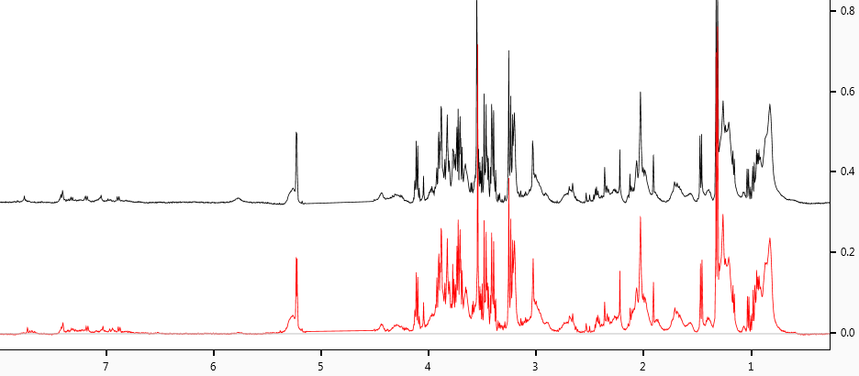
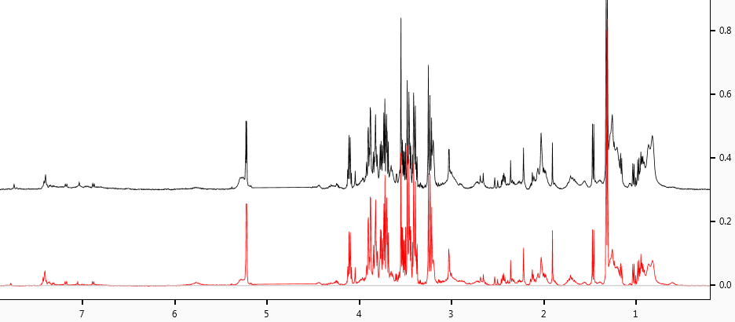
After Sham – No significant changes.
Before Sham
After Sham
After Truama – Significant changes, e.g. decreases in lipoproteins and glycoproteins.
Before Trauma
After Trauma
NMR spectra of the metabolomic changes after trauma injury

Slide 18
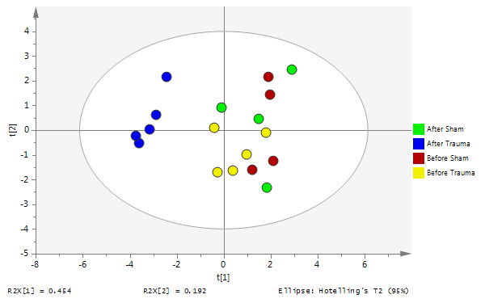
NMR: PCA Analysis
After Trauma Samples

Slide 19
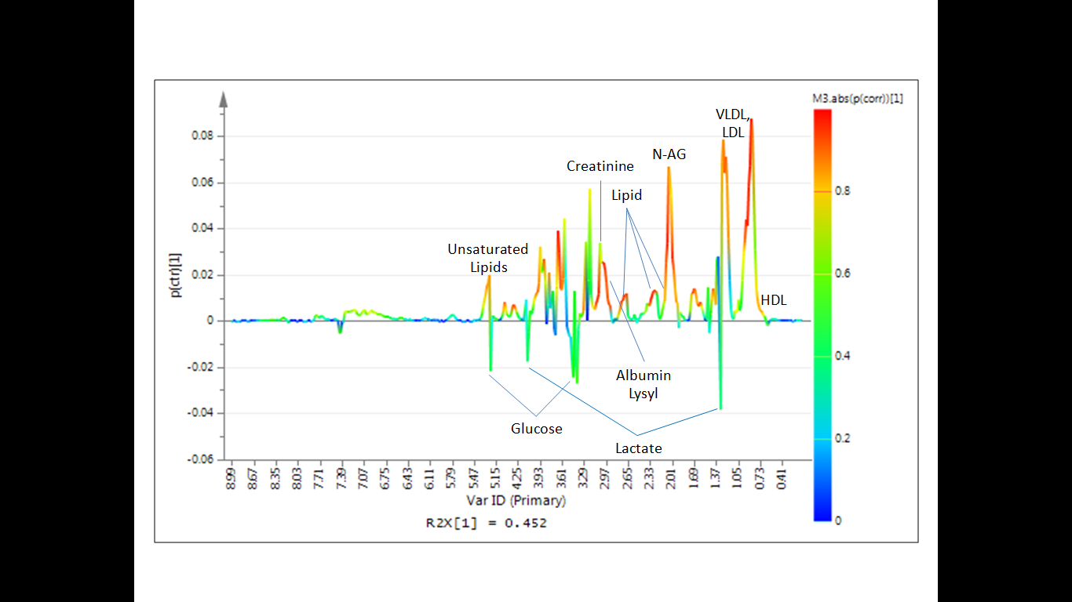
NMR: OPLS-DA Analysis
N-acetylglycoproteins (N-AG)

Slide 20
LC-MS Chromatograms
Before Trauma HILIC (+)
Before Trauma RPLC (+)
After Trauma HILIC (+)
After Trauma RPLC (+)
Before Trauma HILIC (-)
Before Trauma RPLC (-)
After Trauma HILIC (-)
After Trauma RPLC (-)

Slide 21
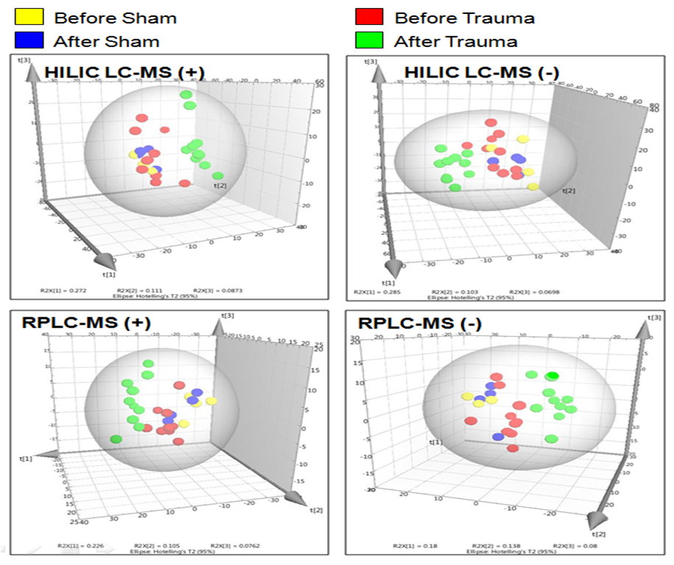
LC-MS Analysis -
OPLS-DA Score Plots

Slide 22
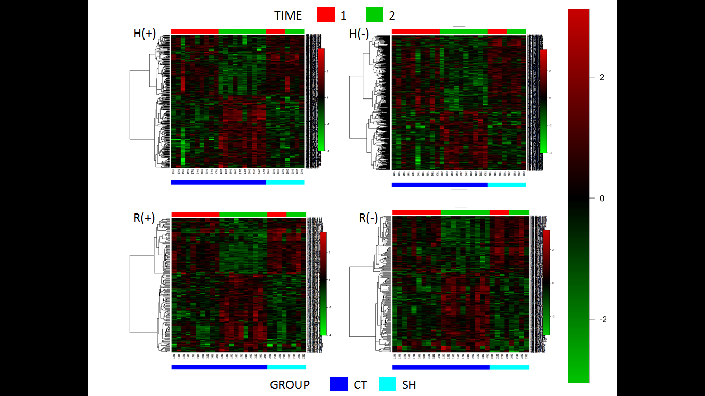
LC-MS Analysis -
Significant Features
Group:
CT- Combat Trauma
SH- Sham
Time:
1- Before Sham/Trauma
2- After Sham/Trauma
Heatmap shows that significant features can be clearly divided into two groups: those that increase after trauma and those that decrease

Slide 23
LC-MS Analysis
Red boxes: increased after injury,
Blue boxes: decreased after injury
Methylated nucleosides & amino acids
PAs, PCs, PEs, PIs, PGs, SM, Cer
Sat’d & Unsat’d Fatty Acids, Oxo & Hydroxy Fatty Acids
Pos HILIC
Neg HILIC
21
Pos RPLC
54
Neg RPLC
Organic Acids
Uric Acid
Ascorbic Acid
Hippuric Acid
9
1
2
10
27
0
0
Purines & Pyrimidines
Inosine
Guanosine
Hypoxanthine
Adenosine
5’-CMP
Thymidine
Uridine
Cytosine
Amino Acids
L-Cystine
Choline
L-methionine
S-Adenosylmethionine
0
0
6
2
5
1
112 unique metabolites for different LCMS modes
26 metabolites detected in more than one mode

Slide 24
Pathway Analysis
Main pathways affected after injury
 | Total Cmpd | Hits | Raw p | -log(p) | Holm adjust | FDR | Impact
Glycerophospholipid metabolism | 39 | 9 | 0.0010 | 6.899 | 0.023 | 0.003 | 0.363
Purine metabolism | 92 | 7 | 0.0050 | 5.295 | 0.068 | 0.008 | 0.046
Pyrimidine metabolism | 60 | 6 | 0.0006 | 7.461 | 0.014 | 0.002 | 0.210
Sphingolipid metabolism | 25 | 3 | 0.0000 | 10.254 | 0.001 | 0.001 | 0.304
Arginine and proline metabolism | 77 | 3 | 0.0024 | 6.039 | 0.048 | 0.006 | 0.146
Cysteine and methionine metabolism | 56 | 3 | 0.0328 | 3.418 | 0.262 | 0.042 | 0.159
Glycerolipid metabolism | 32 | 2 | 0.0001 | 8.831 | 0.004 | 0.001 | 0.204
Phenylalanine metabolism | 45 | 2 | 0.0004 | 7.728 | 0.011 | 0.002 | 0.032

Slide 25
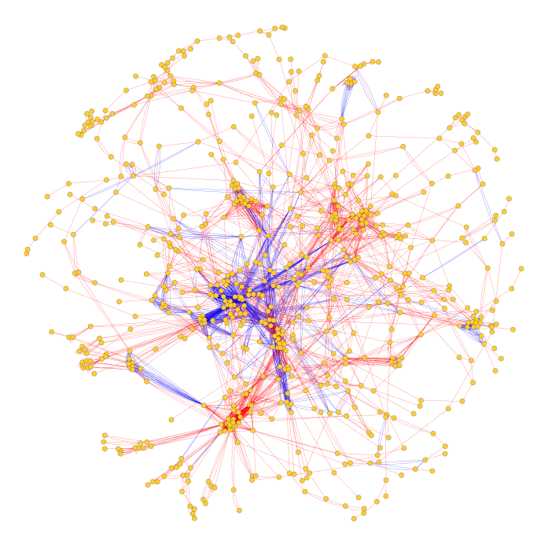
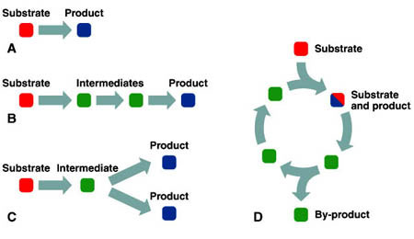
Network Analysis
Pathways
Networks
Recognition of inter-dependence of pathways - Networks
“Omics” platforms used to determine correlations and networks

Slide 26
Correlation Analysis
Explanation of relationships or interactions
Novel insights into biological mechanisms
Easier visualization of associations

Slide 27
Correlation Analysis
Metabolites showing correlations with inflammatory and organ damage markers
Metabolites | IL-10 | TNF-a | CKMB | CRP | Kim1 | PAI-1 | NGAL | hFABP | H2S | Ang-2
LDL | -0.695 | -0.406 | -0.082 | -0.137 | -0.550 | -0.587 | -0.802 | -0.571 | -0.544 | -0.172
2-amino-6-oxo-2,4-hexadienoic acid | -0.736 | -0.433 | -0.383 | -0.508 | -0.531 | -0.510 | -0.621 | -0.247 | -0.704 | 0.054
4,7,10,13,16-docosapentaenoic acid | 0.521 | 0.521 | 0.273 | 0.214 | 0.186 | 0.242 | 0.366 | 0.657 | 0.471 | -0.112
Adrenic Acid | -0.811 | -0.685 | -0.262 | -0.315 | -0.337 | -0.377 | -0.560 | -0.370 | -0.686 | 0.060
Eicosadienoic Acid | -0.769 | -0.628 | -0.259 | -0.402 | -0.367 | -0.451 | -0.645 | -0.164 | -0.585 | -0.093
Glutarylcarnitine | 0.400 | 0.192 | 0.427 | 0.596 | 0.563 | 0.488 | 0.461 | 0.343 | 0.637 | 0.236
LPC(20:3/0:0) | -0.712 | -0.540 | -0.262 | -0.388 | -0.179 | -0.269 | -0.449 | -0.464 | -0.674 | 0.151
LPC(22:5) | -0.783 | -0.622 | -0.314 | -0.478 | -0.306 | -0.429 | -0.540 | -0.407 | -0.688 | 0.126
PA(18:1(9Z)/0:0) | 0.635 | 0.443 | 0.327 | 0.372 | 0.516 | 0.547 | 0.726 | 0.366 | 0.540 | 0.379
PC(18:1/0:0) | -0.782 | -0.741 | -0.186 | -0.558 | -0.438 | -0.585 | -0.633 | -0.374 | -0.669 | 0.033
PC(18:2/0:0) | -0.592 | -0.558 | -0.432 | -0.472 | -0.521 | -0.577 | -0.725 | -0.515 | -0.549 | -0.082
PC(18:3(9Z,12Z,15Z)/0:0) | -0.530 | -0.467 | -0.472 | -0.548 | -0.496 | -0.500 | -0.680 | -0.447 | -0.664 | -0.028
PC(20:4/0:0) | -0.823 | -0.615 | -0.266 | -0.429 | -0.412 | -0.498 | -0.744 | -0.224 | -0.577 | -0.120
PC(20:5(5Z,8Z,11Z,14Z,17Z)/0:0) | -0.525 | -0.357 | -0.347 | -0.739 | -0.705 | -0.576 | -0.673 | -0.196 | -0.636 | -0.142
PC(22:4(7Z,10Z,13Z,16Z)/0:0) | -0.752 | -0.620 | -0.304 | -0.369 | -0.337 | -0.363 | -0.534 | -0.467 | -0.683 | 0.161
PC(22:6/0:0) | -0.757 | -0.536 | -0.375 | -0.427 | -0.326 | -0.448 | -0.773 | -0.303 | -0.594 | -0.134
SN-Glycero-3-phosphocholine | -0.704 | -0.438 | -0.328 | -0.525 | -0.236 | -0.350 | -0.401 | -0.427 | -0.746 | 0.096
Deoxyguanosine | 0.557 | 0.369 | 0.408 | 0.488 | 0.488 | 0.632 | 0.743 | 0.422 | 0.613 | 0.380
Guanosine | 0.499 | 0.307 | 0.397 | 0.513 | 0.609 | 0.670 | 0.720 | 0.436 | 0.552 | 0.288
Inosine | 0.505 | 0.404 | 0.319 | 0.514 | 0.554 | 0.687 | 0.722 | 0.465 | 0.483 | 0.299
Succinoadenosine | 0.625 | 0.461 | 0.340 | 0.498 | 0.697 | 0.554 | 0.768 | 0.379 | 0.649 | 0.383
Uric Acid | 0.564 | 0.418 | 0.407 | 0.478 | 0.235 | 0.501 | 0.563 | 0.573 | 0.527 | 0.082
1-Methylguanosine | 0.539 | 0.381 | 0.627 | 0.447 | 0.426 | 0.514 | 0.684 | 0.524 | 0.628 | 0.169
1-methylnicotinamide | 0.568 | 0.436 | -0.037 | 0.414 | 0.578 | 0.510 | 0.613 | 0.051 | 0.420 | 0.345
1-methyluric Acid | 0.161 | 0.134 | 0.479 | 0.511 | 0.385 | 0.398 | 0.406 | 0.580 | 0.512 | 0.297
3'-O-Methyladenosine | 0.574 | 0.314 | 0.440 | 0.427 | 0.536 | 0.579 | 0.747 | 0.350 | 0.501 | 0.483
3'-O-Methylguanosine | 0.606 | 0.484 | 0.377 | 0.357 | 0.403 | 0.552 | 0.722 | 0.472 | 0.484 | 0.412
Thymine | 0.554 | 0.576 | 0.010 | 0.209 | 0.239 | 0.576 | 0.578 | 0.320 | 0.438 | 0.384
Uridine | 0.385 | 0.596 | 0.263 | 0.235 | 0.455 | 0.498 | 0.745 | 0.455 | 0.425 | 0.513
Arginine | -0.736 | -0.428 | -0.088 | -0.391 | -0.410 | -0.360 | -0.449 | -0.375 | -0.610 | 0.011
Citrulline | 0.801 | 0.521 | 0.322 | 0.466 | 0.457 | 0.559 | 0.747 | 0.061 | 0.560 | 0.147
Cysteine-Homocysteine disulfide | 0.438 | 0.275 | 0.468 | 0.486 | 0.647 | 0.378 | 0.641 | 0.267 | 0.621 | 0.500
L-Cysteinylglycine disulfide | 0.562 | 0.352 | 0.219 | 0.594 | 0.525 | 0.434 | 0.485 | 0.080 | 0.618 | 0.268
L-Cystine | 0.687 | 0.524 | 0.189 | 0.408 | 0.633 | 0.510 | 0.808 | 0.242 | 0.600 | 0.367
L-methionine | 0.723 | 0.586 | -0.023 | 0.476 | 0.495 | 0.410 | 0.598 | 0.205 | 0.577 | 0.232
N1-acetylspermidine | 0.723 | 0.511 | 0.425 | 0.408 | 0.351 | 0.457 | 0.700 | 0.495 | 0.536 | 0.225
S-Adenosylmethionine | 0.639 | 0.437 | 0.352 | 0.697 | 0.546 | 0.558 | 0.585 | 0.417 | 0.641 | 0.088
Color of the cells indicates the significance of the correlation. Red: p < 0.05, Green: p < 0.01, Blue: p <0.001.

Slide 28
Correlation Network
Network connections show correlations among metabolites
Thicker lines indicate stronger correlations

Slide 29
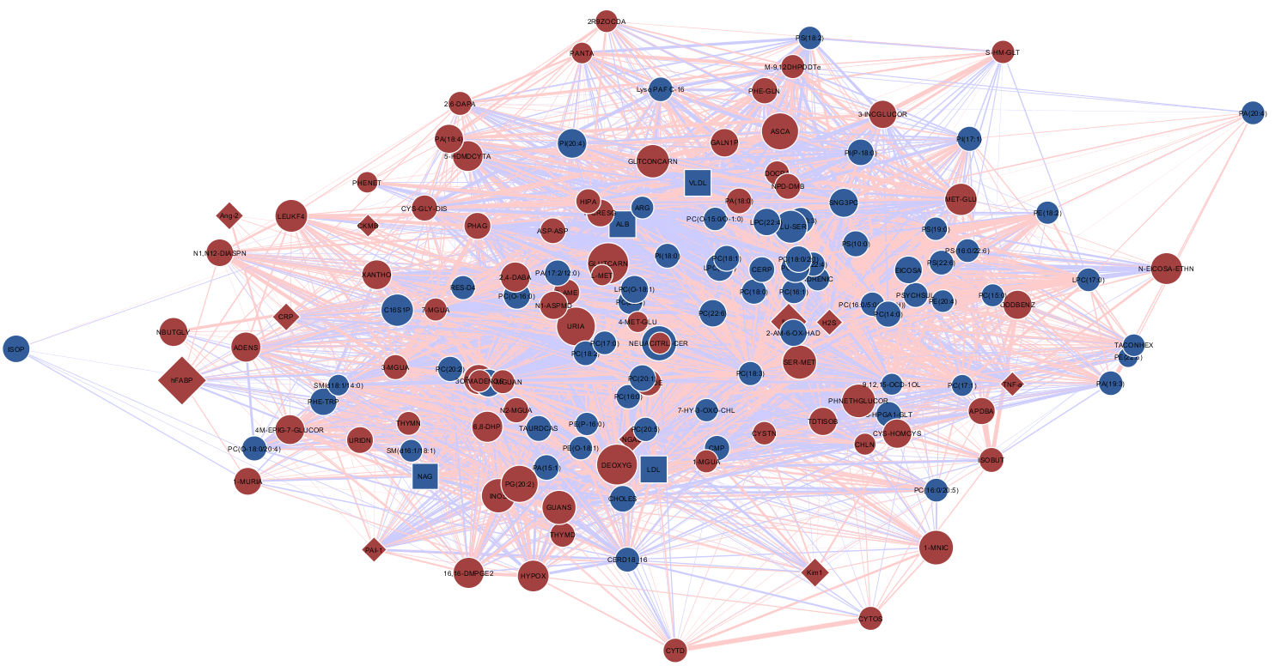
Correlation Network
Red: up-regulated,
Blue: down-regulated
Highly inter-connected correlation network
Systemic nature of metabolic response
Metabolic response intricately interwoven with inflammatory response

Slide 30
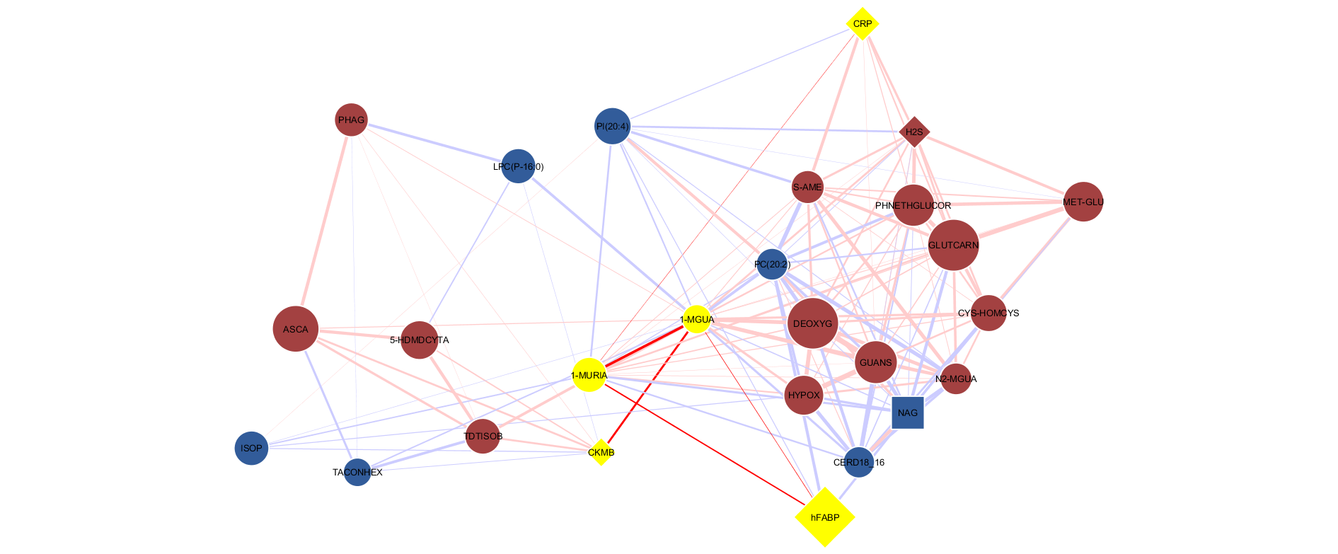
1-methyluric Acid
Sub-network
1-methyluric acid (1-MURIA) is the product of the metabolism of 1-methylxanthine.
1-methyluric acid is linked to:
Oxidative stress
Apoptosis due to GTP depletion
Highly activated inflammatory response (increased methylation)
1-methyluric acid may be a good marker of ischemic myocardial injury.
Generation of 1-methyluric acid may also be a protective mechanism as it was found to be an effective free radical scavenger
H⁺, H₂O
NH₄⁺
H₂O
Ribofuranose
O₂ , H₂O
H+, O₂^{.-}
1-methylguanosine
Guanosine
Deaminase
1-methylxanthosine
Xanthine
Nucleosidase
1-methylxanthine
Xanthine Oxidase
1-methyluric Acid
Pi
α-D-ribose-1-P
H⁺, H₂O
NH₄⁺
O₂ , H₂O
H+, O₂^{.-}
1-methylguanosine
Guanosine
Phosphorylase
1-methylguanine
Guanine Deaminase
1-methylxanthine
Xanthine Oxidase
1-methyluric Acid

Slide 31
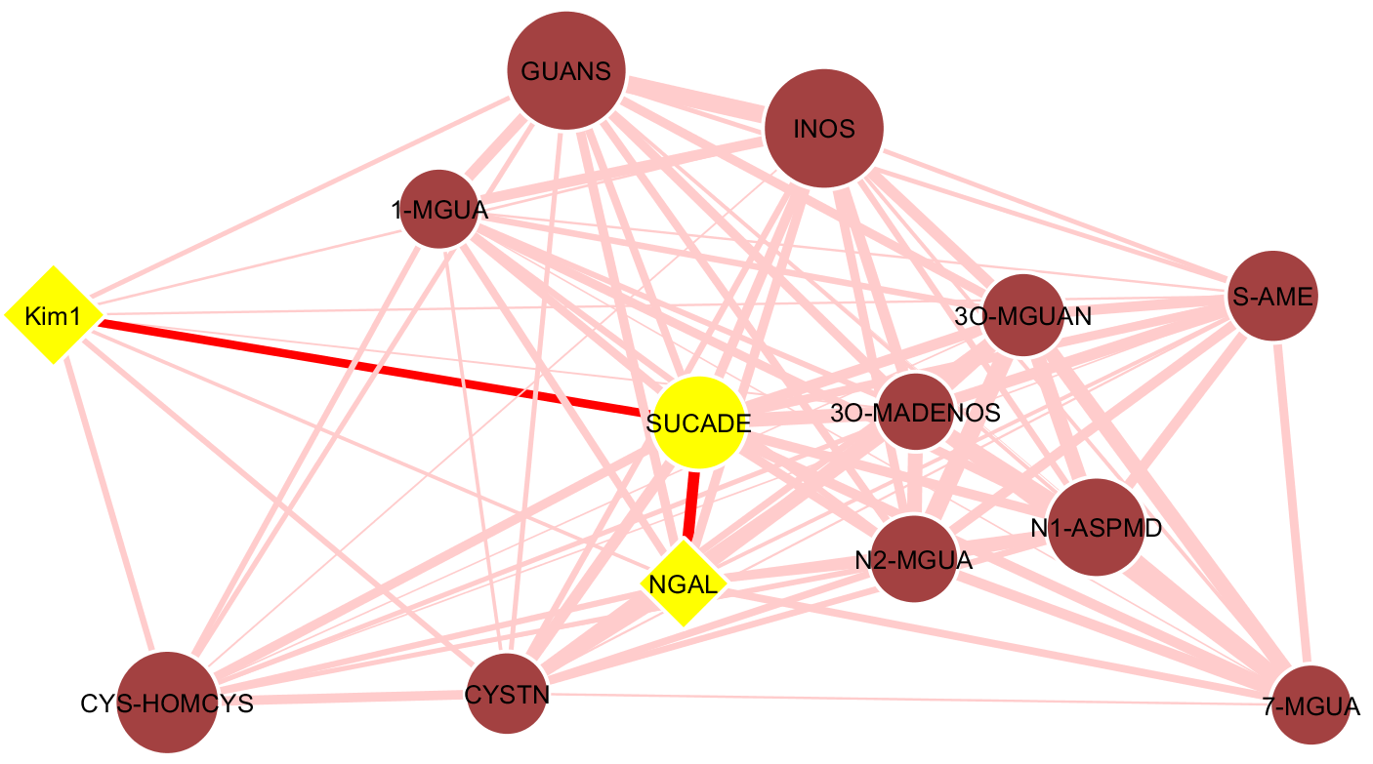
Succinoadenosine
Sub-network
Based on correlation matrix, succinoadenosine (SUCADE) was found to be highly correlated to both KIM-1 and NGAL.
A sub-network was then generated based on highest correlations of succinoadenosine in order to better see its association with NGAL and KIM-1.
Sub-network shows both purine metabolites and cysteine-methionine pathway metabolites.
Most of them are strongly associated with NGAL (inflammatory) and have less association with KIM-1 (renal).
This could be an indication that they are more associated with inflammatory response than with renal injury.

Slide 32
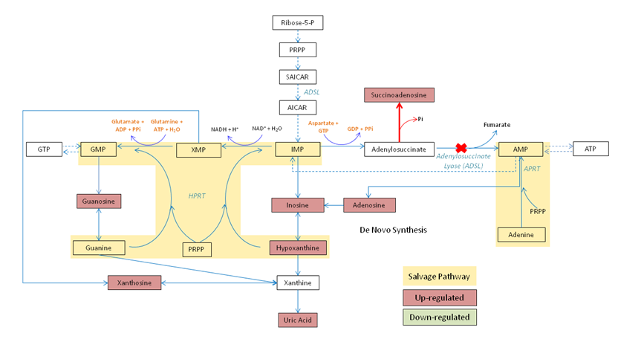
Purine Biosynthesis
Observations
Elevation of succinodenosine after trauma
Inhibition of ADSL activity
Down-regulation of ATP production
Inhibition of ADSL enzyme leads to formation of Succinoadenosine
ATP production is inhibited
Since ATP and GTP co-regulate each other, GTP production is also affected

Slide 33
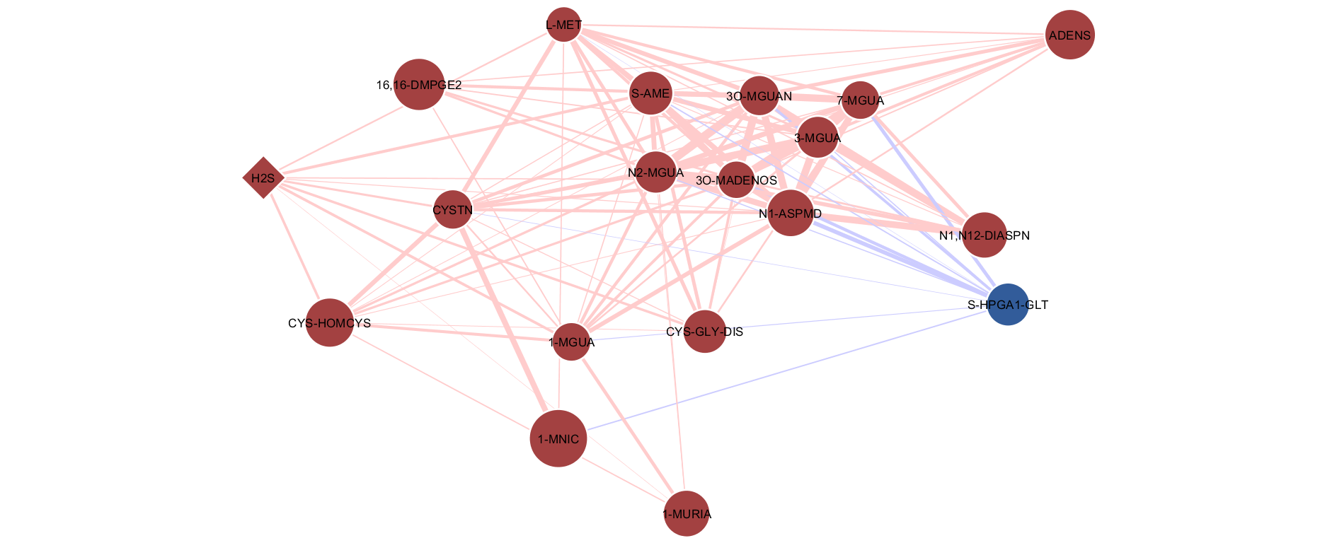
S-Adenosylmethionine (S-AME) Sub-network
Up-regulation of methylated purines as well as up-regulation of other metabolites indicates that S-adenosylmethionine-homocysteine methylation cycle is highly activated after truama.
There is also an observed up-regulation of formation of H₂S whereas formation of glutathione conjugate of Prostaglandin A1 (S-HPGA1-GLT) was observed to be down-regulated.
This could be due to decreased availability of glutathione as its formation is being sacrificed in favour of increased rate of H₂S formation, oxidation of L-cysteine to disulfide form (L-cystine) and re-methylation of homocysteine for methylation cycle.

Slide 34
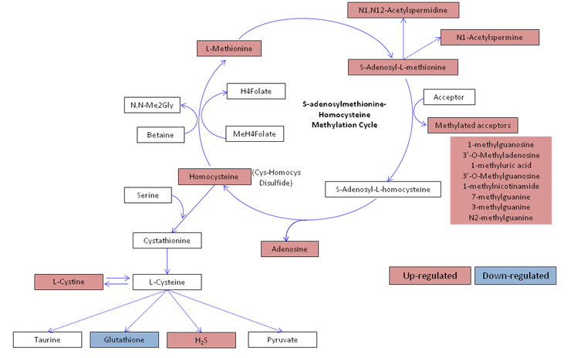
Cysteine-Methionine pathway
Metabolites in S-AME sub-network are also reflected in this pathway
Correlation network generated reflects actual biological processes

Slide 35
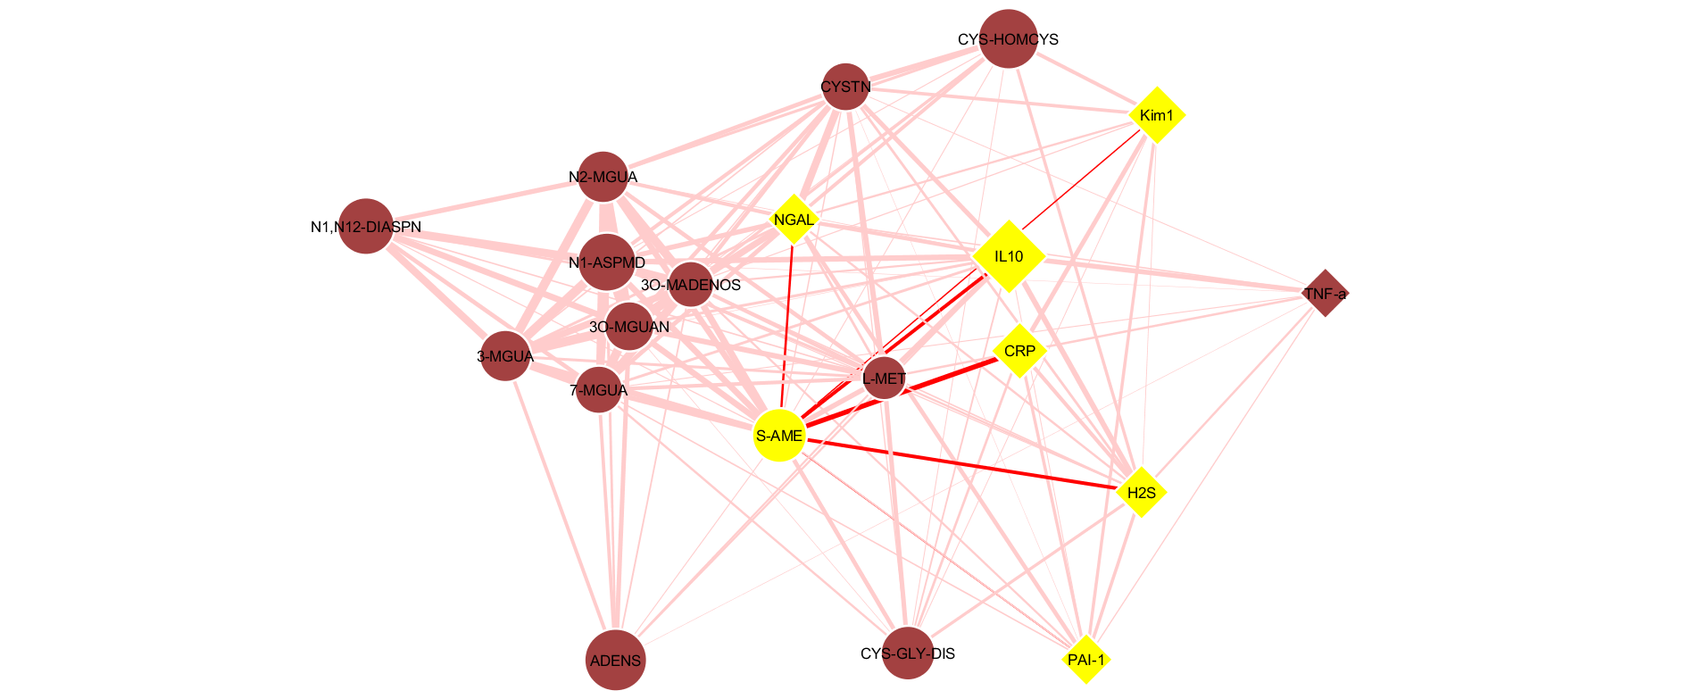
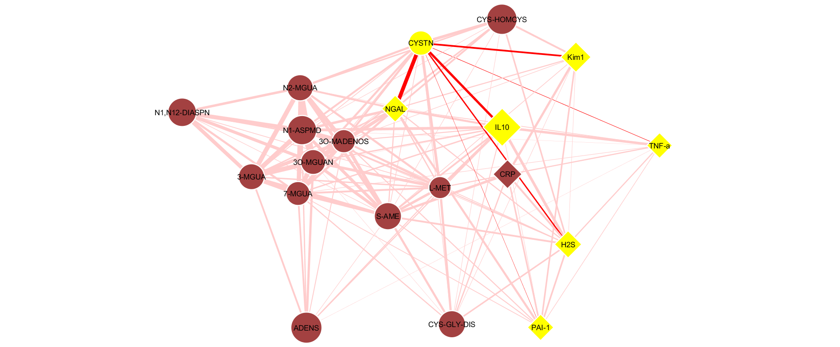
S-Adenosylmethionine
Sub-network
A
S-adenosylmethionine (S-AME) and L-cystine (CYSTN) are both highly correlated with inflammatory markers.
Given the association of these pathways with inflammatory response, involvement of these metabolites in organ injury sub-networks reflects effects of systemic inflammary response syndrome (SIRS) and its role in development of organ failure.
Therefore, regulation of these pathways may potentially be relevant in treatment of traumatic hemorrhagic shock.
B
Associations of S-AME (A) and L-Cystine (B) with the inflammatory markers.

Slide 36
Summary
Correlation network analysis gave new insights into the metabolic and inflammatory response to traumatic hemorrhagic shock
Potential renal and myocardial injury markers were identified
Cysteine-methionine pathway is highly associated with inflammatory response and development of organ failure

Slide 37
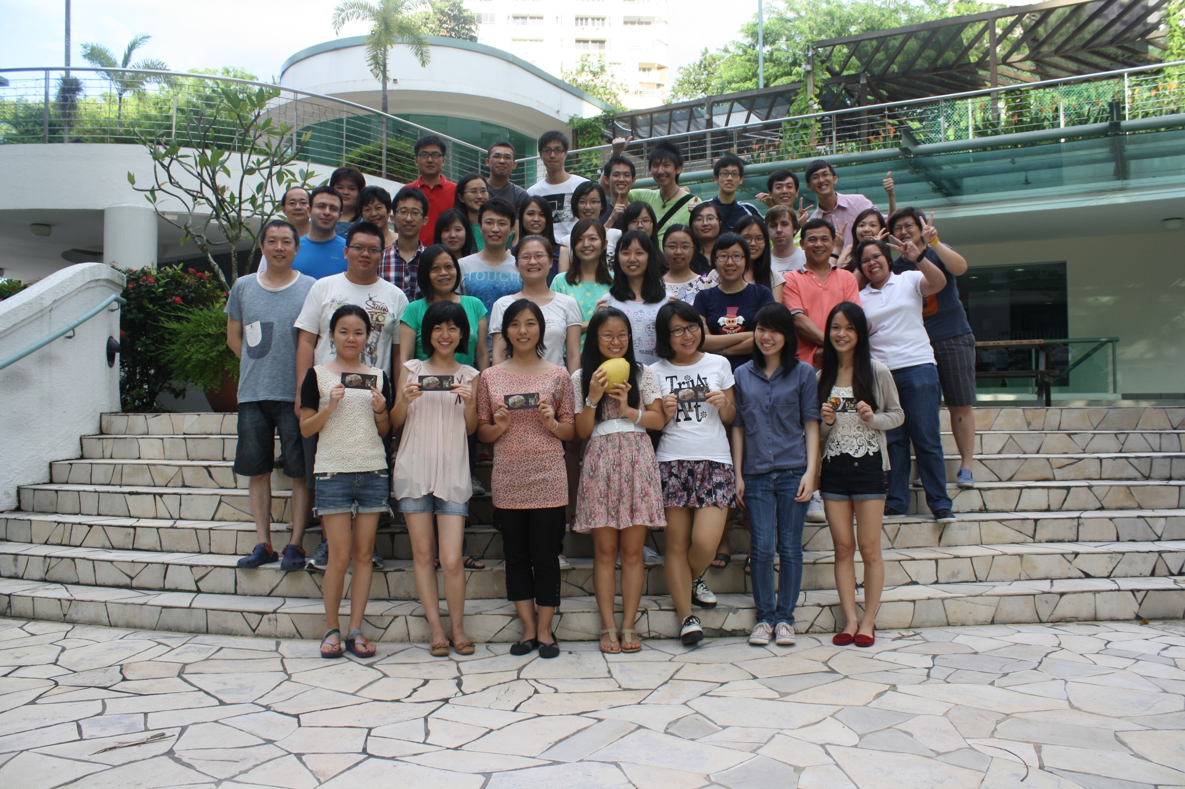

Slide 38
Let Us Meet Again
We welcome you all to our future conferences of
OMICS International
Please Visit:
www.metabolomicsconference.com
www.conferenceseries.com
http://www.conferenceseries.com/clinical-research-conferences.php

