Slide 1
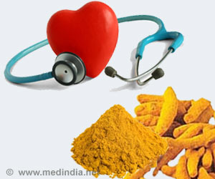
Signaling mechanisms of water soluble curcumin derivative in diabetic cardiovascular complications
Abdel Aziz MT, El Ibrashy IN, Mikhailidis DP, Rezq AM, Wassef MA, Fouad HH, Ahmed HH, Sabry DA, Almalky A, Shawky HM and Hussein RE

Slide 2
Presented by
Rania Elsayed Hussein
Lecturer of Medical Biochemistry & Molecular Biology
Faculty Of Medicine
Cairo University

Slide 3
Diabetic Cardiomyopathy
CARDIOMYOCYTE HYPERTROPHY with subsequent apoptosis and focal myocardial fibrosis are structural hallmarks of diabetic cardiomyopathy and functionally manifest as defective cardiac contractility.

Slide 4
Diabetic Cardiomyopathy
Oxidative stress
DM may lead to myocardial hypertrophy in association with an up-regulation of vasoactive factors such as endothelin-1 and activation of redox-sensitive transcription factors such as NF-κB and activating protein-1

Slide 5
Diabetic Cardiomyopathy
Transcription factors are regulated by transcriptional co-activators, especially those containing histone acetyltransferase (HAT) activity
p300 is the best known of such proteins.

Slide 6
P300 and MEF2
p300 plays an important role in regulating myocyte enhancer factor 2 (MEF2)

Slide 7
P300 and MEF2
MEF2 (MEF2A and MEF2C) are important transcription factors in myocyte hypertrophy and is involved in mediating the hypertrophic action of glucose on cardiomyocytes
MEF2 controls the expression of many fetal cardiac genes.

Slide 8
P300 and MEF2
The normal adult heart has no MEF2- dependent gene expression .
However, MEF2 gene expression is activated in cardiac hypertrophy.
Blockade of MEF2-dependent gene expression completely inhibits cardiac hypertrophy caused by a variety of prohypertrophic stimuli

Slide 9
P300 and MEF2
Association of MEF2 with HATs, like p300, leading to the transcription of effector genes.

Slide 10
P300 and Curcumin
Curcumin has been reported to be an inhibitor of p300-HAT therefore; it may possess an effect in the prevention of cardiac hypertrophy and heart failure.

Slide 11
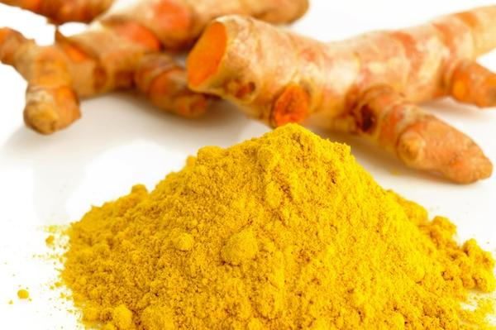
Curcumin
Diferuloylmethane.
It is a nutraceutical widely used in ayurvedic medicine

Slide 12
Some of the most proven biomedical
effects of curcumin
Curcumin
anti-inflammatory
Antioxidant
Antitumour

Slide 13
Curcumin
Can protect against oxidative stress and induce heme oxygenase-1 (HO-1) expression, which exerts cytoprotective effects in mouse pancreatic beta-cells (Pugazhenthi et al., 2007).

Slide 14
Curcumin and DM
Curcumin exhibits therapeutic actions in DM
Abdel Aziz et al., 2010 reported that insulin secretion, HO-1 gene expression and HO activity were significantly increased when rat isolated islets of Langerhans were incubated with curcumin

Slide 15
Curcumin and DM
This increase in insulin secretion was inhibited with stannous mesoporphyrin (SnMP), a HO-1 inhibitor .
This suggests that the action of curcumin on insulin secretion may be, in part, mediated through increased HO-1 gene expression

Slide 16
However, the systemic bioavailability of orally administered curcumin is relatively low , as curcumin and/or its metabolites could not be detected in plasma at oral doses lower than 3.6 g/day

Slide 17
Several water-soluble curcumin derivatives were prepared to achieve clinically efficient systemic bioavailability however, most of them were made through bonds involving the curcumin natural functional groups

Slide 18
Our novel curcumin derivative (NCD) was developed through covalent modification of the curcumin molecule on sites remote from its natural functional groups (Rezq et al., 2010).
PCT/EG2010/000008,WO2011/100984,
Indian National Phase Patent Pending.

Slide 19
Aim of the Work
Comparative evaluation of the effect of natural curcumin and the NCD (3% curcumin content) on signaling mechanisms involved in Diabetic Cardiomyopathy and whether their action is mediated via inducible HO-1.

Slide 20
Materials and Methods
One hundred forty inbred colony (Curl: HEL1) female rats were included in this study.
They were divided equally into the following groups (20 rats/ group):

Slide 21
Group 1
Group 2
1 (a)
Control
1(b)
DM
2(a)
Control/NCD
2(b)
DM/NCD
Group 4
Group 3
DM/Pure curcumin
3(a)
DM/NCD/HO-1 inhibitor
3(b)
DM/HO-1 inhibitor

Slide 22
Materials and Methods
Six animals from each group were used to study some cardiac physiologic parameters such as:
LT ventricular developed pressure
LT ventricular delta pressure/ delta time (contractility index).
Systolic blood pressure.
Heart rate.

Slide 23
The following biochemical parameters were assessed :
Blood glucose
Glycated Hb.(Hb A_{1c})
Plasma Insulin level
HO-1 enzymatic activity and gene expression in cardiac and pancreatic tissues.
Gene expression of p300 and molecular markers of cardiac hypertrophy: ANP, MEF2A, and MEF2C

Slide 24
Results

Slide 25
*
§
*
*
§
*
*
#
●
§
§
*
§
*
§
*
*
*
●
§
#
*
§

Slide 26
*
§
*
#
*
§
#
*
●
*
§
*
*
§
*
#
§
§
●
*
#
*
*
§
§

Slide 27
Heart Rate
#
#
§
§
●
*
§
*
*
*
*
*Values differ significantly from control
§ Values differ significantly from diabetic
# Values differ significantly from diabetic +curcumin derivative
● Values differ significantly from diabetic + inhibitor

Slide 28
*
*
*
●
§
§
§
*
*
§
*
§
§
●
*
*

Slide 29
*
§
*
*
●
§
§
*
*Values differ significantly from control
§ Values differ significantly from diabetic
# Values differ significantly from diabetic +curcumin derivative
●Values differ significantly from diabetic +inhibitor

Slide 30
*
*
●
§
§
§
*
*
*
*Values differ significantly from control
§ Values differ significantly from diabetic
# Values differ significantly from diabetic +curcumin derivative
● Values differ significantly from diabetic + inhibitor

Slide 31
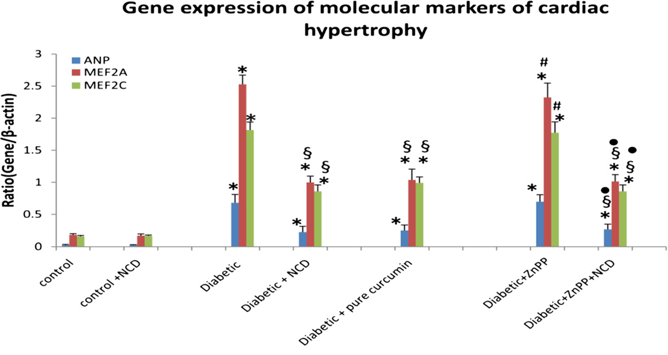
*Values differ significantly from control
§ Values differ significantly from diabetic
# Values differ significantly from diabetic +curcumin derivative
● Values differ significantly from diabetic + inhibitor

Slide 32
Conclusion
NCD and curcumin had the ability to decrease plasma glucose, GHb and increased plasma insulin levels significantly in diabetic rats
These actions may be partially mediated by induction of heme oxygenase-1 gene .

Slide 33
Conclusion
The HO-1 activity and gene expression
were significantly increased in diabetic
heart and pancreas.

Slide 34
Conclusion
Both compounds improved LV function; HR,
systolic pressure, LVDPand LV delta
pressure/delta time (contractility index).

Slide 35
Conclusion
DM up-regulated expression of cardiomyopathy markers (ANP,MEF2A and MEF2C ) and p300.
However, NCD and curcumin (p300 blockers) prevented DM-induced upregulation of these parameters and improved left ventricular function.
Curcumin's action on cardiomyopathy is not mediated through HO-1.

Slide 36
Conclusion
There was no significant difference between administration of NCD and pure curcumin.
However, the effect of NCD by its small dose (20 mg/Kg/day orally for 45 days) taking into consideration that NCD has only a 3.0% curcumin content, gave the same results as pure curcumin (20 mg/Kg/day orally for 45 days).

Slide 37
Conclusion
Thus, NCD was absorbed at a higher rate
than pure curcumin and still retains the
essential potencies of natural curcumin.

Slide 38
Recommendations
Management of DM without the traditional drug side effects is still a challenge to the medical community
There is an increasing demand by the different communities to use the natural products with anti-diabetic activity instead of insulin and oral hypoglycemic drugs which possess undesirable side effects

Slide 39
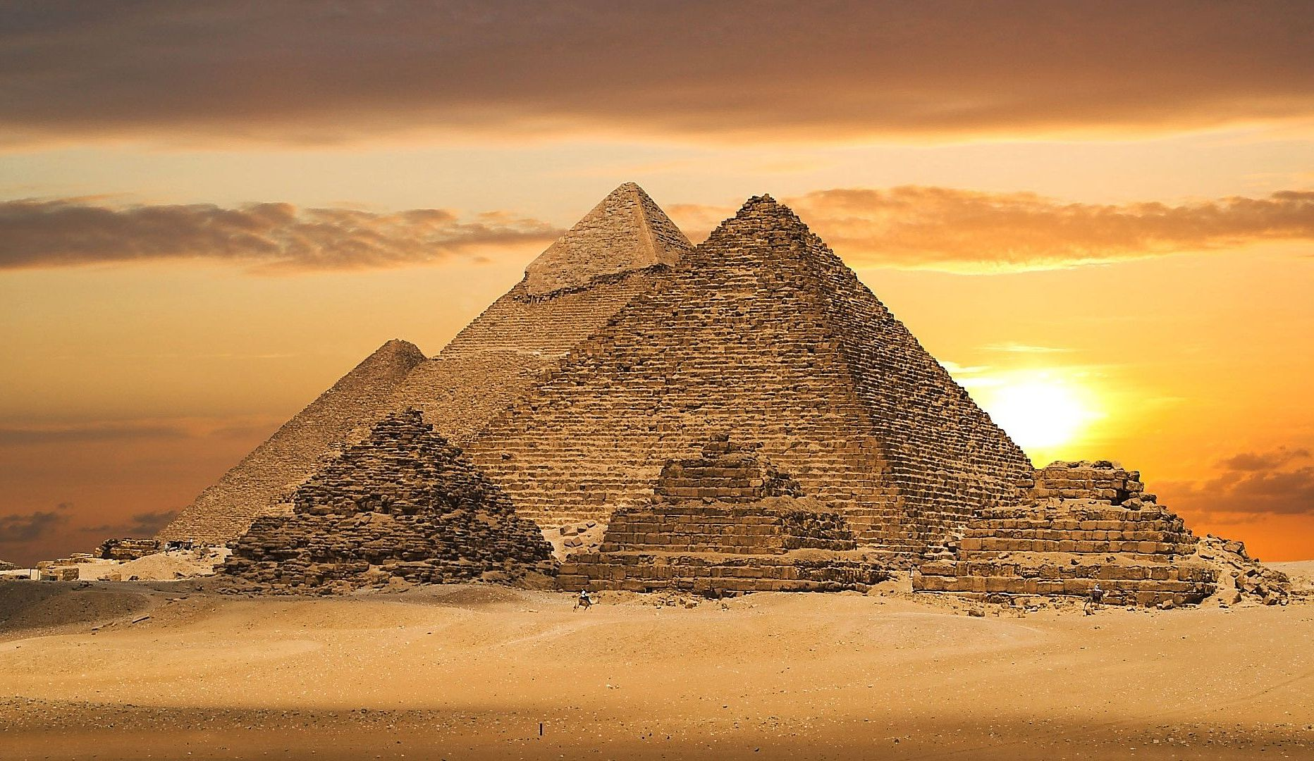
Recommendations
Thank You
The water soluble curcumin derivative provides an opportunity to reach such a goal
Further studies on the NCD should be carried out up to the human clinical trial phases

