Slide 1
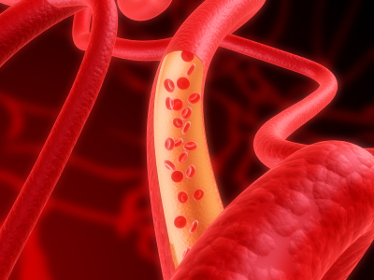
Consumption of non-soy legumes improves vascular function by altering the mechanical properties of arteries
Peter Zahradka
Department of Physiology and Pathophysiology
University of Manitoba
Winnipeg, Canada

Slide 2
Research Goals
To discover novel and innovative agricultural applications that promote health and well-being with a focus on mechanism of action and clinical utility.
Specific products being investigated include:
  cereal grains
  buckwheat
  dairy
  various berries
  pulses
  flax
  oilseeds
"He that takes medicine and neglects diet, wastes the skill of the physician.“
  Chinese Proverb

Slide 3

Pulses
Edible seeds of legume family
Non-soy (soybeans are grown primarily for oil)
Canada is a major producer and exporter
Dried beans
Lentils
Dried peas
Chickpeas
Notes:
Pulses are edible seeds of the legume family, including dried beans, dried peas, chickpeas, and lentils.

Slide 4
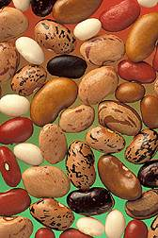
Pulse Properties
Excellent nutritional profile
  Dietary fibre
  Low glycemic index
  Good source of folate; plant-based protein
  Low in fat and sodium
Reported to improve blood vessel function
  Anthocyanins from beans stimulate the production of adiponectin, a naturally produced hormone that protects against vascular disease (Hosfield 2003)
  Flavonoids present in pulses can improve arterial stiffness (He et al 1998)
  Pulse flavonoids can block specific cellular processes that promote atherosclerosis (Dzau et al 2002)

Slide 5
But clinical trials investigating the beneficial actions of pulses on cardiovascular health, particularly with clinical endpoints, are lacking
Notes:
lignans in flaxseed could contribute to glucose and lipid management based on delayed development of hyperglycemia and dyslipidemia in SDG-fed diabetic rats (Prasad, 2001). SDG is presumed to act as a precursor to in-vivo antioxidant lignans such as enterodio and enterolactone , thus is implicated in diabetes prevention and delay given that oxidative stress secondary to hyperglycemia and hyperinsulinemia, as well as depletion of antioxidants, has been shown in diabetes or models of the disease (Hu et al, 2007; Rajesha et al., 2006; Gallan et al., 2003; Halliwell, 2002; Sampson et al, 2002; Devaraj et al, 2001; Sozmen et al, 2001; Jakus, 2000; Opara, 1999; Miyata et al, 1998; Poalisso & Giugliano, 1998).
ALA 55% of fatty acids by weight
high dietary intake (2.0 g/day compared to 0.8 g/day) of ALA decreases the risk of fatal coronary heart disease by about 20%
long-chain n-3 fatty acids reduce the relative risk of coronary morbidity and mortality (Albert et al, 2002, DeLorgeril et al, 1994)
N-3 PUFAs from both seafood and plant sources may reduce CHD risk, with little apparent influence from background n-6 PUFA intake. Plant-based n-3 PUFAs may particularly reduce CHD risk when seafood-based n-3 PUFA intake is low, which has implications for populations with low consumption or availability of fatty fish. (Mozaffarian et al., 2006)
5

Slide 6
The Health Benefits of Pulses:
A Clinical Trial Investigating the Effects of Pulses on Peripheral Artery Disease
Funded by Pulse Canada and Agriculture & Agrifood Canada

Slide 7
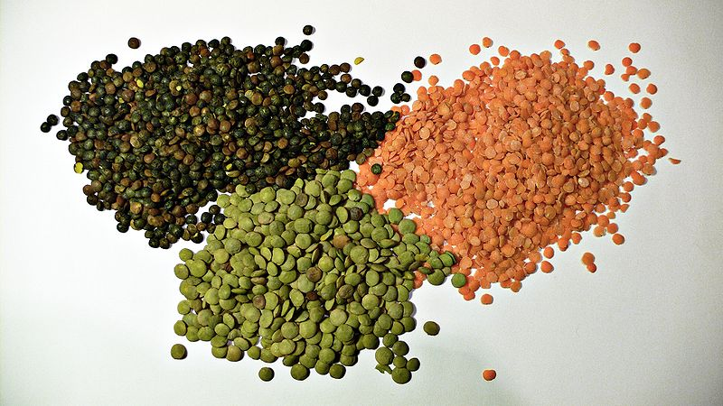
Primary Objective
To investigate the effect of eating at least one ½ cup serving of pulses (beans, peas, lentils, chickpeas) per day on cardiovascular health

Slide 8
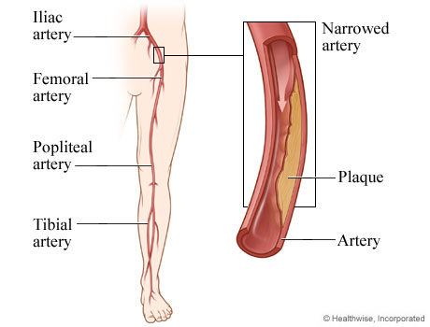
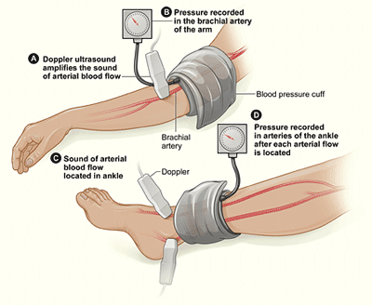
Peripheral Artery Disease (PAD)
12 M affected in NA
20,000 amputations/yr
5 yr survival = 50%
5-10 fold higher risk of heart attack or stroke
~30 M undiagnosed
1.5 M with claudication
Ankle-brachial index < 0.9
(systolic blood pressure at ankle vs arm)

Slide 9
PAD Study Design
Baseline
Cohort = 26 individuals with PAD
8 weeks
Daily ½ cup serving*
locally grown lentils (green, red), beans (pinto, kidney, navy, black), peas (whole green, yellow), or chickpeas
3 Day food records
Anthropometric
Blood samples
Clinical assessments
*¼ cup serving
during week 1
Food
Frequency
Questionnaire
Before the study, 90% of participants consumed legumes 1-3 times per month or less

Slide 10
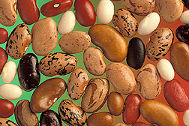
Demographics
  n =26
  Average Age = 70
  Male = 50%, Female = 50%
  Hyperlipidemia = 20
  Hypertension = 22
  Heart Disease = 17
  Type 2 Diabetes = 12
  Kidney disease = 0

Slide 11
Clinical Measurements
Adiponectin
E-selectin
ICAM
IL-6
IL-10
CRP
Lp(a)
TG
HbA1c
LDL/HDL
Uric acid
Weight
Blood pressure
Fasting glucose (P=0.054)
Fasting insulin
Homocysteine
Beta2-microglobulin
Osteoprotegran
Arginase
8-hydroxy-2-deoxyguanosine
Creatinine
Urinary protein
Nitrate/nitrite (nitric oxide)

Slide 12
ABI Improved After Eating Pulses
*
*p<0.05
*
baseline
final
baseline
final
No changes were observed in blood pressure.

Slide 13
Serum Cholesterol was Lower
*
*p<0.05

Slide 14
Improved Arterial Function does not Result from Lower Cholesterol
r = -0.0099
p = 0.963

Slide 15
Muscle Metabolism Improves
High serum acylcarnitines levels occur in PAD and indicate a decline in lipid metabolism

Slide 16
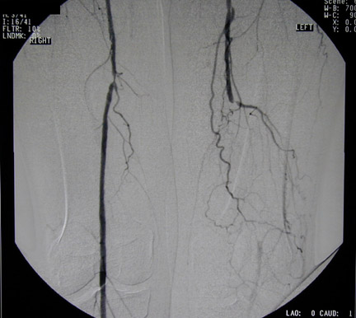
Interpretation
Dietary pulse consumption
⬆ Peripheral blood flow (ABI)
Improved skeletal muscle metabolism
&
Hiatt et al
1992
⬇ short chain acylcarnitines
Hiatt 2004
⬇ Claudication, ⬆ Walking distance

Slide 17
Other Studies Produced Similar Results
Effects of Pulse Varieties on Blood Vessel Function in Individuals with Peripheral Arterial Disease – examined effect of beans on PAD (funded by the Pulse Science Cluster) n=62
Impact of Pulse-enriched Foods on Cognitive Function and Cardiometabolic Health in Obese Adults – multicentre study with University of South Australia (funded by Province of Manitoba – STIC program) n=70

Slide 18
Effect of Pulse Consumption by Spontaneously Hypertensive Rats
Baseline
10 rats per group; age 17 weeks at baseline
4 or 8 weeks
Analyses = blood pressure, arterial stiffness, lipids, urine biomarkers
WKY (control) rats on control & mixed pulse diet
SHR rats on control diet
SHR rats on mixed pulse diet
SHR rats on bean or lentil or pea or chickpea diet
Diet = 30% cooked pulses by weight

Slide 19
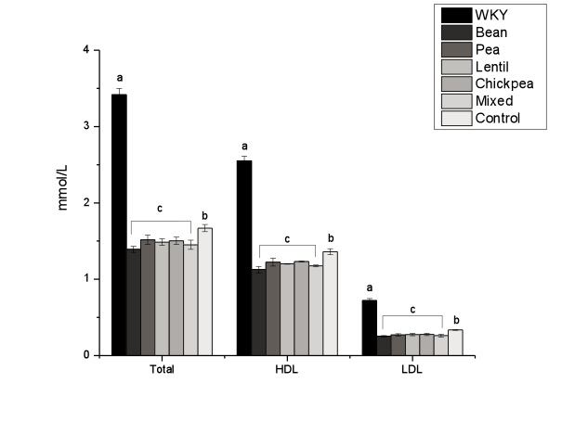
Pulses Reduce Cholesterol

Slide 20
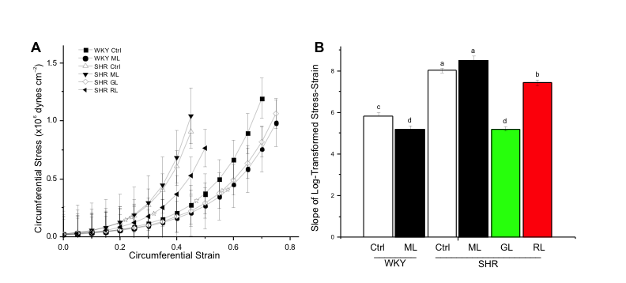
Pulses Decrease Arterial Stiffness
(in Rats)
Myography of mesenteric arteries showed lentils decreased arterial stiffness to that of normotensive controls

Slide 21
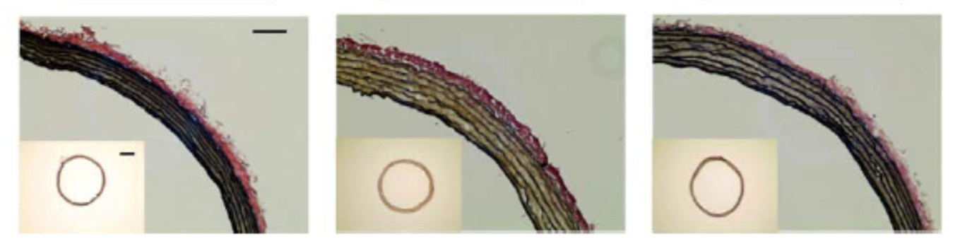
Medial Hypertrophy is Reduced
normal
hypertensive
hypertensive with lentils

Slide 22
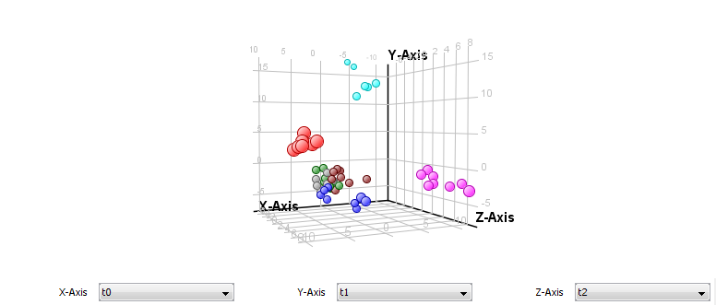
Metabolomics Analysis of Rat Urine
WKY-control
SHR-Beans
SHR-Chickpeas
SHR-control
SHR-Peas
SHR-Lentils
SHR-Mixture
Beans, Peas, Lentils, Chickpeas
Non-targeted analyses are being used to explore mechanism of action and identification of bioactives responsible for the observed health benefits.
Finding markers of pulse consumption will also be useful to assess compliance in
our human studies.

Slide 23
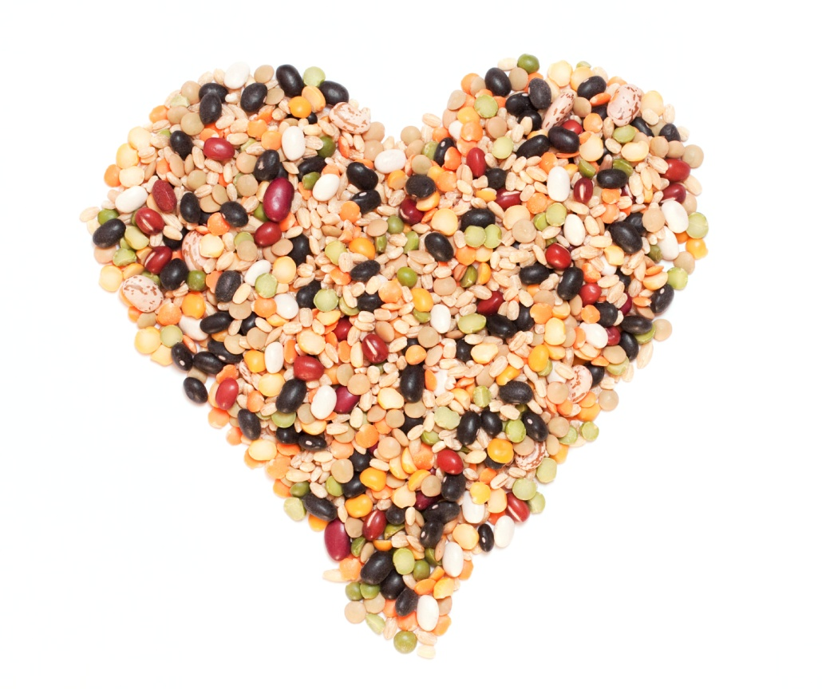
Summary
Eating pulses positively affects functional endpoints of cardiovascular health
Significant improvements in blood flow were obtained in an intervention of only 8 weeks
The improvements are not linked to reductions in lipid levels or better glycemic control
The benefits are probably the result of physical changes to the blood vessels
http://shimamyuko.wordpress.com/2014/01/

Slide 24
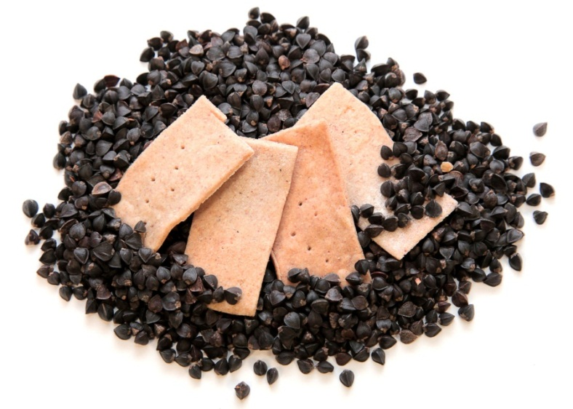
Our Results Indicate Food-Based Treatment of Human Disease is a Viable Approach
However, it is critical to identify agricultural products with bioactive concentrations high enough to be used directly or capable of being extracted and concentrated to provide a concentration high enough for use in either a nutraceutical (pill/supplement) format or as an enriched or fortified food.
Applications include management of obesity, diabetes and other chronic metabolic and endocrine disorders that are often related to poor lifestyle choices or are a consequence of (genetic) disease.

Slide 25
Acknowledgements
Funding
  Pulse Canada & Agriculture and Agri-food Canada provided funding to Pulse Canada for human clinical trials
  Manitoba government: Science, Technology, Energy and Mines
  NSERC Strategic Grants program funded the animal study
Members of the Research Team
  Carla Taylor (Co-investigator)
  Randy Guzman (Collaborator - Vascular Surgeon)
  Alanna Baldwin (Study Coordinator)
  Wendy Weighall (Research Nurse)
  Heather Blewett (PDF)
  Sherif Louis, Brenda Wright (Technicians)
  Connie Maghalaes, Francine St.-Hillaire (Food preparation)
  Angela Hubbard, Erin Kotyk (Food deliveries)
  Karin Dunthorne (Nutrient analyses)
  Karmin O (Folate & vitamin B12 measurements)
  Matt Hanson (Animal studies)
  Hope Anderson (Collaborator - Myography)
  Michel Aliani (Collaborator – Metabolomics)
  Kate Molnar & Sheri Bage (PWV), and animal care staff
  Technical assistants who helped with animal assessments and diet preparation
Facilities
  Asper Clinical Research Institute, St-Boniface Hospital Research Centre, Barbara Burns Food Development Lab (Human Nutritional Sciences, U Manitoba)
Study Participants

