Slide 1
Breast cancer in elderly patients (70 years and older): The University of Tennessee Medical Center at Knoxville 10 year experience
Curzon M, Curzon C, Heidel RE, Desai P, McLoughlin J, Panella T, Bell J and Orucevic A

Slide 2
Introduction
Incidence of breast carcinoma increases with age, (~30% of new breast carcinoma cases being diagnosed in patients ≥70y/o) (1)
There is still a paucity of data on how breast cancer biology influences outcomes in elderly patients.
1. SEER Cancer Statistics Factsheets: Breast Cancer. National Cancer Institute. Bethesda, MD, 2014 April 2014.

Slide 3
Introduction
A few studies showed that breast carcinoma in elderly patients have a higher probability of “favorable” tumor biology:
Hormone receptor positive (ER and/or PR positive)
HER2 negative breast carcinomas
Node-negative carcinomas (2, 3)
However, in spite of a higher probability of “favorable” tumor biology, almost 50% of deaths from breast carcinoma occur in the elderly patient population (≥70 y/o) (1).
1. SEER Cancer Statistics Factsheets: Breast Cancer. National Cancer Institute. Bethesda, MD, 2014 April 2014.
2. Aapro, M. and H. Wildiers, Ann Oncol, 2012. 23 Suppl 6: p. vi52-5. 3. Bauer, K.R., et al. Cancer, 2007. 109(9): p. 1721-8.

Slide 4
Introduction
We have shown in two previous studies on the overall survival of Caucasian women that:
ER/PR/HER2 status was not predictive of overall survival of Caucasian female breast carcinoma patients
TNM stage was predictive of overall survival (4, 5)
Objective of this study was to assess whether ER/PR/HER2 subtype and TNM stage of invasive breast carcinoma had significant impact on overall survival in the elderly subcohort of these patients (≥70y/o).
4. Ferguson, N.L., et al., Breast J, 2013. 19(1): p. 22-30. 5. Orucevic, A., et al Breast J 2015. 21(2): p. 147-154.

Slide 5
Materials and methods
Overall survival was assessed in a cohort of 232 elderly Caucasian female patients (≥70y/o) from our institution during a 10 year interval (01/1998-7/2008) when controlled for ER/PR/HER2 status, TNM stage and grade
Analyzed by Kaplan Meier curve and multivariate Cox regression analysis.
Last follow-up day was August 2013.

Slide 6
Materials and methods
Five ER/PR/HER2 subtypes classified per 2011 St. Gallen International Expert Consensus recommendations (6) were further subclassified into 3 subtypes:
- Traditionally considered “favorable” subtype-ER+/PR+/HER2-
- Traditionally considered “unfavorable” BC subtypes: HER2+ and triple negative
6. Goldhirsch, et al., 2011. 22(8):1736-1747.

Slide 7
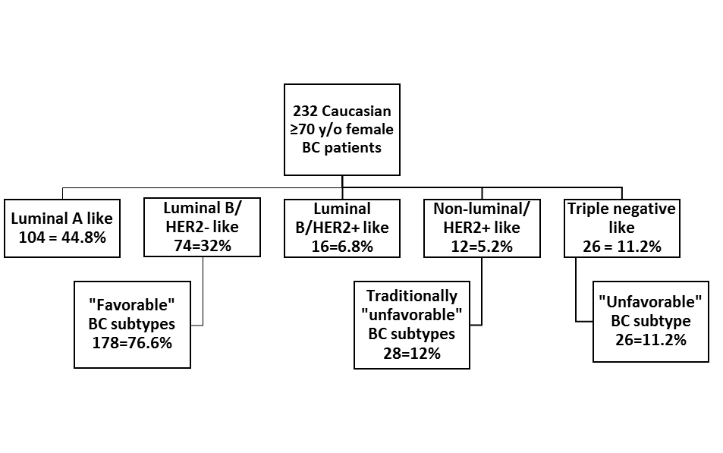

Slide 8

Results: Clinicopathologic characteristics of invasive carcinomas
Table legend: *= mean value; ** = most frequent; IDC = Invasive ductal carcinoma

Slide 9
Results
The majority of our patients (178/232 = 76.8%) were of the “favorable” breast carcinoma subtype (ER+ and/or PR+, HER2-), subdivided to the luminal A-like and luminal B/HER2 negative-like subtypes.
23.2% patients were of traditionally considered “unfavorable” subtype:
1) HER2+ subtype =12% (28/232), subdivided to luminal B/HER2 positive-like subtype (16/232) and HER2 positive/non-luminal like subtype (12/232) and
2) triple negative subtype = 11.2% (26/232)

Slide 10
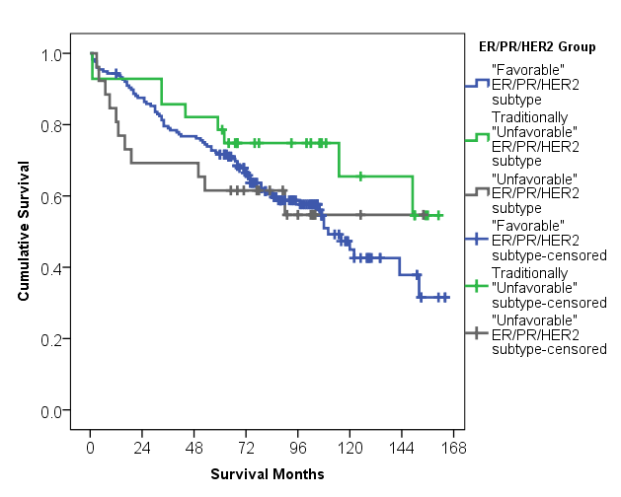
Kaplan Meier curve:
Stratified by the ER/PR/HER2 “favorable” (luminal A-like and luminal B/HER2- like), traditionally “unfavorable” (luminal B/HER2 positive like and nonluminal/HER2+ like) and “unfavorable” triple negative subtype.
ER/PR/HER2 subtype had no significant impact on overall survival (p=.285)

Slide 11
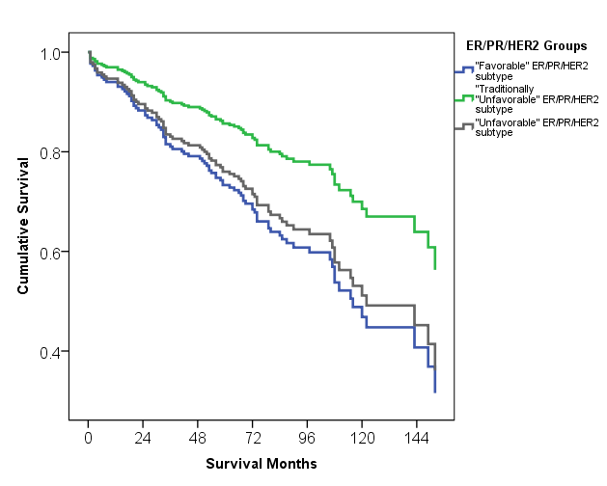
Cox regression analysis:
Overall survival curve output by ER/PR/HER2 subtype.
ER/PR/HER2 subtype was not significant predictor of overall survival (p=.095-.95)

Slide 12
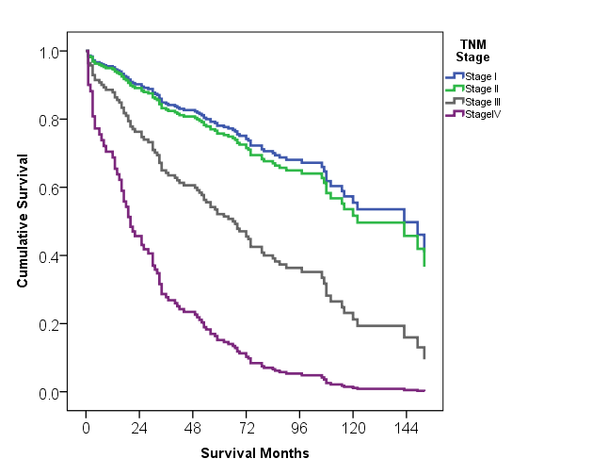
Overall survival curve output by TNM stage:
TNM stage was significant predictor of overall survival in stages III and IV (p<.001)
There was no significant difference between TNM stage I and stage II in this analysis (p=.641).
[Grade was not a significant predictor of overall survival (p=.47)]

Slide 13
Treatment in the ≥70 y/o age group and comparison to ≤40 y/o age group
The majority of patients underwent modified radical or total mastectomy (61.6% vs 67.9% in ≤40y/o)
Postsurgery treatment for ≥70 y/o in comparison to ≤40 y/o
32.3% had radiation; (46.1% ≤40y/o)
21.4% received adjuvant chemotherapy (82% ≤40y/o);
57.2% ER+ patients received hormonal therapy (76.5% of ≤40y/o).

Slide 14
Summary of results
We observed a trend for better overall survival in HER2+ breast carcinoma patients that were traditionally considered as “unfavorable” breast carcinoma subtype over patients in “favorable” breast carcinoma subtype (ER and/or PR+, HER2-);
Did not reach statistical significance.
No ER/PR/HER2 subtype was significantly predictive of better overall survival.

Slide 15
Summary of results
TNM stage was significantly predictive of overall survival (advanced stages).
These results were similar to our two previously published studies where ER/PR/HER2 status was not predictive of overall survival of Caucasian female breast carcinoma patients, irrespective of classification system used, while TNM stage was predictive of overall survival

Slide 16
Discussion
Possible causes for the results from our previous studies and now seen in the ≥70 y/o sub-cohort were attributed to:
The composition of our study population (we were only studying Caucasian female breast cancer patients)
Type of ER/PR/HER2 classification system used (St. Gallen breast carcinoma subtype classification or triple negative vs non-triple negative breast carcinoma subtype)
The time period of the study (1998-2008) when screening wherein diagnostics and treatment of breast carcinoma patients improved significantly over prior time periods.

Slide 17
Discussion
In at least two other different studies, elderly patients with “unfavorable” triple negative breast carcinoma phenotype had a better or the same outcome when compared to their corresponding younger cohort (7, 8).
Better survival was seen in spite of significantly lower use of chemotherapy and radiotherapy in the elderly patients
Raises the possibility that the same “unfavorable” breast carcinoma subtype exhibit a different tumor biology in younger and older patients
7. Dreyer, G., et al., Breast, 2013. 22(5): p. 761-6. 8. Thike, A.A., et al.,. Am J Surg Pathol, 2010. 34(7): p. 956-64.

Slide 18
Conclusions
Our study on elderly Caucasian female breast carcinoma patients from our institution showed that:
ER/PR/HER2 status was not predictive of overall survival
TNM stage was predictive of overall survival
Results are similar to two of our previously published studies on Caucasian female breast cancer patients.

Slide 19
Conclusions
Standardized treatment recommendations for patients >70 years old are less strictly defined than for other age groups.
Further studies (perhaps in a clinical trial setting) are warranted, may possibly reconcile and stratify given therapy with outcome.

Slide 20
Thank you

Slide 21
References
1. SEER Cancer Statistics Factsheets: Breast Cancer. National Cancer Institute. Bethesda, MD, http://seer.cancer.gov/statfacts/html/breast.html 2014 April 2014 [cited 2015 4-8-15].
2. Aapro, M. and H. Wildiers, Triple-negative breast cancer in the older population. Ann Oncol, 2012. 23 Suppl 6: p. vi52-5.
3. Bauer, K.R., et al., Descriptive analysis of estrogen receptor (ER)-negative, progesterone receptor (PR)-negative, and HER2-negative invasive breast cancer, the so-called triple-negative phenotype: a population-based study from the California cancer Registry. Cancer, 2007. 109(9): p. 1721-8.
4. Ferguson, N.L., et al., Prognostic value of breast cancer subtypes, Ki-67 proliferation index, age, and pathologic tumor characteristics on breast cancer survival in Caucasian women. Breast J, 2013. 19(1): p. 22-30.
5. Orucevic, A., Chen, J., McLoughlin, J., Heidel, R., Panella, T., Bell, J., Is the TNM staging system for breast cancer still relevant in the era of biomarkers and emerging personalized medicine for breast cancer – an institution’s 10 year experience Breast J 2015. 21(2): p. 147-154.
6. Goldhirsch, A., et al., Strategies for subtypes--dealing with the diversity of breast cancer: highlights of the St. Gallen International Expert Consensus on the Primary Therapy of Early Breast Cancer 2011. Annals of Oncology : Official Journal of the European Society for Medical Oncology / ESMO, 2011. 22(8): p. 1736-1747.
7. Dreyer, G., et al., Triple negative breast cancer: clinical characteristics in the different histological subtypes. Breast, 2013. 22(5): p. 761-6.
8. Thike, A.A., et al., Triple negative breast cancer: outcome correlation with immunohistochemical detection of basal markers. Am J Surg Pathol, 2010. 34(7): p. 956-64.

