Slide 1
Translational evidence and the accuracy of prokaryotic gene annotation
Luciano Brocchieri
Department of Molecular Genetics & Microbiology and Genetics Institute
University of Florida, Gainesville, FL 32610

Slide 2
From gene prediction to genome annotation
Computational gene predictions. E.g., GeneMark2.5 (Borodovsky and McIninch 1993), GeneMarkHMM (Lukashin and Borodovsky 1998), Glimmer3.0 (Delcher et al. 2007), Prodigal (Hyatt et al. 2010), etc.
  Union of predictions (comprehensive compilation)
  Intersection of prediction (robust predictions)
Evolutionary conservation
  Annotations modeled on closely-related species
  Long-range conservation indicative of functionality
Expression
  Microarrays
  RNA-seq
  Proteomics

Slide 3
Missing genes in genome annotation
Extensive conservation analysis of genomic ORFs from 1,300 bacterial chromosomes has revealed conservation across distantly related genomes of 40,000 ORFs not represented in genome annotations (Warren et al., BMC Bioinformatics 2010)
More than 52,000 genes predicted by Glimmer3.0 and not included in 1,574 bacterial chromosome annotations are confirmed by evolutionary conservation and functional characterization (Wood et al., Biology Direct 2012)
Significant 3-base periodicity identifies more than 68,000 con-served ORFs in annotated inter-genic regions of 2,000 prokaryotic chromosomes (Oden and Brocchieri, Bioinformatics 2015)

Slide 4
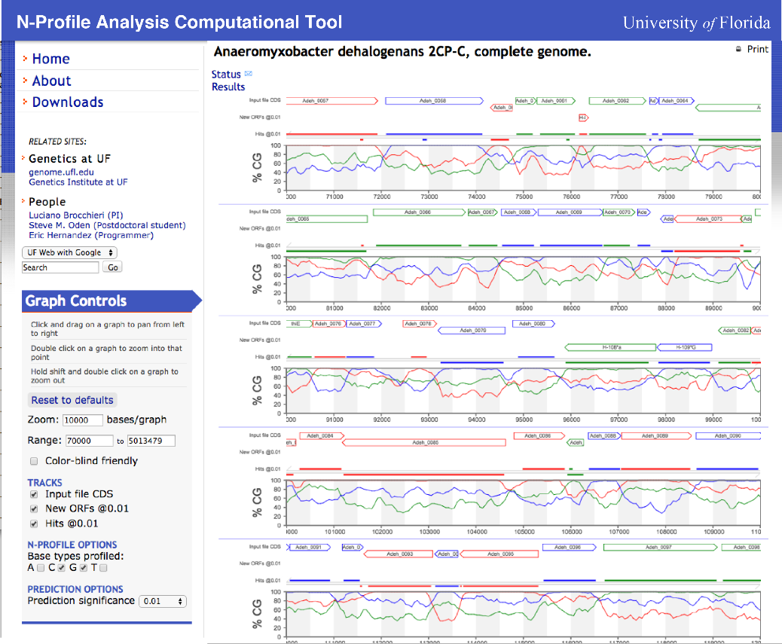
NPACT and the identification of coding regions by 3-base periodicity (http://genome.ufl.edu/npact)
ORFs not included in gene annotations can be identified by significant 3-base periodicity in the sequence (Oden and Brocchieri 2015, in revision)

Slide 5
Why are genes missed in genome annotation?
Missed genes do not depend on date of annotation (Wood et al., Biology Direct 2012)
Lack of sensitivity of computational gene predictors
Lack of consistency among computational gene predictors
Lack of specificity of computational gene predictors
Stringent criteria (e.g., on consistency or conservation) for acceptance during annotation
Problems with the annotation pipelines

Slide 6
Gene annotation and conservation
We define a gene to be conserved if:
Has sequence similarity with E-value ≤ 1.0E-6.
Is conserved in length:
1/1.2 ≤ [length target] / [length query] ≤ 1.2
Is conserved across genera or phyla.

Slide 7
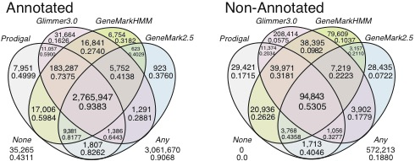
Conservation by class of prediction
None (NPACT)
101,019
0.0677
Genes exclusively predicted by one method tend to be less conserved.
Glimmer3.0 predicts substantially more exclusive genes than other methods, of which a greater number but a smaller fraction are conserved.

Slide 8
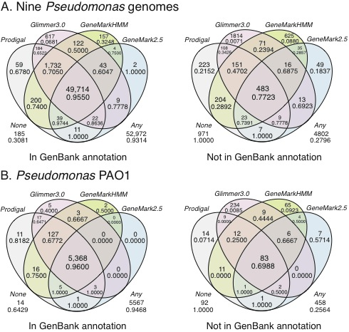
Gene predictions and periodicity in Pseudomonas aeruginosa strains

Slide 9
Experimental evidence of expression in P. aeruginosa PAO1: RNA-seq

Slide 10
Expression of predicted genes by length and conservation classes
Published annotation
Newly identified ORFs
ORFs with RNA-seq coverage

Slide 11
What do we learn about gene predictions from transcription in bacteria?
Unexpected patterns
Contradictory patterns of expression of well defined protein coding genes

Slide 12
What do we learn about gene predictions from transcription in bacteria?
The problem of antisense transcription
In the case of prediction of H-443*A , sequence features are more convincing than RNA-seq expression evidence.
‘Pervasive transcription’ in bacterial genomes (see Wade and Grainger, Nature reviews 2014) limits the detective power of RNA-seq

Slide 13
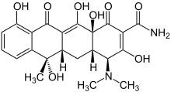
Ribosome footprinting
(Ingolia et al, Science 2009)
cycloheximide
Schematic representation of the ribosome footprinting. In application to P. aeruginosa tetracycline replaces cycloheximide

Slide 14
Ribosome footprints at initiation sites
The antibiotic tetracycline inhibits translation-elongation stalling actively-translating ribosomes

Slide 15
Ribosome footprints at initiation sites
However, tetracycline does not prevent more ribosomes to be recruited at the initiation site.

Slide 16
Ribosome footprints of initiation sites
The accumulation of ribosomes will result in increased numbers of profile-reads corresponding to the initiation site.

Slide 17
Ribosome footprint coverage in P. aeruginosa
# of reads
Example of ribosome footprint coverage in P. aeruginosa PAO1 showing relation with S-profiles, annotated genes and newly identified ORFs.

Slide 18
Ribosome footprint coverage by codon position
Metagene analysis of ribosome-footprint coverage
Coverage is averaged over all genes, relative to the start of translation

Slide 19
Ribosome footprint coverage by codon position: center of reads
Metagene analysis of coverage by read center + 2 nt
Coverage is averaged over all genes, relative to the start of translation

Slide 20
Translational evidence by ribosome footprinting in P. aeruginosa
Ribosome-footprint read-count patterns identify mRNA translation, translation-initiation sites, and translational pausing.

Slide 21
Ribosome-footprint-coverage patterns are robustly reproducible
Similar patterns of coverage of groEL observed in independent biological replicates.
What drives ribosome-footprint coverage patterns?

Slide 22
Newly identified genes in P. aeruginosa
Position relative to predicted start of translation
Examples of RFP-based gene discovery in P. aeruginosa PAO1 showing relation with S-profiles and annotated genes.

Slide 23
Identification of new genes by ribosome-footprint evidence
A new gene is found to be expressed 5’ of the gene eco for Ecotin, a protease inhibitor localized to the periplasmic space.

Slide 24
Translational evidence for newly identified ORFs

Slide 25
Scoring RFP expression
“Strength” of evidence decreases for poorly translated mRNA.

Slide 26
Scoring RFP expression
Expression Index
: Count of RFP reads in codon positions [-2,+2] / 5;
: Count of RFP reads in codon positions [+8, len/2] / (len/2 - 8);
“Strength” of the evidence of expression is measured by an “Expression Index”.

Slide 27
Expression of predicted genes by length and conservation classes
Published annotation
Newly identified ORFs
ORFs with Expression Index ≥ 12.0

Slide 28
Conservation and expression of genes annotated in Pseudomonas aeruginosa PAO1
5,457/5,567
3,208/5,567
0.980
0.576
Conserved
Expressed
Number and fraction of conserved or expressed genes of all genes annotated in P. aeruginosa PAO1

Slide 29
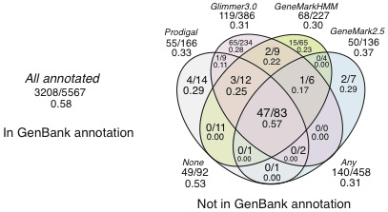
Conservation and expression of predicted genes not included in annotations by class of prediction
Conserved
Expressed
Number and fraction of conserved or expressed genes of all genes predicted by different sets of predictors in P. aeruginosa PAO1

Slide 30
Identification of translation-initiation sites by ribosome-footprinting
Hyothetical gene 1889. RFP evidence of translation from alternative start at +600.

Slide 31
Start of translation identification by RFP read accumulation
 | Annotated | Newly identified
Same start | 85.0% | 77.8%
Different start | 15.0% | 22.2%
Ribosome footprints confirm the predicted start of translation of 85% of annotated genes, and of 78% of the newly-identified ORFS, among those with evidence of translation.

Slide 32
Alternative start of translation?
RFP read patterns suggest that translation of cysH [phospho-adenylylsulphate reductase (PAPS) reductase] starts 75 nucleotides downstream of the computationally-predicted start

Slide 33
Alternative start of translation?
FliA, sigma factor of RNA polymerase for flagellum genes transcription.
CheY is involved in transmission of sensory signal to the flagellal motor.

Slide 34
Post-transcriptional control of translation after oxidative stress

Slide 35
Lab members
Thanks to
Steve Oden – Postdoctoral associate. Development of gene finding methods and software, gene content analysis in human and prokaryotes.
Nathan Bird– Programmer with Acceleration.com.
Anna Picca – Postdoctoral associate. RNA-seq and ribosome profiling
Ying Zhang – Postdoctoral associate. RNA-seq
Collaborators
Silvia Tornaletti (UF Dept. of Medicine). RNA biology.
Shouguang Jin (UF Dept. of Molecular Genetics and Microbiology). P. aeruginosa samples and advice
Funding
NIH R01 GM087485­01A2
MGM, Genetics Institute, College of Medicine.

