Slide 1



About OMICS Group
OMICS Group International is an amalgamation of Open Access publications and worldwide international science conferences and events. Established in the year 2007 with the sole aim of making the information on Sciences and technology ‘Open Access’, OMICS Group publishes 500 online open access scholarly journals in all aspects of Science, Engineering, Management and Technology journals. OMICS Group has been instrumental in taking the knowledge on Science & technology to the doorsteps of ordinary men and women. Research Scholars, Students, Libraries, Educational Institutions, Research centers and the industry are main stakeholders that benefitted greatly from this knowledge dissemination. OMICS International also organizes 500 International conferences annually across the globe, where knowledge transfer takes place through debates, round table discussions, poster presentations, workshops, symposia and exhibitions.

Slide 2
About OMICS International Conferences
About OMICS Group
OMICS International is a pioneer and leading science event organizer, which publishes around 500 open access journals and conducts over 300 Medical, Clinical, Engineering, Life Sciences, Pharma scientific conferences all over the globe annually with the support of more than 1000 scientific associations and 30,000 editorial board members and 3.5 million followers to its credit.
OMICS International has organized 500 conferences, workshops and national symposiums across the major cities including San Francisco, Las Vegas, San Antonio, Omaha, Orlando, Raleigh, SantaClara, Chicago, Philadelphia, Baltimore, United Kingdom, Valencia, Dubai, Beijing, Hyderabad, Bengaluru and Mumbai.

Slide 3
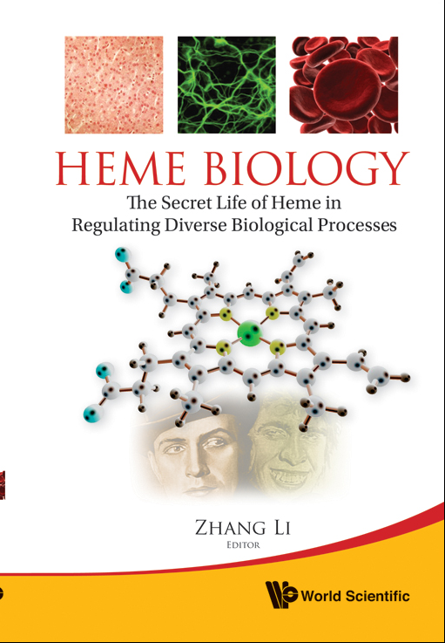

Slide 4
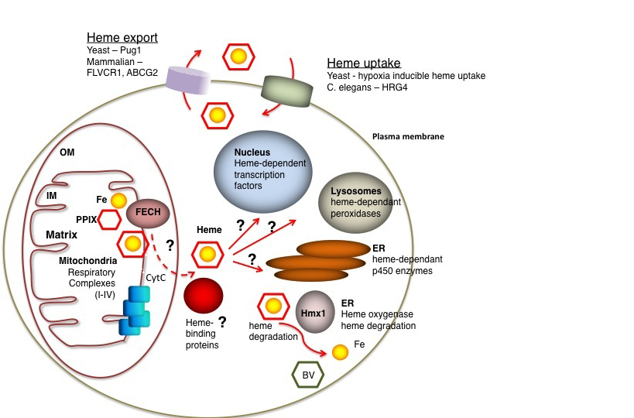

Slide 5
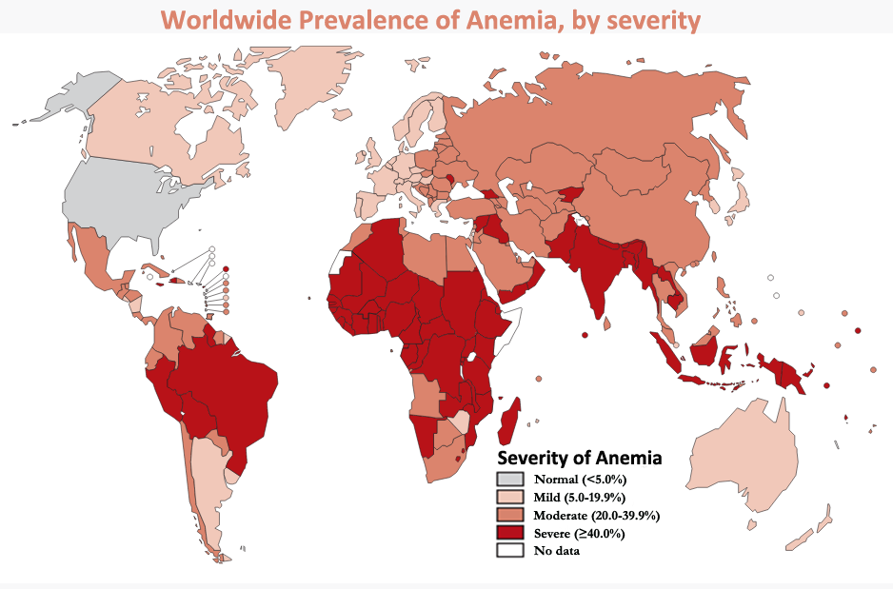

Slide 6
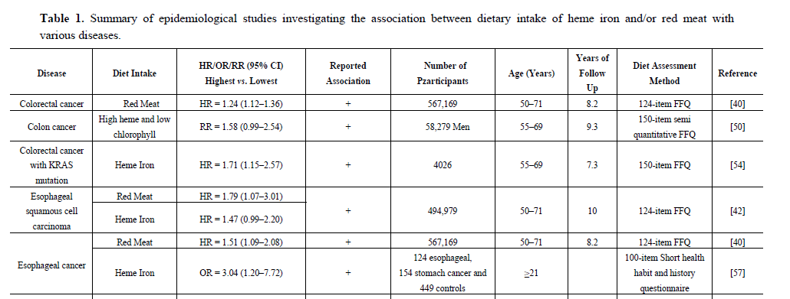
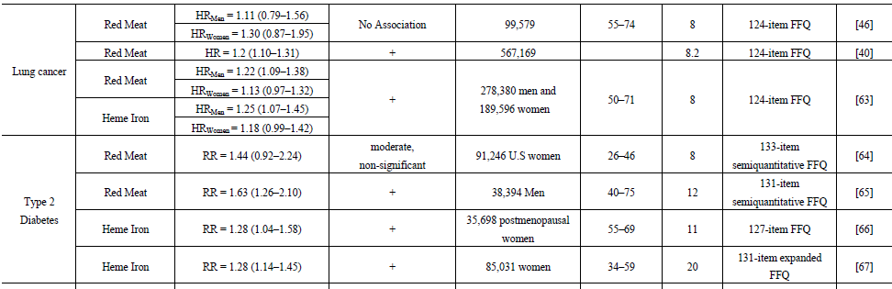

Slide 7
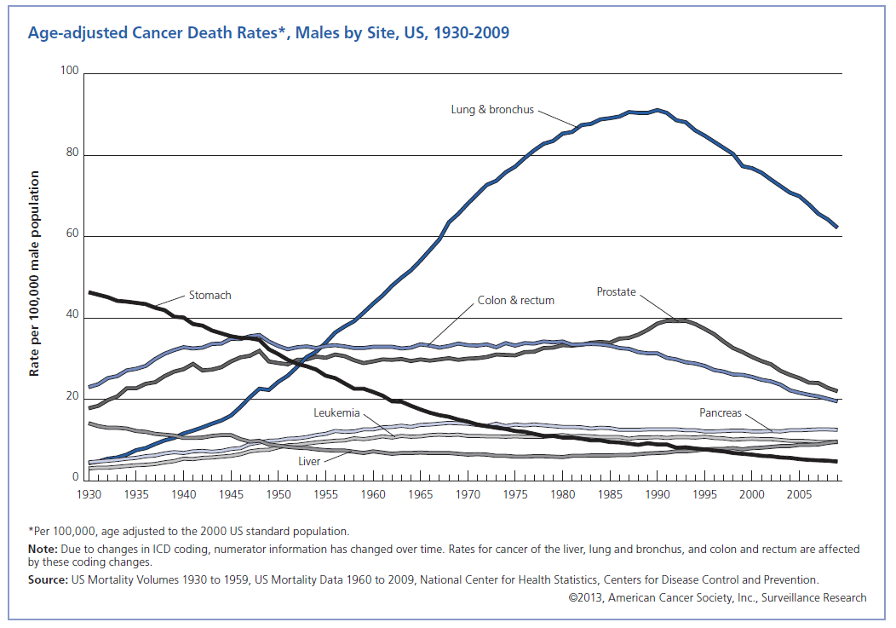

Slide 8
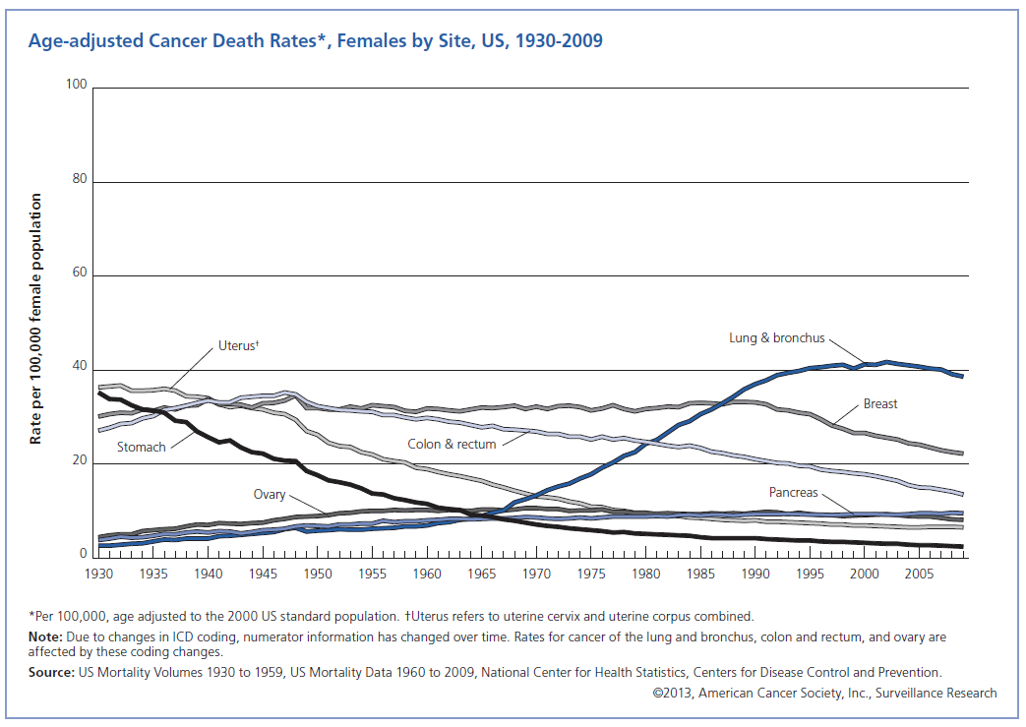

Slide 9
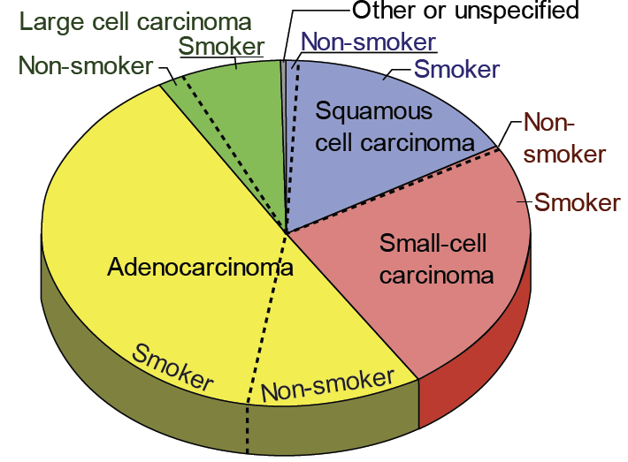
Lung Cancer
Non-small cell lung cancer (NSCLC, 85%)
Adenocarcinoma
Squamous cell carcinoma
Large cell carcinomas
Small Cell Lung Cancer (15%)

Slide 10
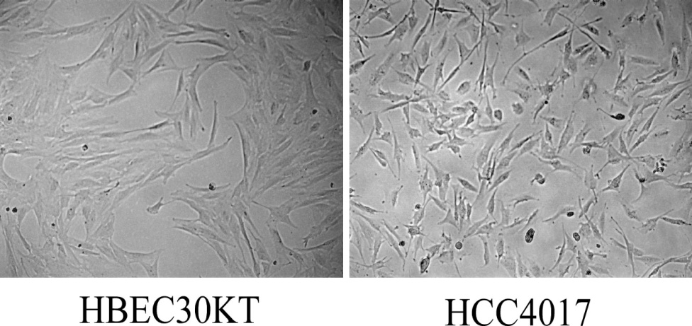
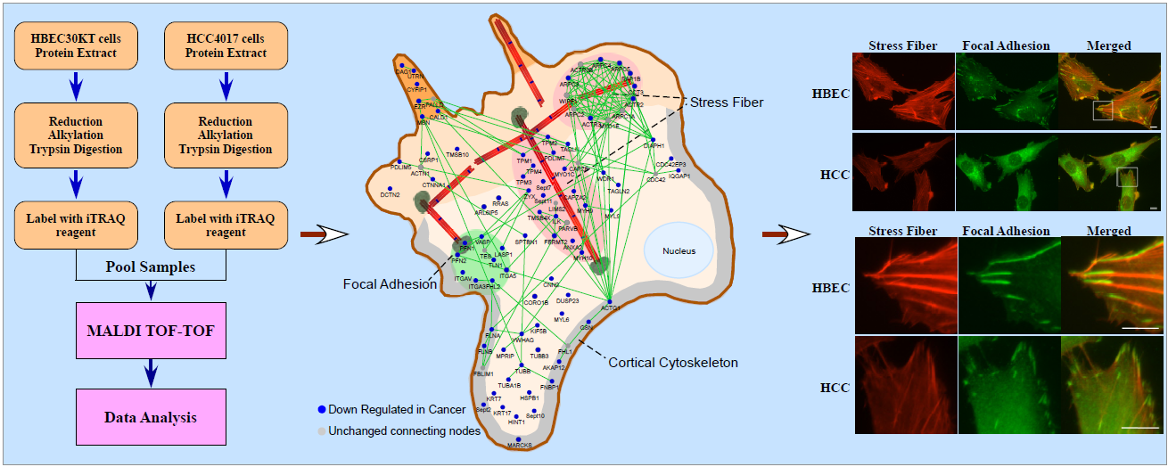
Normal
NSCLC

Slide 11
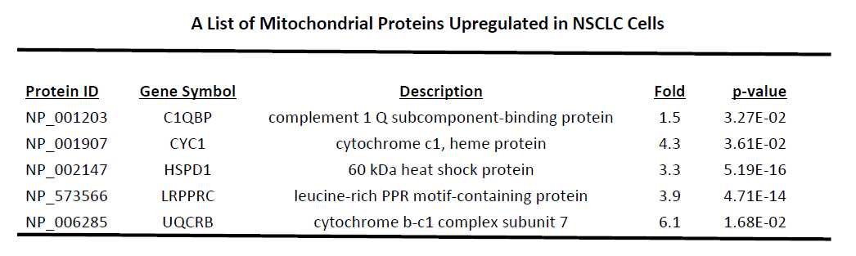
Proteomic data indicate that hemoproteins are increased in lung cancer cells

Slide 12
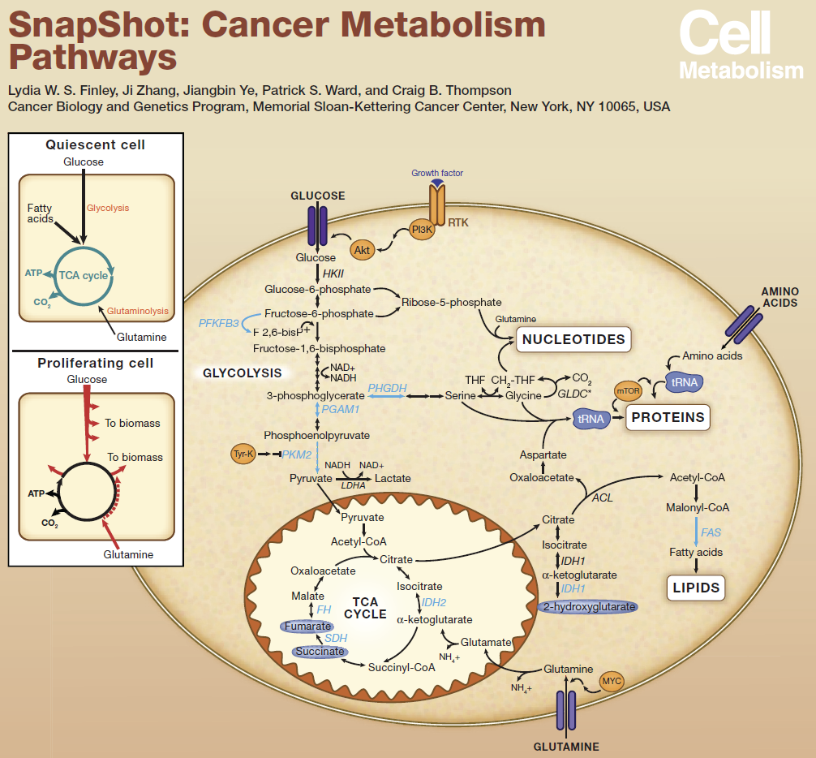

Slide 13
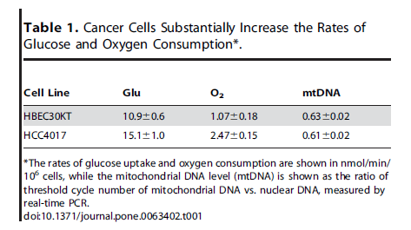

Slide 14
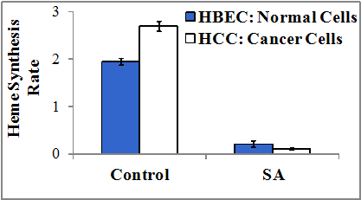
Heme synthesis is significantly enhanced in cancer cells compared to the normal cells

Slide 15
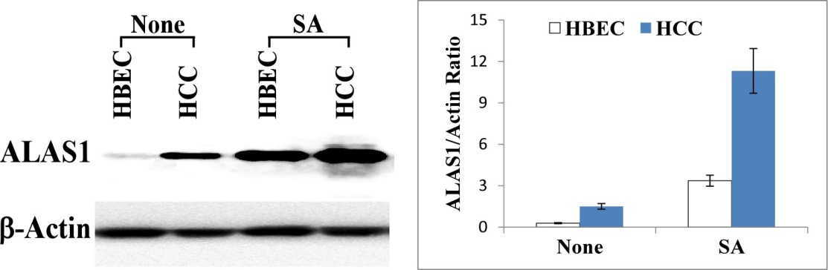
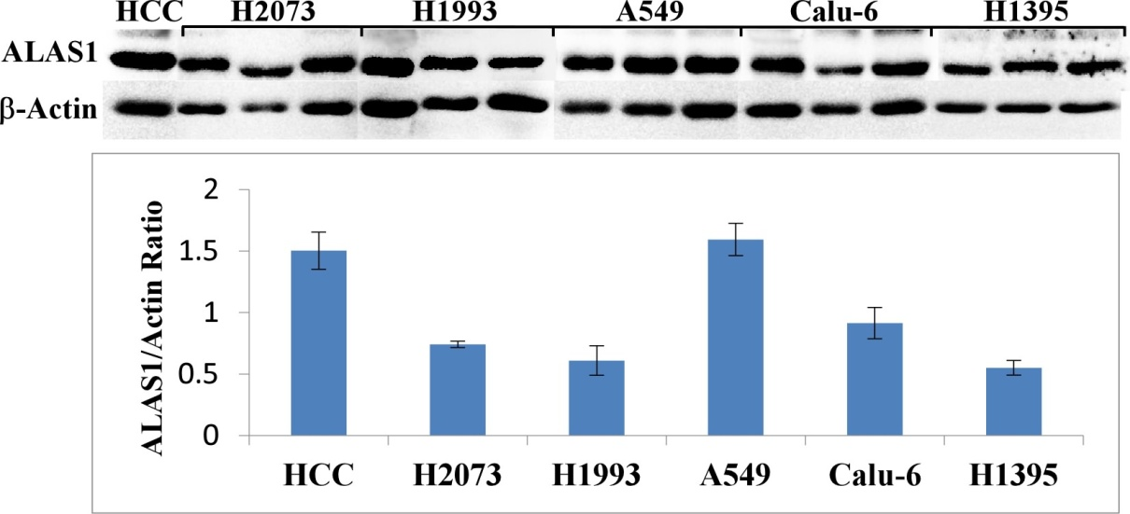
The level of the rate-limiting heme biosynthetic enzyme ALAS1 is dramatically enhanced in NSCLC cells
and in mouse xenograft tumors

Slide 16
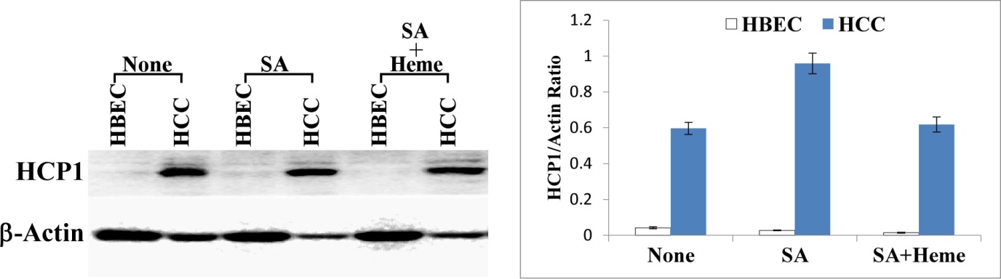
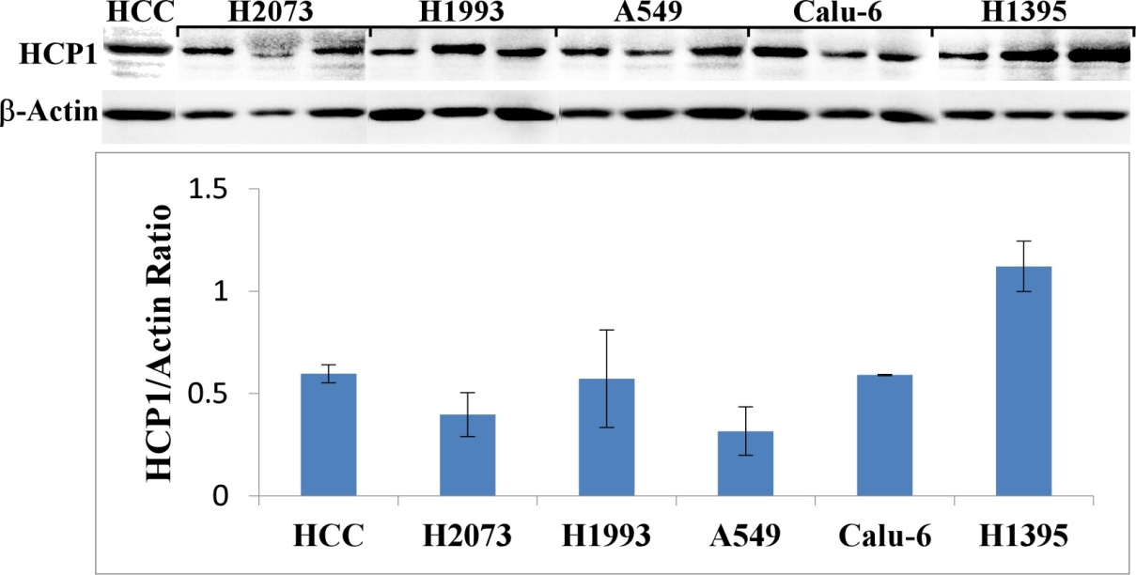
The level of heme-transporting HCP1 is dramatically enhanced in NSCLC cells
and in mouse xenograft tumors

Slide 17
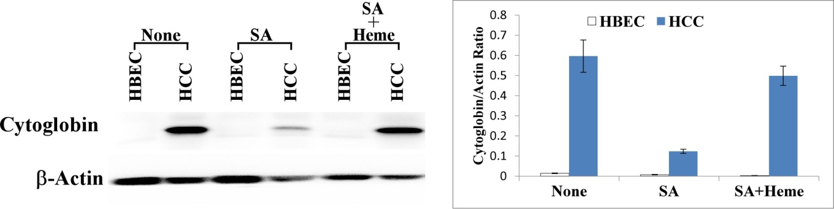
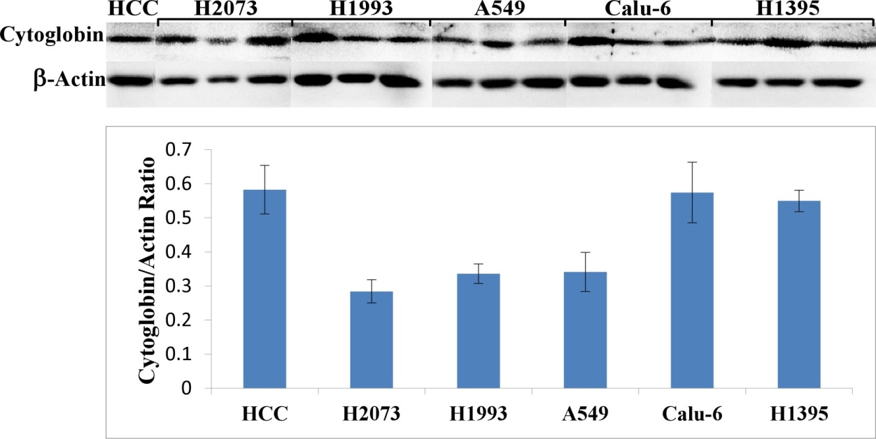
The levels of hemoproteins, such as the oxygen-binding cytoglobin, are dramatically enhanced in NSCLC cells
and in mouse xenograft tumors

Slide 18
Parent m/z [M+H]⁺ (-HCl)
[(651.94-36.5)+1]=616
Daughter piece
(after lost CH₂COO⁻: 616-59=557)

Slide 19
Sample 1A
hemin
3
10
5
6
9
13
11
8
1
12
4
7
2

Slide 20
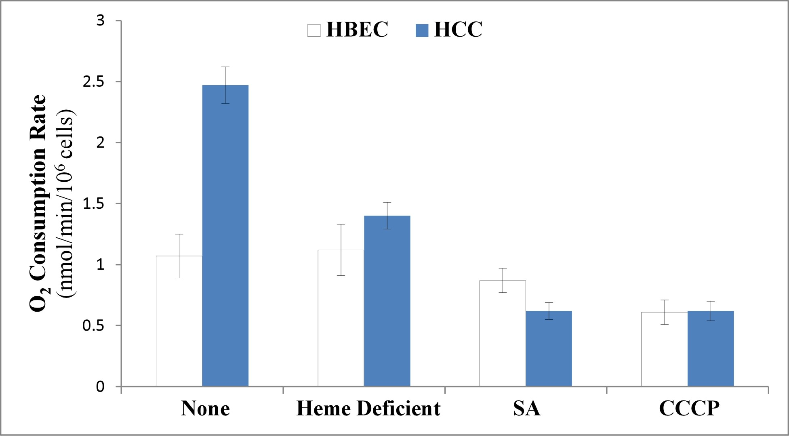
Oxygen consumption is intensified in NSCLC cells, and inhibition of heme uptake and biosynthesis suppresses it

Slide 21
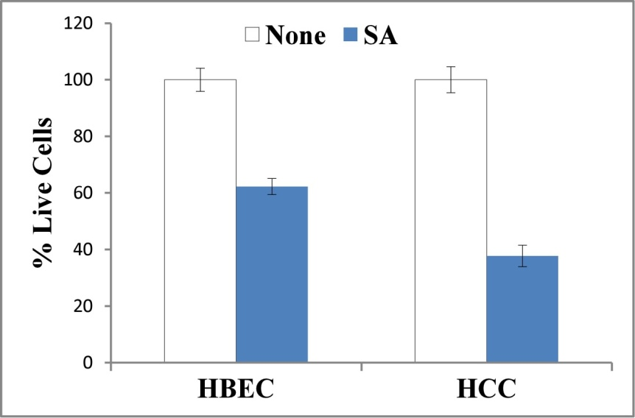
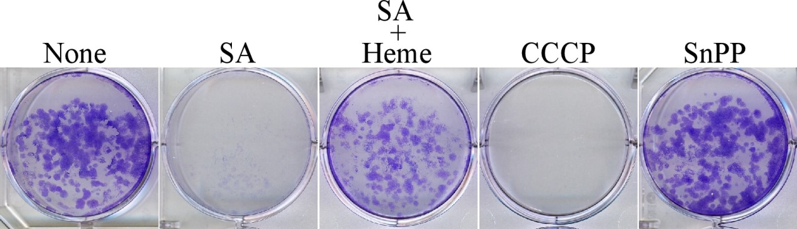
Reduction of intracellular heme level inhibits NSCLC cell proliferation and colony formation

Slide 22
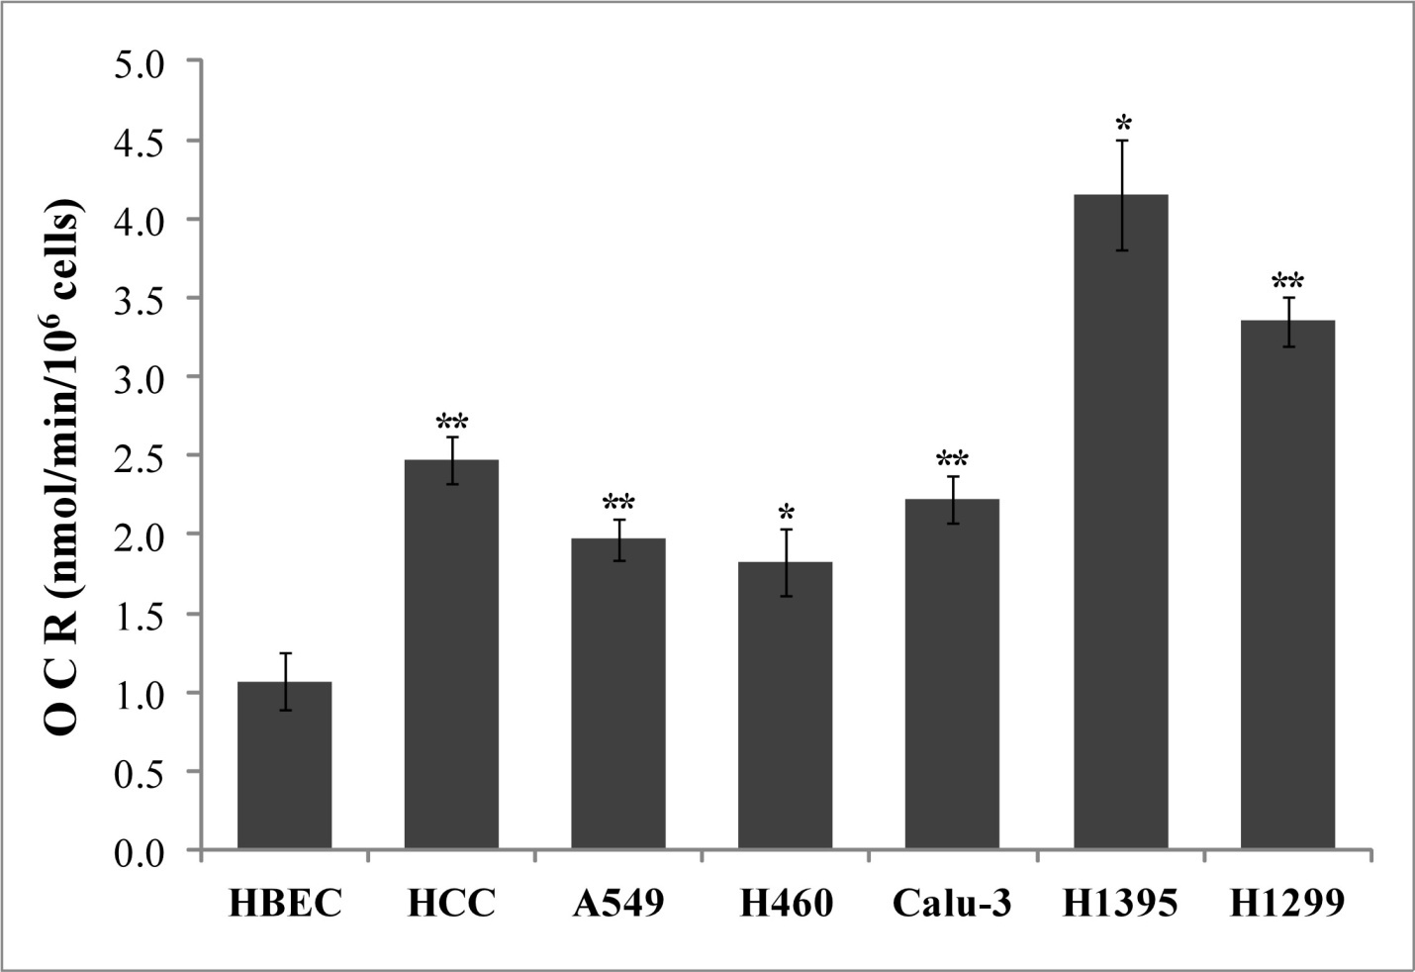
Most NSCLC Cell Lines Exhibit Intensified Oxygen Consumption

Slide 23
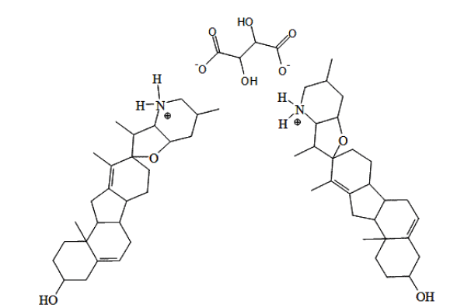
Cyclopamine Tartrate (CycT), an Inhibitor of Hedgehog Signaling, Strongly Inhibits Lung Cancer Cell Proliferation

Slide 24
Glucose, Glutamine and Cyclopamine Tartrate Strongly Impact the Rate of Oxygen Consumption in NSCLC cells

Slide 25
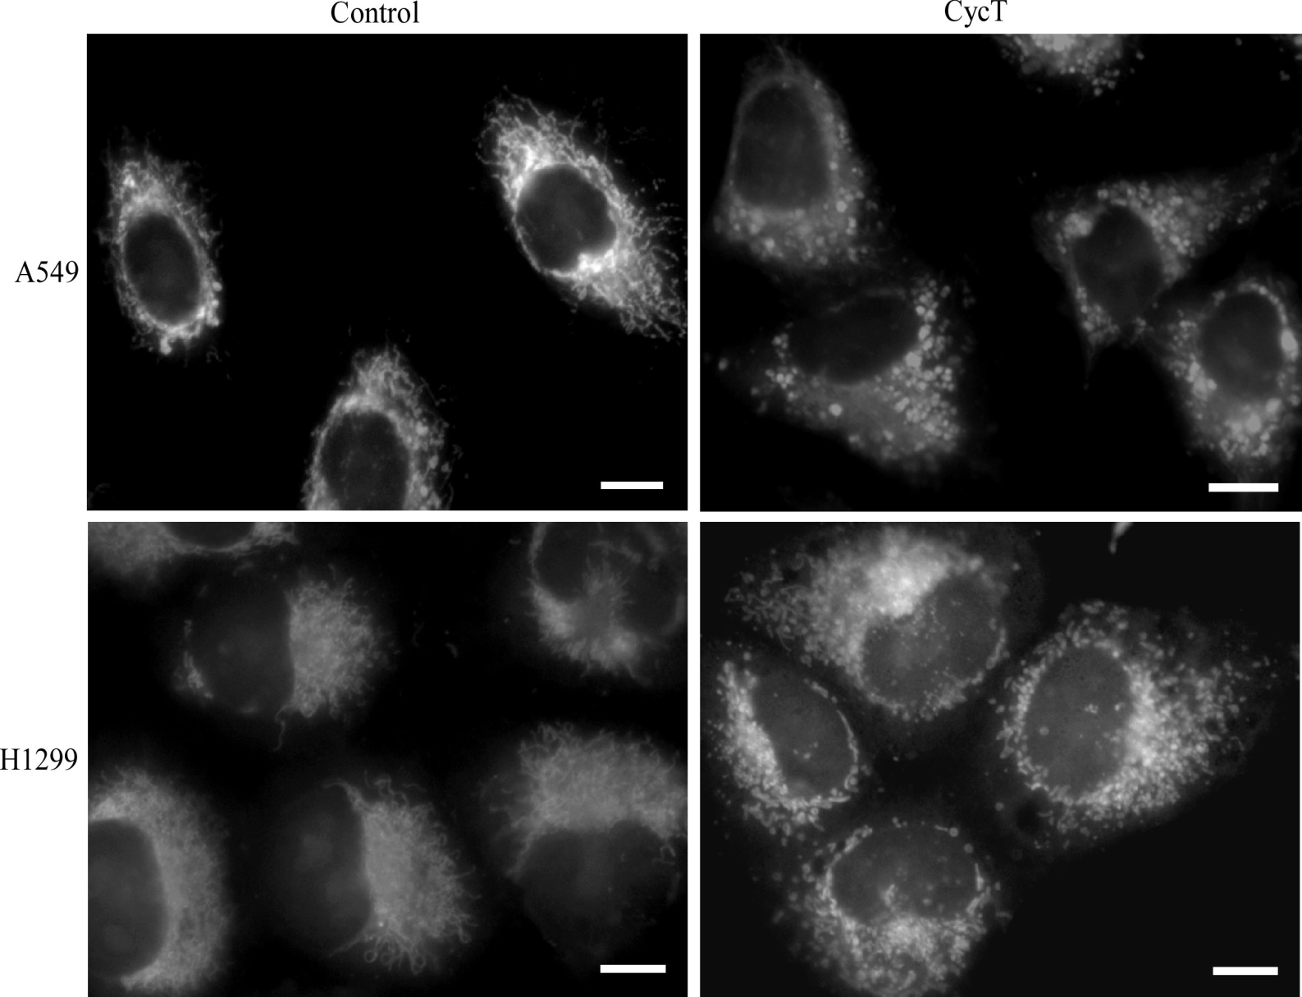
Cyclopamine Tartrate Causes Mitochondrial Fragmentation

Slide 26
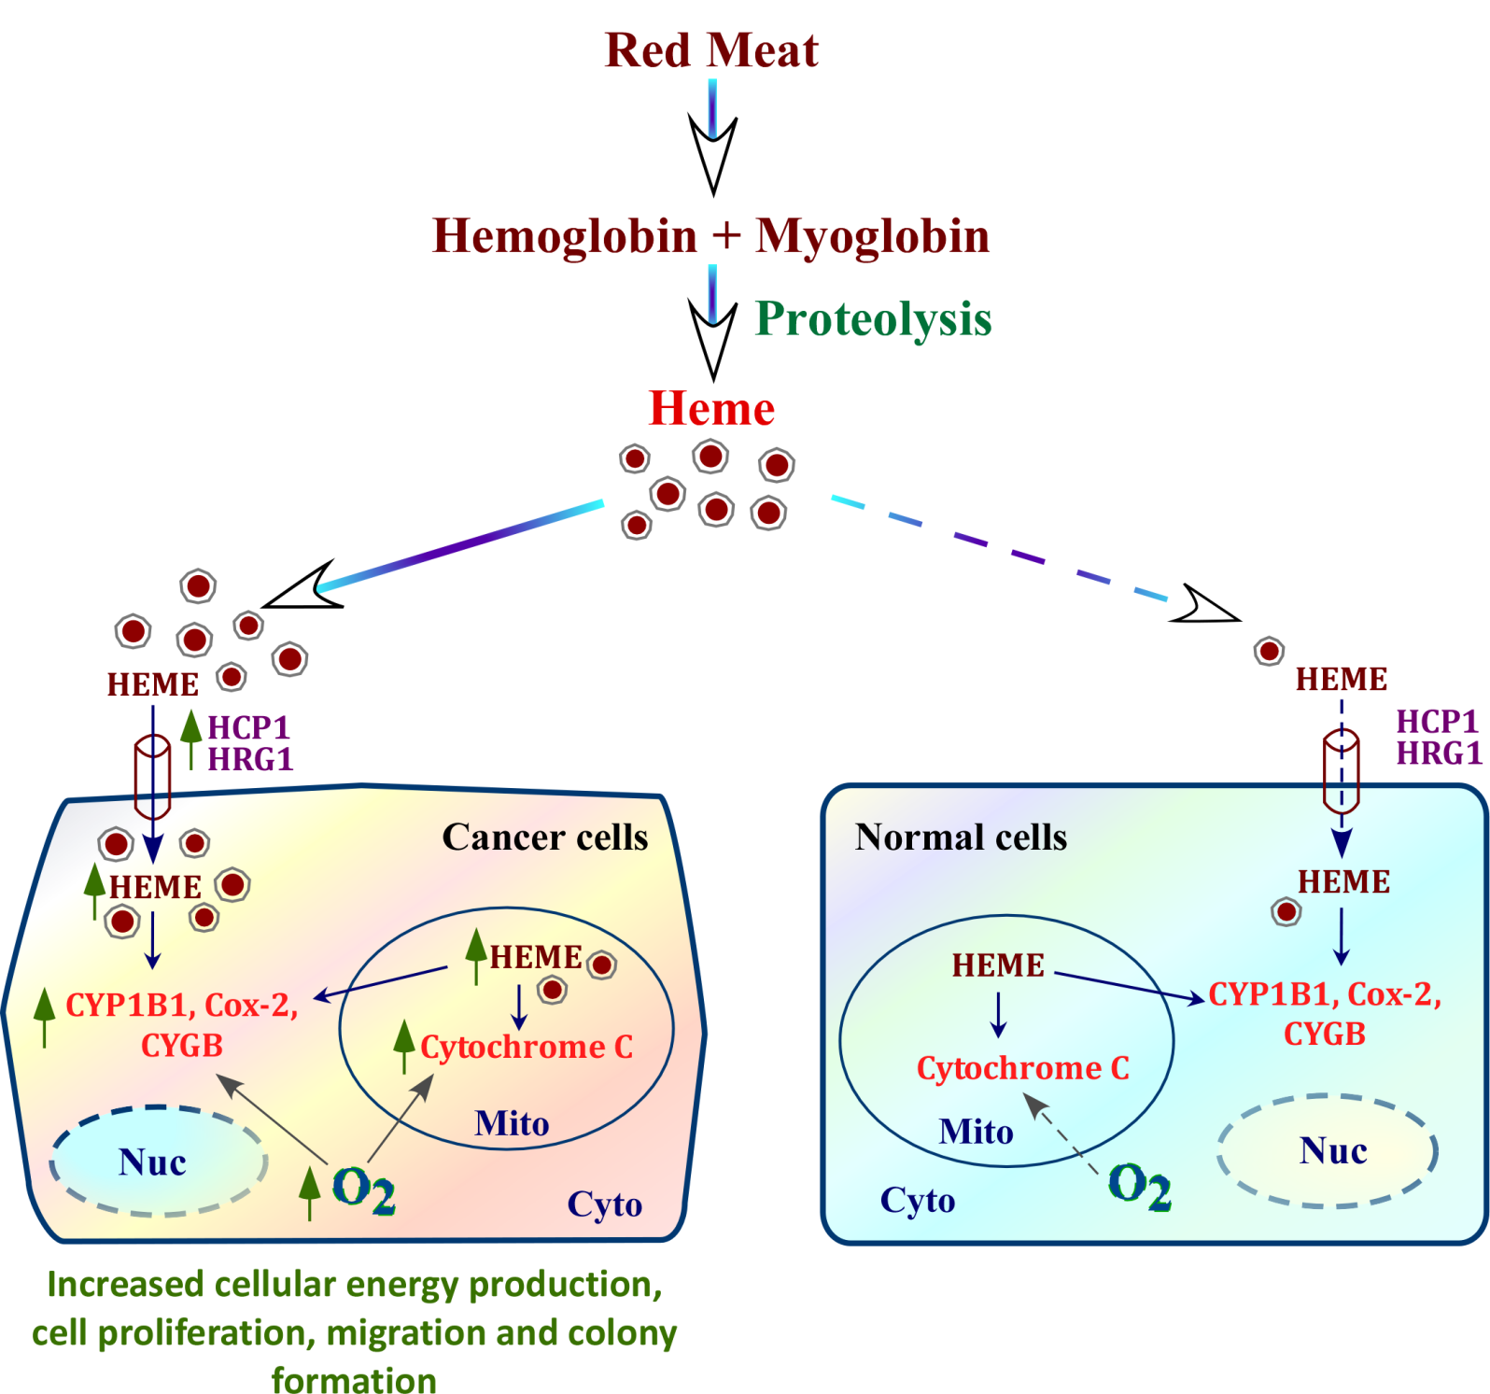

Slide 27
UT Dallas
Jagmohan Hooda
Md M Alam
Sneha Lal
Jonathan Michael Comer
Purna Chaitanya Konduri
Sarada Preeta Kalainayakan
Sagar Sohoni
Tianyuan Wang
Daniela Cadinu
Robert M Henke
Penn State
Bruce and Anne Stanley
Dongxiao Sun

Slide 28
Let Us Meet Again
We welcome you all to our future conferences of
OMICS International
Please Visit:
www.metabolomicsconference.com
www.conferenceseries.com
http://www.conferenceseries.com/clinical-research-conferences.php

