Slide 1

Data Analytics and Mathematical Modeling for Psychiatric Diagnosis in a Big Data Processing Environment
Kazuo Ishii, PhD, Professor of Genomic Sciences
Kazuo Ishii^{1*}, Shusuke Numata², Makoto Kinoshita²and Tetsuro Ohmori²
1 Tokyo University of Agriculture and Technology, Tokyo, Japan
2 University of Tokushima School of Medicine, Tokushima, Japan
*E-mail: kazuoishii@cc.tuat.ac.jp
Notes:
Hello Everyone. Thank you for the opportunity to talk my present research in this honorable conference.
My name is Kazuo Ishii, PhD, the professor of genomic sciences of the Tokyo University of Agriculture and Technology from Tokyo, Japan.
Today I would like to talk about Data Analytics and Mathematical Modeling for Psychiatric Diagnosis in a Big Data Processing Environment.

Slide 2
Agenda
Back ground
Research Aim and Target
Research Scheme
Practical Case Study
Summary
Notes:
”This is the Agenda of Today’s presentation.”

Slide 3
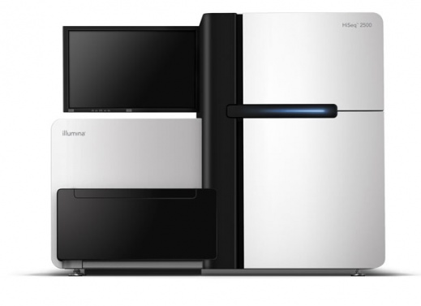
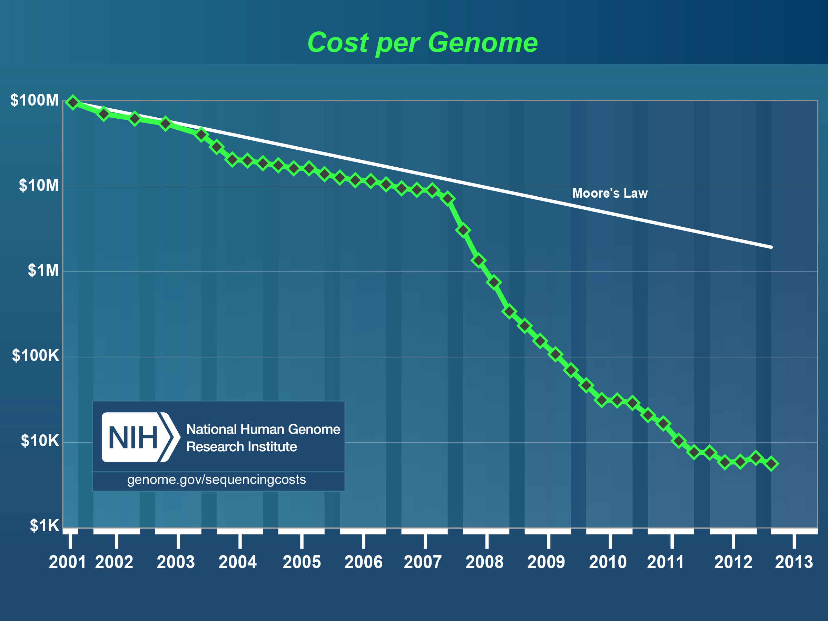
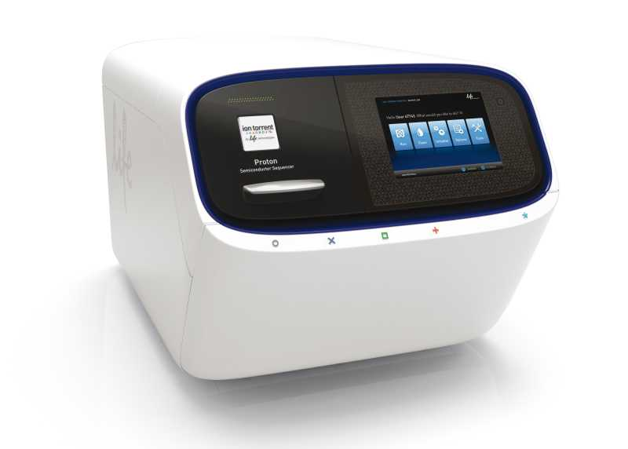
Era of Genomic Big Data
Back ground
Genomic Big Data production by Next Generation Sequencing Technologies is increasing year after year.
Next Generation Sequencers
Notes:
“Emergence of the next generation sequencing technologies and its application to clinical and biological research led to the era of Genomic Big Data.
The cost of human genome sequencing is lowering year after year, and its speed surpasses the Moore's law after 2005.
Today, realizing the personal medicine with Big Data is a fascinating topic in the current clinical research.“

Slide 4
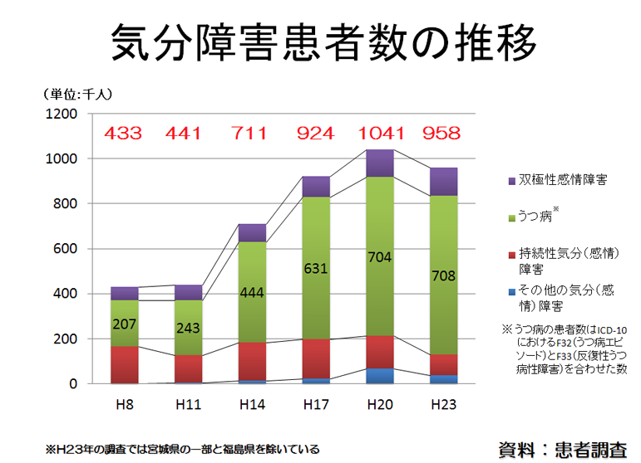
Mental Health
Back ground
Neuropsychiatric Disorders, such as depression, bipolar disorders are increasing year after year.
But, no effective evidence based-diagnosis.
Big Data-based
new diagnosis
system is expected
to provide
revolutionary
innovation
in mental health.
Increasing Number of Mental Illness
(x 1000 persons)
Bipolar Disorders
Depression
Persistent Mood Disorders
Others
1996 1999 2002 2005 2008 2011
From Japanese Government Documents (2012)
Notes:
“In the clinical study, Big data Analysis is very popular in cancer and cardiovascular diseases,
but not in the neuropsychiatric disorders, because of its ambiguous causality and the difficulty of obtaining the specimen samples.
In Japan, neuropsychiatric disorders, such as depression and bipolar disorders, are increasing year after year because of bad economical status of Japan in decades, and natural disaster including the big earthquake.
Diagnosis of neuropsychiatric disorders were performed based on only the interview by the doctor at the clinical sites.
And there is no evidence-based diagnosis for neuropsychiatric disorders, such as biochemical and molecular biological tests.
Therefore, big data based new diagnosis system using genomic big data is expected to provide revolutionary innovation in mental health.”

Slide 5
Research Aim and Target
Research Aim and Target
Aim:
Development of Big Data Mining Method
Development of optimized algorithm and mathematical modeling methods for genomic big data; from
500,000 - 10,000,000 explanatory variables
(biological markers)
Target (Data is provided by Tokushima Univ.)
Diagnosis system for three major mental disorders; depression, etc
Notes:
“The aim of our research is Development of Big Data Mining Method.
That is Development of optimized algorithm and mathematical modeling methods with genomic big data.
We use 500,000 - 10,000,000 explanatory variables obtained from NGS and microarray.
And we explore the suitable diagnostic markers and create the optimized and mathematical model for neuropsychiatric diagnosis.
Our research target is focusing on the three major mental disorders, such as depression.”

Slide 6
Overview of Research Process
Mathematical Modeling for Big Data
Research
Scheme
Unstructured
Data
Hadoop MapReduce, shell scripting, data processing with
NoSQL, Monte Carlo Simulation
Structured
Data
Data processing with RDMS（MySQL, PostgreSQL）
Selection of
Explanatory
Variables
Statistical significance tests (Student's t test, Mann-whitney U test, etc), sparse modeling
Multivariable analyses
(Multiple Regression,
Discriminant analysis),
Support Vector Machine (SVM),
Machine Learning (SOM etc.),
Baysean Filtering, etc.
Discrimination
of Data
Mathematical
Modeling
Linear Regression Model,
Logistic Regression Model and Mixed Model, etc.
Coefficient of determination, Wilks Lambda, Akaike's Information Criterion (AIC),
Bayesian Information Criterion (BIC), etc.
Optimization
of Models
Evaluation
of Models
Cross validation, including Leave-one Out
Notes:
In this slide, the outline of the analytics process was shown.
Six process were contained in the overall step;
Unstructured data, structured data, Selection, Discrimination, Mathematical modeling, Optimization and Evaluation.
Processing unstructured data contains Hadoop MapReduce, shell scripting, data processing with NoSQL, Monte Carlo Simulation.
Processing structured data contains Data processing with RDMS（MySQL, PostgreSQL）.
Selection of Explanatory Variables staistical hypothesis testsing, such as Student's t test and Mann-whitney U test
sparse modeling will be also reviewed in this process.
In the Discrimination Process, variety of data mining and Machine earning methods were evaluated., such as
Multivariable analyses (Multiple Regression, Discriminant analysis), Support Vector Machine (SVM), self organizing map (SOM), Baysean Filtering, etc.
In the Mathematical Modeling Process, Linear Regression Model, Logistic Regression Model and Mixed Model, and other mathematical models will be evaluated.
In the final step mathematical models were evaluated with cross validation including leave-one out method.

Slide 7
HPC and Cloud (Amazon)
Research Scheme
Powerful and High Performance
HPC
Very Large Memory and Many Core CPUs
4TB Memory, 80 core CPU
Cloud (Amazon)
Many Core CPUs
but memory is not so large
244 GB Memory, 32 core CPU x n
More core CPUs available by using many instances.
Platform should be selected based on its purpose
Notes:
This is a comparison between HPC and AWS Cloud.
HPC possesses larger memory than AWS.
Both platform has different character.
Therefore, Platform should be selected based on its purpose.

Slide 8
Example of Methylation Calling Software
Research Scheme
Bismark − Mapping with bowtie
PASH − small memory and fast
BSMAP − Mapping with SOAP
Methylcoder
BS-Seq − for plants
Kismeth − for plants, web-based
Notes:
Here, I show the case of Methylation Calling Software, Bismark.
Bismark is based on the mapping of Bowtie.

Slide 9
Platform should be selected based on its purpose
Research Scheme
Data Analysis of Methyl-Seq requires extremely large memory
ex.
BisMark (Methylation site calling soft)
-> 870 GB in one process
R -> 900 GB in one process
requires about 1TB memory
Amazon – Cloud could not
analyze methylation calling with BisMark
Notes:
Because Bismark and R require larger memory, Amazon – Cloud could not analyze methylation calling with BisMark

Slide 10
Practical Case Study
Practical Case Study
Here, we only show the case of 450K MicroArray in this presentation.
Results of NGS will be shown elsewhere.
Notes:
Here I will only show the practical case of data mining using microarray.
Results of NGS will be shown elsewhere, because of preparing patent pending,

Slide 11
Research Process in This Method
Mathematical Modeling for Big Data
Structured
Data
Illumina 450K DNA Methylation Microarray
Selection of
Explanatory
Variables
Mann-whitney U test and Ranking
Discrimination
of Data
Linear Discriminant Analysis (LDA)
Mathematical
Modeling
Discriminant Function
Optimization
of Models
Backward Elimination Method
Cross validation (Training set and Validation set)
Evaluation
of Models
Notes:
In this result, Illumina 450K methylation Microarray were used for Structured data.
Mann-whitney U test and its Ranking was used for the Selection of Explanatory Variables.
Linear Discriminant Analysis (LDA) was used for the Discrimination of Data..
Discriminant Function was used for the Mathematical Model.
Backward Elimination Method was used for Optimization of Models.
Cross validation with Training set and Validation set was used for Evaluation of Models.

Slide 12
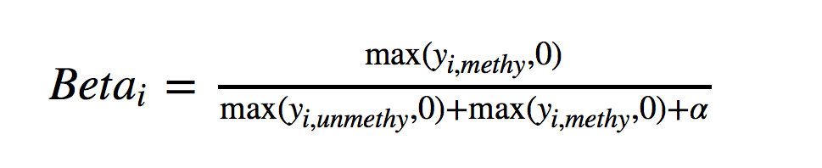
DNA Methylation rate does not show a normal distribution
Beta-value for an i^{th} interrogated CpG site is defined as:
where y_{i,menty} and y_{i,unmenty} are the intensities measured by the i^{th} methylated and unmethylated probes, respectively
Both Next Generation Sequencing Data and
Methylation MicroArray Data
Notes:
The DNA methylation was evaluated by bata-value.
bata-value is calculated based on the ratio of each methylated site and each sum of (methylated and unmethylated sites).

Slide 13
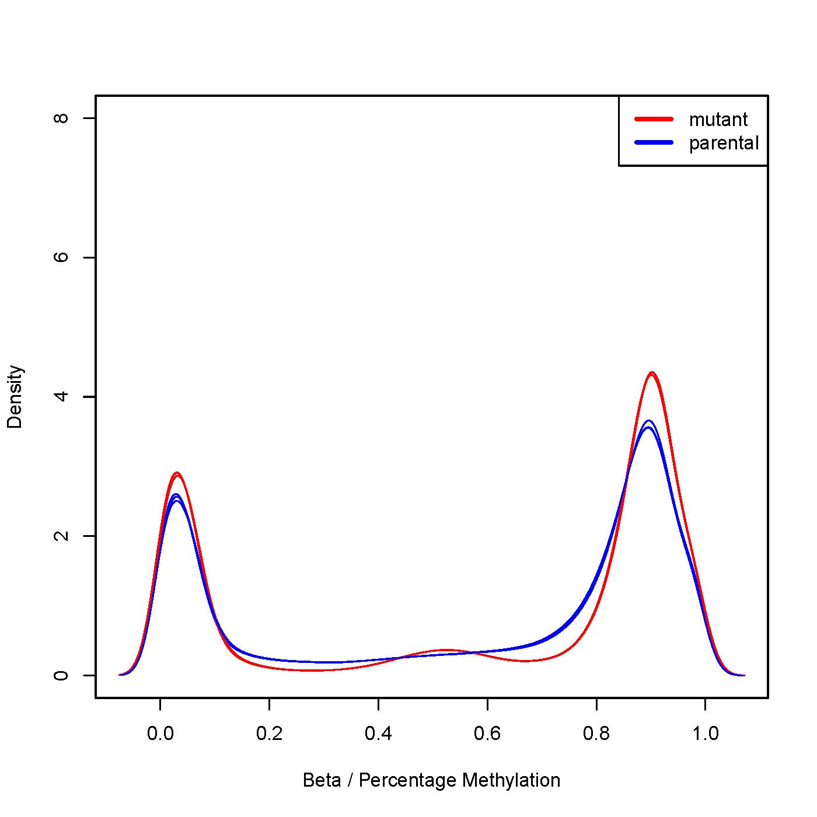
DNA Methylation rate does not show a normal distribution
No equal variances
Range:
0 <= Beta <= 1
Sites
Beta Score
Both Next Generation Sequencing Data and
Methylation MicroArray Data
Protocol Exchange (2014) doi:10.1038/protex.2014.002
Notes:
This is a graphical plots of beta scores.
In the horizon axis, Beta score is indicated.
In the vertical axis, frequency of methylation sites is indicated.
By this visualization, you can find that DNA Methylation rate does not
show a normal distribution.

Slide 14
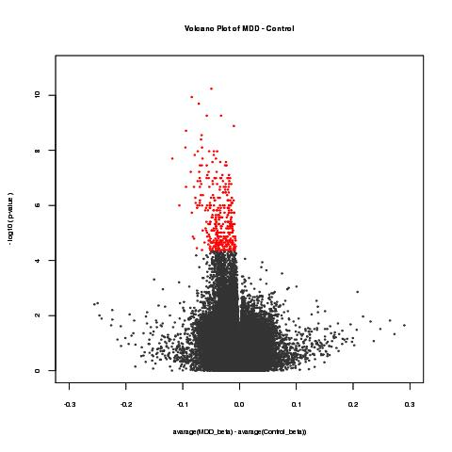
Mon Parametric Test is Required
Mann–Whitney U test
Selected Sites
- Log2(P)
20 patients and
19 healthy volunteers
This is the example of one neuropsychiatric diseases.
20 patients and 19 healthy volunteers were tested with 500, 000 explanatory variables.
両群の平均値の差
Notes:
This is the example of one neuropsychiatric diseases.
20 patients and 19 healthy volunteers were tested with 500, 000 explanatory variables with Mann-Whiteny U test.
The significance of the makers were selected by p-value, and 362 methylation sites were selected for explanatory variables.

Slide 15
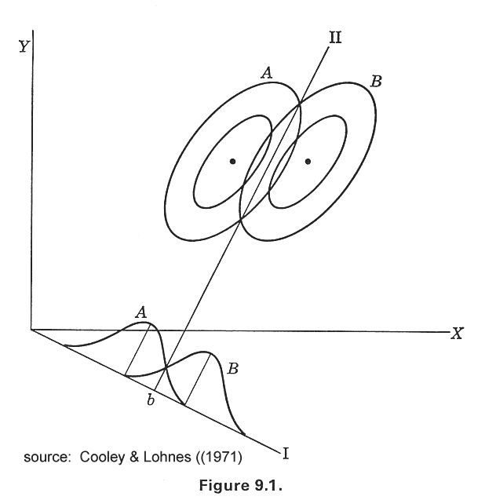
Linear Discriminant Analysis
Discriminant Function
Notes:
”Linear Discriminant Analysis is the multivariable analysis to discriminate sample to two or more categories with multiple variables.
The criterion of Discriminant Analysis is modeled by discriminant function.”

Slide 16
Discriminant Function
Discriminant Score
where
f_{km} = the value (score) on the canonical discriminant function for case m in the group k.
X_{ikm} = the value on discriminant variable Xi for case m in group k; and
u_{i} = coefficients which produce the desired characteristics in the function.
Notes:
A discriminant function is a linear function, consists of explanatory variables.
A discriminant function gives Discriminant Score to discriminate the sample.

Slide 17
Evaluation of the Discrimination
Sensitivity and Specificity
Sensitivity = true positives / (true positive + false negative)
= Diagnosed as patients / Patients
Specificity = true negatives / (true negative + false positives)
= Diagnosed as non patients / Healthy Volunteers
Notes:
The discriminant efficiency was evaluated by Sensitivity and Specificity.
Sensitivity means ratio of the positive patients in all patients.
Specificity means ratio of the negative healthy volunteers in all healthy volunteers.

Slide 18
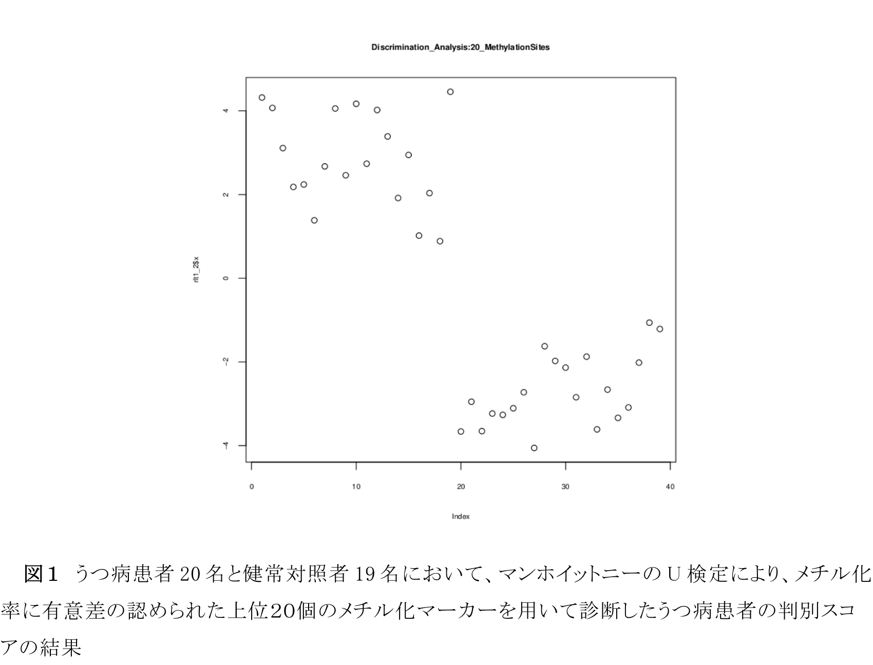
Discriminant Analysis of a Psychiatric Disorder with
DNA Methylation Markers in a Training group
Discriminant analysis with 20 patients and 19 healthy volunteers (Training group)
With methylation rate of DNA Markers top20 ranked by Mann-whitny U test
20 patients and
19 healthy volunteers
Negative
Discriminant Score
Positive
Healthy
Volunteer
Patients
Notes:
This is the evaluation result using a Training group by discrimination analysis with top 20 significant methylation sites by Mann^Whiteny U test.
Discrimination Score were plot into the scatchard plot
In the training group, Discrimination analysis could completely discriminate between 19 healthy volunteer and 20 patients.
Upper left area is the area of estimated diagnosis negative.
And lower right area is the area of diagnosis positive.
We can achieve the perfect discrimination model in a Psychiatric Disorder.

Slide 19
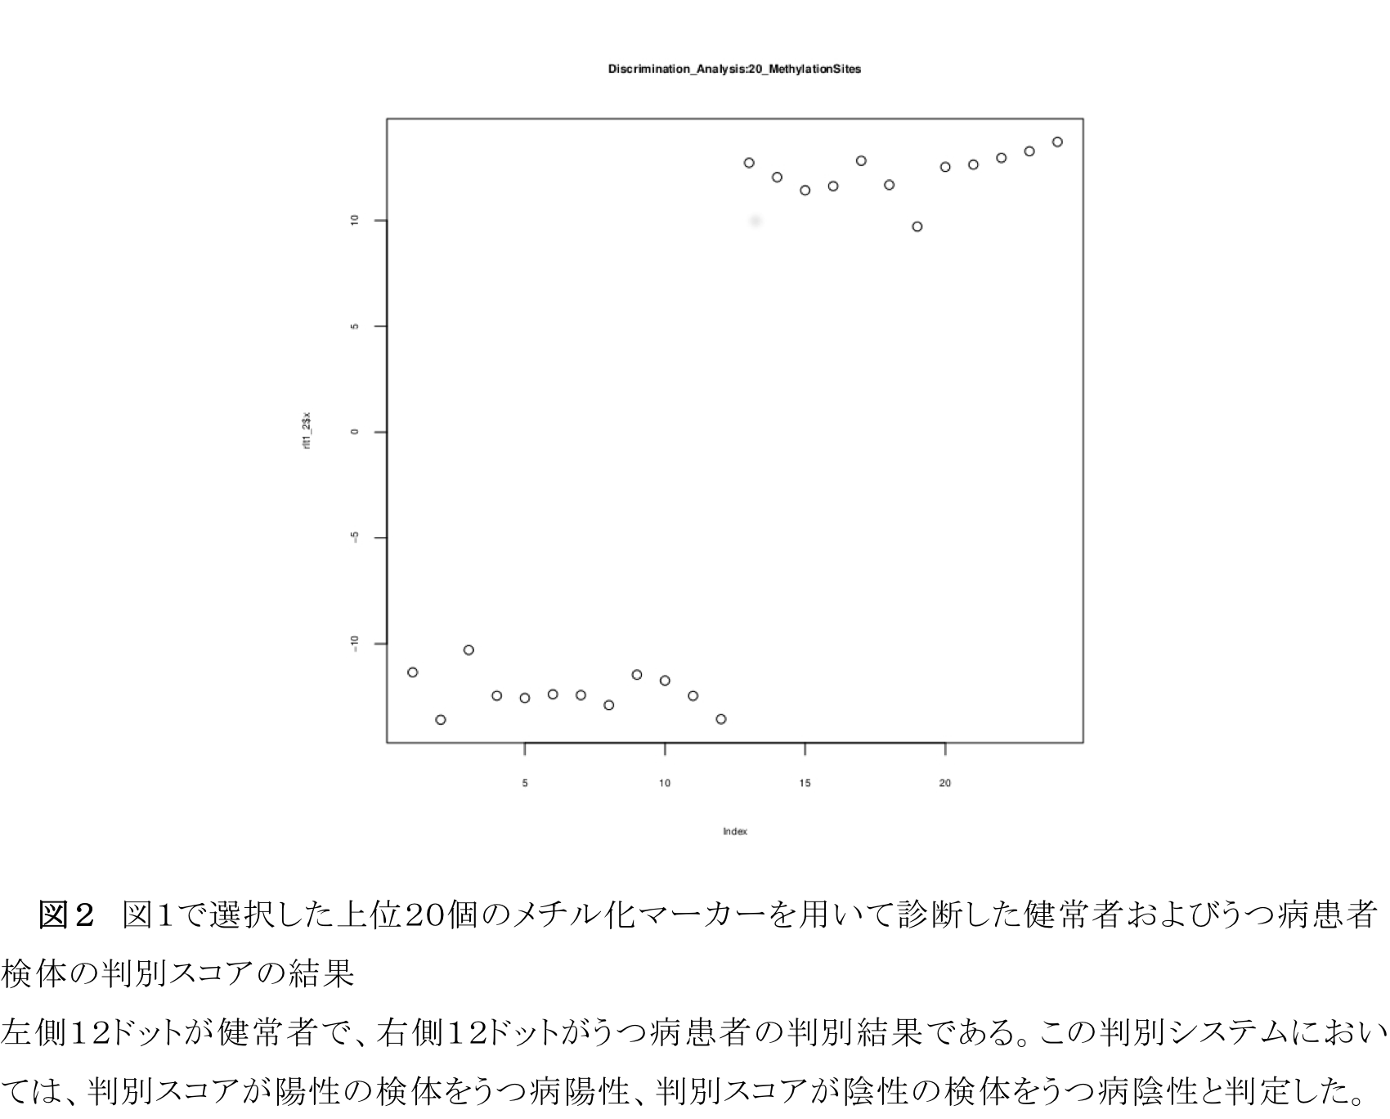
Discriminant Analysis of a Psychiatric Disorder with
DNA Methylation Markers in a Validation group
Discriminant Analysis with 12 patients and 12 healthy volunteers (Validation group)
With Methylation rate of DNA Markers top20 ranked by Mann-whitny U test
12 patients and
12 healthy volunteers
12 patients and
12 healthy volunteers
Positive
Discriminant Score
Negative
Healthy
Volunteer
Patients
The discriminant function was reconstructed for evaluation of variables.
Notes:
This is the evaluation result using a Varidation group by discrimination analysis with the same top 20 methylation sites used in the training group..
Discrimination Score were plot into the scatchard plot.
In the Variation group, Discrimination analysis could completely discriminate 12 healthy volunteer and 12 patients.
Upper left area is the area of estimated diagnosis negative.
And lower right area is the area of diagnosis positive.
This discrimination model shows the perfect discrimination efficiency in a Varidation group .

Slide 20
Cluster Analysis of a Psychiatric Disorder with
DNA Methylation Markers in a Training group
Patients
Healthy
Volunteer
20 patients and
19 healthy volunteers
Notes:
This slide shows the hierarchical clustering using top 12 significant methylation sites by Training group.
Healthy volunteers and Patients were perfectly separated with the hierarchical clustering using top 12 significant methylation sites.
Left cluster is patient and right cluster is healthy volunteer.

Slide 21
Summary
Big Data processing environment should be selected based on its performance and purpose of data analysis
Multivariable diagnosis methods using DNA methylation ratio works well for Diagnosis of Psychiatric Diseases
Selection with a non parametric test and multivariable analysis is extremely effective
Notes:
This is the summary,
We are analyzing big scale clinical data from microarrays, next generation sequencers and meta data.
For methylation analysis requires extremely large memory in the analysis.
Amazon cloud could not analyze the big scale methylation data, which requires almost 1TB memory.
In this case we should need special strategy by the distributed file systems and distributed processing systems,
So Big Data processing environment should be selected based on its performance and purpose of data analysis.
For the development of diagnosis system, selection of non-parametric testing and discrimination of discriminant analysis is very effective.
It achieved the perfect discrimination between patients and healthy volunteer.

