Slide 1
About OMICS Group
OMICS Group International is an amalgamation of Open Access publications and worldwide international science conferences and events. Established in the year 2007 with the sole aim of making the information on Sciences and technology ‘Open Access’, OMICS Group publishes 400 online open access scholarly journals in all aspects of Science, Engineering, Management and Technology journals. OMICS Group has been instrumental in taking the knowledge on Science & technology to the doorsteps of ordinary men and women. Research Scholars, Students, Libraries, Educational Institutions, Research centers and the industry are main stakeholders that benefitted greatly from this knowledge dissemination. OMICS Group also organizes 300 International conferences annually across the globe, where knowledge transfer takes place through debates, round table discussions, poster presentations, workshops, symposia and exhibitions.

Slide 2
About OMICS Group Conferences
OMICS Group International is a pioneer and leading science event organizer, which publishes around 400 open access journals and conducts over 300 Medical, Clinical, Engineering, Life Sciences, Phrama scientific conferences all over the globe annually with the support of more than 1000 scientific associations and 30,000 editorial board members and 3.5 million followers to its credit.
OMICS Group has organized 500 conferences, workshops and national symposiums across the major cities including San Francisco, Las Vegas, San Antonio, Omaha, Orlando, Raleigh, Santa Clara, Chicago, Philadelphia, Baltimore, United Kingdom, Valencia, Dubai, Beijing, Hyderabad, Bengaluru and Mumbai.

Slide 3
3rd International Conference on Forensic Research & Technology
Forensic Anthropology
Dr Jerry Melbye, PhD
Fellow, American Academy of Forensic Sciences
Diplomate, American Board of Forensic Anthropology

Slide 4
Research
Dr. Melbye’s research interests include forensic osteology, paleopathology, the science of mummies, and crime scene recovery and analysis. Fieldwork experience includes Ontario, Quebec, Newfoundland, Labrador, the Yukon, the American Southwest, the American Midwest, Chile, Egypt and Mexico.

Slide 5
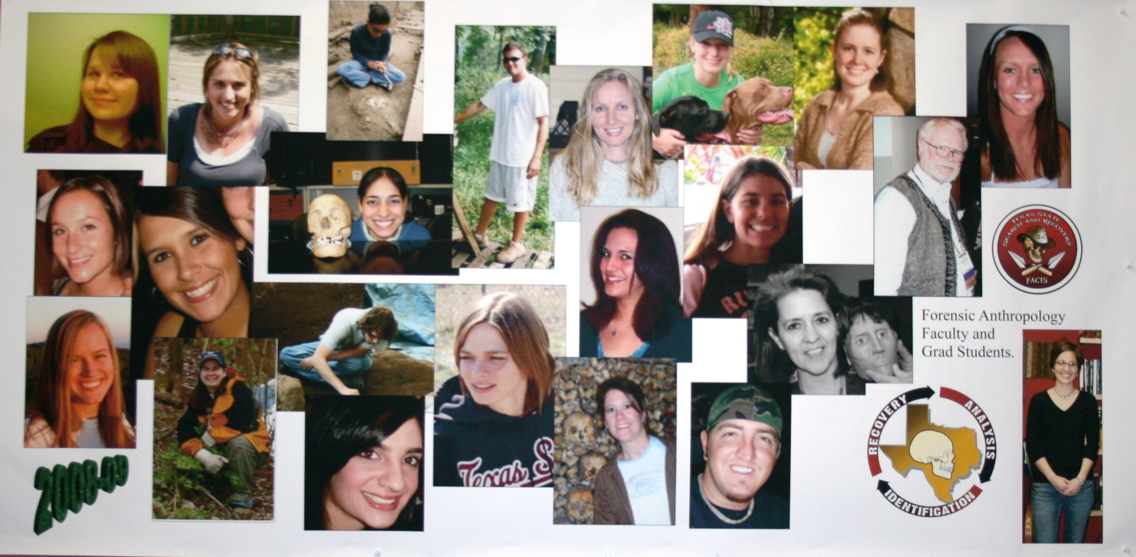
Some of Dr. Melbye’s University Students
Dr. Melbye

Slide 6
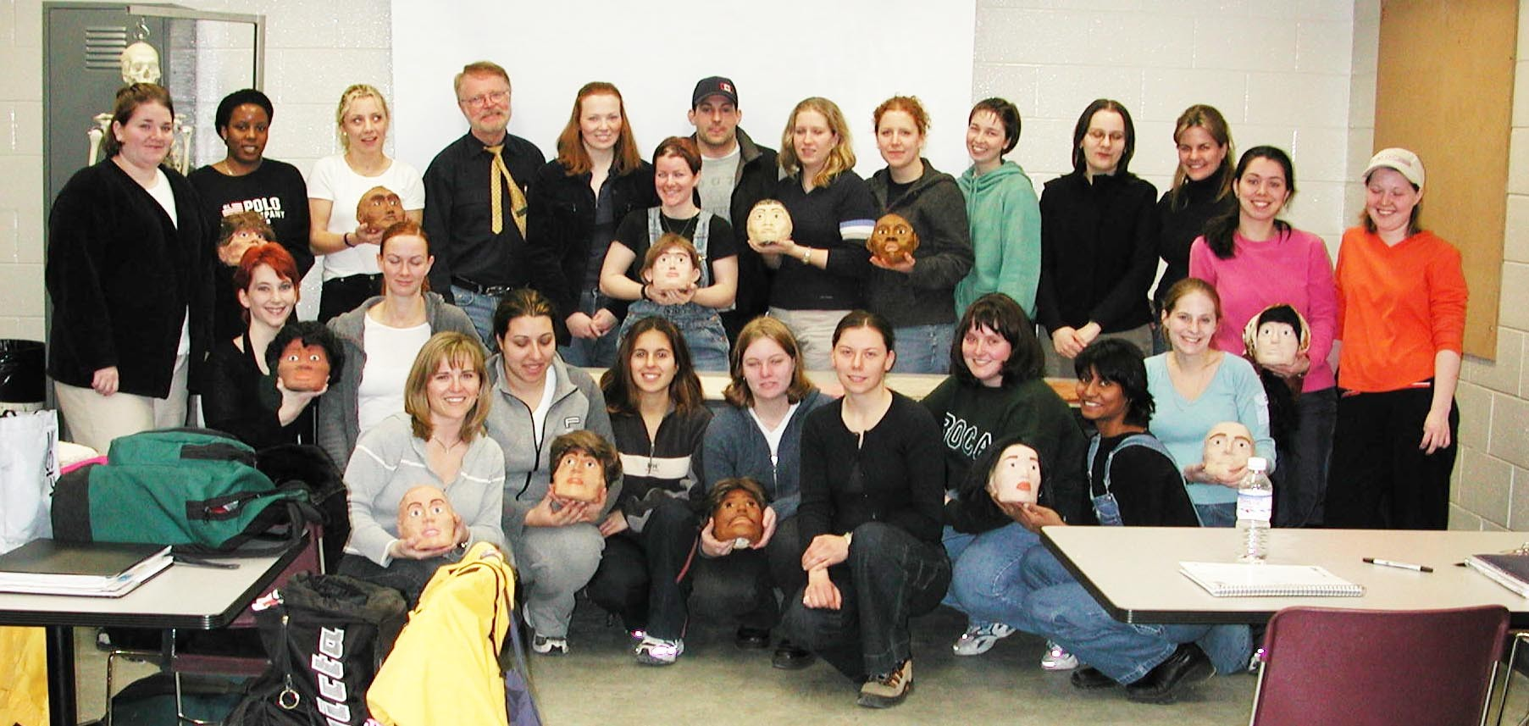
Some of Dr. Melbye’s University Students
Dr. Melbye

Slide 7
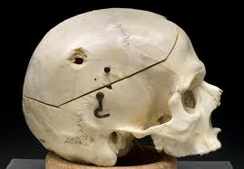
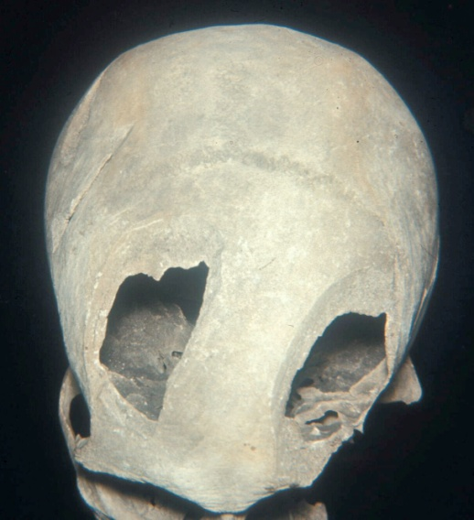
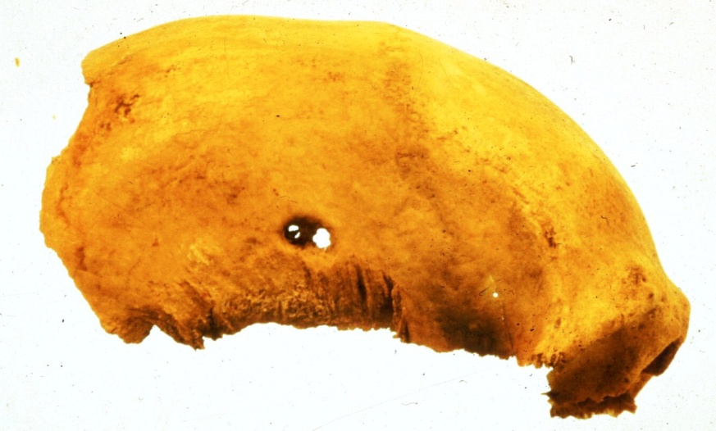
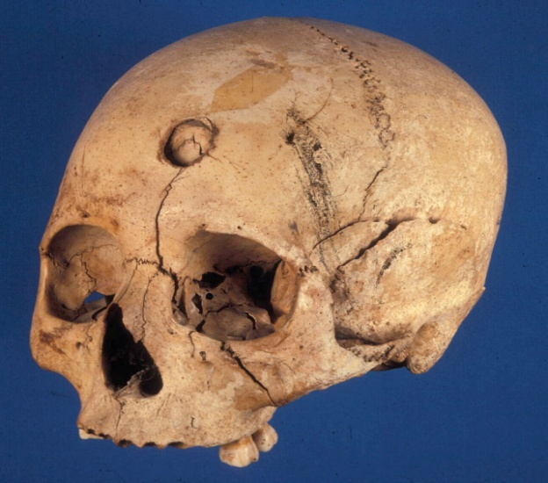
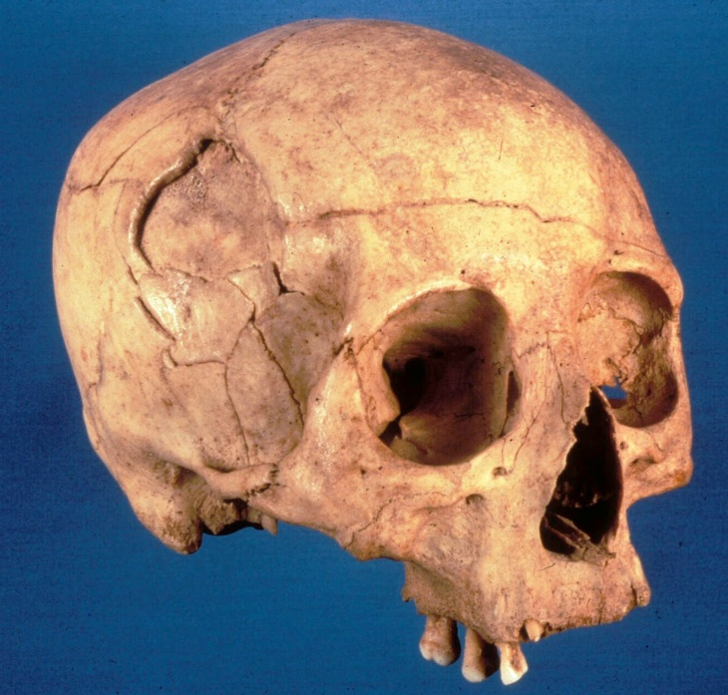
Pathology (Evidence of Violence)

Slide 8
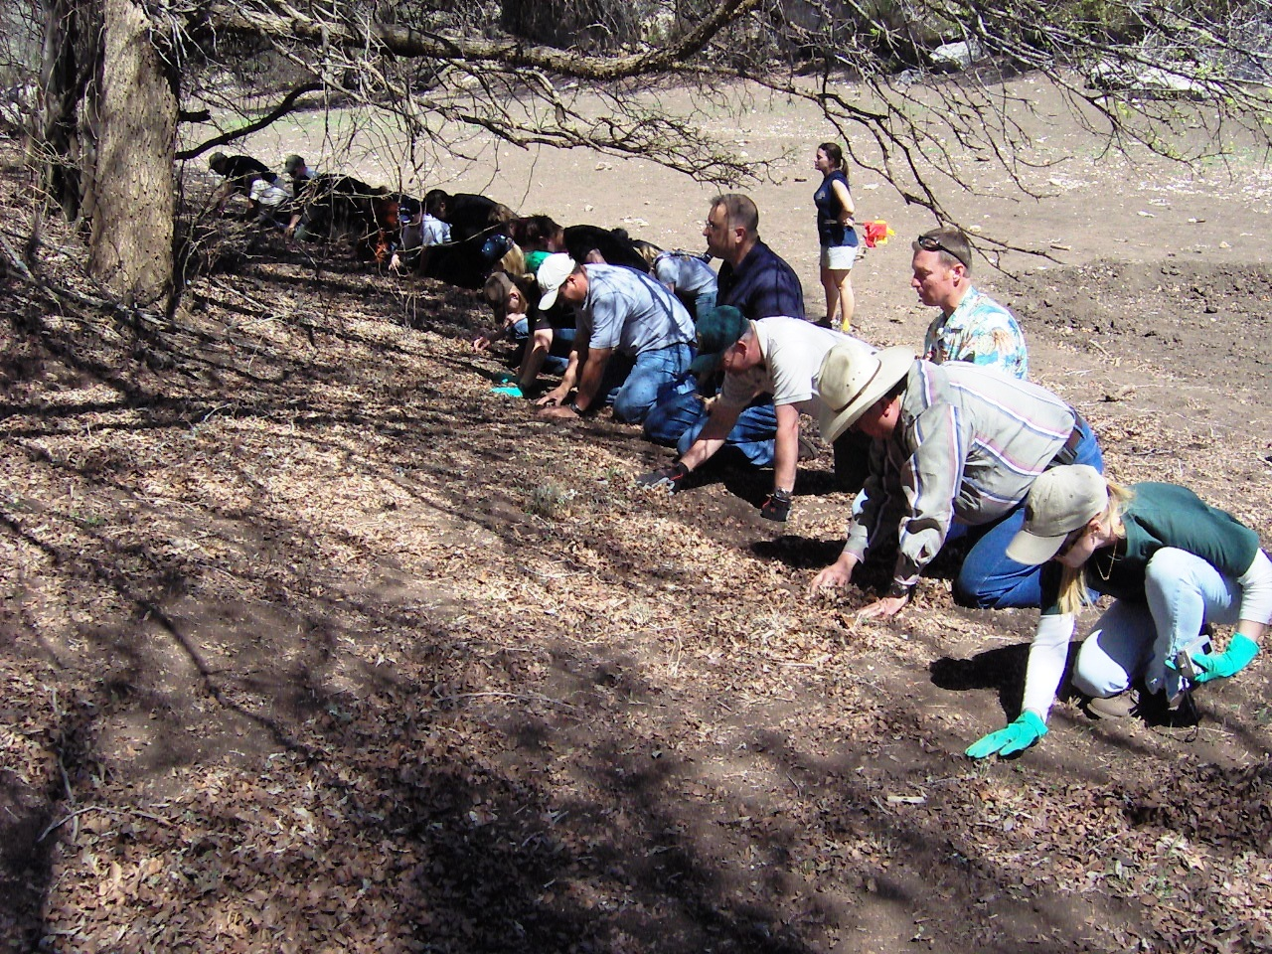
Searching for Victims

Slide 9
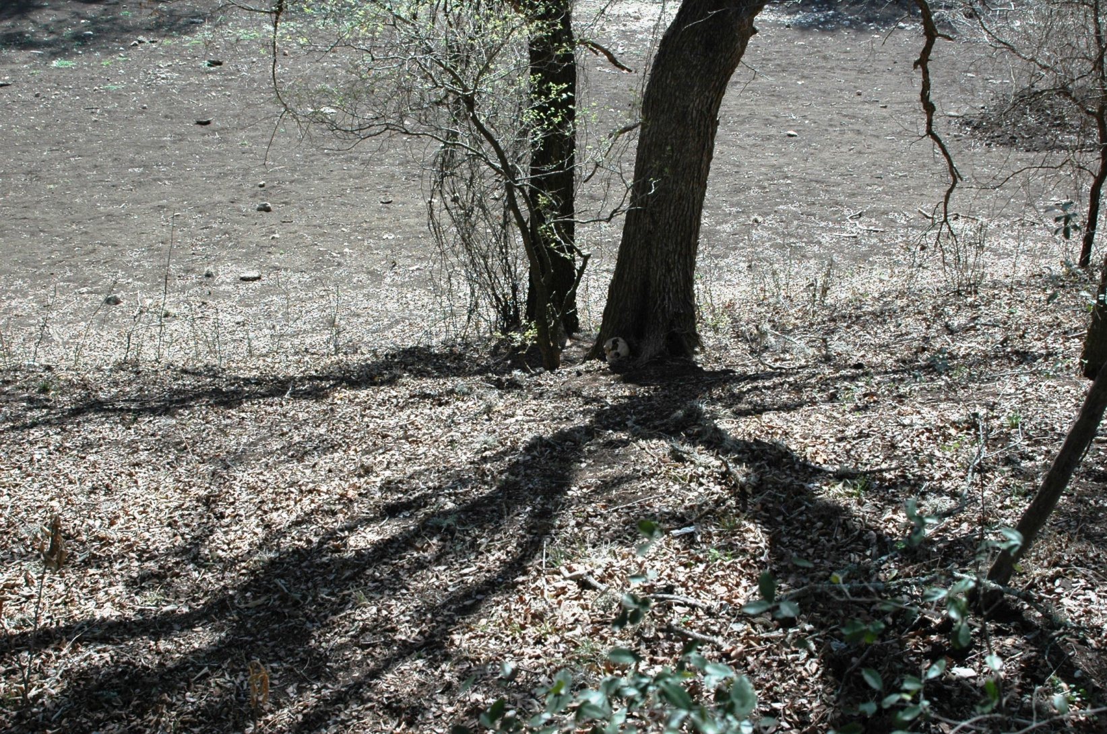
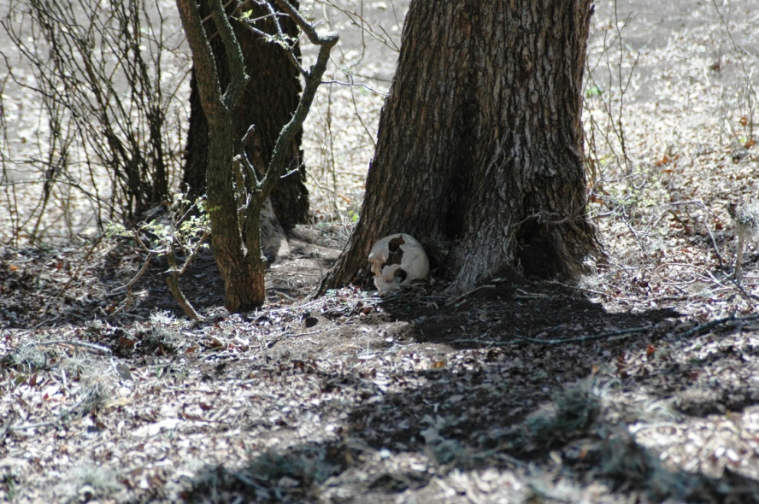
Searching for Victims
A Skull with Trauma

Slide 10
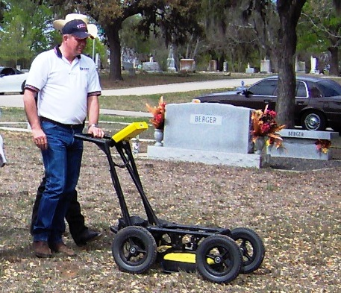
Searching for Victims
Ground Penetrating Radar is an aid to finding bodies

Slide 11
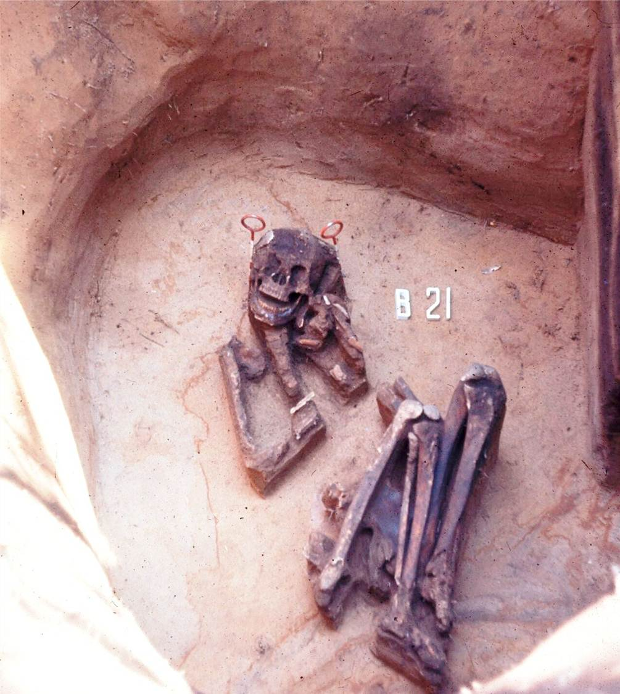
Excavating the Evidence
A careful excavation tells a powerful story in a court of law

Slide 12
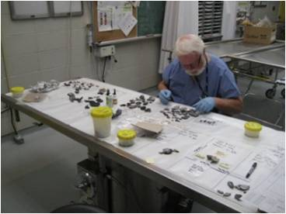
Analysis
Dr. Melbye putting the pieces of human bone together to find evidence of violence to a victim

Slide 13
I. Scope
(what is the scope of Forensic Anthropology work)
A. Mass Disasters
Notes:
There are expectations that victims have and needs that require addressing
Expectations
-quick response- why is this taking so long? In times of crisis our sense of time slows down
-response must meet the needs- effective
-identifications must be done quickly- why does it take so long
-families require accurate information
-families expectations are high given the awareness of how other disaster families have been treated and a general awareness of forensic issues in the public (Discovery Channel phenomenon)

Slide 14
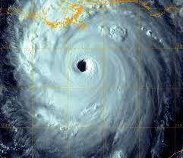
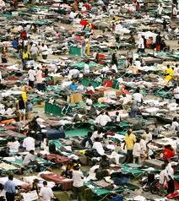
I. Scope
A. Mass Disasters
Hurricane
New Orleans
Notes:
There are expectations that victims have and needs that require addressing
Expectations
-quick response- why is this taking so long? In times of crisis our sense of time slows down
-response must meet the needs- effective
-identifications must be done quickly- why does it take so long
-families require accurate information
-families expectations are high given the awareness of how other disaster families have been treated and a general awareness of forensic issues in the public (Discovery Channel phenomenon)

Slide 15
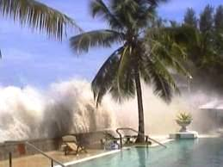
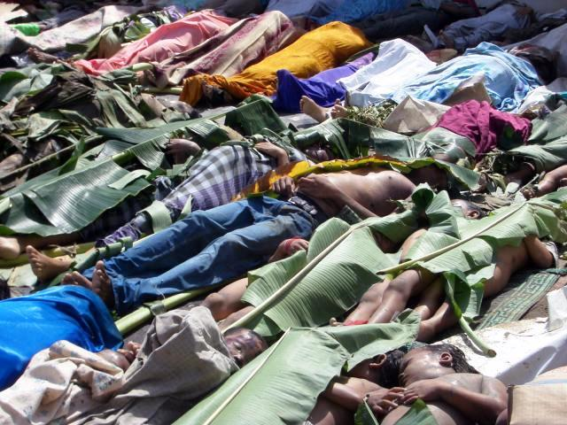
I. Scope
A. Mass Disasters
Tsunami
Indonesia
Hurricane
New Orleans
Notes:
There are expectations that victims have and needs that require addressing
Expectations
-quick response- why is this taking so long? In times of crisis our sense of time slows down
-response must meet the needs- effective
-identifications must be done quickly- why does it take so long
-families require accurate information
-families expectations are high given the awareness of how other disaster families have been treated and a general awareness of forensic issues in the public (Discovery Channel phenomenon)

Slide 16
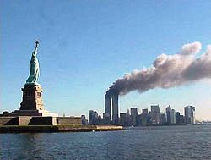
I. Scope
A. Mass Disasters
9/11
New York
Tsunami
Indonesia
Hurricane
New Orleans
Notes:
There are expectations that victims have and needs that require addressing
Expectations
-quick response- why is this taking so long? In times of crisis our sense of time slows down
-response must meet the needs- effective
-identifications must be done quickly- why does it take so long
-families require accurate information
-families expectations are high given the awareness of how other disaster families have been treated and a general awareness of forensic issues in the public (Discovery Channel phenomenon)

Slide 17
I. Scope
A. Mass Disasters
B. Political Atrocities
Notes:
There are expectations that victims have and needs that require addressing
Expectations
-quick response- why is this taking so long? In times of crisis our sense of time slows down
-response must meet the needs- effective
-identifications must be done quickly- why does it take so long
-families require accurate information
-families expectations are high given the awareness of how other disaster families have been treated and a general awareness of forensic issues in the public (Discovery Channel phenomenon)

Slide 18
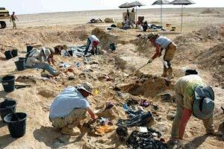
I. Scope
Iraq
A. Mass Disasters
B. Political Atrocities
Notes:
There are expectations that victims have and needs that require addressing
Expectations
-quick response- why is this taking so long? In times of crisis our sense of time slows down
-response must meet the needs- effective
-identifications must be done quickly- why does it take so long
-families require accurate information
-families expectations are high given the awareness of how other disaster families have been treated and a general awareness of forensic issues in the public (Discovery Channel phenomenon)

Slide 19
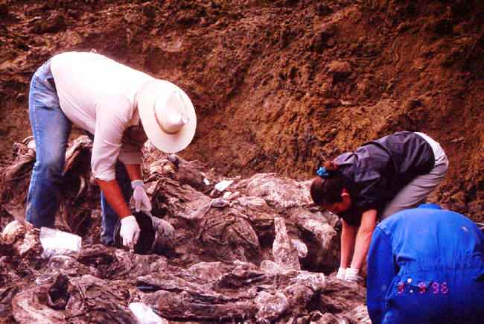
I. Scope
Iraq
A. Mass Disasters
B. Political Atrocities
Bosnia
Notes:
There are expectations that victims have and needs that require addressing
Expectations
-quick response- why is this taking so long? In times of crisis our sense of time slows down
-response must meet the needs- effective
-identifications must be done quickly- why does it take so long
-families require accurate information
-families expectations are high given the awareness of how other disaster families have been treated and a general awareness of forensic issues in the public (Discovery Channel phenomenon)

Slide 20
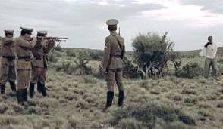
I. Scope
Iraq
A. Mass Disasters
B. Political Atrocities
Bosnia
Argentina
Notes:
There are expectations that victims have and needs that require addressing
Expectations
-quick response- why is this taking so long? In times of crisis our sense of time slows down
-response must meet the needs- effective
-identifications must be done quickly- why does it take so long
-families require accurate information
-families expectations are high given the awareness of how other disaster families have been treated and a general awareness of forensic issues in the public (Discovery Channel phenomenon)

Slide 21
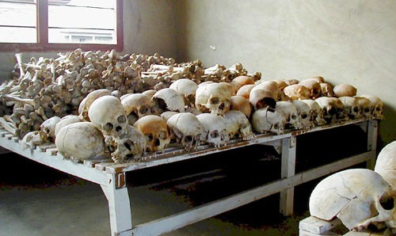
I. Scope
Iraq
A. Mass Disasters
B. Political Atrocities
Bosnia
Rwanda
Argentina
Notes:
There are expectations that victims have and needs that require addressing
Expectations
-quick response- why is this taking so long? In times of crisis our sense of time slows down
-response must meet the needs- effective
-identifications must be done quickly- why does it take so long
-families require accurate information
-families expectations are high given the awareness of how other disaster families have been treated and a general awareness of forensic issues in the public (Discovery Channel phenomenon)

Slide 22
I. Scope
A. Mass Disasters
B. Political Atrocities
C. Suspicious Deaths
Notes:
There are expectations that victims have and needs that require addressing
Expectations
-quick response- why is this taking so long? In times of crisis our sense of time slows down
-response must meet the needs- effective
-identifications must be done quickly- why does it take so long
-families require accurate information
-families expectations are high given the awareness of how other disaster families have been treated and a general awareness of forensic issues in the public (Discovery Channel phenomenon)

Slide 23
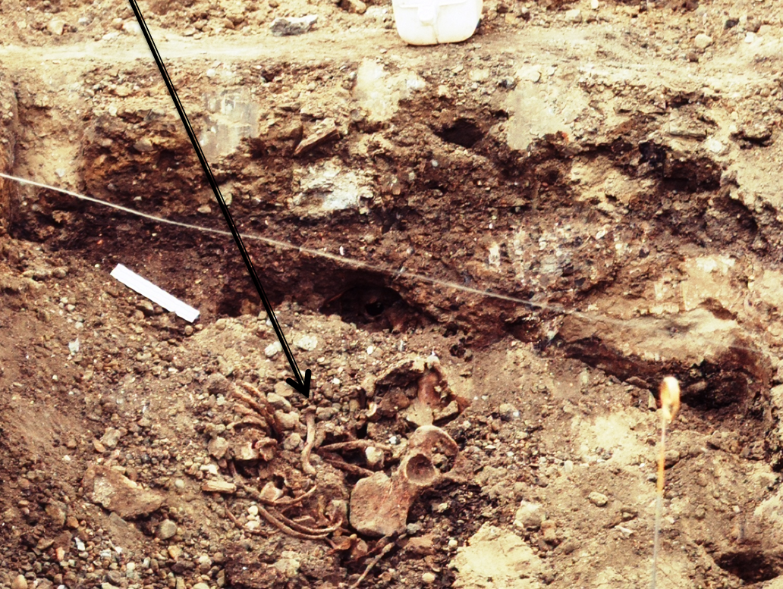
I. Scope
A. Mass Disasters
B. Political Atrocities
C. Suspicious Deaths
Notes:
There are expectations that victims have and needs that require addressing
Expectations
-quick response- why is this taking so long? In times of crisis our sense of time slows down
-response must meet the needs- effective
-identifications must be done quickly- why does it take so long
-families require accurate information
-families expectations are high given the awareness of how other disaster families have been treated and a general awareness of forensic issues in the public (Discovery Channel phenomenon)

Slide 24
Let Us Meet Again
We welcome you all to our future conferences of OMICS Group International
Please Visit: www.omicsgroup.com
www.conferenceseries.com

