Slide 1


Use specific response toward environment as a selective marker for therapy in breast cancer cells.
Hsiu-Ni Kung
Anatomy and Cell Biology, Medical school,
National Taiwan University
Notes:
It is my honor to present my recent works to all of you. I am Hsiu-Ni Kung, from Taiwan. The topic I am going to discuss with you today is “ Use specific response toward environment as a selective marker for therapy in breast cancer cells”

Slide 2
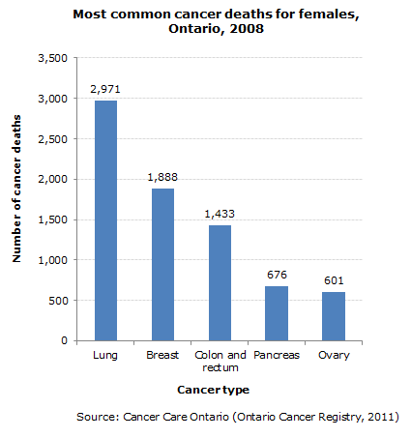
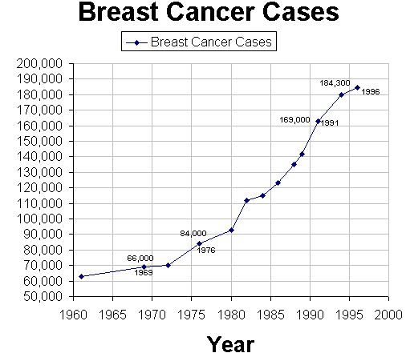
Notes:
Breast tumor is the second of the most common cancer death for female, just after lung cancer, not only in US, but in the whole world.
And there are accumulating breast cancer cases since 1960 toward today.

Slide 3
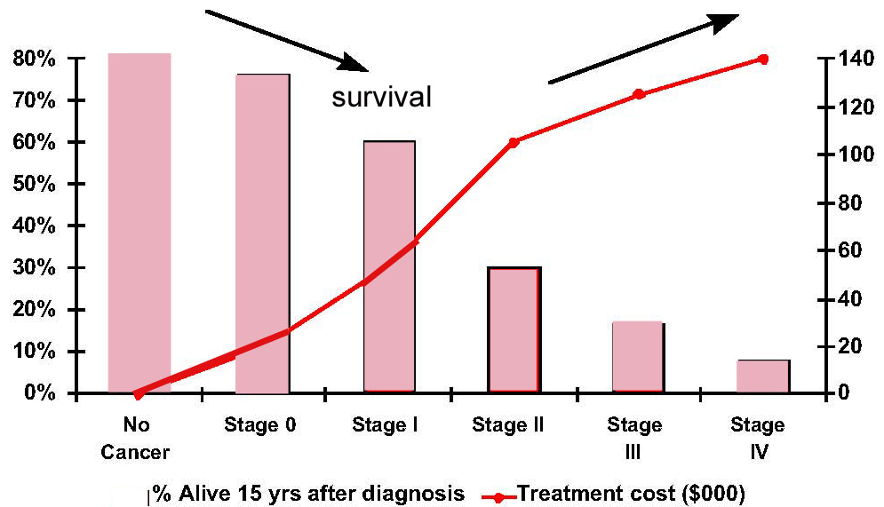
Metastatic Breast Cancer Survival Rates
http://cancercarepliss.blogspot.tw/2011/07/metastatic-breast-cancer-survival-rates.html
Notes:
The survival rate of patients drop very fast according to the malignancy of cancer, while the cost for the cancer treatment raised dramatically as indicated by the red line.

Slide 4
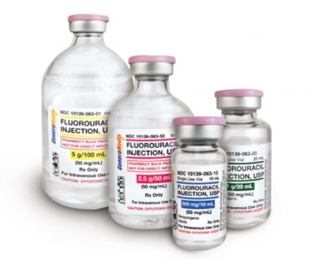
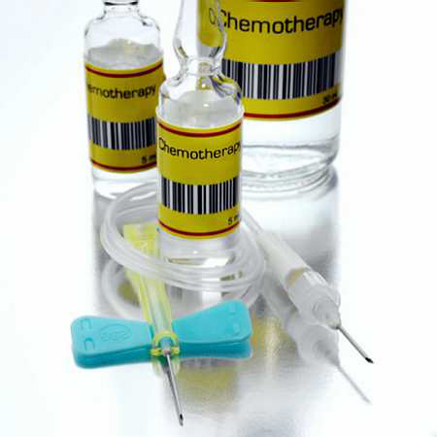

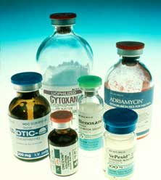
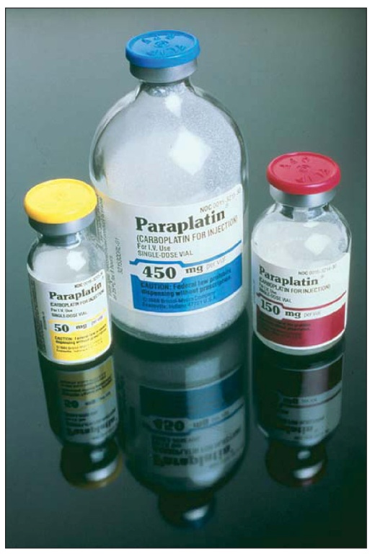
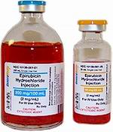

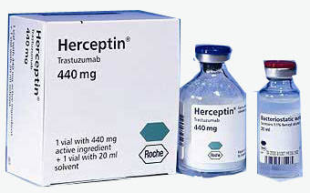
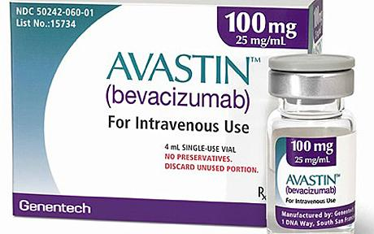
Notes:
Even though researches and doctors found many drugs to treat breast cancer, people still suffer from the low sensitivity of drugs, high side effects, and low life quality in the process of chemotherapy.
How to treated patients in the right direction and with the right drug becomes a very important issue in the clinic to increase the life quality and lower down the burden of public health.

Slide 5
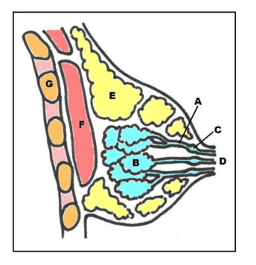
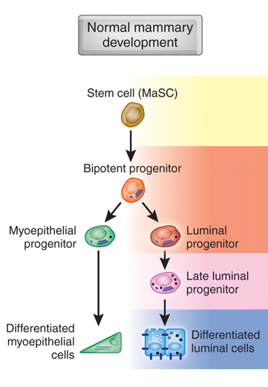
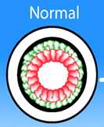
Breast tumor lineage
Basal progenitor
Differentiated Basal cell
Basement membrane
Basal cells
Basal type tumor
Luminal type tumor
Luminal cells
(Aleix Prat and Charles M Perou, Nature review, 2009)
Notes:
In the next few pages, I am going to introduce a little of breast cancer and where they come from.
Breast tumor is a heterogenic disease with many different parent lineage.
Let’s take a close look into the breast.
Here is the sagital section of normal breast tissue, these blue bags are the mammary gland. If we enlarge the cross section of a acinus, we can see there are two layers of breast cells inside the acinus, one layer that line on the basement membrane (that is showed in thick black line) is the basal cells showed in green, and another layer of cells that lye on the basal cells and face the lumen is luminal cells, which is color in red. These two kind of cells come from the same progenitor cells, but differentiated into different cells in both morphology and function. Breast cancers which raised from basal or luminal cells can be characterized to basal and luminal subtypes.
g

Slide 6
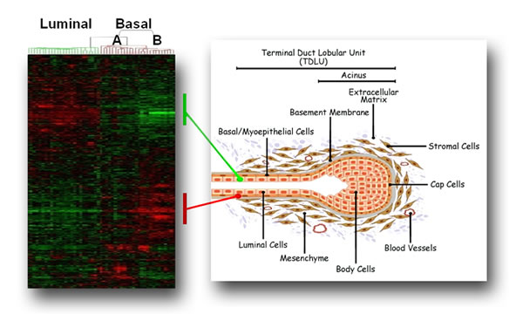
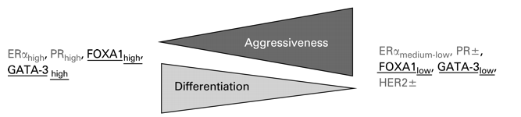
EGFR, c-Met
Luminal type tumor
Basal type tumor
(Badve and Nakshatri, J Clin Pathol,2009)
Notes:
Luminal and basal cells have totally different gene expression pattern, and can be seperated based on different surface markers , such as Estrogen Receptor and Progesterone receptor can be found on the surface of luminal subtypes, and CK8/18 and GATA3 can also be served as luminal markers as well. The basal tumors are more invasive, metastatic, and have poor prognosis than luminal tumors. Since there’s not many markers on basal cells surface, that makes it more difficult to find the treatment targets on basal type tumors, there is not efficient drug to treat basal tumors so far.
But it is far from enough to separate breast tumors to just luminal and basal type.

Slide 7
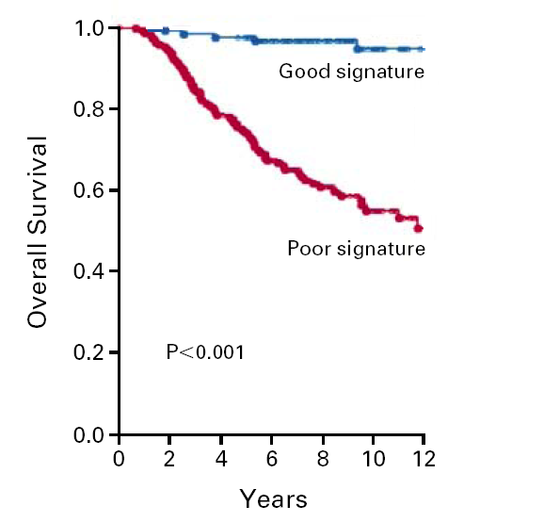
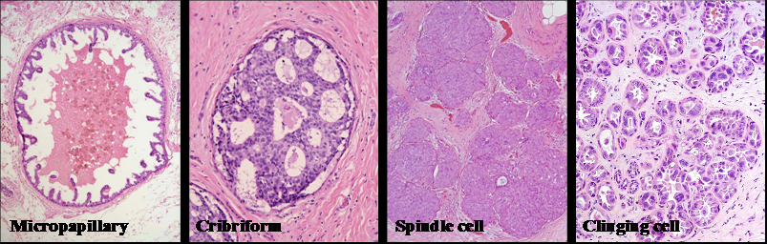
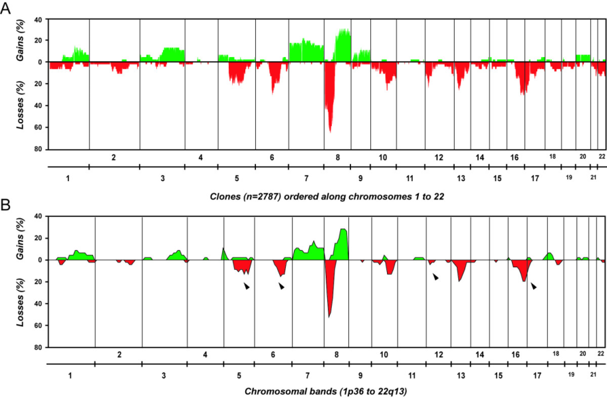
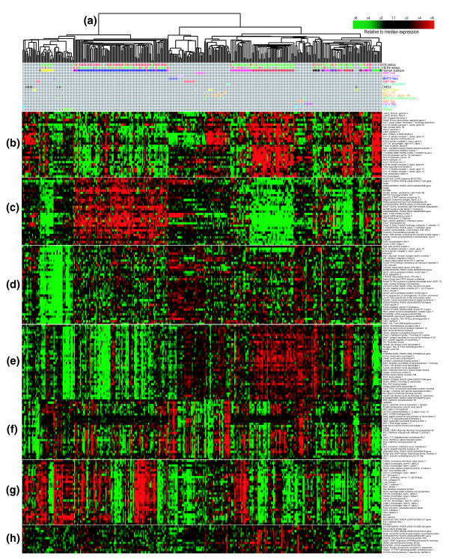
The Heterogeneity among Human Breast Cancers
Yi-Hsuan Hsiao, et al., J. cancer, 2010
van de Vijver 2002
Jason I Herschkowitz, et al., Genomw biology. 2010
Genetic characteristics
Non-genetic characteristics : environmental change (stress)
Notes:
Researchers try to find the best drug for breast tumor therapy, and thy developed many methods to divide various type of tumor, such as tumor grades, gene expression or signature. Even two patience are belong to the same subtype, they can use the same drug theoretically, but the drug sensitivity and the outcome can be so different. So, we try to ask questions, is there any factors, other then gene expression, can affect the characteristic of tumor? We called it non-genetic characteristics.

Slide 8
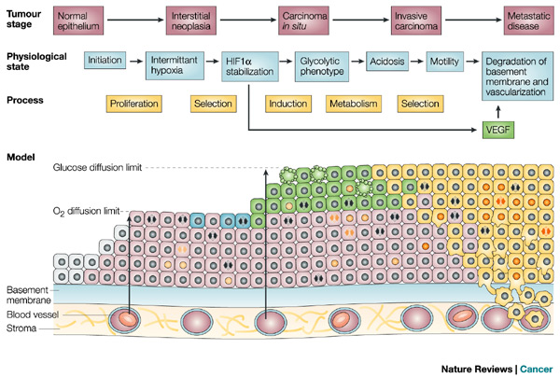
Microenvironmental stresses impact tumor phenotypes
(short term) and exert selection pressure (long-term)
Notes:
In the process of rapid tumor growth, tumor cells soon face the limitation of Oxygen and Glucose, and the accumulation of metabolic wast, these are called “microenvironmental stress”.

Slide 9
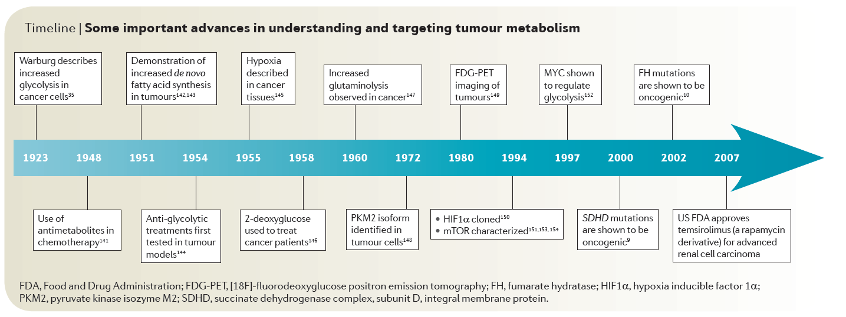
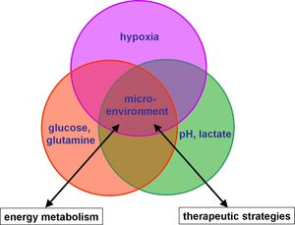
Microenvironments
1. Hypoxia & heterogeneity
2. Glutamine requirement
Notes:
The microenvironment changes include hypoxia, nutrient deprivation, such as lack of glucose or glutamine, two main energy resources used by tumor cells, and low PH in the surrounding environment.
Thus, I will focus on hypoxia, glutamine metabolism and the tumor heterogeneity.
If there is enough time for me, at Last, I will talk about gene alteration and drug resistance under hypoxia.

Slide 10
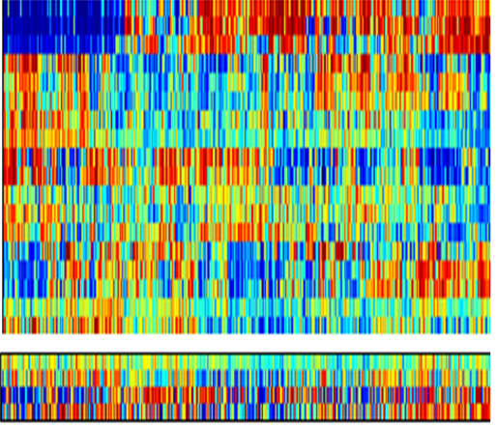
1. Hypoxia & heterogeneity
The integration of the non-genetic stress signatures
with oncogenic signaling pathways
1143 Breast Tumors
Acidosis
ER
PR
p53
Catenin
E2F1
PI3k
Myc
Ras
IFNa
IFNg
Akt
p63
Src
HER2
EGFR
TGFb
STAT3
TNFa
Acidosis
Gluc. Dep.
LacAcid
Hypoxia
Glucose Deprived
Lactic Acidosis
Hypoxia
Notes:
First of all, we use microarray to get the signature of each non-genetic stress, and integrate them into the pathway analysis of 1143 breast tumors.

Slide 11
1. Hypoxia & heterogeneity
Microenvironment signaling identified subtypes among ERBB2+ Tumors.
Basal
Her2
Erbb2
LumA
LumA/B
LumB
Mixed
ER
PR
p53
Catenin
E2F1
PI3k
Myc
Ras
IFNα
IFNγ
Akt
p63
Src
HER2
EGFR
TGFβ
STAT3
TNFα
Acidosis
Gluc.Dep.
LacAcad
Hypoxia
Subgroup
2
5
8
7
10
11
17
1
12
13
15
3
4
6
9
16
14
Notes:
And we find that except the original basal and luminal type of tumors, one subgroup “HER2 subtype” is distinguished from others from the pathway analysis.
And from the non-genetic analysis, the HER2 subtype can be separated into two subgroups, we named them subgroup 7 and 10.

Slide 12
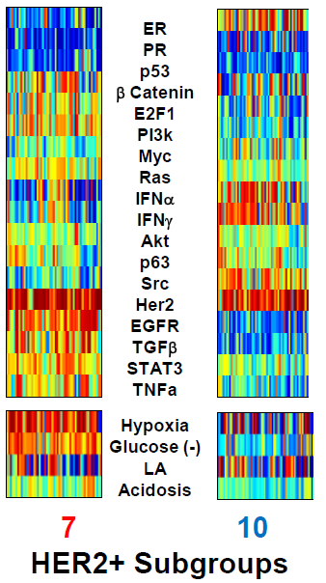
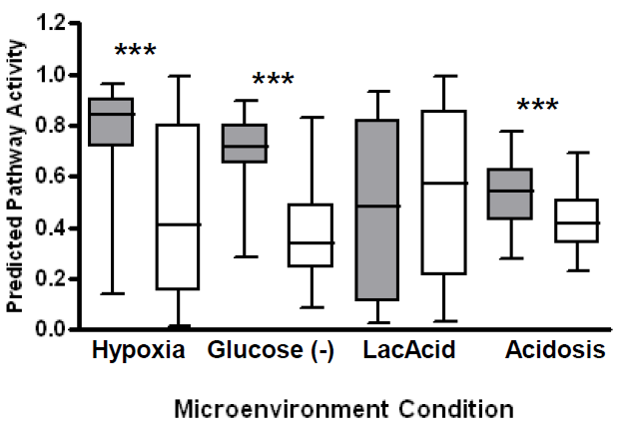

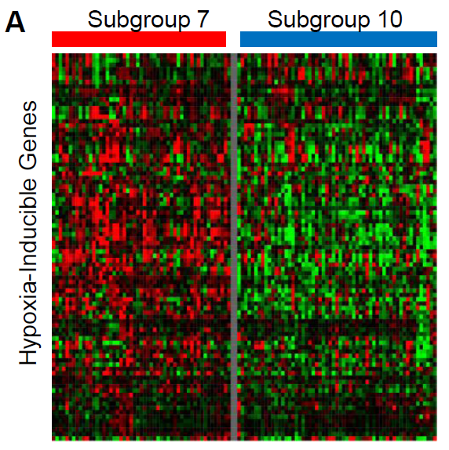
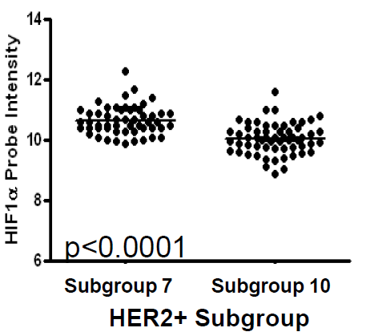
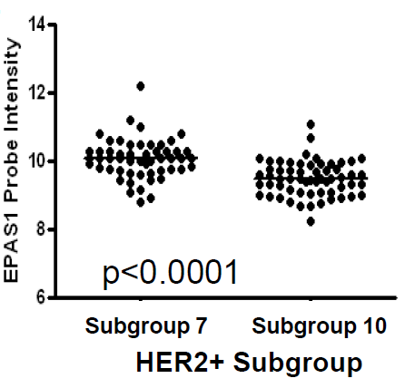

1. Hypoxia & heterogeneity
Hypoxia pathway is higher in subgroup 7.
HIF2a
Notes:
These two subgroups are dramatically in the response to hypoxia, glucose deprivation and acidosis. We first focused on hypoxia. Take all the hypoxia-induced genes out, the expression of them in subgroup 7 are much higher in subgroup 10. Even the hypoxia-indicator genes, HIF1a and HIF2a.

Slide 13
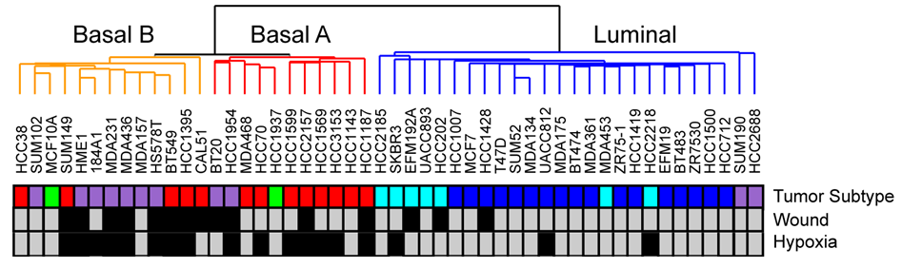
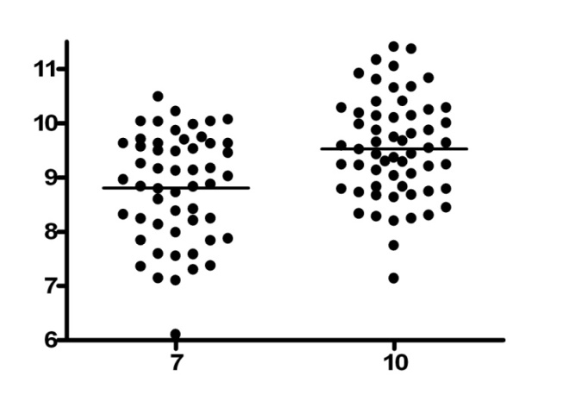
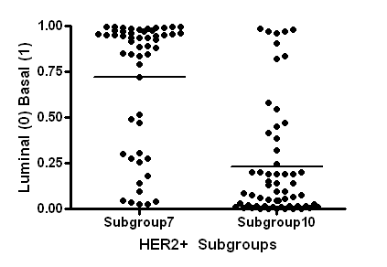
1. Hypoxia & heterogeneity
Subgroup 10 has higher expression of luminal regulator genes.
high
low
(Jessica Kao, et al., 2009, Plos One)
p<0.0001
GATA3
Notes:
From the hypoxic response of the two groups, and a report also mentioned that basal type breast cancer has higher hypoxic response than luminal type. We then set a hypothesis that the difference of these two subgroups maybe the same as the difference between basal and luminal types of breast tumor. So we check the expression of GATA3, a key luminal regulator gene, and found that GATA3 level is higher in subgroup 10. And we also use the training set of basal and luminal type to fit in subgroup 7 and 10. The basal type is set as one, and luminal type is set as 0. We can see that subgroup 7 is much attend to basal type and subgroup 10 is much like luminal type from the chart.

Slide 14
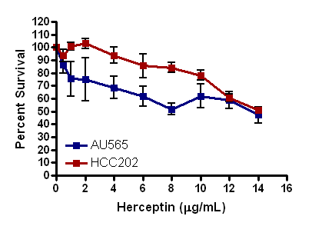
1. Hypoxia & heterogeneity
Different response to HER2 inhibitor treatment in AU565 (subgroup7) and HCC202 (subgroup10) .
Herceptin : HER2 inhibitor
*
(Michael L Gatza et al., 2011, breast cancer research)
Notes:
We us two breast cancer cell lines to present subgroup 7 and 10 to see if the sensitivity of Her2 inhibitor since both of these groups are HER2 positive.
The survival rates of these two subgroups are different, subgroup 10 is higher than subgroup 7.

Slide 15
1. Hypoxia & heterogeneity
Basal
Her2
Erbb2
LumA
LumA/B
LumB
Mixed
ER
PR
p53
Catenin
E2F1
PI3k
Myc
Ras
IFNα
IFNγ
Akt
p63
Src
HER2
EGFR
TGFβ
STAT3
TNFα
Acidosis
Gluc.Dep.
LacAcad
Hypoxia
Subgroup
2
5
8
7
10
11
17
1
12
13
15
3
4
6
9
16
14
Notes:
From the data shown above, we can use the environmental stress response to predict the response to clinical drugs to avoid the repeated trying trial for patients.

Slide 16
Microenvironments
1. Hypoxia & heterogeneity
2. Glutamine requirement
Notes:
Then we are moving to the second part, the glutamine requirement.

Slide 17
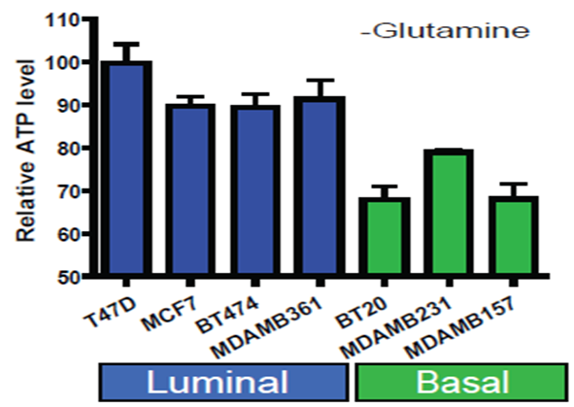
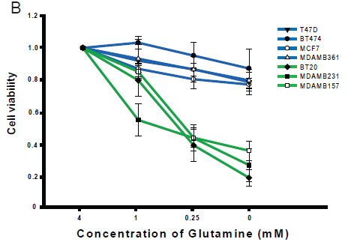
2. Glutamine requirement
Basal cells use more glutamine as the energy source.
glucose
glutamine
ATP
Notes:
Tumor cells tend to uptake more nutrients to get more energy for the rapid growth of tumor. The two main energy resource for tumor cells are glucose and glutamine.
We pay attention to the glutamine requirement. Dose the sensitivity to glutamine deprivation can be a marker or even a targeting treatment for breast tumor?
In the beginning, we want to know the effect of glutamine concentrations on ATP production and breast cancer cell survival.
7 breast cancer cell lines are used to test the AT production under glutamine deprivation condition.
Cells in the left marked with blue are luminal cells, and the greens are basal breast cancer cells. The ATP production of basal cells is significantly reduced.
And then those cells are put in medium containing different concentrations of glutamine from 4 to 0 mM for 48h. We surprisingly find that two groups of cell response dramatically different to glutamine deprivation. Those cells that don’t growth under low glutamine concentrations are basal breast cancer cells.

Slide 18
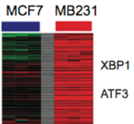
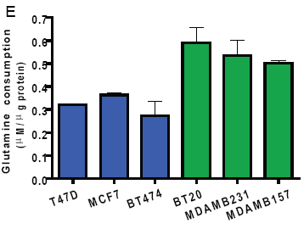
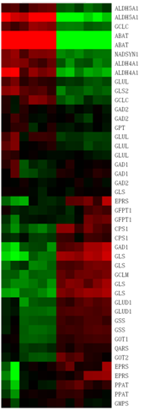
2. Glutamine requirement
Basal breast cells consume more glutamine, and exhibit canonical AAR response during glutamine deprivation
MCF7
MB231
MCF7
MB231
Glutamine metabolism
Canonical AAR
(ATF3/XBP1)
Luminal
Basal
MCF7 / MDAMB231
without glutamine
What are the genetic determinants of
glutamine addiction vs. independence ?
Notes:
Since basal and luminal cells have different response to glutamine deprivation environment, the glutamine consumption is measured in these cells.
The basal cells consume more glutamine than luminal cells.
We pick two cells from luminal and basal cells that are MCF7 andMDAMB 231 cell, and put them into medium containing with or without glutamine and perform microarray.
The expression of glutamine metabolism genes are reversed in these two cell, and we surprisingly find that compared to normal culture in 4mM glutamine, only 231 cells, but not MCF7, have the canonical glutamine deprivation response, including increased of ATF3 and XBP1 genes. We know that basal cells need more glutamine for survival, that is called glutamine addiction.
Then we want to know what are the genetic determinants of glutamine addiction and independent.

Slide 19
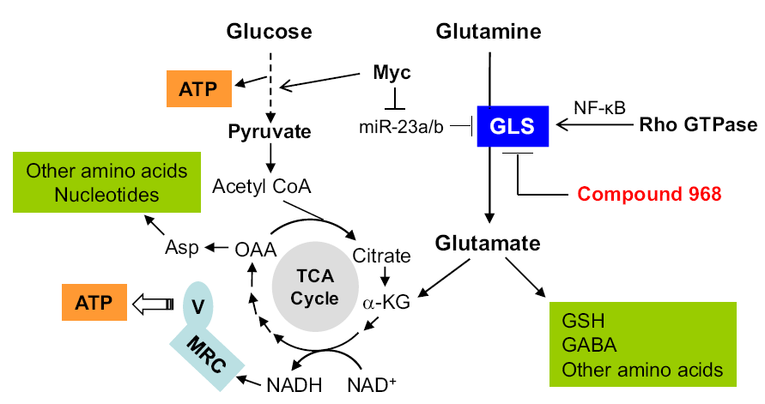
2. Glutamine requirement
(Jiun-Bin Wang, et al., 2010, cancer cell)
GLUL
GLUL
glutamine synthetase/GS
GLUL
(Glutamine synthetase, GS)
NH3+Glutamate
Glutamine
GLS1- Liver
GLS2- Kidney
(Glutaminase)
GLS 1/2
glutaminase
Notes:
In the glutamine metabolism pathway, many studies mainly focus on the Myc regulation of GLS expression through suppress some miRNA, such as miR-23a and b, and the expression of glutaminase affect the glutamine sensitivity of cells in breast cancers.
We wonder if there is any other regulator of glutamine sensitivity of breast cells. We check the metabolism of glutamine.There are two enzymes directly regulate the synthesis of glutamine, GLUL, also called glutamine synthetase, GS, that can transform glutamine and amino group to glutamine, and another enzyme is glutaminase 1/2, 1 is liver type, 2 is kidney type, different cells will use GLS1 or 2 to digest glutamine into glutamate for making other macromolecules.

Slide 20
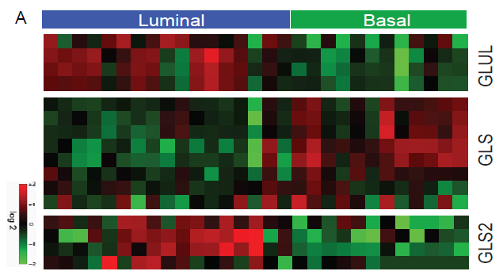
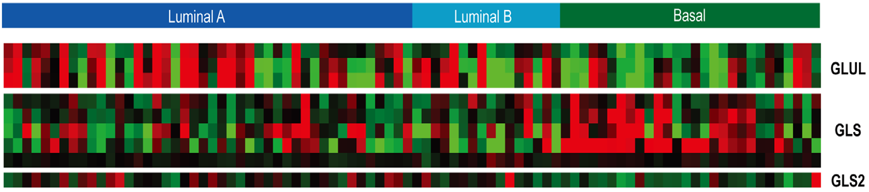
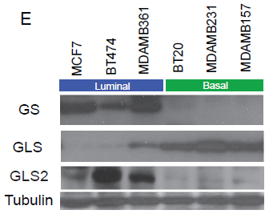
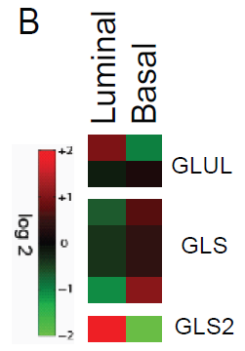
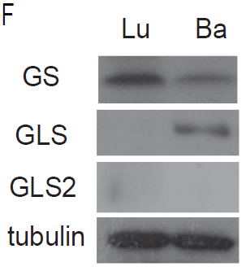
2. Glutamine requirement
Luminal-specific expression of GLUL and higher intracellular glutamine synthetase level
Breast cancer cells
Breast tumors
GLUL
GLS1
GLS2
Primary breast cells
Notes:
First of all, we check the expression of GLUL and GLS1/2 in microarray dataset of breast cancer cells. We separate all cells into luminal and basal types based on the expression of some typical markers. We can see that in the array analysis, luminal cell and basal cells tend to use different GLS to catalyse glutamine into glutamate. About the expression of another enzyme, GLUL, that can produce glutamine from glutamate, GS expression levels are higher in luminal cells than in basal breast cancer cell lines.

Slide 21
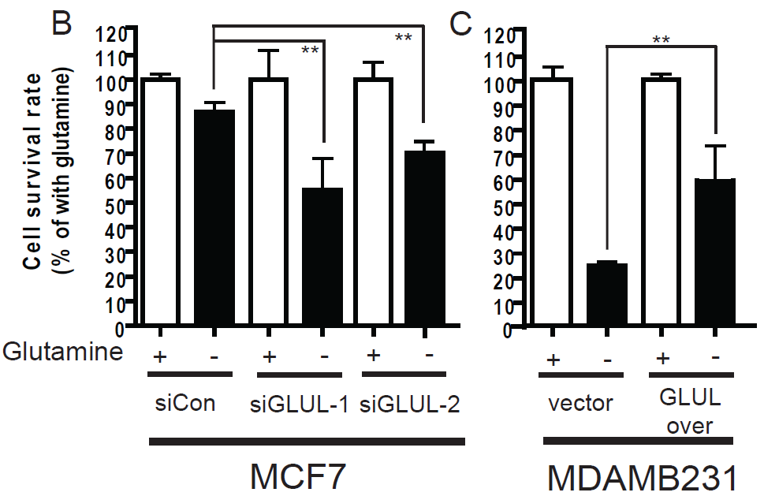
2. Glutamine requirement
High level of GLUL confer resistance of glutamine deprivation.
MCF7: higher GLUL
MDAMB231: lower GLUL
(Luminal cell)
(Basal cell)
Notes:
Next, we want to know whether GLUL is important in glutamine sensitivity of breast cells, MCF7 and MDAMB231 cells are selected to be a representative of luminal and basal cells. Luminal cells have higher GLUL and basal cells have lower GLUL expression, we knockdown the expression of GLUL in MCF7 and culture them in medium without glutamine for 48h, the cell survival rate decreased 40%. And then we overexpress GLUL in 231 cell, the survival rate in glutamine deprivation medium increased 50%. This figure give us a hint that change the expression of GLUL can regulate the sensitivity of glutamine on cells.

Slide 22
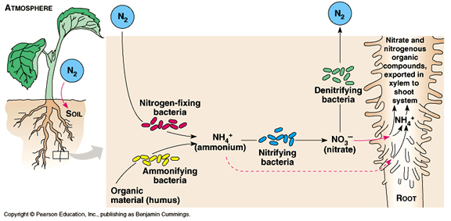

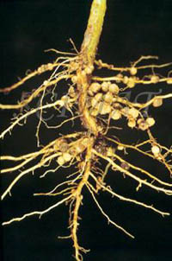
2. Glutamine requirement
Glutamine symbiosis
Postsynaptic neuron
Glutamate
Glia cell
Glutamate
GS
Glutamine
Glutamate
GLS
Glutamine
Presynaptic neuron
Glutamine symbiosis
Notes:
In the nature, two cells or organisms rely on each other for glutamine and glutamate transportation, which is called glutamine synbiosis, such as Neuron cell and glial cell, plant and the special bacterial infected into the root.
From the case of basal and luminal breast cancer cells, basal cells rely on more glutamine for survival,
where the luminal cells seem more glutamine-independent,
and these two cells are lined next to each other,
We then ask a question: is there also glutamine symbiosis between these two types of cells?
(There are two major cells in the brain, neuron cells and the supporting glial cell, neuron cells don’t produce glutamine themselves, they use the glutamine produced by glial cells. That’s called glutamine symbiosis. )

Slide 23
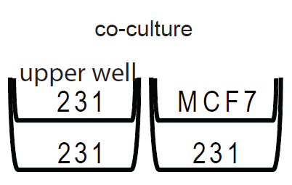
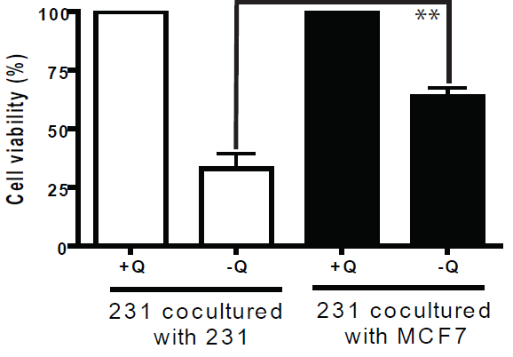
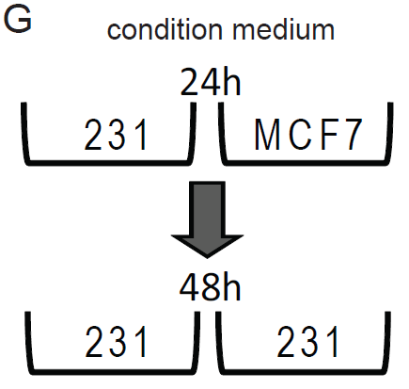
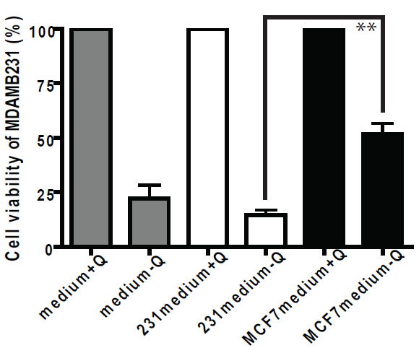
2. Glutamine requirement
Luminal and basal cells have Glutamine symbiosis
Notes:
We use transwells to culture 231 with 231 or MCF7 respectively for 48h in medium with or without glutamine. And cell viability is counted in lower layer of 231 cells. The survival rate of 231 cells cocultured with 231 without glutamine is about 30% left compare with cells cultured with glutamine. And co-culture with MCF7 can rescue 231 cells from glutamine deprivation- caused death for 40%. And the condition medium transfer culture system also show similar resulte. From this result, there might be a potential glutamine symbiosis system between basal and luminal cells.

Slide 24

2. Glutamine requirement
GLUL
Notes:
In this part, we found two things,
one is that luminal cells have more GLUL that can produce glutamine by themselves, and the basal cells are dependent on the extracellular glutamine for living.
Two is that when facing glutamine deprivation environment, luminal cells can export glutamine to basal cells to rescue basal cells from death.
Glutamine deprivation could be a potential therapeutic strategy for basal cells, but the glutamine production ability of luminal cells should be blocked also when doing the treatment.

Slide 25
Heterogeneity
/target therapy
Nutrient requirement
microenvironment
Notes:
So, all the work can be summarized by this chart, the heterogeneity and drug resistance in tumor can be regulated not only the gene alternation, but also the microenvironment stress and nutrient metabolism.

Slide 26





Jhih-Pu Syu
Hsiang-Yun Huang
Jen-Tsan Ashley Chi
Michael L. Gatza
Jeffrey R. Marks
Notes:
In the last, I would like to give my appreciation to many colleagues and students who have contributed to all the work I shared today.
The first and the second part is donewith the help of Dr. Chi, Dr. Marks, and Dr. Gatzain in Duke University, IGSP and surgery.
And the third art is done in National Taiwan University with a PhD student, Jhih-Pu Syu, and a master student, Hsiang-Yun Huang.
Thank you for their hard work.
And thank you for all your attention.
I would like to take questions.
Thank you very much.

