Slide 1



About OMICS Group
OMICS Group International is an amalgamation of Open Access publications and worldwide international science conferences and events. Established in the year 2007 with the sole aim of making the information on Sciences and technology ‘Open Access’, OMICS Group publishes 500 online open access scholarly journals in all aspects of Science, Engineering, Management and Technology journals. OMICS Group has been instrumental in taking the knowledge on Science & technology to the doorsteps of ordinary men and women. Research Scholars, Students, Libraries, Educational Institutions, Research centers and the industry are main stakeholders that benefitted greatly from this knowledge dissemination. OMICS International also organizes 500 International conferences annually across the globe, where knowledge transfer takes place through debates, round table discussions, poster presentations, workshops, symposia and exhibitions.

Slide 2
About OMICS International Conferences
About OMICS Group
OMICS International is a pioneer and leading science event organizer, which publishes around 500 open access journals and conducts over 300 Medical, Clinical, Engineering, Life Sciences, Pharma scientific conferences all over the globe annually with the support of more than 1000 scientific associations and 30,000 editorial board members and 3.5 million followers to its credit.
OMICS International has organized 500 conferences, workshops and national symposiums across the major cities including San Francisco, Las Vegas, San Antonio, Omaha, Orlando, Raleigh, Santa Clara, Chicago, Philadelphia, Baltimore, United Kingdom, Valencia, Dubai, Beijing, Hyderabad, Bengaluru and Mumbai.

Slide 3

Combined metabolomic and transcriptomic profiling revealed the time-dependent effects of metformin on LoVo cells
Houkai Li Dr.
Shanghai University of Traditional Chinese Medicine, 201203, Shanghai, China

Slide 4
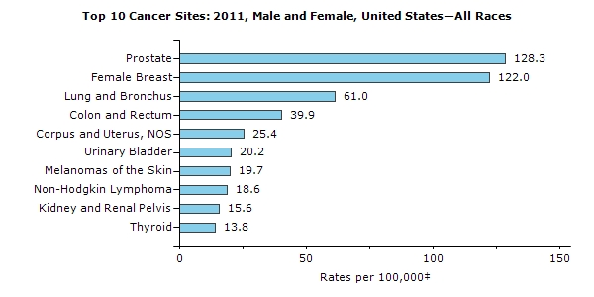

The incidence rates of cancers in US (2011)

Slide 5
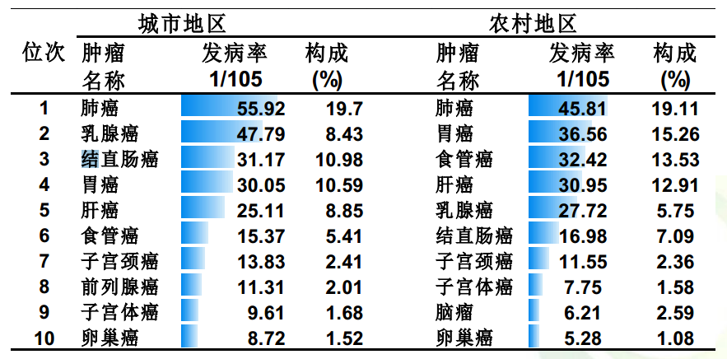
The incidence rates of cancers in China (2013)
Urban
Rural
Per 10⁵
Rate(%)
Per 10⁵
Rate(%)
Lung
Lung
Breast
Stomach
Colon and rectum
Esophagus
Stomach
Liver
Liver
Breast
Esophagus
Colon and rectum
Cervix uterus
Cervix uterus
Prostate
Corpus uteri
Corpus uteri
Ovarian
Ovarian
Brain

Slide 6
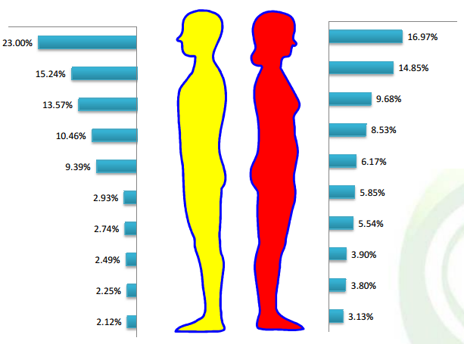
The mobility of Top 10 cancers in China (2013)
Lung
Breast
Stomach
Lung
Liver
Colon and rectum
Esophagus
Stomach
Colon and rectum
Liver
Bladder
Esophagus
Prostate
Cervix uterus
Pancreas
Thyroid
Lymphoma
Corpus uteri
Brain
Ovarian

Slide 7
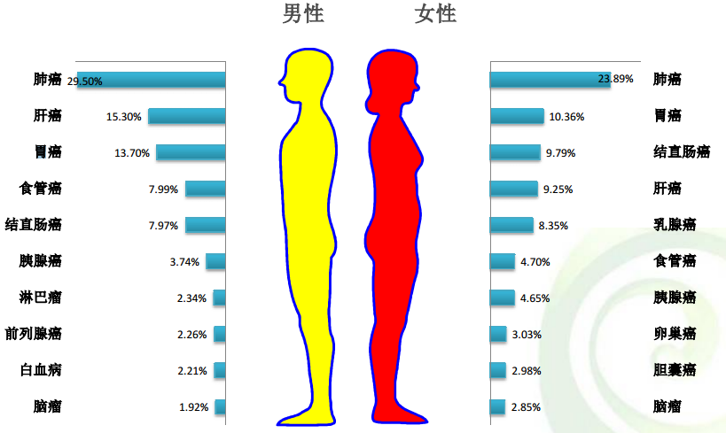
The death ratio of Top 10 cancers in China (2013)
Lung
Lung
Liver
Stomach
Stomach
Colon and rectum
Esophagus
Liver
Colon and rectum
Breast
Pancreas
Esophagus
Lymphoma
Pancreas
Prostate
Ovarian
Leukemias
Bladder
Brain
Brain

Slide 8
The new perspective for the old antidiabetic drug, Metformin
2005
2007
2008
2009
2010-2011
Association of
Obesity with
cancer risk
Association of MET
use with cancer risk
in diabetic patients
Role of AMPK/mTOR
In the MET’s
anti-tumor effects
Evidence for MET ‘s
anti-tumor activity
Sensitivity of CSCs
to MET
Evidence of MET in
Human Tumor therapy
Metabolic
Preclinical
Mechanistic
Therapeutic
Epidemiological
Oncotarget 2011; 2: 896 - 917

Slide 9
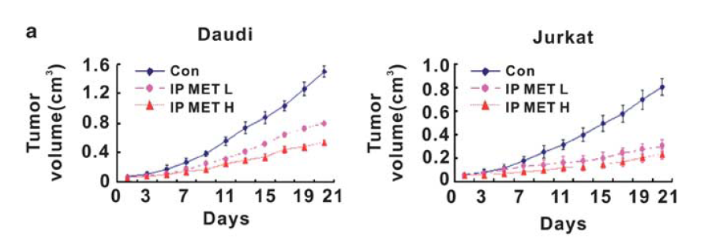
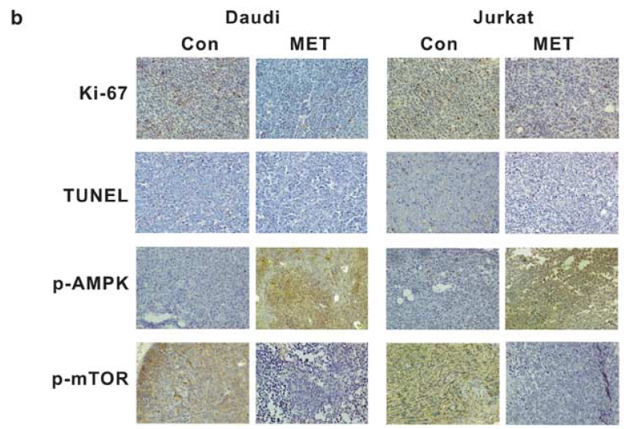
Metformin blocked lymphoma cells growth via inibition mTOR pathway
Cell Death and Disease (2012) 3, e275; doi:10.1038/cddis.2012.13
Notes:
Daudi: human B lymphoma cells; Jurkat:人类T cell lymphoblast-like cell line

Slide 10
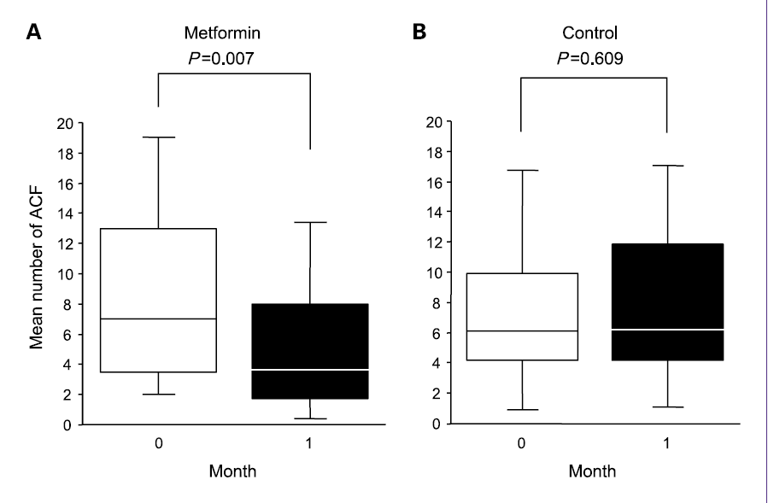
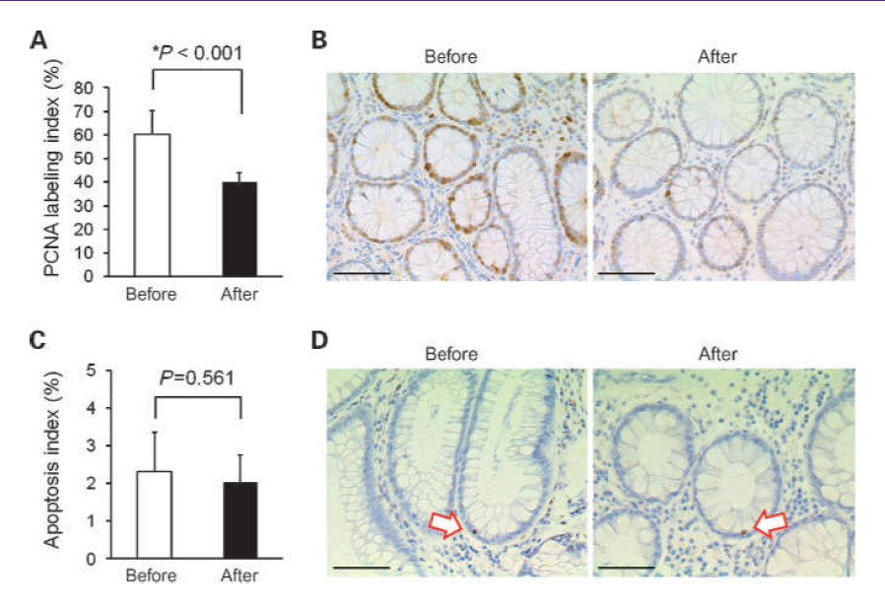
Metformin Suppresses Colorectal Aberrant Crypt Foci in a Short-term Clinical Trial

Slide 11
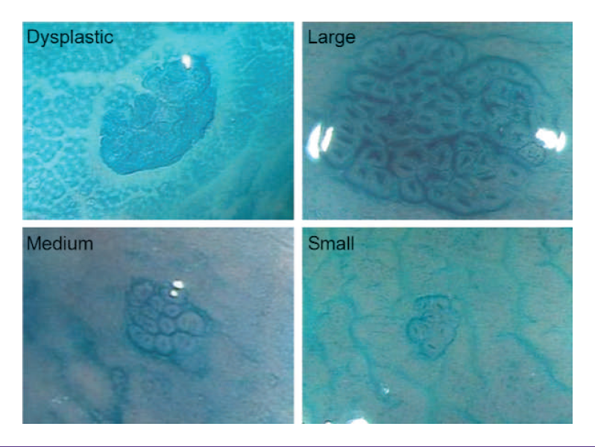
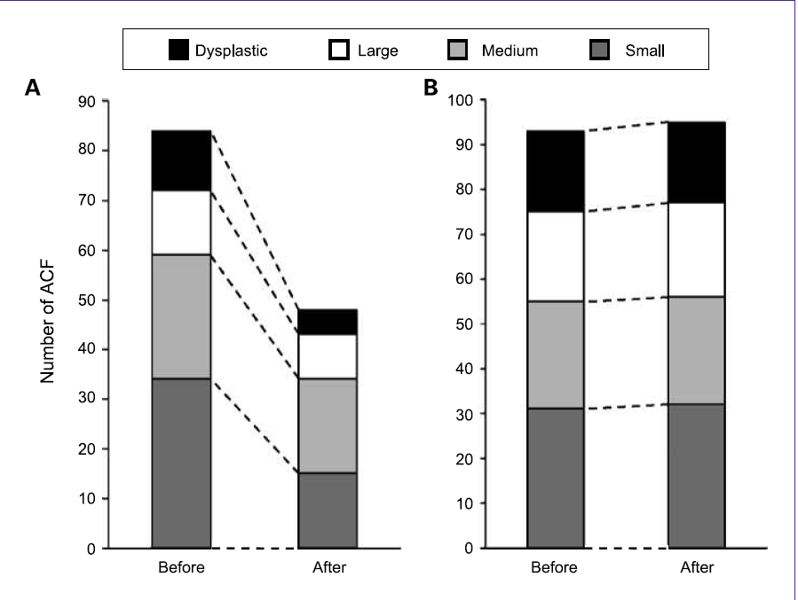
Metformin decreased the number of ACF with different sizes
Cancer Prev Res 2010;3:1077-1083.

Slide 12
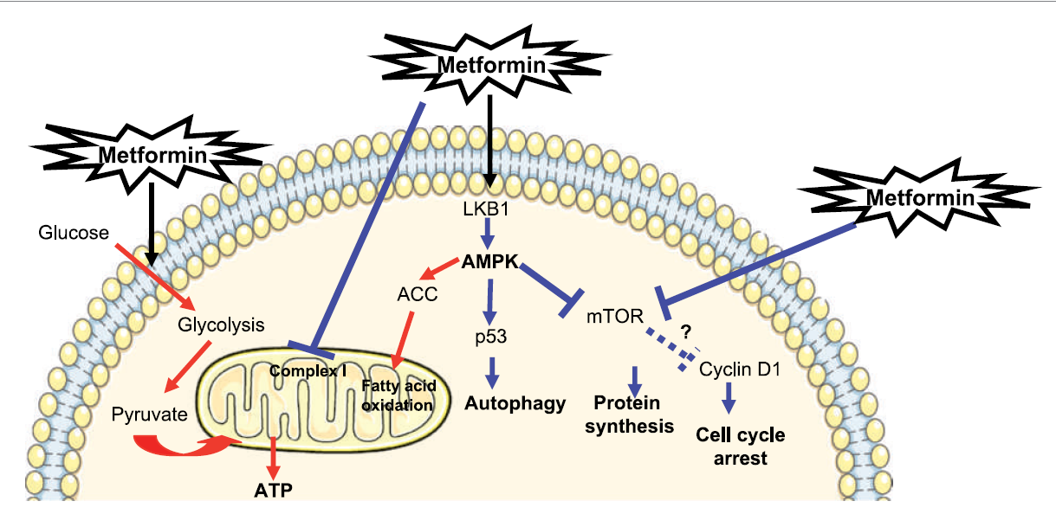
Potential mechanism of metformin on cancer cells
Mol Cancer Ther 2010;9:1092-1099.

Slide 13
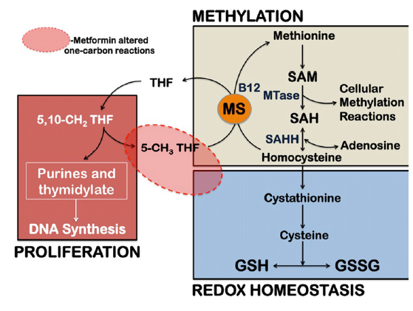
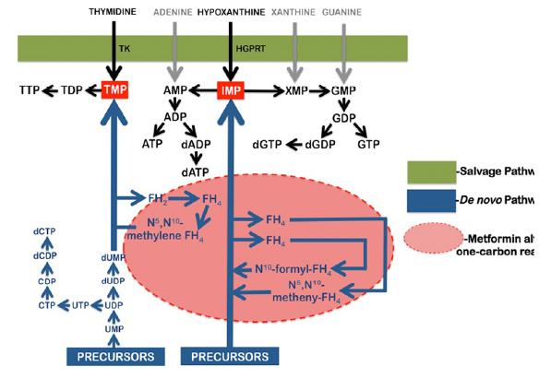
Metabolomic study reveals impairment on one-carbon metabolism by metformin on cancer cells
AGING, July 2012, Vol.4 No.7

Slide 14
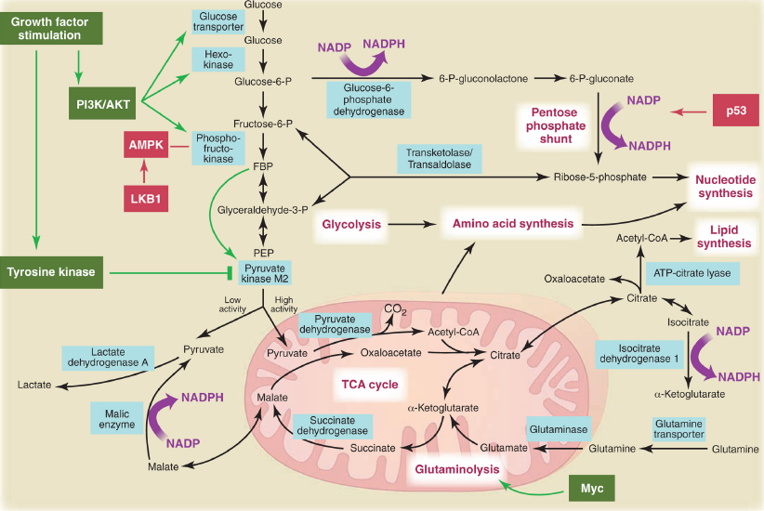
Crosstalk between metabolic and signaling pathways in cancer cells
Science. 2009 May 22; 324(5930): 1029–1033.

Slide 15

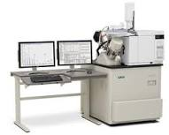
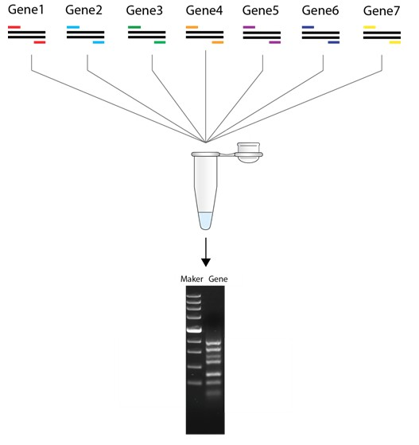
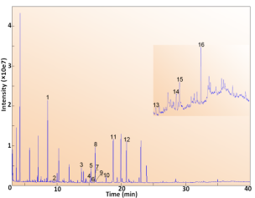
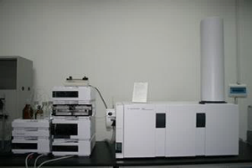
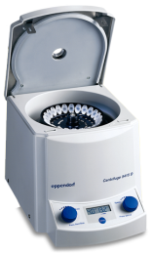
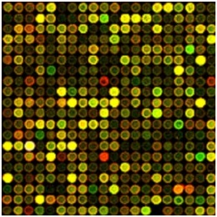
Process of sample preparation
Metabolic profiling
Transcriptomic profiling

Slide 16
Metformin suppressed the proliferation of colon cancer cells
Caco2
HT-29
*
*
OD value
OD value
Met (mM)
Met (mM)
Notes:
Metformin inhibits colon cancer cells proliferation CCK-8 kit; left: Caco2, 48h; right: HT-29, 48h

Slide 17
Metformin inhibited the proliferation of LoVo cells dose- and time-dependently
24h
48h
*
*
OD value
OD value
Met (mM)
Met (mM)
Notes:
LoVo cell, Medium: 10% FBS DMEM/F12 (left: 24h, right: 48h);

Slide 18
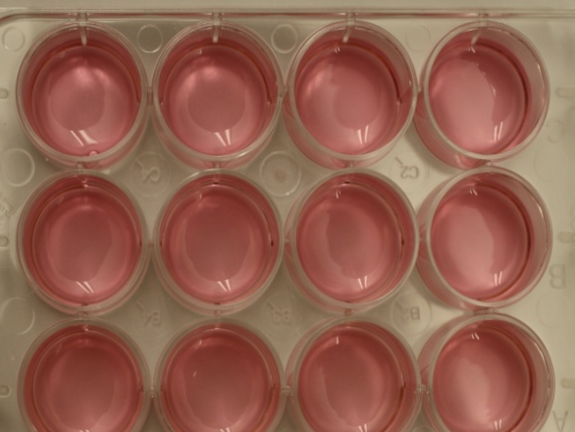
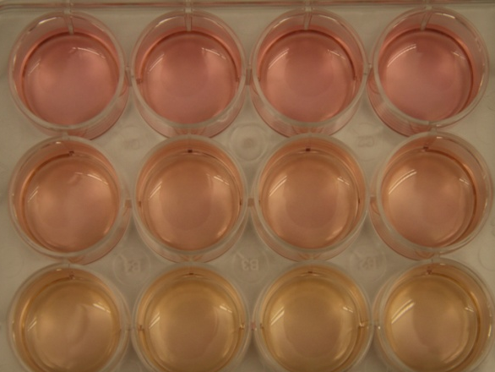
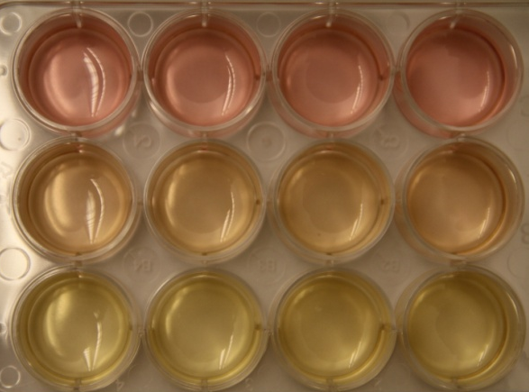
Metformin accelerated the acidization of culture media
*
*
**
**
OD Value
pH value
Con
Met 1mM
Met 10mM
8h
24h
48h

Slide 19
The metabolic alteration by metformin

Slide 20
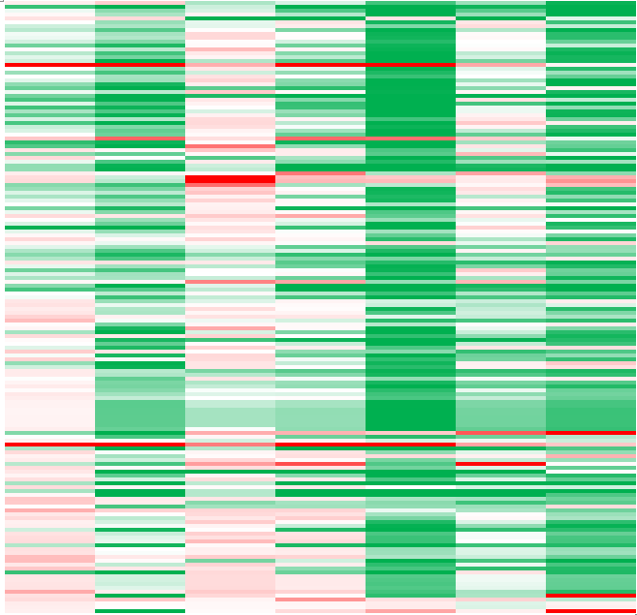
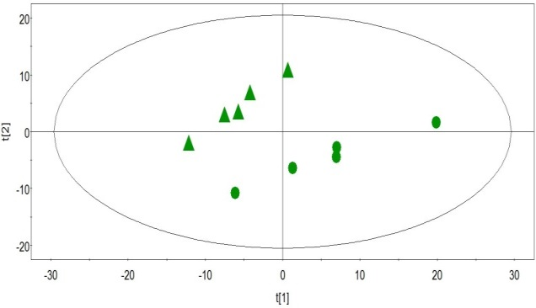
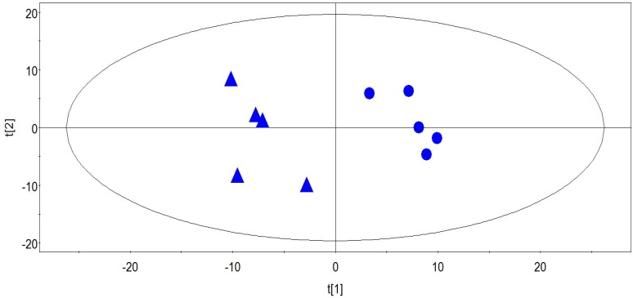
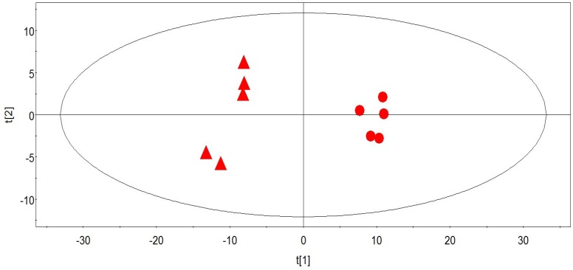
Time-dependent metabolic shift
Met 24h
Con 24h
Met 48h
Con 48h
Met 8h
48
45
66
Fold change
0.2
1.0
5.0

Slide 21
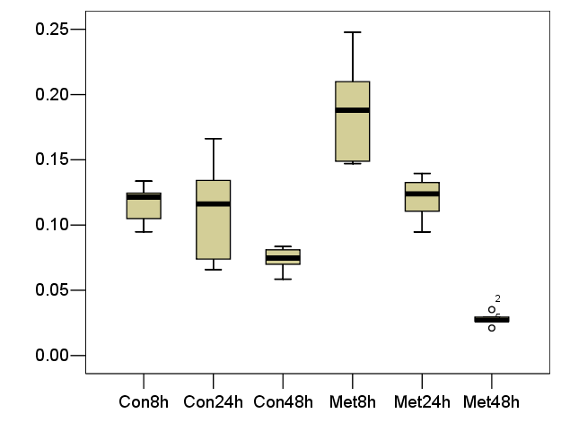
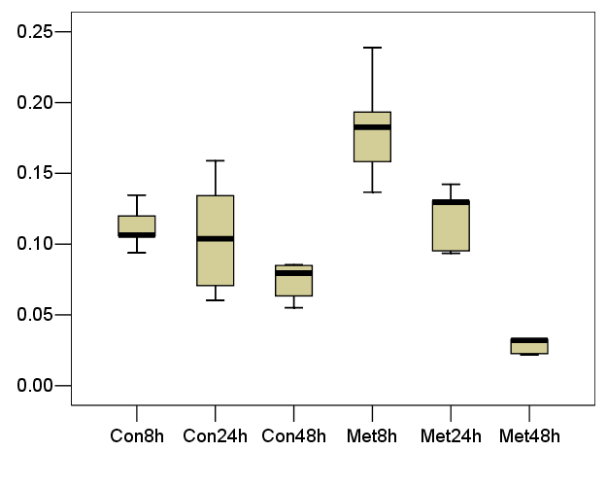
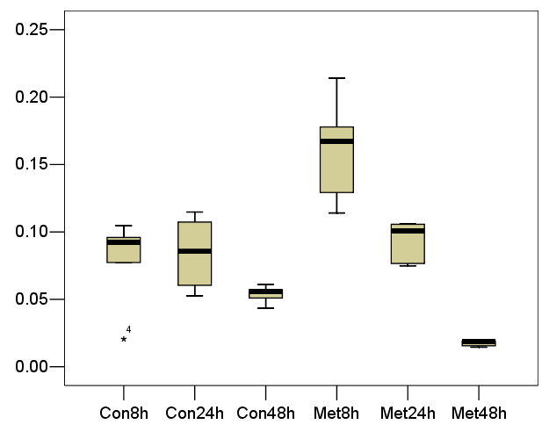
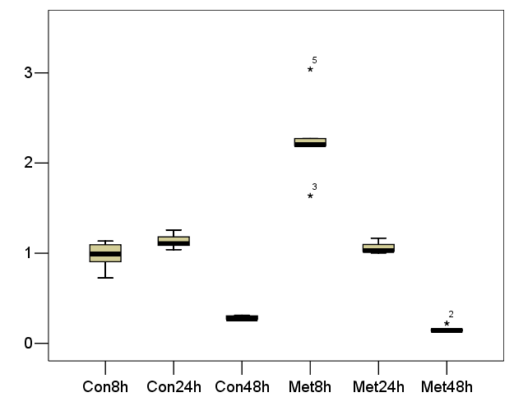
Valine
Leucine
Isoleucine
Glutamine

Slide 22
The main metabolic changes

Slide 23
Transcriptomic profiling on metformin-treated cells

Slide 24
Alteration of transcriptional pathways

Slide 25
Alteration of transcriptional pathways

Slide 27
Summary
Metformin inhibits the proliferation of LoVo cells in time- and dose-dependent way;
Significant metabolic alteration is prior to the change of cell viability reduction;
Metformin may block the energy metabolism of LoVo cells by short time treatment;

Slide 28
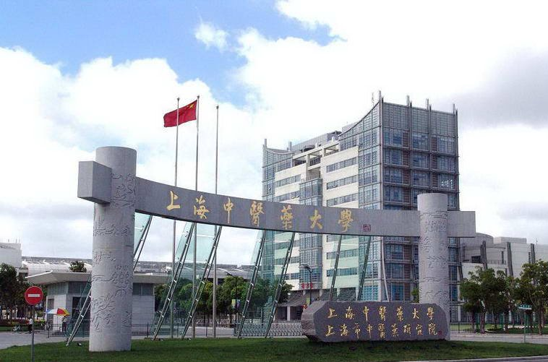
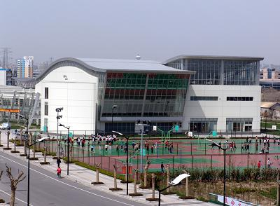
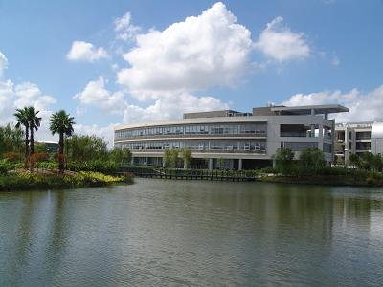
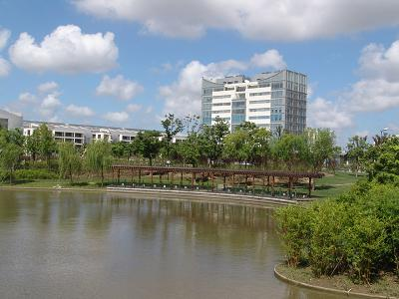

Slide 29
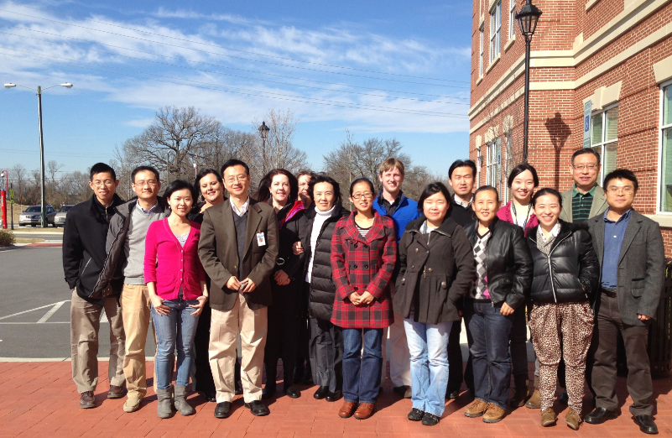
Acknowledgement
Prof. Wei Jia
Dr. Guoxiang Xie
Dr. Yunping Qiu
Dr. Ke Wang
Ms. Ningning Zheng

Slide 30
Let Us Meet Again
We welcome you all to our future conferences of
OMICS International
Please Visit:
www.metabolomicsconference.com
www.conferenceseries.com
http://www.conferenceseries.com/clinical-research-conferences.php

