Slide 1
HER2 positive breast carcinoma in the pre and post adjuvant anti-HER-2 therapy era: a single academic institution experience in the setting outside of clinical trials
Heather M. Gage, MD, Avanti Rangnekar, Robert E. Heidel, PhD, Timothy Panella, MD, John Bell, MD, and Amila Orucevic, MD, PhD
The Graduate School of Medicine
The Department of Pathology

Slide 2
Introduction
HER2+ breast carcinoma (BC)
Considered “unfavorable” due to its aggressive nature and high mortality rate¹
High tumor grade, high cell proliferation rate, high frequency of visceral metastasis
Often negative estrogen and progesterone receptors
Adjuvant anti-HER2 therapy
FDA approved in 1998 for HER2+ metastatic disease
Used since 2005 for adjuvant treatment of operable HER2+ BC
In large randomized clinical trials (NCCTG N9831 and NSABP B-31)²⁻⁶
Reduces the risk of recurrence
Improves survival in patients
1. Ross, J.S., et al., 2009, The oncologist, 14(4): p. 320-368.
2. Slamon, D., et al.,, 2011, NEJM, 365(14): p. 1273-1283.
3. Seal, M.D., et al., 2012., Current oncology, 19(4): p. 197-201.
4. Rodrigues, M.J., et al., 2012, Annals of Oncology
5. Gianni, L., et al., 2011, The lancet oncology. 12(3): p. 236-244.
6. Perez, E.A., et al., 2011, Journal of clinical oncology29(25): p. 3366-3373.

Slide 3
Objectives
Evaluate whether adjuvant anti-HER2 therapy has similar beneficial effect on survival outside of trials
Existing data from clinical trials
Highly controlled population of patients studied
Want to see if therapy is similarly beneficial in community-based practice
HER2+BC in Caucasian females at our academic institution
Clinicopathologic characteristics
Measured their overall survival
Comparing the treatments that they received before or after 11/2005
Implementation date of treatment with adjuvant anti-HER2 therapy as standard practice⁷
7. Romond, E.H., et al, 2005, N Eng J Med, 353(16): p. 1673-1684.

Slide 4
Methods
Stage I-III HER2+BC patients from 1998-2009
167 patients
Divided into 2 groups
Group 0: patients diagnosed before 11/2005
78/167 patients
Group 1: patients diagnosed after 11/2005
89/167 patients
Further divided into HER2+ subtypes⁸
8. Goldhirsch A, et al. 2011. Ann Onc. 22(8): 1736-1746

Slide 5
Methods
167 HER2+ BC patients
Time Period
1/1998-12/2009
Followed ≤108 months
Group 0 (G0)= 78 HER2+ BC patients
Time Period
1/1998-11/2005
Group 1 (G1)= 89 HER2+ BC patients
Time Period
11/2005-12/2009
48/78 G0 patients
ER+/PR+/HER2+
(Luminal B/HER2+ subtype)
30/78 G0 patients
ER-/PR-/HER2+
(HER2+/Non-luminal subtype)
49/89 G1 patients
ER+/PR+/HER2+
(Luminal B/HER2+ subtype)
40/89 G1 patients
ER-/PR-/HER2+
(HER2+/Non-luminal subtype)

Slide 6
Results
HER2+ patient’s grouping | Group 0 Luminal B /HER2+ subtype | Group 0 HER2+/Non-luminal subtype | Group 1 Luminal B /HER2+ subtype | Group 1 HER2+/Non-luminal subtype
HER2+ subtype frequency | 48/78 = 61.5% | 30/78 = 38.5% | 49/89 = 55.1% | 40/89 = 44.9%
Age* | 57.1 | 59.4 | 54.6 | 57.5
Type of BC** | IDC | IDC | IDC | IDC
Grade** | 3 | 3 | 3 | 3
Size in mm* | 25.6 | 22.5 | 22.9 | 33.1
TNM Anatomic stage | Stage III | Stage I | Stage I | Stage II
Survival months* | 78.75 | 69.63 | 80 | 78.73
Alive patients - frequency | 21/48 = 43.8% | 15/30 = 50.0% | 43/49 = 87.8% | 34/40 = 85.0%

Slide 7
Results: Treatments
HER2+ patient’s grouping | Group 0 Luminal B /HER2+ subtype | Group 0 HER2+/Non-luminal subtype | Group 1 Luminal B /HER2+ subtype | Group 1 HER2+/Non-luminal subtype
Most frequent surgery type | MRM 25/48 = 52.1% | MRM 20/30 = 66.6% | MRM 20/49 = 40.8% | MRM 20/40 = 50.0%
Radiation therapy received | 27/46 = 58.6% | 10/29 = 34.4 % | 26/47 = 55.3% | 21/40 = 52.5%
Hormonal therapy received | 39/48 = 81.3% | 0/30 = 0% | 43/49 = 87.8% | 0/40 = 0%
Chemotherapy received | 31/48 = 64.6% | 21/30 = 70.0% | 31/47 = 66.0% | 38/40 = 95.0%
Anti-HER2 therapy received | 5/48 = 10.4% | 7/30 = 23.3% | 30/49 = 61.2% | 35/40 = 87.5%

Slide 8
Results
Clinicopathologic characteristics
Mostly high grade
>20 mm in size
G0: 53.8 % mortality at 108 months
G1
73% received adjuvant anti-HER2 therapy
13.5% mortality at 108 months (p<0.001)
ER/PR phenotype: No significant impact on OS (p=0.672)

Slide 9
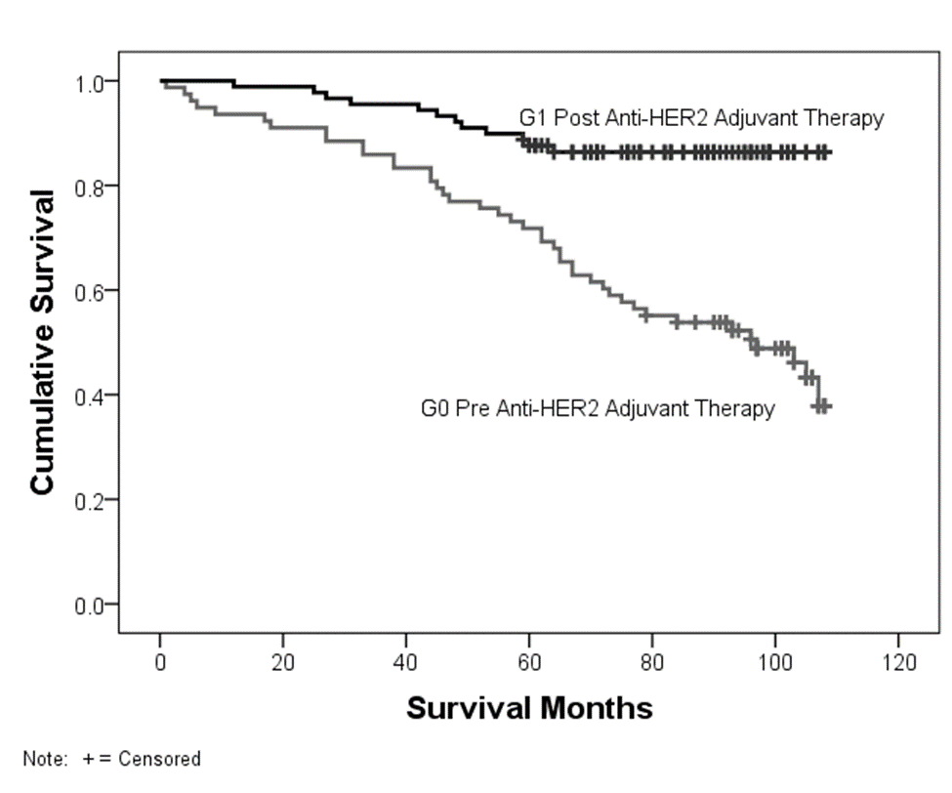
Results

Slide 10
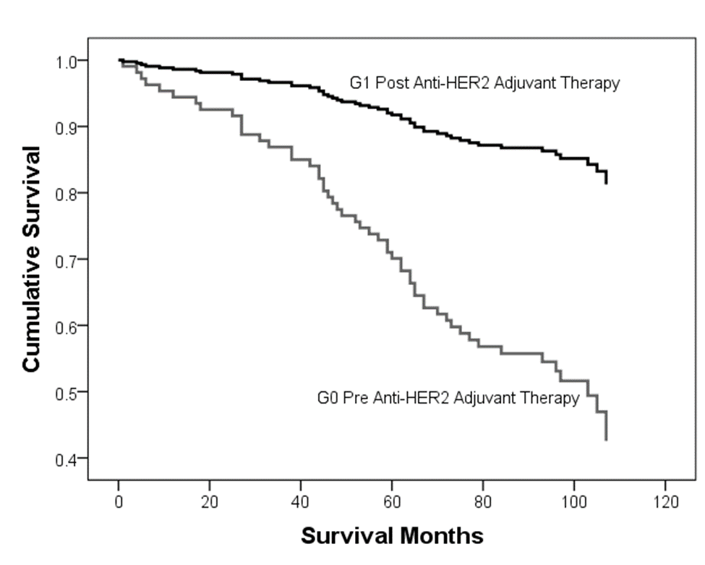
Results
Controlled for age, grade, and TNM stage

Slide 11
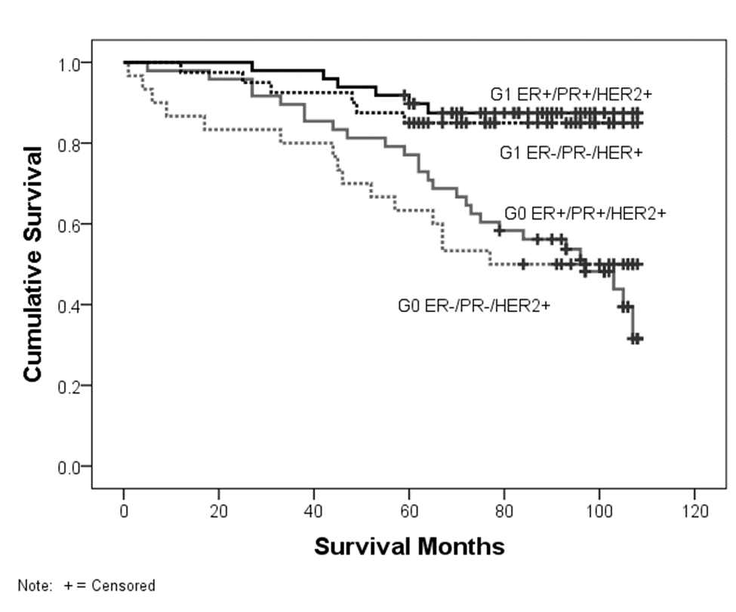
Results

Slide 12
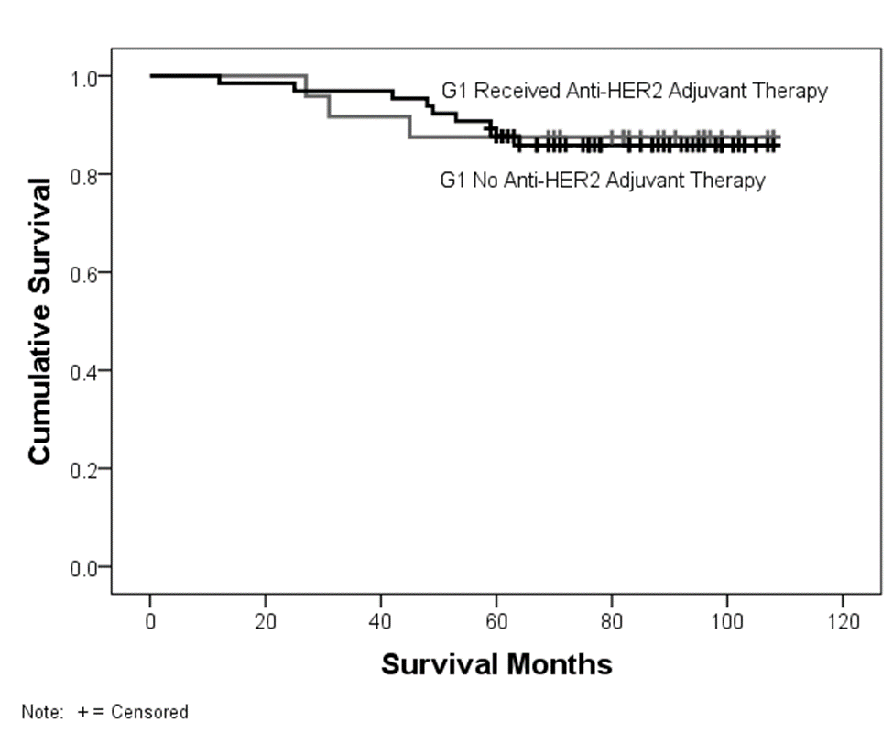
Results

Slide 13
Conclusions
Overall survival
Significantly improved in G1 versus G0
Supports adjuvant anti-HER2 therapy as a valuable treatment for significantly improving outcomes in HER2+ breast carcinoma in the settings outside of clinical trials
Community-based data on overall survival emerging now

Slide 14
REFERENCES
1. Ross, J.S., et al., The HER-2 receptor and breast cancer: ten years of targeted anti-HER-2 therapy and personalized medicine. The oncologist, 2009. 14(4): p. 320-368.
2. Slamon, D., et al., Adjuvant trastuzumab in HER2-positive breast cancer. The New England journal of medicine, 2011. 365(14): p. 1273-1283.
3. Seal, M.D., et al., Outcomes of women with early-stage breast cancer receiving adjuvant trastuzumab. Current oncology (Toronto, Ont.), 2012. 19(4): p. 197-201.
4. Rodrigues, M.J., et al., Benefit of adjuvant trastuzumab-based chemotherapy in T1ab node-negative HER2-overexpressing breast carcinomas: a multicenter retrospective series. Annals of Oncology : Official Journal of the European Society for Medical Oncology / ESMO, 2012.
5. Gianni, L., et al., Treatment with trastuzumab for 1 year after adjuvant chemotherapy in patients with HER2-positive early breast cancer: a 4-year follow-up of a randomised controlled trial. The lancet oncology, 2011. 12(3): p. 236-244.
6. Perez, E.A., et al., Four-year follow-up of trastuzumab plus adjuvant chemotherapy for operable human epidermal growth factor receptor 2-positive breast cancer: joint analysis of data from NCCTG N9831 and NSABP B-31. Journal of clinical oncology : official journal of the American Society of Clinical Oncology, 2011. 29(25): p. 3366-3373.
7. Romond, E.H., et al., Trastuzumab plus adjuvant chemotherapy for operable HER2-positive breast cancer. The New England journal of medicine, 2005. 353(16): p. 1673-1684.
8. Goldhirsch, A, et al. Strategies for subtypes—dealing with the diversity of breast cancer: highlights of the St. Gallen International Expert Consensus on the Primary Therapy of Early Breast Cancer 2011. Annals of Oncology, 2011. 22(8): 1736-1747

