Slide 1
About OMICS Group
OMICS Group International is an amalgamation of Open Access publications and worldwide international science conferences and events. Established in the year 2007 with the sole aim of making the information on Sciences and technology ‘Open Access’, OMICS Group publishes 400 online open access scholarly journals in all aspects of Science, Engineering, Management and Technology journals. OMICS Group has been instrumental in taking the knowledge on Science & technology to the doorsteps of ordinary men and women. Research Scholars, Students, Libraries, Educational Institutions, Research centers and the industry are main stakeholders that benefitted greatly from this knowledge dissemination. OMICS Group also organizes 300 International conferences annually across the globe, where knowledge transfer takes place through debates, round table discussions, poster presentations, workshops, symposia and exhibitions.

Slide 2
About OMICS Group Conferences
OMICS Group International is a pioneer and leading science event organizer, which publishes around 400 open access journals and conducts over 300 Medical, Clinical, Engineering, Life Sciences, Pharma scientific conferences all over the globe annually with the support of more than 1000 scientific associations and 30,000 editorial board members and 3.5 million followers to its credit.
OMICS Group has organized 500 conferences, workshops and national symposiums across the major cities including San Francisco, Las Vegas, San Antonio, Omaha, Orlando, Raleigh, Santa Clara, Chicago, Philadelphia, Baltimore, United Kingdom, Valencia, Dubai, Beijing, Hyderabad, Bengaluru and Mumbai.

Slide 3
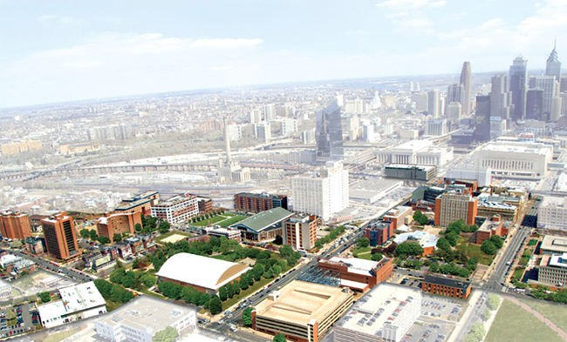
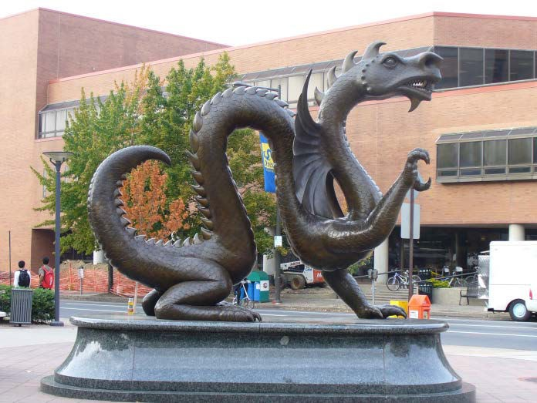
Nanomechanical Biosensors
Dr. Haifeng (Frank) Ji 08/11/2014
Associate Professor Department of Chemistry Drexel University

Slide 4
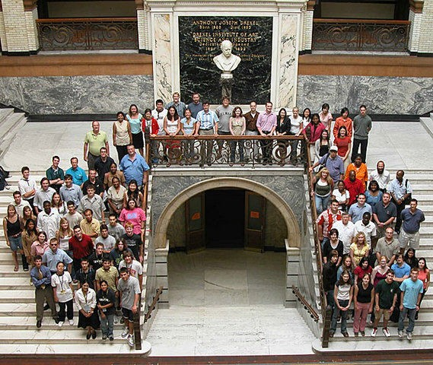

Slide 5
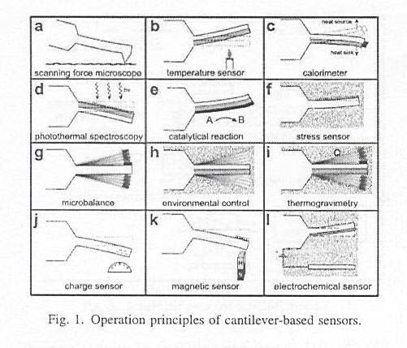
•
J. K. Gimzewski, C. Gerber, E. Meyer, and R. R. Schlittler, “Observation of a Chemical Reaction Using a Micromechanical Sensor,” Chem. Phys. Lett., 1994, 217, 589-594
G. Y. Chen, R. J. Warmack, T. Thundat, D. P. Allison, and A. Huang, “Resonance Response of Scanning Force Microscopy Cantilevers,” Rev. Sci. Instrum. 1994, 65, 2532-2537
T. Thundat, R. J. Warmack, G. Y. Chen, and D. P. Allison “Thermal and ambient-induced deflections of scanning force microscope cantilevers”, Appl. Phys. Lett. 1994, 64(21), 2894-2896
•
•
500
400
300
200
100
0
1992 1994 1996 1998 2000 2002 2004 2006 2008
Year
Number of publications

Slide 6
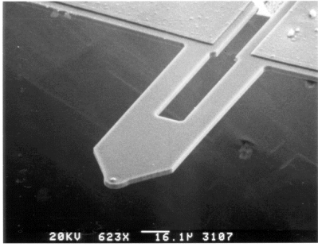
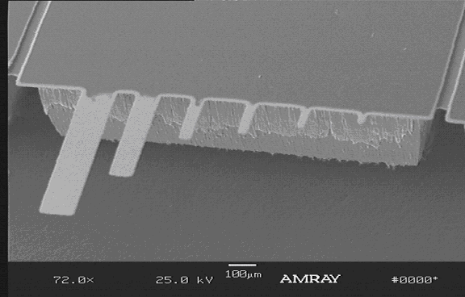
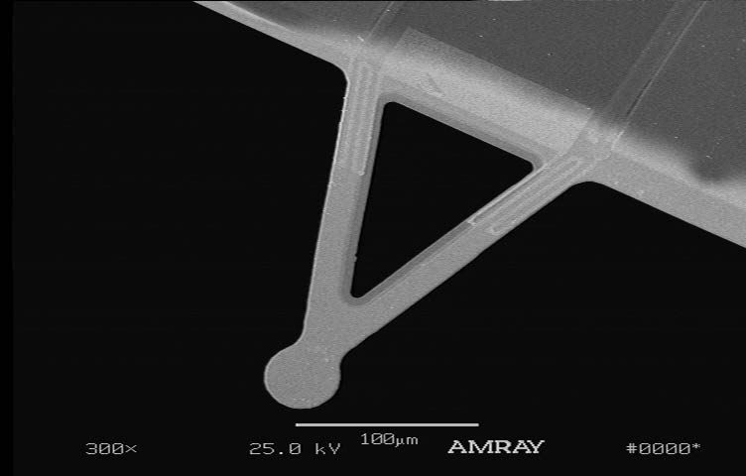
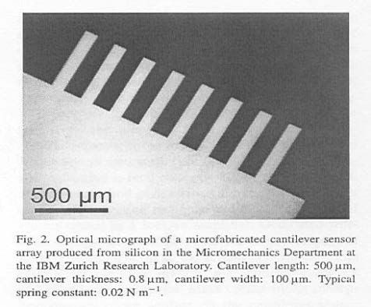
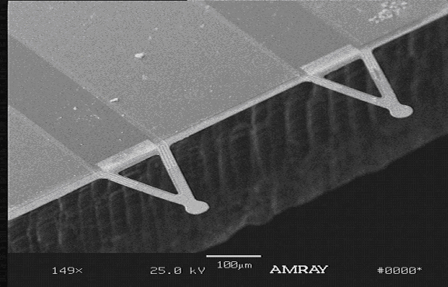
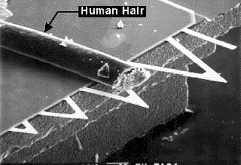
V-shaped microcantilevers L—200 μm
W—40 μm t—2 μm

Slide 7
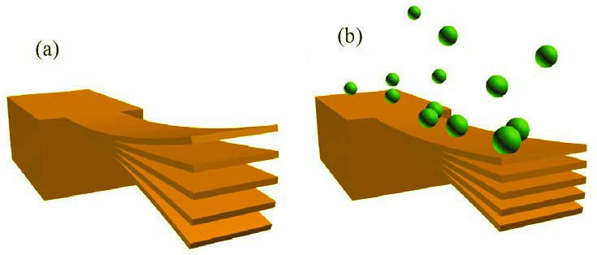
Two independent properties (bending, frequency) of a microcantilever can be simultaneously detected.
Resonance frequency. The resonance frequency of an oscillating cantilever can be expressed as
(1)
_{f =} 1 K
_{m}*
2π
where K is the spring constant of the lever and m* is the effective mass of the microcantilever.
Preferred MC: short and stiff (Si₃N₄, SiC)
Application: gas

Slide 8


2. Microcantilever bending. One unique
where R is the radius of curvature for the cantilever, v and E are Poisson’s ratio and Young’s modulus for the substrate, respectively,
t is the thickness of the cantilever and ds is the film stress.
characteristics of microcantilevers is that the device can be made to undergo bending due to molecular adsorption by confining the adsorption to one side of the cantilever. Using Stoney’s formula, the radius of curvature of bending of the cantilever due to adsorption can be written as:
1 6(1 − υ )
δs
3(1 − υ)L²
_{R} =
Et²
Δz = (
)δs
Et
2
Figure. Two mechanisms of binding-induced surface stress in different types of responsive coatings. (Left) Expansive stresses for antigen- antibody interaction (Right) Compressive stress due to neutralization of excessive charge on the surface

Slide 9
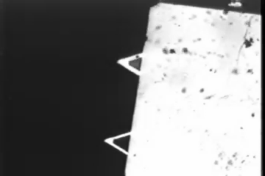
A modified microcantilever (top) bended down upon exposure to methanol vapor and returned to its original position when the methanol vapor was replaced with air. For comparison, unmodified microcantilever (bottom) did not bend upon exposure to methanol.

Slide 10
1. Piezoelectric sensors -- QCM
2. Optical sensors – Fiber optical, Color, Fl, Surface plasmon resonance (SPR), Evanescent wave (EW), Laser
3. Electrochemical sensors
  Potentiometric sensors
  Amperometric sensors
  Others
4. Thermometric sensors, calorimeter
5. FET sensors
6. Flow meter sensor (nanoporous, microfluidic)
7. Cantilever sensors

Slide 11
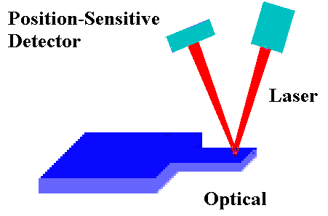
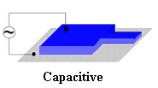
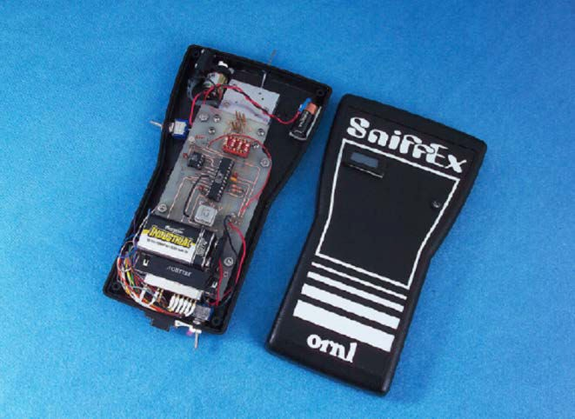
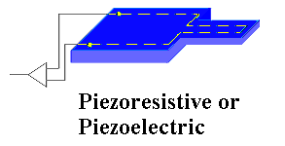
ORNL, Berkeley, GA Tech, Purdue Univ., IBM Switzerland

Slide 12
Scan tunneling – Univ. Minnesota Nanofabrication Center
Interferometry – IBM Switzerland
Electric field gradient distribution – NIST
Force-Distance – IBM Switzerland
MOSFET methods – Northwestern Univ. International Institute for Nanotechnology
Liquid inside the microcantilever – MIT
The 2008 Conferee Networking (CN) "Micromechanical Chem/Bio Sensors”

Slide 13
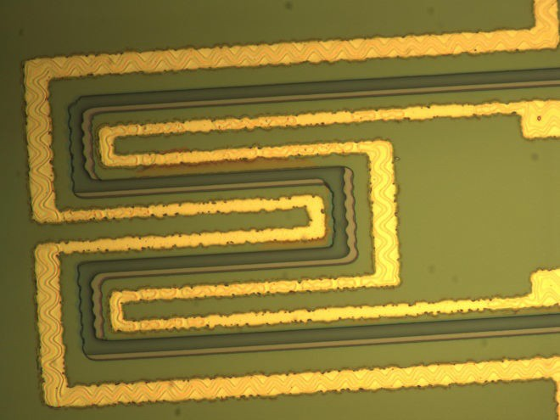
 | V_{out} before bending | V’_{out} after 100 nm bending | ^{ΔV}out | ^{ΔV}out^{/V}out
Calculation | 2.8911 | 2.8875 | 0.0036 | 0.125%
Simulation | 2.64279628 | 2.63906121 | 0.00373507 | 0.14133%
Experimen t | 2.4723 | 2.4685 | 0.0038 | 0.1537%
Table 2. The Vout of the second coil upon 2 V Vin of the first coil. The two coils are separated by 10 μm. The thickness and width of the coils are 1 mm, and 10 mm, respectively.
This structure consists of one primary metal coil on a microcantilever and a secondary coil on the surrounding substrate. When voltage is applied on the primary coil, the created magnetic field causes induced voltage on the secondary coil.
Method | V_{out} (mV) (before bending) | V_{out} (mV) (with 1 nm bending) | ΔV/V_{out}
Calculation | 279.89 | 279.24 | 0.23%
Simulation | 256.3556735 | 255.7546534 | 0.24%
Table 3. The Vout of the second coil upon 2 V Vin of the first coil. The two coils are separated by 1 μm. The thickness and width of the coils are 1 mm, and 10 mm, respectively.

Slide 14
Display
AGC
Clock/ Calendar
Microcontroller
Preamplifier
Preamplifier
Sensor Array
ADC_{S}
Battery
 | Temperature reference
Vibration reference

Slide 15
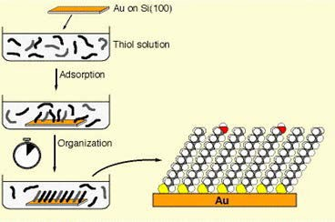
1. Self Assembled Monolayers and Surface Conjugation Chemistry
Chemical modification of the silica and gold surface is well developed. Some of the common choices include:
Carboxyl (-COOH)-modified cantilever,
Amino (-NH2)-modified cantilever,
Hydroxyl (-OH)-modified cantilever,
Hydrazide (-NHNH2)-modified cantilever,
Amide (-CONH2)-modified cantilever;
Chloromethyl (-CH2Cl)-modified cantilever,
Epoxy-modified cantilever,
Aldehyde (-CHO)-modified cantilever
(I) Tosyl-modified cantilever.

Slide 16
Receptors | Analytes | D amplitudes | Mechanism | Comments
18-crown-6 | _{K}+ | 0 nm | Crown ether-ions
15-crown-5 | Na⁺ | 0 nm | Crown ether-ions
calixcrown | _{Sr}2+ | 0 nm | Calix-crown-ions
Glucose oxidase | glucose | 7 nm | Enzyme-organic | Depend on
AChE | OPs | 9 nm | Enzyme-organic | Conjugation
Cystein-Cu²⁺ complex | OPs | 30 nm | Complex-organic | Chemistry
SH group | HgMe⁺ | 22 nm | Complex-ions
phosphate | _{Ca}2+ | 40 nm | Ion pairs
Anti-Cd-EDTA | EDTA-Cd²⁺ | 100 nm | Antibody-ions
cysteine | _{Cu}2+ | 150 nm | Ion pairs
ammonium | CrO ²⁻ 4 | 450 nm | Ion pair
Anti-SARS | SARS | 800 nm | Antibody-Bacteria
Anti-E.Coli | E. Coli | 800 nm | Antibody-Bacteria
Anti-Tularemia | Tularemia | 700 nm | Antibody-Virus

Slide 17
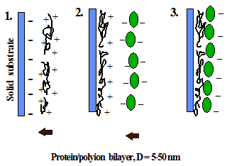
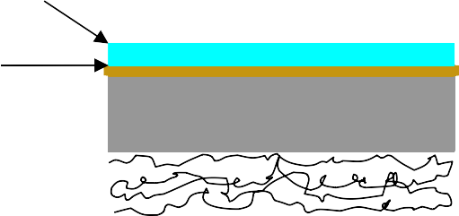
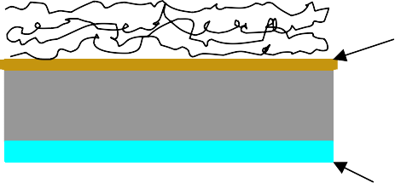
2. Self Assembled Multilayers
GOx containing Multilayer
PFDT layer
Gold
Silicon
Silicon
Microcantilever-A
TTS layer
Microcantilever-B
n
n
The example of PDDA/PSS modification process of a microcantilever
N
+
Cl⁻
SO₃ PSS
-
PDDA

Slide 18
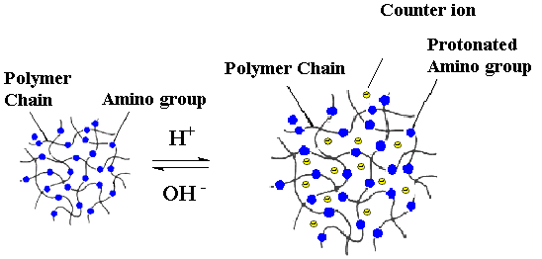
Structures of several pH sensitive hydrogels
CH₃ CH₃ CH₃ H CH₃
CH₃ CH₃ CH₃ CH₃ CH₃
H H CH₃
x Y z
n
n
R₁ R₂ R₁ C O R₁
O CH₂ CH₂
4
R R
R
C O R O
CH₂ CH₂
4
C O C O C O
R₁ = -COOCH₂CH₂OH R₂ = -COOCH₂CH₂NH₂
R = -COOH
NH₂ NH O CH₂ CH₂ N
O
PMAA-PEG
O
R₁ C O
R
C O
p(HEMA)
CH₃ H
CH₃ CH₃
PAMD-PNIPA-PDMEM

Slide 19
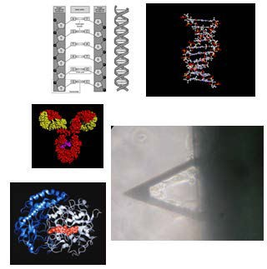
Biosensors
Biosensor 1: DNA hybridization on the cantilever surface
Biosensor 2. Antibody based sensors, examples: E. Coli, Tularemia, and SARS
Biosensor 3. Membrane based sensors, example, serotonin for drug screening
Biosensor 4: Enzyme based sensors, example, glucose, OPs
Biosensor 5. Other proteins based sensors, such as for Ca²⁺.
Whole cell
Whole organs/systems

Slide 20
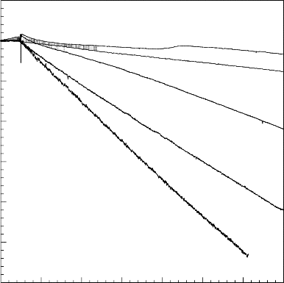
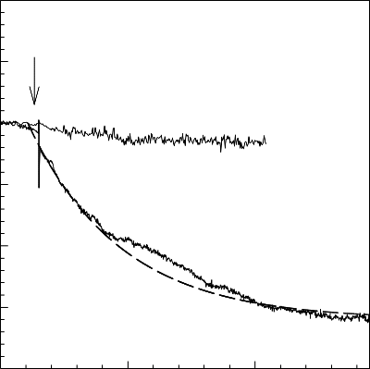
Tularemia (Francisella tularensis) is a small, nonmotile, aerobic, gram-negative coccobacillus. It is one of the most infectious pathogenic bacteria known.
Bending response as a function of time for antibody immobilized microcantilevers upon injection of different concentration (organisms/mL) solutions of F. Tularensis in 0.1M phosphate-buffered saline buffer (pH=7.3)
200
0
10
4
-200
10⁵
Deflection, nm
-400
10⁶
-600
10⁷
-800
10⁸
-1000
-1200
0
60
120
180 240 300 360
420
Time, min
E. coli O157:H7, first recognized in 1982 in the United States, is an epidemiologically significant cause of food borne disease worldwide. E. coli O157:H7 can readily contaminate ground beef, raw milk, poultry products, fresh apple cider, cold sandwiches, vegetables, and drinking water supplies.
100
50
Injection
Negative control
Deflection, nm
0
-50
-100
Positive control
Bending response as a function of time for an antibody immobilized microcantilever upon injection of a 5×10⁶ cfu/mL solution of E.coli O157:H7 in 0.1M PBS buffer (pH=7.3)
-150
-200
0
100
200
Time, minute

Slide 21
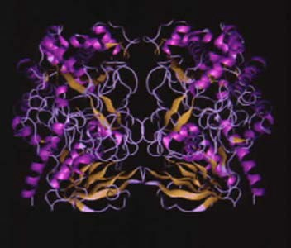
Supported by US Army-Technologies for Metabolic Monitoring
topology of Glucose Oxidase (GOx) enzyme
Glucose Oxidase
β − D − glu cos e + O + H O ⎯⎯⎯⎯⎯→ D − gluconic acid +
H O
2 2
2 2

Slide 22
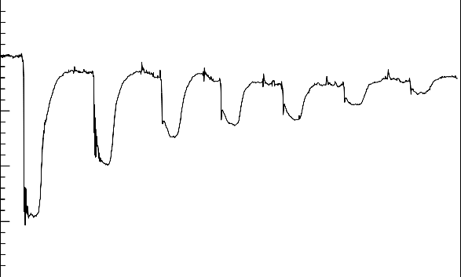
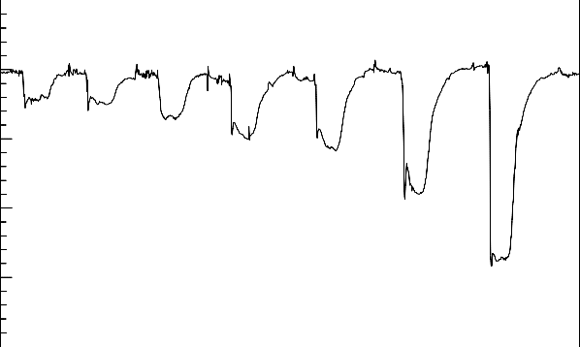
20
20
0
0
Deflection, nm
-20
Deflection, nm
2 mM _{4 mM}
4 mM
2 mM
-20
6 mM
8 mM
6 mM
8 mM
-40
20 mM
10 mM
-40
10 mM
-60
20 mM
50 mM
-60
50 mM
-80
0
500
1000
1500
Time, s
2000
2500
3000
-80
0
500
1000 1500
Time, s
2000
2500
70
60
50
40
Deflection, nm
30
Deflection of microcantilever modified by glucose oxidase multilayer vs. the
concentration of different glucose solutions.
20
y = 1.0907x + 6.4802 R² = 0.9887
10
0
0
10
20 30
Glucose concentration, mM
40
50

Slide 23
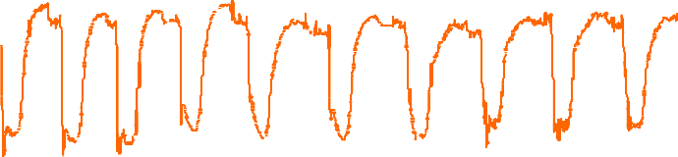
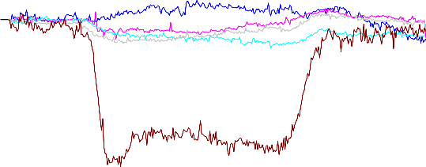
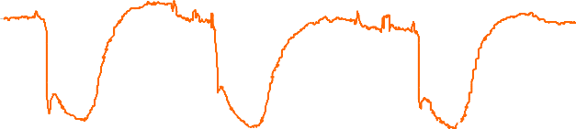
20
20
10
0
10
-10
Deflection, nm
0
-20
Deflection,nm
-10
-30
-20
-40
0
500
1000
1500
2000
Time, s
2500
3000
3500
4000
-30
Blank Mannose
Fructose
Galactose Glucose
Repeat within one MC, 10mM glucose, 60ml/hr
-40
20
10
0
-10
-20
-30
-50
Deflection, nm
0
500 1000 1500 2000 2500 3000 3500
Time, s
MCL deflection with exposure to glucose, mannose, fructose, and galactose at concentration of 10 mM.
0
200
400
600
Time, s
800
1000
1200

Slide 24
GOx
β − D − Glu cos e ⎯ ⎯→ GluconicAcid + H O
- 80 kcal/mol
2 2
E + G ⎯⎯^{k1} → GOx − G
ox
V =
C_{E} k₂
GOx − G ⎯⎯^{K2} → gluconicacid + E
k k
red
1 +
2
+
2
k₁[G] k₃ [O₂ ]
E + O ⎯⎯^{K3} → E + H O
red 2 ox
2 2

Slide 25
β − D − Glu cos e ⎯ ⎯→ GluconicAcid + H O
GOx
- 80 KJ / mol
2 2
The conversion rate of glucose in the thin multilayer film calculated above is corresponding to
8.85 x 10⁻¹² mol / min, and it would produce thermal output (dQ/dt) on the order of 7.2 x10⁻⁹ J/s.
At equilibrium or steady state, the temperature difference between the GOx/PEI multilayer covered surface and the surroundings is constant, i.e. the dT/dt = 0. From one-dimensional heat flow equation,
the heat flow can be given by:
dQ
= kA( ^{dT} ) + hA( ^{dT} )
x→o⁻ x−o⁺
dt dx dx
where k is the thermal conductivity of silicon (83.5 W/m K), A is the MCL surface area (8.51x10⁻³ mm²), h is the convection coefficient of water in these experimental conditions (1020 W/m²•K) that can be calculated from Nux, assuming the water is laminar flow (see supplemental materials).
Thus, solving the equation 9 revealed that the temperature difference between the GOx/gold surface and surrounding solutions (DT) was 7.7x10⁻⁴ K.
h[3(1 + m)² + (1 + mn)(m² +
1 ₎
mn
ΔT =
2D
Contribution from thermal change is negligible.
6(α − α )(1 + m)² L² + D ²
1 2
Calculation results show that thermal effect can cause only 7x10⁻³ nm deflection.

Slide 26


β − D − Glu cos e ⎯ ⎯→ GluconicAcid + H O
GOx
PEI
2 2
NH
2
40
20
Injection of a pH = 4.5 solution
Deflection, nm
0
-20
pH = 6.5 solution was circulated back
200 300 400 500
Time, s
-40
0
100
pH changes from 6.5 to 4.5
The pH change in the multilayer surface does not contribute significantly
to the MCL deflection

Slide 27
Glu cos e + E_{ox} → GluconicAcid + E_{red}
^{E}red
O₂ → E_{ox} + H ₂O₂
At equilibrium, the [H₂O₂] = 0.01 mM.
Control experiments showed that no bending was observed upon exposure of the MC to a 10 mM H₂O₂ solution.
Hydrogen peroxide has no contribution to the deflection of microcantilever.

Slide 28
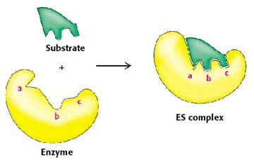
GOx
β − D − Glu cos e ⎯ ⎯→ GluconicAcid + H O
+ 80 kJ/mol
2 2
Induced fit: binding good substrate causes enzyme to fold to active conformation
E + G ⎯⎯^{k1} → GOx − G
ox
GOx − G ⎯⎯^{k2} → gluconicacid + E
red
E + O ⎯⎯^{k3} → E + H O
red 2 ox
2 2
V =
C_{E} k₂
1 +
k₂ k₂
+
k₁[G] k₃ [O₂ ]

Slide 29
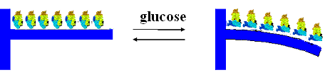
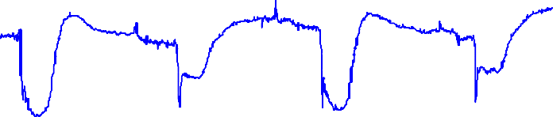
E_{OX} + Glu cos e → E_{RED} • Glu cos e
E_{RED} • Glu cos e → E_{RED} + GluconicAcid
E_{RED} + O₂ → E_{OX} • H ₂O₂
E_{OX} • H ₂O₂ → E_{OX} + H ₂O₂
Evidence 1
Evidence 2
10mM glucose without O2
L-glucose vs D-glucose
0
-10
-20
-30
-40
-50
-60
-10
-20
-30
-40
-50
-60
Deflection, nm
without O2
with O2
-70
-80
150
D-glucose
-70
-80
1850
650
1150
Time,s
1650
2150
2050
2250
2450
2650
Conclusion: GOx conformational change Is most likely the primary source for MCL deflection

Slide 30
Conformational change of the proteins is most likely the primary source of the nanomechanical bending.
The MCL technique offers unique opportunities in the design of small and cost- effective analytical methods for studying the conformational change of proteins and protein-ligand interaction under varying conditions of ionic strength or electrolyte identity. Advantages are reduces costs and fast throughput characteristics. (NIH SBIR/STTR)
It provides an alternative, label-free bioassay for drug screening applications. (NIH R01)
Biomolecular design to enhance the k₁ of the enzyme-analyte binding could be another approach to increase the sensitivity. (traditionally, increasing reaction rate was used to increase the sensitivity).
– OPH variants modified MCLs may provide a highly sensitive device in nerve agents monitoring. (NSF/DOD/EPA)

Slide 31
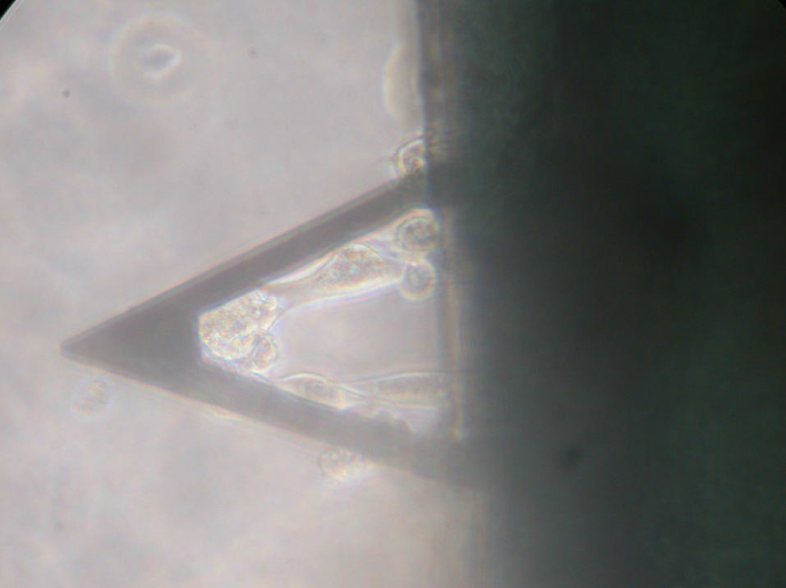
and cell based detection

Slide 32
Let Us Meet Again
We welcome you all to our future conferences of OMICS Group International
Please Visit:
www.omicsgroup.com
www.conferenceseries.com
www.pharmaceuticalconferences.com

