Slide 1
Anti-cancer telomerase vaccines: are they entering
the age of maturity?
Gilberto Filaci

Slide 2
Disclosure
GX301 rights are held by Mediolanum Farmaceutici SpA under
an agreement with Genovax srl.
Gilberto Filaci is a stockholder of Genovax and a consultant to
Mediolanum Farmaceutici .

Slide 3
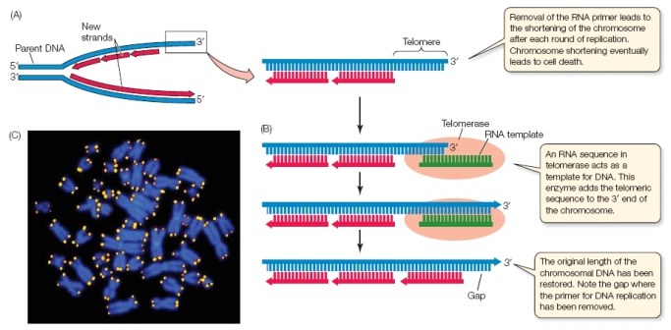
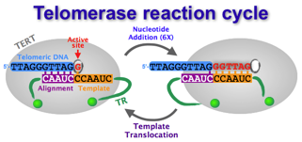
TELOMERASE

Slide 4
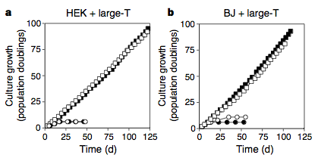
Telomerase is essential for tumor cell immortalization and survival
(Normal renal cells)
(Normal fibroblasts)

Slide 5
Telomerase-specific CTL can be generated from patients

Slide 6
Telomerase and the immunotherapy of cancer

Slide 7
Is telomerase immunogenic in vivo?
Immunogenicity: the ability of a substance to provoke an immune response
Miller-Keane Encyclopedia and Dictionary of Medicine, Nursing, and Allied Health, Seventh Edition. © 2003 by Saunders, an imprint of Elsevier, Inc.

Slide 8
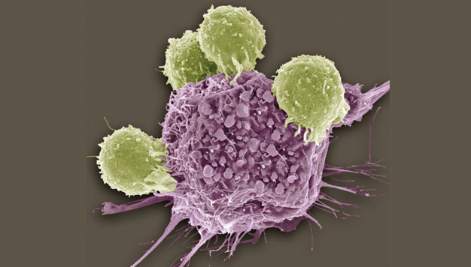
For a TAA immunogenicity can be defined as its ability
to provoke a protective immune response
Antigen expressed
by cancer cells
Presence of Ag-specific lymphocytes in
the immune cell repertoire of patients

Slide 9
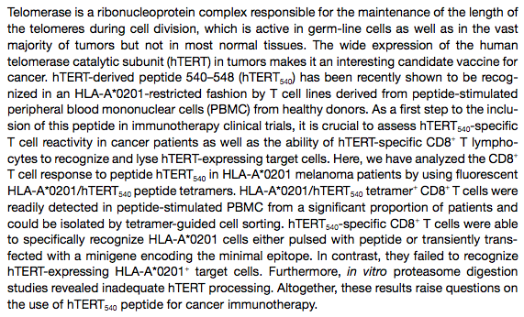
Is telomerase presented by cancer cells?

Slide 10
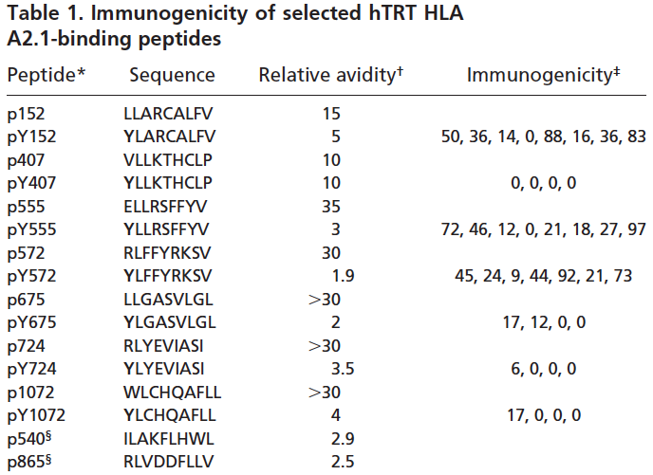
Is telomerase presented by cancer cells?

Slide 11
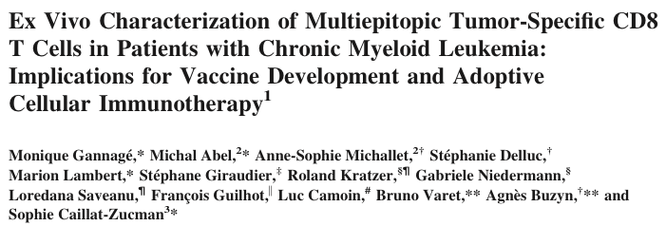
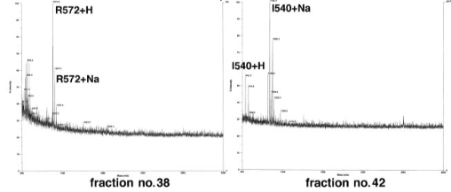
Is telomerase presented by cancer cells?
YES

Slide 12
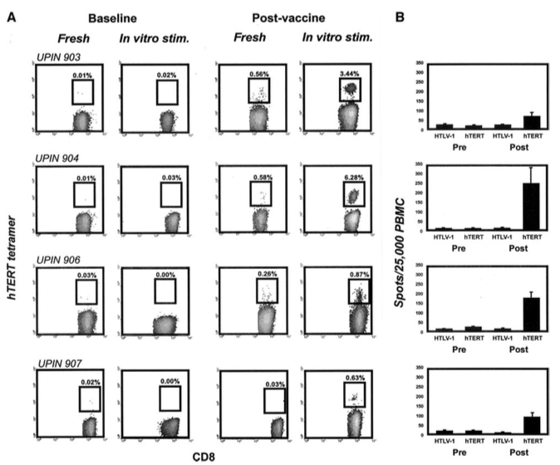
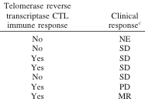
The first telomerase vaccine: p540 peptide loaded DC
Vonderheide RH et al.

Slide 13
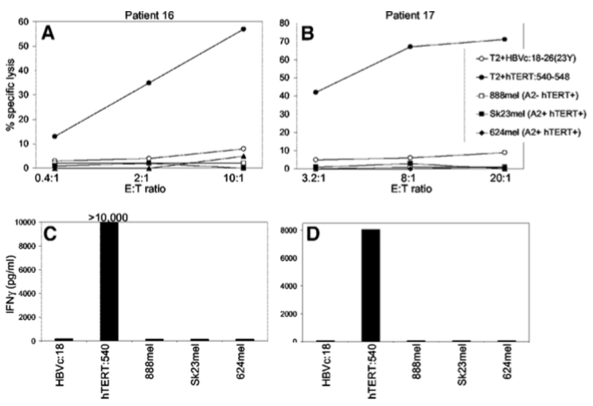
The issue: is telomerase immunogenic and protective in vivo?
p540 telomerase peptide
in incomplete Freund’s adjuvant

Slide 14
For a TAA immunogenicity can be defined as its ability
to provoke a protective immune response
Presence of Ag-specific lymphocytes in
the immune cell repertoire of patients
Antigen expressed
by cancer cells
Presence of Ag-specific lymphocytes in
the immune cell repertoire of patients

Slide 15
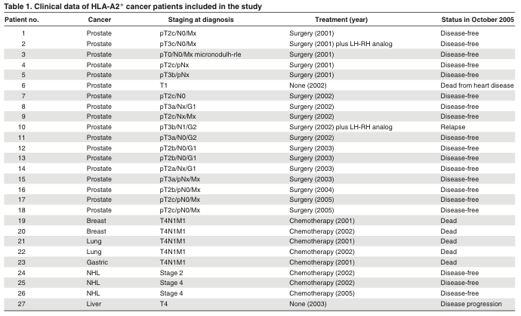
Are telomerase-specific lymphocytes represented in the T cell repertoire ?
The case of cancer patients
Filaci et al. Blood 2006; 107:1505-1512

Slide 16
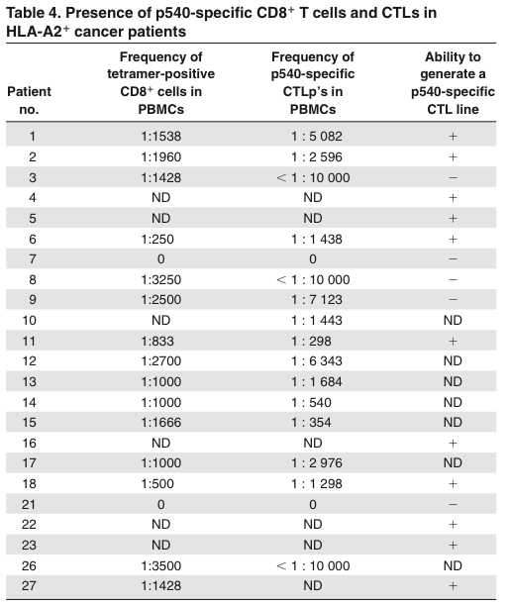
Are telomerase-specific lymphocytes represented in the T cell repertoire ?
The case of cancer patients
p540 peptide-specific CTL
In > 90% of patients
Filaci et al. Blood 2006; 107:1505-1512

Slide 17
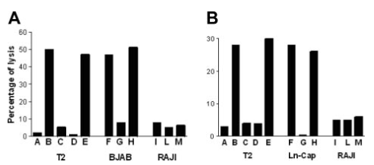
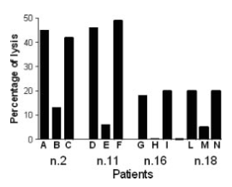
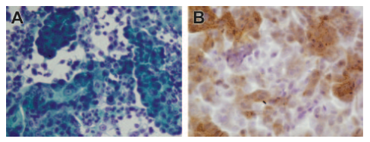
Are telomerase-specific lymphocytes represented in the T cell repertoire ?
The case of cancer patients
Filaci et al. Blood 2006; 107:1505-1512

Slide 18
Are telomerase-specific lymphocytes represented in the T cell repertoire ?
YES
in cancer patients
What about healthy subjects?

Slide 19
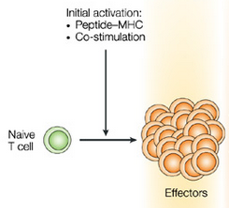
Are telomerase-specific lymphocytes represented in the T cell repertoire ?
The case of healthy subjects
Is a detectable telomerase-specific immune reactivity a consistent feature
among individuals or just a sporadic event?
Is it linked to a particular HLA haplotype?
Is it CD4+ or CD8+ T cell dependent?

Slide 20
Are telomerase-specific lymphocytes represented in the T cell repertoire ?
The case of healthy subjects
Hum Vaccin Immunother. 2015;11:838-50
Four telomerase peptides
p540-548 p611-626 p672-686 p766-780
(HLA-A2)
(HLA-DR)
(HLA-DP)
(HLA-DQ))
(HLA-DR1)
(HLA-DR7)
(HLA-DQR15)
(HLA-Class-I)
(HLA-DR4)
(HLA-DR7)
(HLA-DQR15)
(HLA-Class-I)

Slide 21
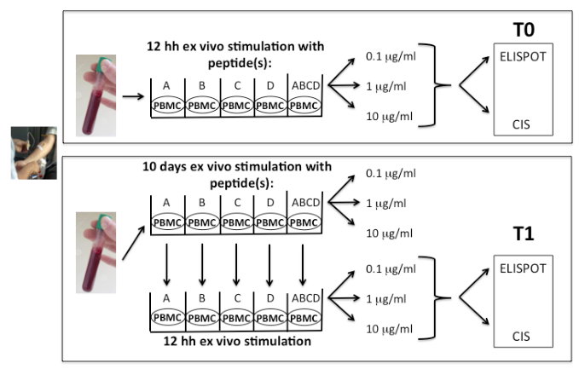
Are telomerase-specific lymphocytes represented in the T cell repertoire ?
The case of healthy subjects
21 healthy donors:
11 HLA-A2+
10 HLA-A2-

Slide 22
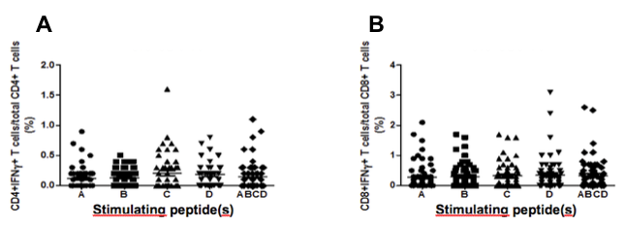
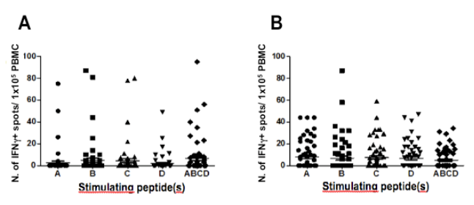
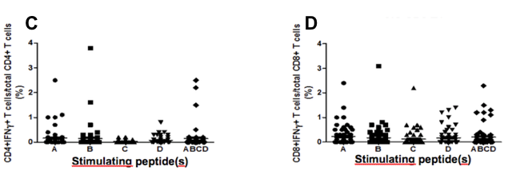
Are telomerase-specific lymphocytes represented in the T cell repertoire ?
The case of healthy subjects
YES
CIS: CD4+
ELISPOT
CIS: CD8+

Slide 23
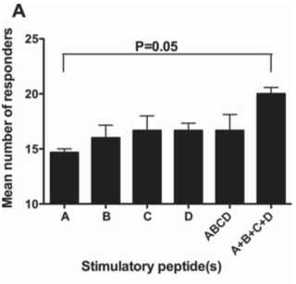
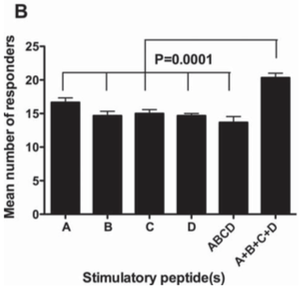
Do the selected peptides have different immunogenicity?
NO
(Measuring the responders…)
4 is better than 1
ELISPOT + CIS
T0 T1

Slide 24
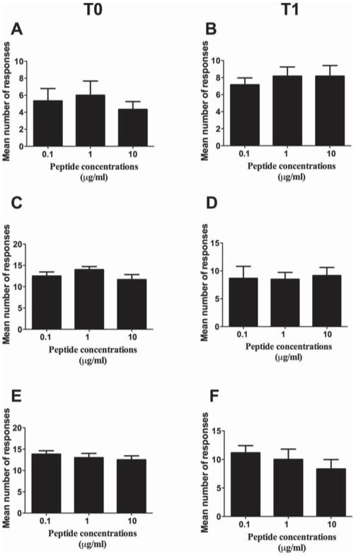
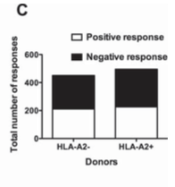
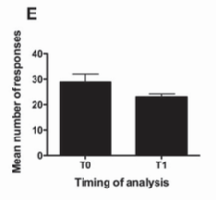
What about concentration, haplotype and timing of stimulation?
NO RELEVANCE
Concentration
Haplotype
Timing

Slide 25
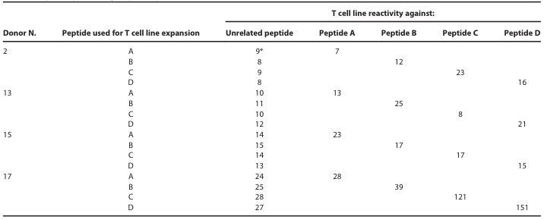
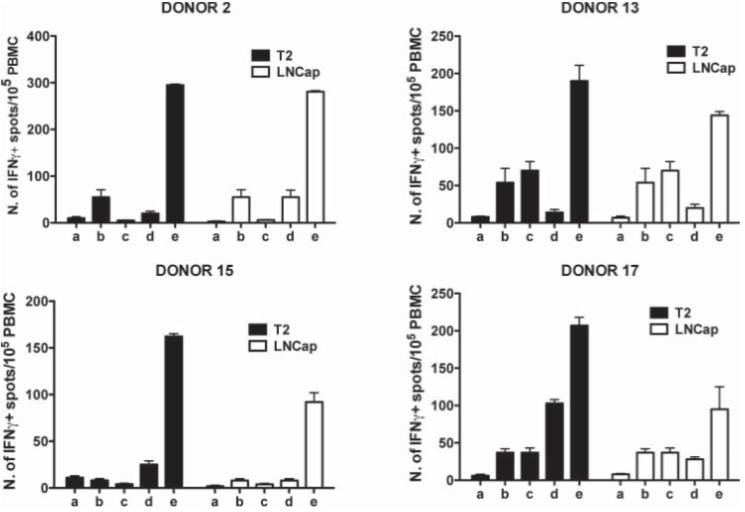
Are telomerase-specific T cells potentially protective?
Selection of telomerase-specific T cell lines
Reactivity against tumor cells

Slide 26
Summarizing
Telomerase-specific T cells are consistently present in the healthy
T cell repertoire
Both CD4+ and CD8+ T cells are involved in the reactivity against
telomerase
No need for particular HLA haplotypes due to the promiscuity of
several telomerase peptides
Telomerase-specific T cells efficiently recognize tumor cells

Slide 27
For a TAA immunogenicity can be defined as its ability
to provoke a protective immune response
Telomerase immunogenicity is
definitively proven
Antigen expressed
by cancer cells
Presence of Ag-specific lymphocytes in
the immune cell repertoire of patients

Slide 28
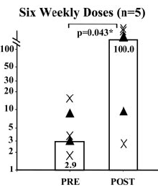
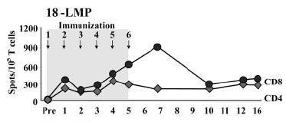
Is telomerase vaccination immunologically and clinically effective?
Metastatic prostate cancer
LAMP-TERT mRNA transfected DC i.d.

Slide 29
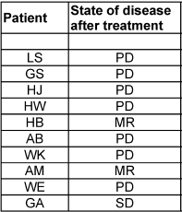
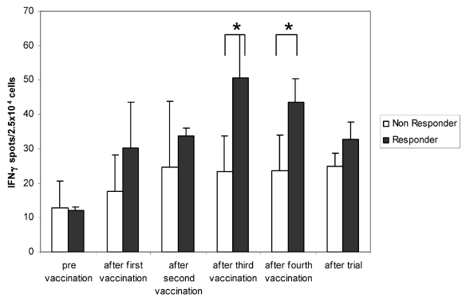
Is telomerase vaccination immunologically and clinically effective?
Metastatic renal cancer
Telomerase peptides loaded DC i.d.
plus intratumoral
Märten A, et al.

Slide 30
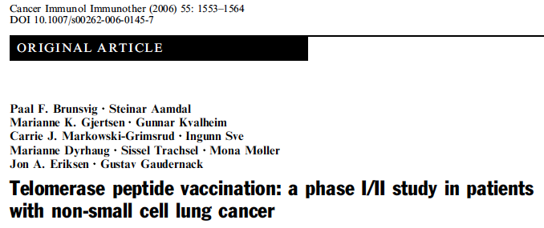
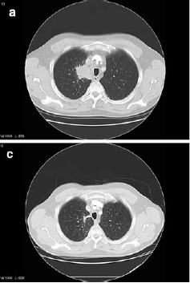
Is telomerase vaccination immunologically and clinically effective?
Metastatic NSCL cancer
Telomerase peptides: p611-626
(GV1001 vaccine) p540-548
Montanide + GMCSF
28% SD; 1 CR

Slide 31
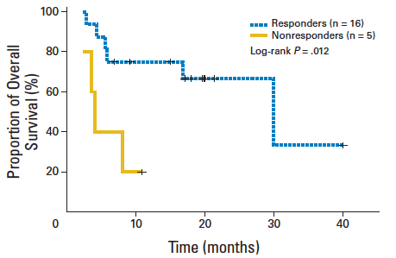
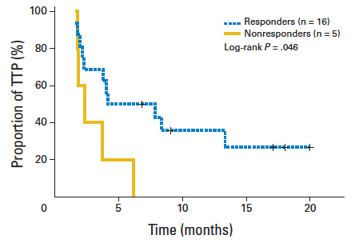
Is telomerase vaccination immunologically and clinically effective?
Advanced NSCL cancer
Telomerase peptide: optimized cryptic
(Vx-001 vaccine) TERT-572Y (572-580)
Y instead of R
Montanide

Slide 32
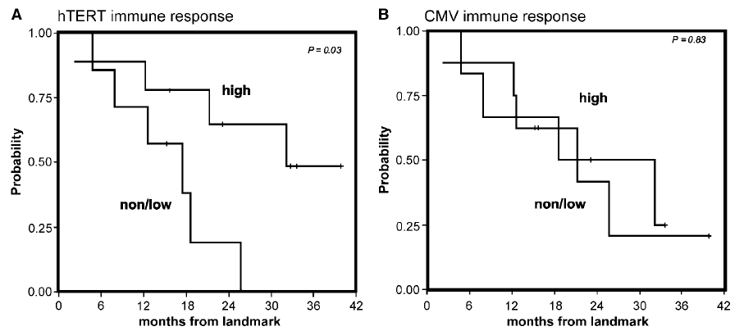
Is telomerase vaccination immunologically and clinically effective?
Metastatic breast cancer
Telomerase peptide: p540-548
Montanide + GMCSF
Overall survival
Overall survival

Slide 33
Is telomerase vaccination immunologically and clinically effective?
YES, BUT PARTIALLY
CLEAR CORRELATION BETWEEN IMMUNOLOGICAL AND CLINICAL RESPONSES.
HENCE THE NEW ISSUE IS:
How to increase the immunological response rate?

Slide 34
How to increase the immunological response rate?
HLA restriction: needs for widening HLA-haplotype coverage
Needs for activation of both CD4+ and CD8+ T cells
Needs for appropriate innate immunity activation
Use of multiple and promiscuous peptides
+
Dual and complementary adjuvants

Slide 35
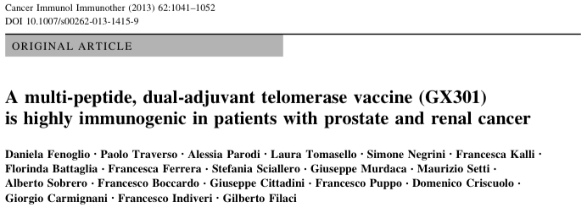
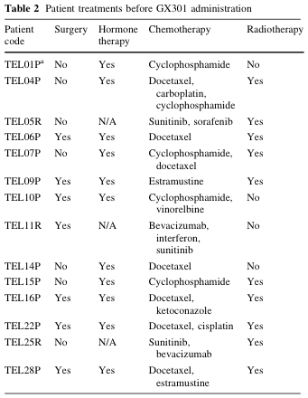
How to increase the immunological response rate?
Stage IV prostate or renal cancer
Telomerase peptides: p540-548
(GX301 vaccine) p611-626
p672-686
p766-780
Montanide + Imiquimod
No grade 3-4 side effects
No reticulocyte reduction
No B or T lymphocyte reduction
No autoimmunity

Slide 36
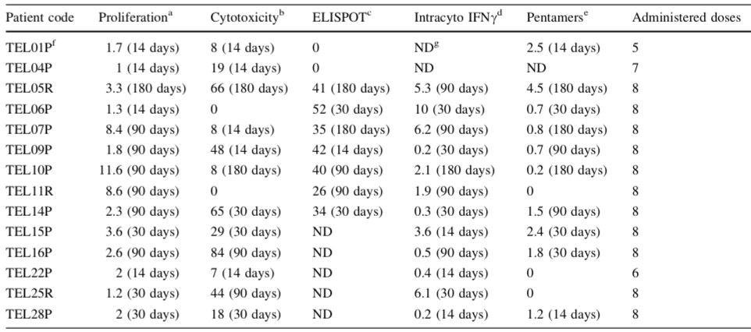
How to increase the immunological response rate?
OVERALL IMMUNOLOGICAL RESPONSE RATE = 100%

Slide 37
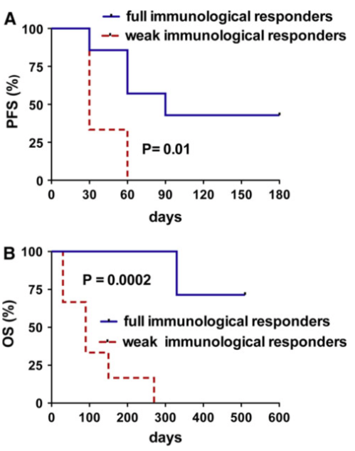
How to increase the immunological response rate?
OS (PROSTATE CANCER PATIENTS)
Our series= 14 months
Literature = 9 months

Slide 38
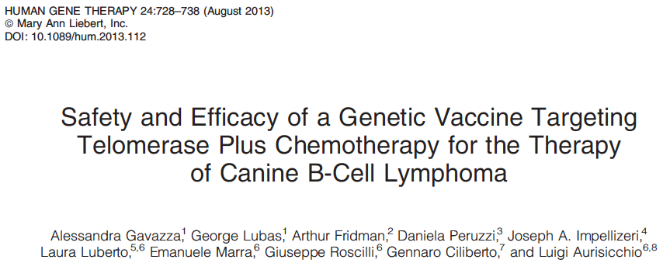
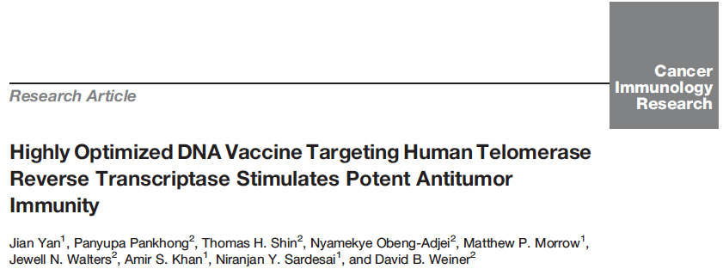
What’s next?
Combining telomerase and other TAA immunization
Combining telomerase vaccination with inhibition of immunosuppressive factors
DNA vaccines?
Combinatorial therapy with immune checkpoint inhibitors

Slide 39
Conclusions
Telomerase vaccines are fully immunogenic
Immune responses to telomerase are associated with clinical responses
Multiple peptide immunization is appropriate for increasing the rate of
immunological responses
Strategies for increasing the rate of clinical responses NEED to be
identified (combinatorial therapy?....)

Slide 40
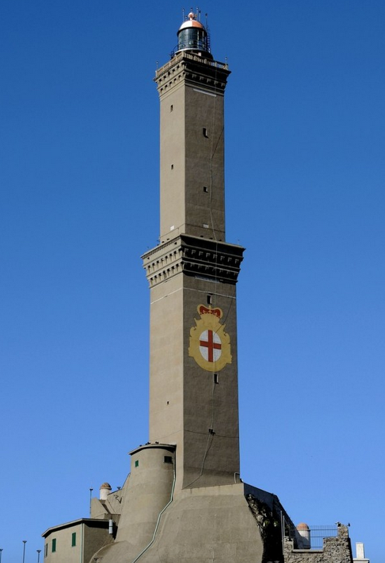
Many thanks to:
University of Genoa
Daniela Fenoglio
Alessia Parodi
Francesca Kalli
Giorgia Nasi
Monica Curto
Paolo Traverso
Giorgio Carmignani
Mediolanum Farmaceutici
Francesco Gianese
Giuseppina Lamperti
CEBR
Urology
Clinic

Slide 41
Thanks to everybody for… your patience

