Slide 1
Sparse-matrix analysis of small molecules and protein targets for drug discovery
Gerald J. Wyckoff, UMKC

Slide 2
What drives our research?
The pharmaceutical industry is facing spiraling drug development costs while R&D productivity remains stalled
  6 of the 10 highest-grossing branded products will or have lost patent exclusivity this year (2014)
  Reuters notes that the industry spent $65 billion on drug R&D in the U.S. in 2009, but approval rates have sunk 44% over the past 13 years
Drug Lead Generation
5 years
Drug Lead Optimization
3 years
Product Realization
4.5 years
Target
Identification
Target
Validation
Drug Lead
Identification
Assays &
In Vivo
Formal
Preclinical
PhI / IIa
PhII
PhIII
Registration
Fail Rate:
12%
Fail Rate:
28%
Fail Rate:
17%
Fail Rate
(combined):
18%
Fail Rate:
34%
Fail Rate:
22%
Fail Rate:
82%
Fail Rate:
~50%

Slide 3
Background
Importance of identifying valid targets and therapeutic compounds
Tools currently in use:
  Structure-based virtual screening
  Receptor-based virtual screening
  Other computational tools
Drawbacks to current implementation of high-throughput virtual screening:
  Computationally intensive
  Limited access due to high cost of infrastructure
  GCP/ICH compliance?
Solution:
  Virtual screening in the cloud
    Provides computational resources scalably and only when needed
  Sparse-Matrix Maps
    Don’t lose data after screening

Slide 4

Maslow’s Hammer

Slide 5
Solution
Treat Small Molecule Drug Discovery like a “Big Data” Problem
  Sparse matrix maps of clustered small molecules and phylogenetic representations of protein targets.
  Maps represent opportunities to find novel targets of existing drugs, and novel drugs for existing targets.
  Create representations of data already familiar to most pharmaceutical scientists
Rests on two existing technologies at Zorilla Research and in our lab:
  SABLE (Structural Alignment By Likelihood Estimation) integration to existing cloud-based suite of drug development tools
    Developed at UMKC
    Performs extremely detailed protein alignments
    Allows prediction of interactions, aiding both drug repurposing and off-target effect analysis
  Chemical Information Fingerprinting
    Developed by the PI in a previous STTR grant
    Gives a Bitwise score of three-dimensional information
    Allows for rapid cluster analysis of small molecules AND protein targets
  Clustering algorithms deployed in R

Slide 6
The Process
There are approximately 40,000 proteins and approximately 15 million distinct small molecules.
600,000,000,000 (600 Billion) combinations.
This is a big data problem.
  Gather all known interactions
  Cluster all small molecules (fingerprinting)
    Fingerprint generates a bitwise score- important for proper functioning of cluster tools.
  Cluster all proteins
    Known methods
  Map all interactions
Treat this exactly like other big data problems in biology.
Map interaction pathways on proteins, ADMET on small molecules
  Absorption, Distribution, Metabolism, Discretion and Toxicity
Record interaction strength/rank (from modeling/docking)

Slide 7
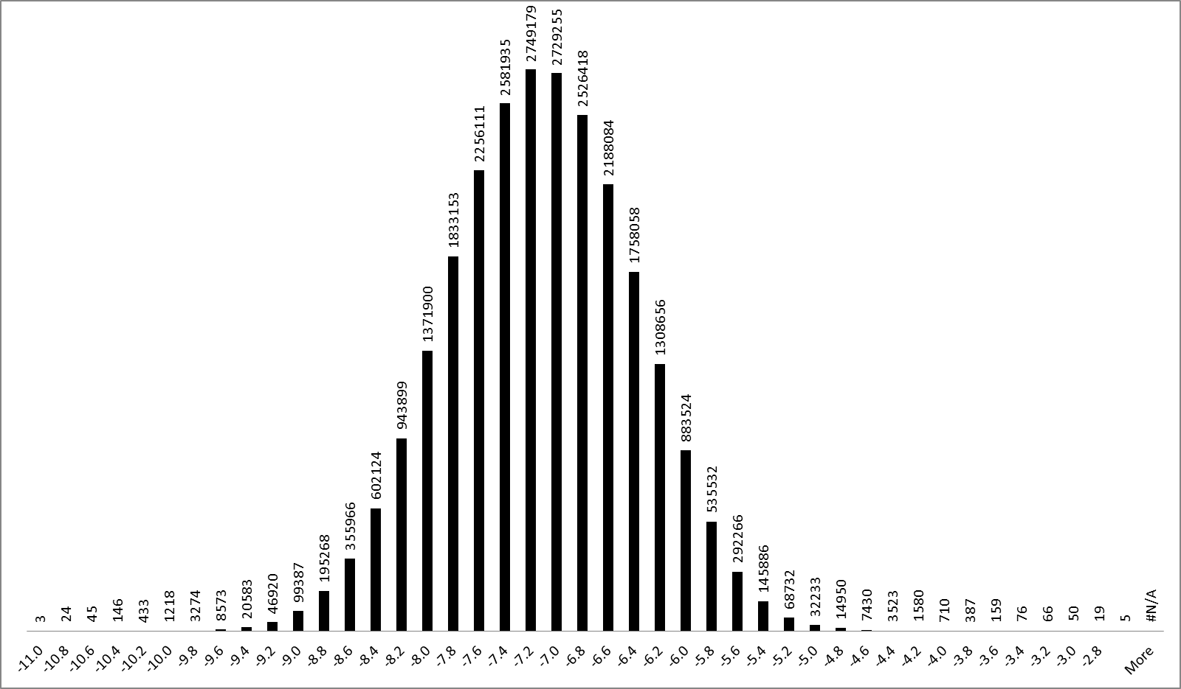
LOTS of distribution data
Total Values
25567735
AvgValue
-7.170062456
StDev
0.722973362
3 SD
-9.338982541
# at ≥3SD
34299
% at ≥3SD
0.134149544
4 SD
-10.0619559
# at ≥4SD
1869
% at ≥4SD
0.007309994

Slide 8
Problem with Data organization
For targets:
  How to build an appropriate distance measure
  May be three or four that would work appropriately
  Come up with a single distance measure
  This distance allows confidence in groups
For small molecules
  Same problems
  More acute:
    Not clear that chirality and such should be dealt with at all
    Different measures could mean radically different placement
  Ideally we handle this in a similar way to targets

Slide 9
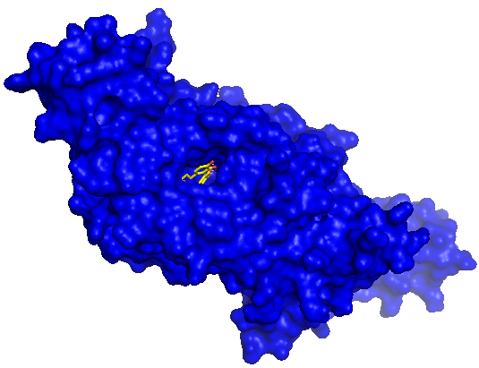
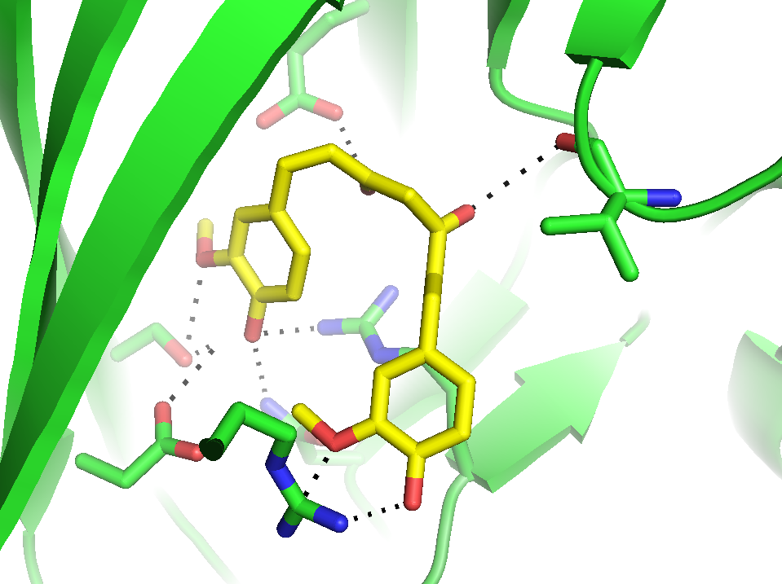
Organize the data
E383
 | 4LEJ
Pose | VINAValue | NNScore
1 | -9.2 | 527.32 | pM
2 | -9.1 | 1.26 | uM
3 | -8.5 | 2.33 | uM
4 | -8.2 | 146.81 | nM
5 | -7.7 | 3.86 | uM
6 | -7.4 | 1.71 | uM
7 | -7.3 | 317.74 | nM
8 | -7 | 260.64 | nM
9 | -6.8 | 256.9 | uM
V446
R405
S323
N318
Predicted to form 9 hydrogen bonds involving 7 different residues: Arg286, Asn318, Ser323, Glu383, Asp397, Arg405, Val446
D397
R286

Slide 10
Each row is an experiment
 | 1AIV | 1AVS | 1BLF | 1BR1 | 1BR2 | 1DS3 | 1F6R | 1F6S | 1FXZ | 1HLU | 1IC2d | 1IC2m
zinc_85881626 | -9.6 | -6.5 | -9.3 | -8.1 | -9 | -6.3 | -7 | -6.4 | -9 | -8 | -7.1 | -6.2
 | -9.5 | -6.5 | -9 | -7.9 | -8.7 | -6.2 | -6.9 | -6.4 | -9 | -7.4 | -6.8 | -6
 | -9.3 | -6.5 | -9 | -7.8 | -8.3 | -6.2 | -6.9 | -6.3 | -8.5 | -7.4 | -6.7 | -6
 | -9.2 | -6.3 | -8.7 | -7.5 | -8 | -6.2 | -6.9 | -6.2 | -8.4 | -7.3 | -6.6 | -6
 | -9.2 | -6.3 | -8.5 | -7.3 | -7.9 | -6 | -6.9 | -6.1 | -8.1 | -7.3 | -6.5 | -5.9
 | -9.1 | -6.2 | -8.5 | -7.3 | -7.8 | -6 | -6.9 | -6.1 | -8.1 | -7.2 | -6.5 | -5.9
 | -8.7 | -6.2 | -8.4 | -6.9 | -7.7 | -6 | -6.8 | -6.1 | -7.9 | -7.2 | -6.5 | -5.9
 | -8.5 | -6.1 | -8.4 | -6.9 | -7.7 | -5.9 | -6.8 | -6.1 | -7.8 | -7.2 | -6.5 | -5.9
 | -8.4 | -6 | -8.4 | -6.9 | -7.7 | -5.8 | -6.7 | -6 | -7.8 | -7.2 | -6.5 | -5.8
Sample of data for each ligand docked into the individual protein structures

Slide 11
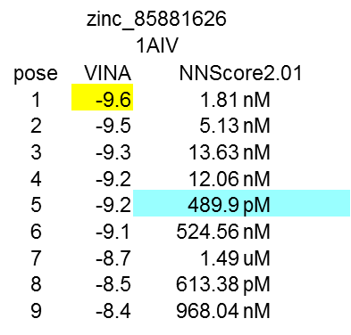
Rescoring
Not enough to use one view of the data
Rescore all data in order to assure best possible view of data
NNScore 2.0

Slide 12
SABLE
SABLE (Structural Alignment By Likelihood Estimation) integration to existing cloud-based suite of drug development tools
  Developed at UMKC
  Protected by a provisional patent
  Performs extremely detailed protein structure alignments
  Allows prediction of interactions, aiding both drug repurposing and off-target effect analysis
  Brings off-target and repurposing screens in silico
    Cost-savings to drug developers
    Applicable in early and late stages of development

Slide 13
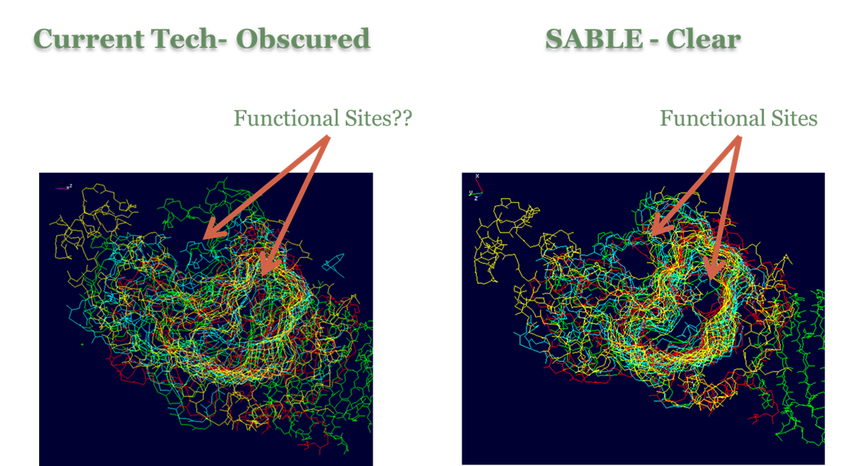
As can be seen above, the SABLE technology allows for a more complete and accurate alignment of proteins, leading to better visualization and modeling of functional sites that are the target of drug discovery.

Slide 14
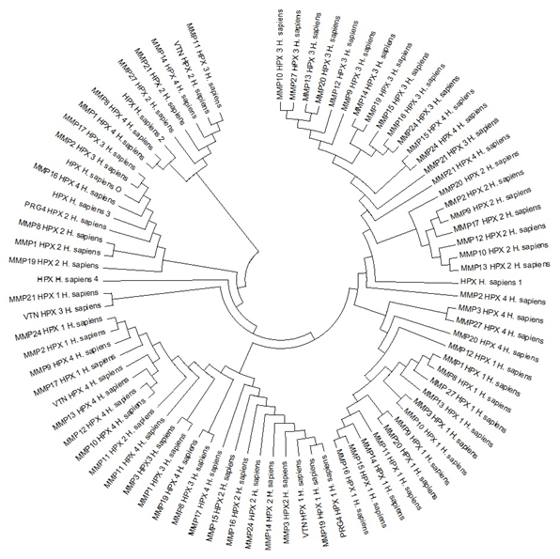
Large Phylogenies
Enabled by both amino acid and structural data
Organized data in target fields
No loss of data even when a target isn’t screened
Inference across data

Slide 15
Visualization of Clustered Data
Clustered Data sets
Small Molecules
Small molecule data is on the top (X-axis).
Protein data is at left (Y-axis).
Data has been clustered using hierarchical methods.
Red/Blue data is interaction/non-interaction data.
Clear patterns for testing potential drug/target pairs exist from this visualization.
Framework allows pathway and ADMET data incorporation early.
Protein Targets

Slide 16
Clustered data sets
Top level data
Smoothing function
Smooth combined data – across data we have versus data that is not available.
Build in smoothing function for all data
In Silico data
Experimental data
Literature data
Combined likelihood
Score - Bayseian

Slide 17
What next?
Find nodes within the sparse matrix.
Superposition proteins in a cluster downstream of a node.
  Use SABLE
  Map interaction domains using SCIPDB
Analyze superposition of alternative small molecules within the cluster.
Dock and model promising leads.
  Consider off-target effects, ADMET up front
    This is precisely where analysts have said the market needs to go
Send for bench screening of leads.
  Process cuts down on mass bench screening
  This is faster and cheaper than current processes

Slide 18
Future Goals
Build integrated suite of tools (including Zorilla applications)
Improve ancestral protein prediction in phylogenetic analysis
Answer fundamental evolutionary questions relating to structure/function

Slide 19
Acknowledgments
The Wyckoff Lab
  Lee Likins, Scott Foy, Ming Yang
Ada Solidar (B-tech Consulting)
HaRo Pharmaceuticals
Tomasz Skorski (Temple University)
The Miziorko Lab (UMKC)
  John VanNice
  Andrew Skaff
Jeff Murphy (Nickel City Software)
Brian Geisbrecht (K-State)
  And his lab
John Walker (SLU)
NIH 1 R41 GM 088922-01A1
NIH 2 R44 GM097902-02A1
NIH 1 R21 AI113552-01
VaSSA Informatics, LLC for major funding
Digital Sandbox KC
Missouri Technology Corporation
UMKC SBS, UMRB, UMKC FRG, KCALSI for additional funding
For Further Information, contact: wyckoffg@umkc.edu

