Slide 1
Advancement in Personalized Imaging
David Cheng, MD, PhD
Division Chief of Nuclear Medicine and Molecular Imaging
Sidra Medical and Research Center
Doha, Qatar

Slide 2
Disclosure
Avid Radiopharmaceuticals: consultant
Navidea Radiopharmaceuticals: consultant
Bayer Radiopharmaceuticals: consultant

Slide 3
Objectives of this talk
To understand the advantages and limitations of clinical radiotracer imaging
  Radiotracer principle limits mass to be <1% of normal physiologic conditions
    No pharmacologic effects should take place
    Requires high affinity radioligands (K_{d} in nmolars or lower)
  Novel technology such as CZT (for SPECT) and PET/MRI scanners
    Still being validated in attenuation correction and texture density representation
  Digital PET technology from Philips
    High sensitivity and resolution

Slide 4
Objectives of this talk (cont’d)
What are the steps necessary for advancement
  Development of new radioligands
    translation of histopathologic staining into non-invasive clinical imaging
    Validation with clinical outcome
      Take years, maybe decades (e.g. FDG, choline for prostate CA)
What else can we do?
  New clinical applications of known radiotracers
    Integrate old knowledge with new questions and challenges
Given the limited time, can only sample some of the not so mainstream pre- and clinical efforts

Slide 5
MRS Imaging in brain tumors
Common metabolites used as biomarkers:
  Reduced or absent: N-acetyl-aspartate (NAA) and total creatine (tCr) attributed to edema and necrosis
    Only significant independent predictor of active tumor growth is tCr
  increased: choline (Cho) reflecting cellular proliferation, altered phospholipid metabolism, and lactate due to metabolic acidosis
    Cho peak includes water soluble Cho compounds, including phosphocholine (PCho), glycerophosphocholine (GPC), and free choline
NAA in childhood tumors may reflect immature oligodendroglia

Slide 6
8 year-old male with right thalamic anaplastic astrocytoma using T2 weighted MR image
A Tzika Intern J Oncol 32:517-526, 2008

Slide 7
Breast specific γ-camera
33 women with surgically proven DCIS had mammography and ^{99m}Tc-tetrofosmin (740 MBq/20 mCi)
  CZT (cadmium zinc telluride semiconductor) detector
  Intrinsic spatial resolution = 1.6 mm
Scintigraphy sensitivity in low-intermediate-grade DCIS is 100% (n=9) vs 91.3% in intermediate-high grade (n=24, NS)
Scintigraphy demonstrated extent of disease better than mammography with microcalcifications (preoperatively)
Overall, sensitivity between scintigraphy and mammography was not statistically significant

Slide 8
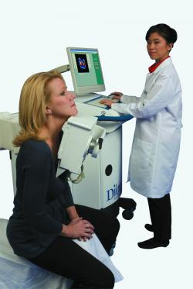
Breast specific γ-imaging (BSGI)
Imaging Technology News, May 15, 2013

Slide 9
75 year-old female with intermediate-grade papillary-type DCIS (8 mm) also seen on mammography (B)
A Spanu et al. JNM 53(10):1528-1533, 2012

Slide 10
52 year-old female with high-grade comedo-type DCIS as scattered microcalcifications
A Spanu et al. JNM 53(10):1528-1533, 2012

Slide 11
¹⁸F-Fluoromisonidazole imaging
¹⁸F-FMISO PET/CT imaging has been used to assess hypoxia (370 MBq/10 mCi)
  Hypoxia significantly reduces growth effects of E2 and the inhibitory effects of anti-estrogen receptors (Kurebayashi et al, Jpn J Cancer Res 92:1093-1101, 2001)
Hypoxia induced factor (HIF-1α) associated with resistance to treatment (Generali et al, Clin Cancer Res 12:4562-4568, 2006)
Pharmacokinetics of FMISO is poor and via diffusion with mean tumor-to-background ratios of 1.15 (SUVavg 1.85) at 2 hours and 1.22 (SUVavg 1.80) at 4 hours
  20 post-menopausal female patients with ER-α⁺ stage II-IV breast cancers (J Cheng et al, JNM 54:333-340, 2013)

Slide 12
65 year-old female with R-breast primary using 18F-FMISO pre and post 3 mo tx with Letrozol (JNM, 2013)
Pre
Post

Slide 13
58 year-old female with R-axillary LN using ¹⁸F-FMISO pre- and post 3 mo tx with Letrozol (JNM 2013)
Pre
Post

Slide 14
Prostate Specific Membrane Antigen (PSMA) imaging
¹¹¹In-Prostascint (Capromab) is a murine monoclonal anti-PSMA within cytoplasmic domain
  Pharmokinetics is slow with low tumor-to-background ratio
PSMA present in neovasculature of gastric and colorectal adenocarcinomas (Haffner et al, Human Path 40:1754-1761, 2009)
PSMA present in neovasculature of (clear cell) renal cell carcinoma (Baccala et al, Urology 70:385-390, 2007)
Humanized J591 (mAb) is directed against extracellular epitope of PSMA
  Usage limited by slow pharmacokinetics

Slide 15
PSMA imaging using diabody
J591C is bivalent homodimeric V_{H}-V_{L} domains with added cysteine at or near the C-terminus for stability
  Connected by 5-8 amino acid linker
  Intermediate size of 55kDa
  Relatively rapid circulation, tissue penetration and systemic clearance
^{99m}Tc is directly chelated by tricarbonyl moiety (His)₆-tag

Slide 16
^{99m}Tc-J591Cdia Imaging
Serial imaging with DU145-PSMA tumor
PSMA-negative DU145 tumor
PSMA-positive DU145 tumor plus 20X cold competition
Time-activity curves
Kampmeier et al, EJNMMI Res 4:13, 2014

Slide 17
Metformin as adjunct therapy
Metformin (MET) is an adenosine monophosphate-activated protein kinase (AMPK) activator
  commonly used in the treatment of diabetes
  can improve progression-free survival of patients with multiple cancers
AMPK may have opposite effects on glucose uptake versus proliferation
Habibollahi et al, JNM 54:252-258, 2013)

Slide 18
¹⁸F-FDG versus ¹⁸F-FLT effects of Metformin
FDG = 2-deoxy-2-¹⁸F-fluoro-D-glucose
FLT = 3’-deoxy-3’-¹⁸F-fluorothymidine
Habibollahi et al, JNM 54:252-258, 2013

Slide 19
Post islet cell transplant imaging
Post islet transplant patients can achieve insulin independent glycemic control in type 1 diabetes
  only 10% is sustained over 5 years
Glucagon-like peptide 1 (GLP-1) is an incretin peptide released from the intestine in response to nutrient ingestion
  augments glucose-induced insulin secretion from pancreatic β-cells
  receptor-bound GLP-1 (GLP-1R) localizes to pancreatic duct cells and expressed only in β-cells
Exendin-4 shows similar biologic properties as human GLP-1
  Shares 53% sequence identity with greater stability

Slide 20
¹⁸F-TTCO-exendin-4 imaging post-intraportal islet cell transplantation
Wu et al, JNM 54:244-251, 2013

Slide 21
Summary
It is an exciting time to integrate and translate scientific knowledge into clinical practice
  Understand basic principles in order to differentiate promising efforts from confusing flawed data
  New technology and radiotracers need time for validation
    Need wide participation in these efforts to avoid biases from selected groups
  Cost in research and development is a big factor
    Choose judiciously of the project you wish to invest your time
    Frequent exchanges between colleagues can be invaluable

Slide 22
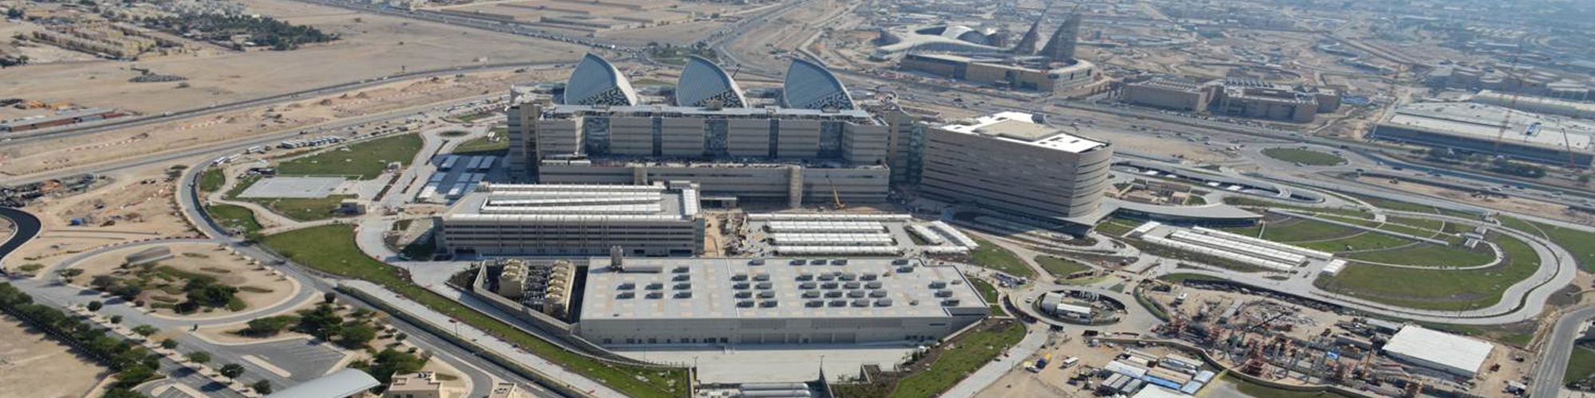
Sidra Medical and Research Center

Slide 23
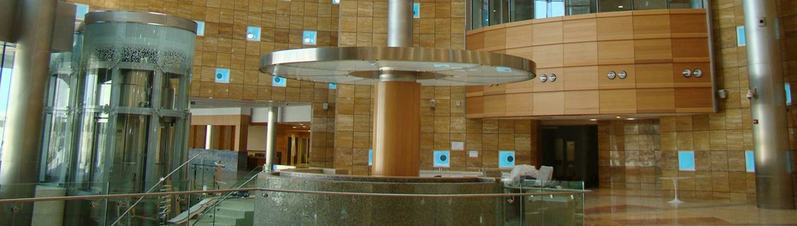
Entrance - Lobby

Slide 24
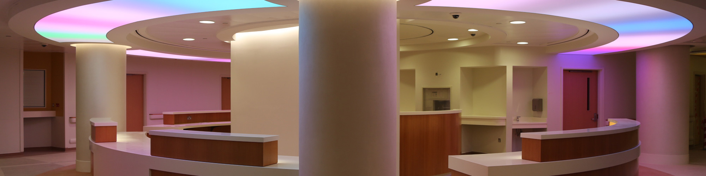
Nursing Station

Slide 25
Thank you

