Slide 1
Baseline genetics and fenofibrate response in the ACCORD clinical trial
Daniel Rotroff PhD, MSPH
Postdoctoral Research Fellow, Bioinformatics Research Center, North Carolina State University
September 18, 2015

Slide 2
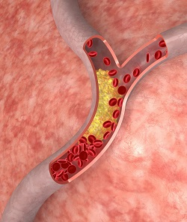
Background on Dyslipidemia
~31.7% of adults in the U.S. have high LDL, and less than ½ are receiving cholesterol treatment.
Individuals with high cholesterol are at ~2x risk for heart disease.
People with type 2 diabetes are 2-3x more likely to develop cardiovascular disease, placing individuals with high cholesterol and type 2 diabetes at especially high risk.

Slide 3
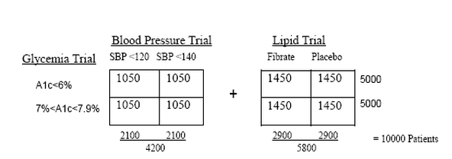
Rationale for the Action to Control Cardiovascular Risk in Diabetes (ACCORD) Clinical Trial
“The purpose of this study is to prevent major cardiovascular events (heart attack, stroke, or cardiovascular death) in adults with type 2 diabetes mellitus using intensive glycemic control, intensive blood pressure control, and multiple lipid management.”
-https://clinicaltrials.gov/ct2/show/study/NCT00000620
All individuals enrolled have type 2 diabetes.
Conclusion was that these treatments do not reduce cardiovascular events over standard treatments--one trial arm actually increased mortality.
However, variability in response was observed.

Slide 4
Our goals with the ACCORD data
Start with baseline genetic mapping of lipid phenotypes
Characterize background etiology of dyslipidemia in individuals with type II diabetes
Refine rare-variant methods
Interrogate drug response associations for major trial drugs
Fenofibrate
Rosiglitazone
Metformin
Sulfonylurea
Statin
Insulin
Collaborators: Alessandro Doria’s group at Joslin Diabetes Center and Harvard Medical School are investigating genetic associations with adverse cardiovascular outcomes

Slide 5
Genotyping Array and Study Design
Genotyped using the Affymetrix Axiom Biobank Genotyping Array-exome chip.
This platform became available on November 1, 2012 and this project was one of the first to use the array.
The array contains several marker sets:
The GWA markers were selected to maximize genome-wide coverage of imputed variants in European, Asian, African and Latino populations
~250k genome-wide association (GWA) markers,
~250k exome markers focusing on rare variants,
~70k novel loss-of-function markers,
~20k eQTLs and
~2k pharmacogenomic markers.

Slide 6
Genotyping Array and Study Design
New platform-significant efforts to create a sound QC pipeline
Duplicate samples and HapMap samples were included on each plate
Considerations were made for:
Hardy-Weinberg equilibrium
Genomic inflation
Sample/probe concordance
Plate effects
Predicted vs Recorded Gender
Autosomal heterozygosity
Cryptic relatedness
Population stratification
Others…
583,613 variants after QC (from 628,679 total).
89,212 of these were monomorphic
Imputed using 1000 genomes reference panel
26,862,499 imputed variants after QC (71.7% of total imputed variants)

Slide 7
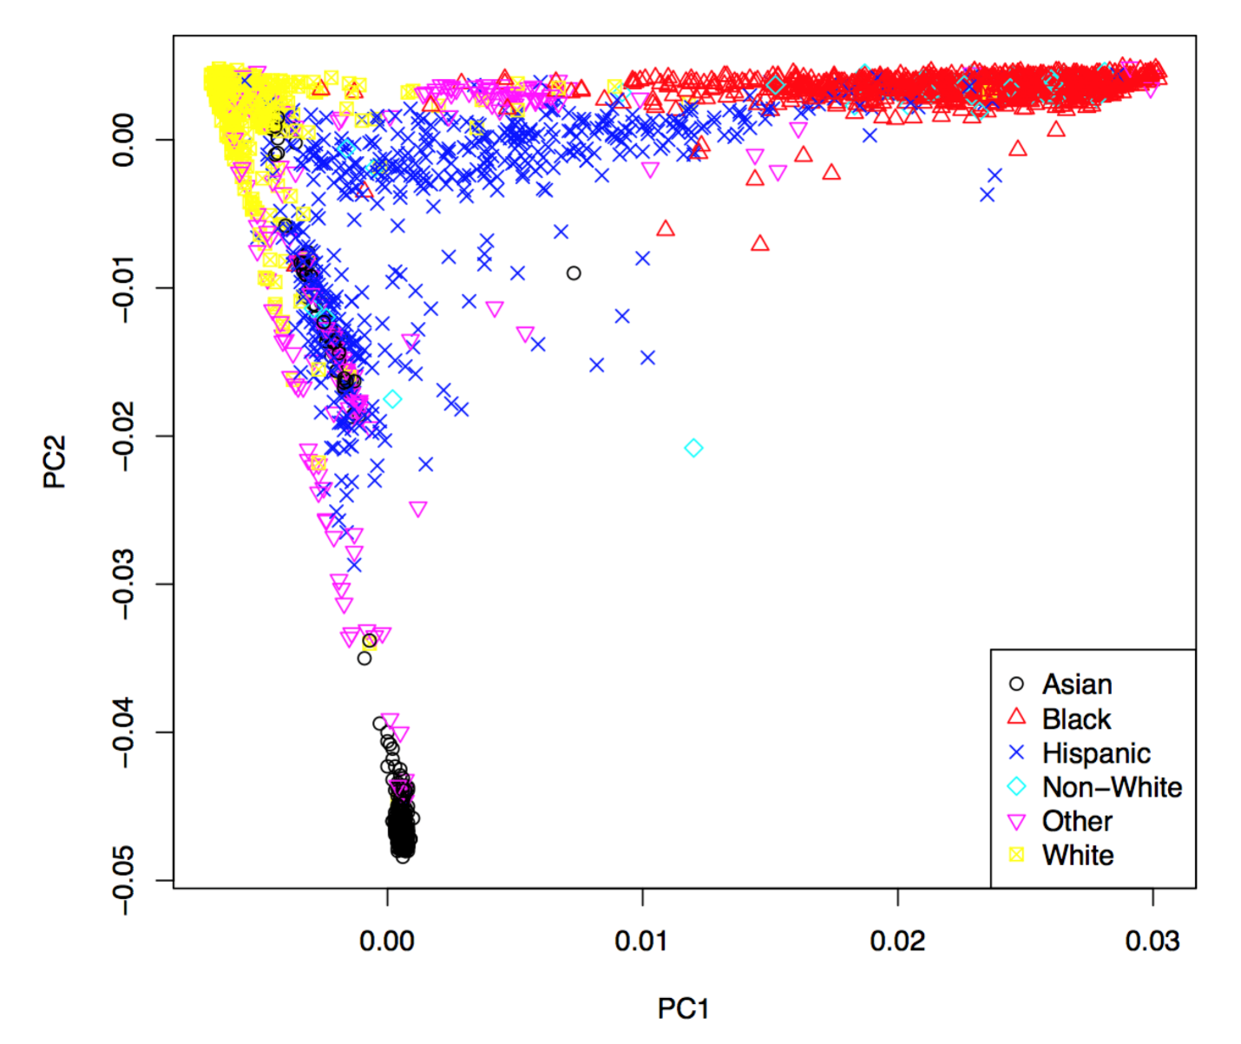
Genotyping Array and Study Design
Population stratification across the ACCORD Trial (n=7929)

Slide 8
Genetic Associations with Baseline Lipids
Common Variant Analysis (MAF ≥ 3%) and n=7929
292,816 genotyped and 7,812,348 imputed variants had MAF ≥ 3%
Phenotypes: HDL, LDL, Total Cholesterol, Triglycerides
Study parameters and covariates were incorporated into the model via expert opinion and backwards selection

Slide 9
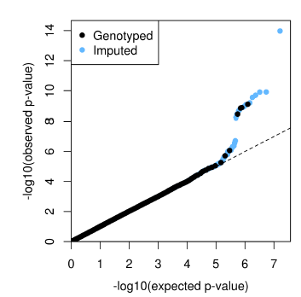
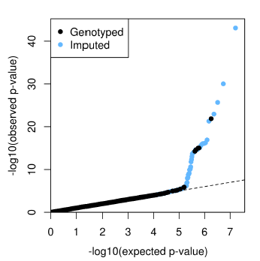
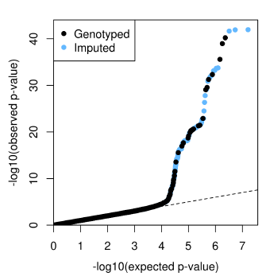
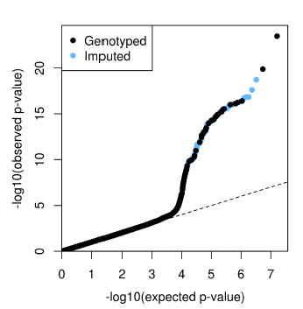
Genetic Associations with Baseline Lipids
Total Cholesterol
LDL
HDL
Triglycerides

Slide 10
Genetic Associations with Baseline Lipids
Total Cholesterol
LDL

Slide 11
Genetic Associations with Baseline Lipids
HDL
Triglycerides

Slide 12
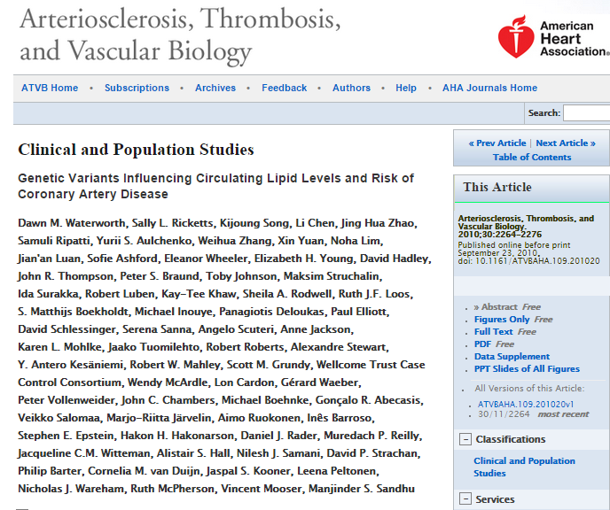
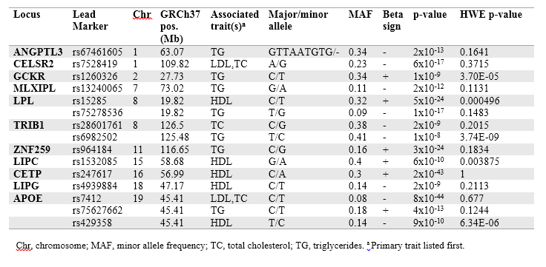
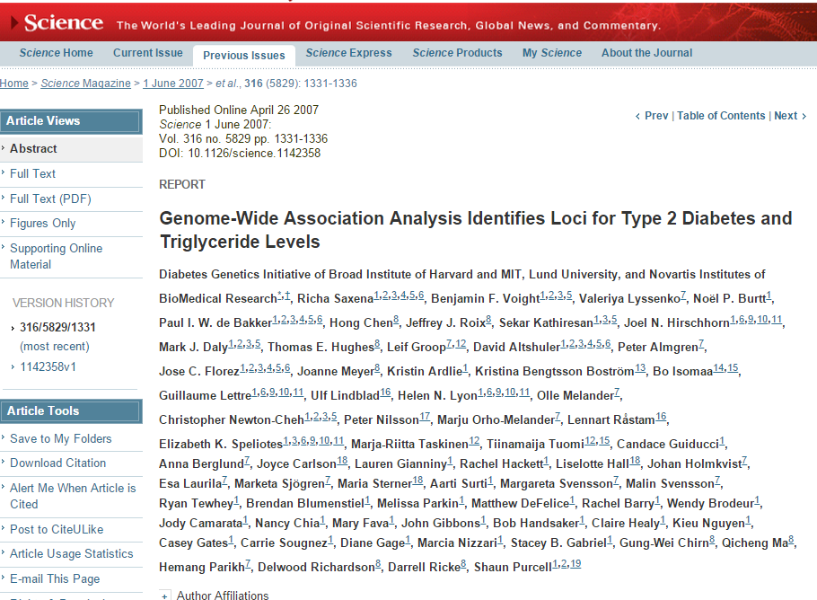
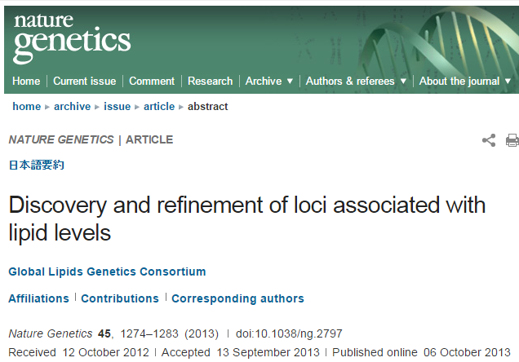
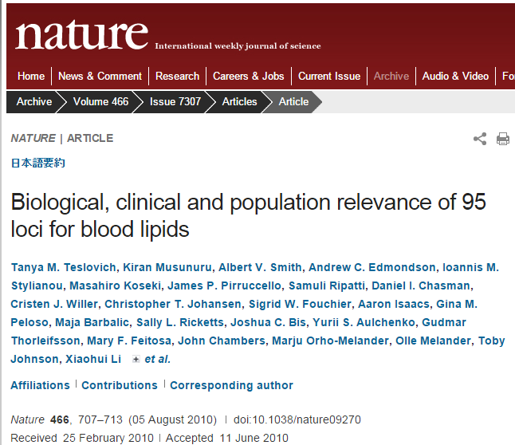
Common Genetic Associations with Baseline Lipids

Slide 13
Genetic Associations with Baseline Lipids
Rare Variant Analysis (MAF $<$ 3%) and n=7929
We used a suite of 5 commonly used methods
All methods rely on collapsing of SNPs into genes
16,480 genes that contained >1 SNP with MAF < 3%
146,689 genotyped and 73,295 imputed SNPs were included (median 9 SNPs/gene)
5 tests were combined using a correlated Lancaster approach*
Methods were then adjusted for multiple comparisons using an FDR approach
*Hongying Dai, J., and Yuehua Cui. "A modified generalized Fisher method for combining probabilities from dependent tests." Frontiers in genetics 5 (2014).

Slide 14
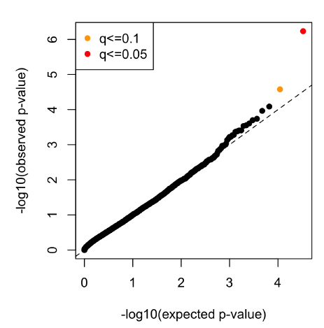
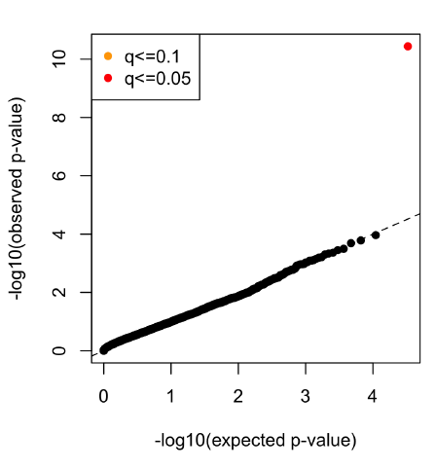
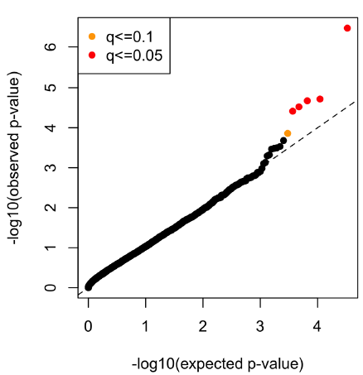
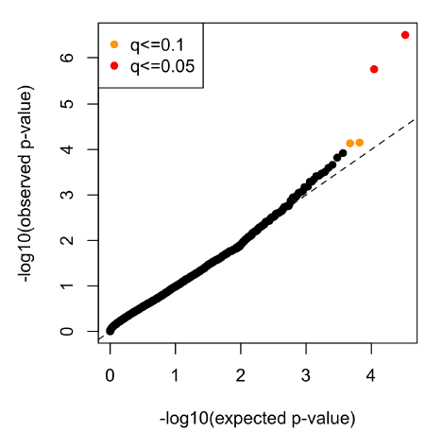
Rare Genetic Associations with Baseline Lipids
Total Cholesterol
LDL
HDL
Triglycerides

Slide 15
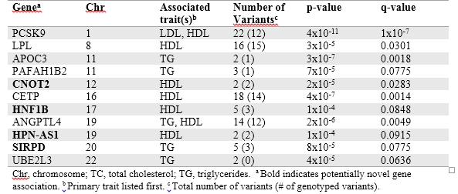
Rare Genetic Associations with Baseline Lipids

Slide 16
Baseline Common and Rare Variant Conclusions
Most statistically significant SNPs are in genes previously identified in large meta-analyses
Indicates that the QC and analysis pipeline for this exome chip are working as expected
Suggests that the underlying genetic factors contributing to dyslipidemia are similar in patients with type 2 diabetes
Next Steps
Patients in ACCORD were prescribed many different diabetes, blood pressure, and cholesterol lowering drugs
We can modify the analysis pipeline used for the baseline analysis to interrogate variants associated with drug response
Fenofibrate was the first drug chosen
due to the ACCORD lipid arm trial design

Slide 17
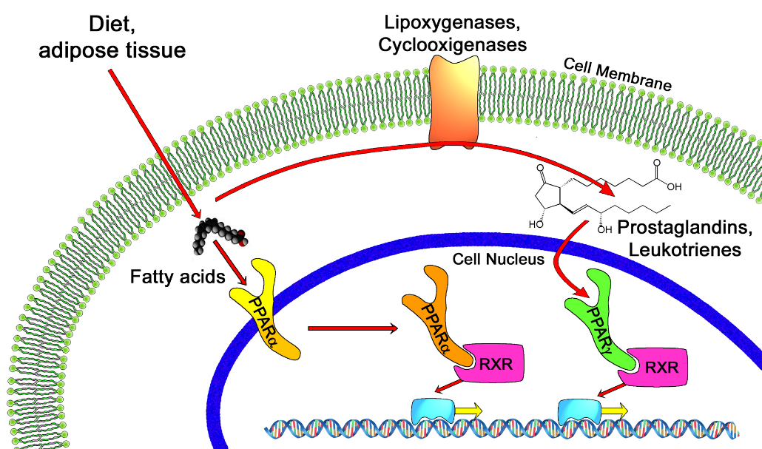
Background on Fibrates
Used to treat high cholesterol (↑HDL, ↓LDL), usually in combination with statins.
Use of fibrates alone has been shown to reduce the number of non-fatal myocardial infarctions, but not all-cause mortality.
Have also been shown to reduce insulin resistance for individuals with type 2 diabetes.
Activates PPARα, which regulates lipid metabolism in the liver.

Slide 18
Study Design
All individuals were on statin and started fibrate at the beginning of the trial
Must maintain fibrate compliance for 90 (+/- 10) consecutive days
Phenotypes: HDL, LDL, Triglycerides, Cholesterol
Concomitant medications were a major challenge, with over 71 different drugs accounted for in the trial (with a varying degree of detailed records)
Created the following scoring metric:
0
Not on medication during the time-frame
1
On medication prior to pre-treatment time point, dropped medication prior to post-treatment time point
2
Started medication at or after pre-treatment time point, but dropped prior to post-treatment time point
3
Started medication at or after pre-treatment time point and complied through post-treatment time point
4
On medication prior to pre-treatment time point and complied to post-treatment time point

Slide 19
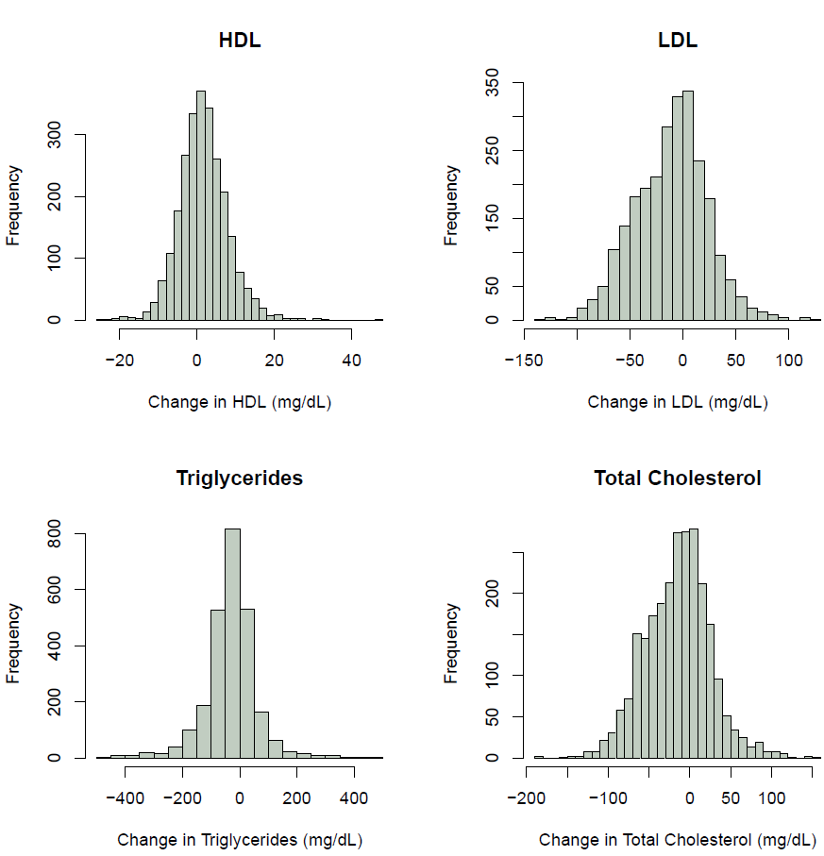
Variation in Fibrate Response

Slide 20
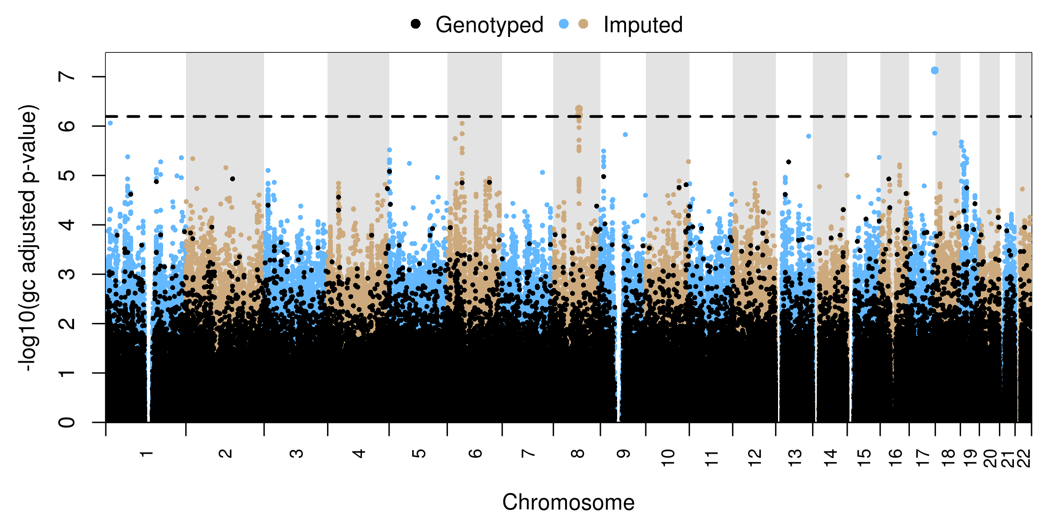
Fibrate Common Variant Analysis
LDL All Races Combined (n=1261)
MRPL2
PRRX1
SLC25A10
LDLR
GMIP, ATP13A1, SNF101,ZNF101
SYN2
PTPRD
OSTF1,NMRK1
LOC102724939
FCRL5
FGF14
LHFP

Slide 21
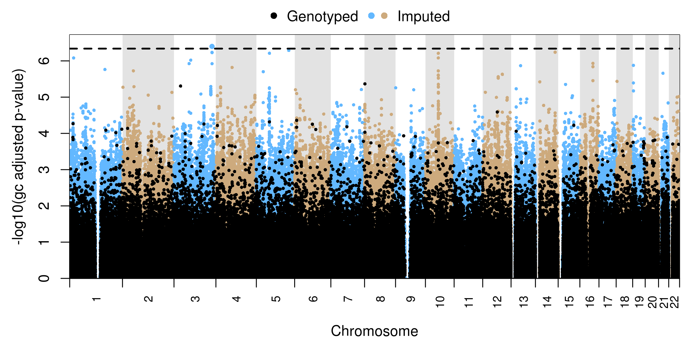
Fibrate Common Variant Analysis
LDL Only Black Subjects (n=137)
IPO11, IPO11-LRRC70
BICC1, LOC102724768, FAM13C
NLGN1, PEX5L
LOC102724716, DLGAP1
IGSF21
NRXN1
GPR75-ASB3, ERLEC1
SORCS2
RIN3
SMAD3
NFIC
MYT1L
ROBO1
CLN8
TTC5
GRIA1
ARHGEF5
FRMD3
FOXP1
OFCC1

Slide 22
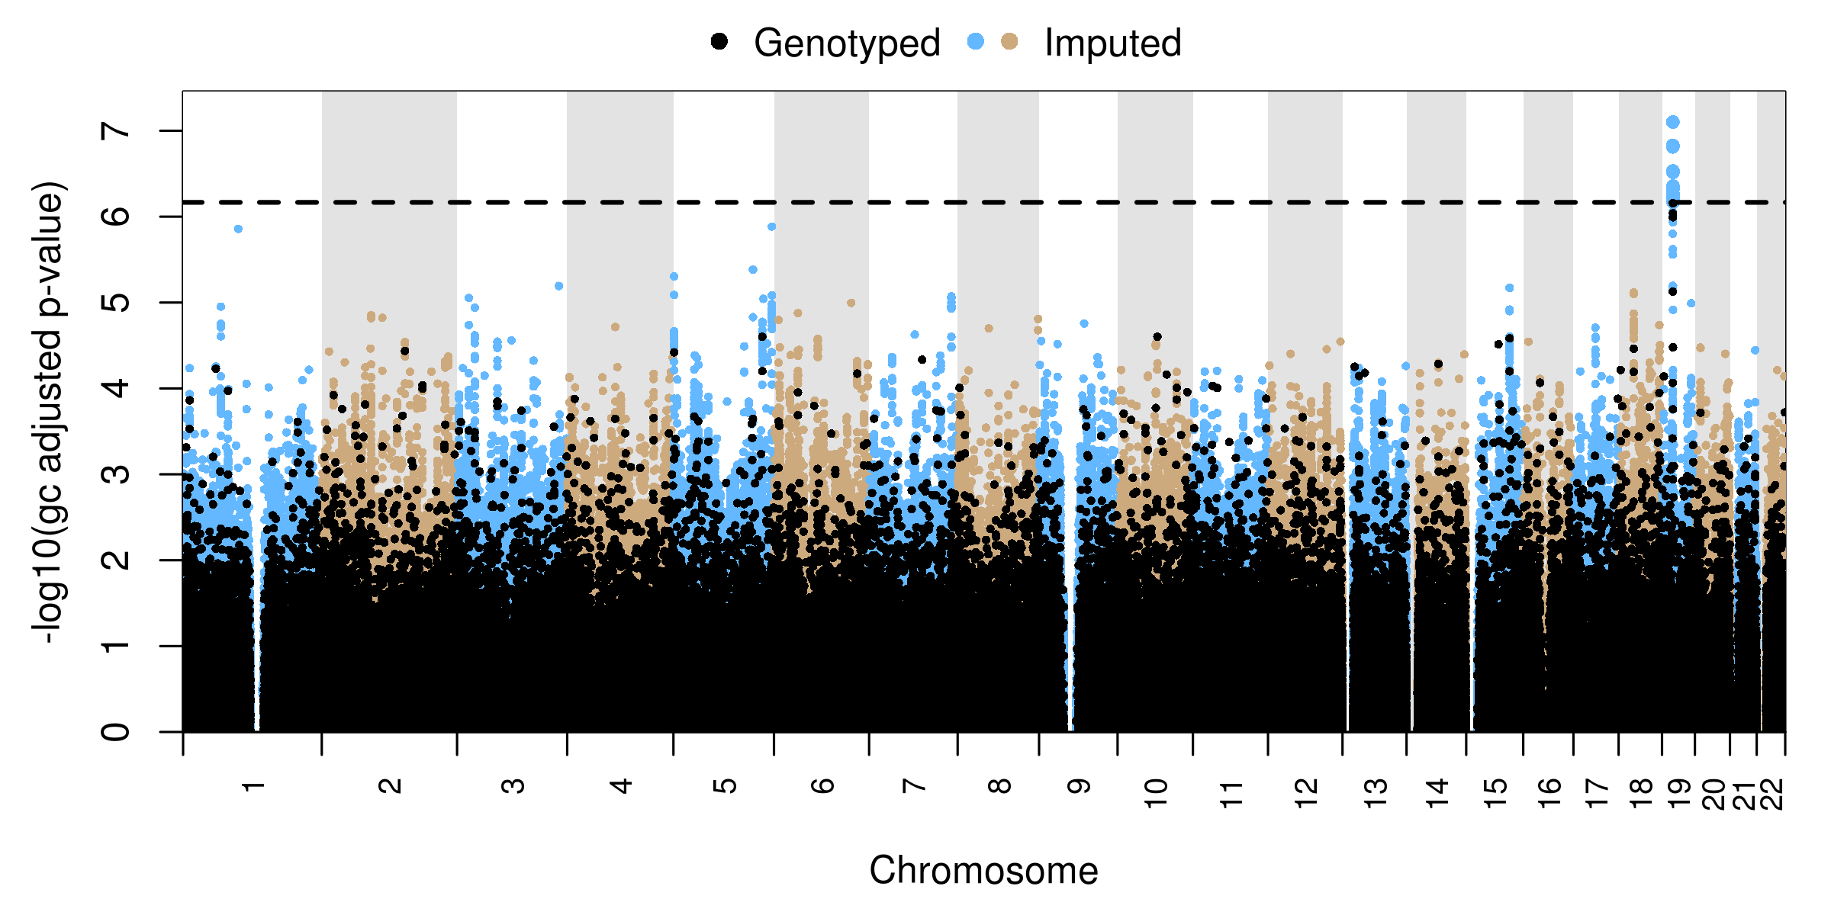
Fibrate Common Variant Analysis
LDL Only White Subjects (n=779)
MAU2, GATAD2A, PBX4, GMIP, ATP13A1

Slide 23
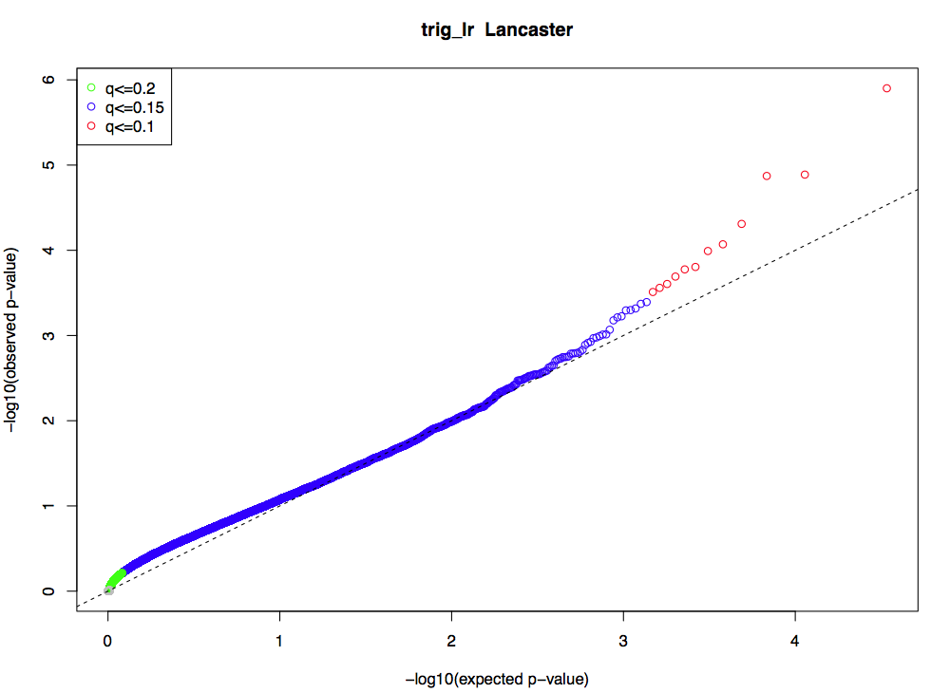
Rare Variant Analysis
Triglycerides All Races Combined (n=1261)
23
TMEM210
DCUN1D4
DUSP3
HES2
RAB27B
LOC101928772
EVA1C
NHLRC1
LOC101927763
MICU1
IDE
CREG2
CDH6

Slide 24
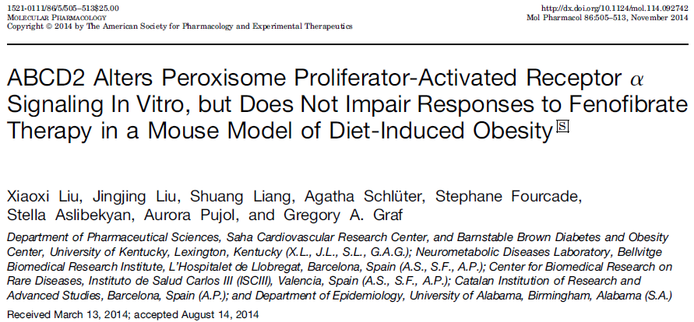
Functional Validation
Tested for significant changes in gene expression in mice treated with fenofibrate for 14 days vs vehicle.
Tested overlapping common variants (p < 1x10⁻⁶) and rare variants (q< .05).

Slide 25
Functional Validation
Analysis | Entrez | ID | Gene Symbol | GeneName | log₂(fold change) | P value | Q value
Common Variant | 17127 | s24166 | Smad3 | SMAD family member 3 (Mothers against decapentaplegic homolog 3) | -2.23132 | 0.002884 | 0.10383
Rare Variant | 100737 | s13991 | Dcun1d4 | DCN1, defective in cullin neddylation 1, domain containing 4 (S. cerevisiae) | 1.468273 | 0.013352 | 0.191611
Common Variant | 170759 | s02971 | Atp13a1 | ATPase type 13A1 | -1.5789 | 0.015968 | 0.191611
Common Variant | 76582 | s20442 | Ipo11 | importin 11 | -1.8763 | 0.02241 | 0.201693
Rare Variant | 80718 | s01094 | Rab27b | RAB27b, member RAS oncogene family | -1.36406 | 0.033066 | 0.238072

Slide 26
SMAD3
Receptor-regulated SMAD that is an intracellular signal transducer and transcriptional modulator activated by TGF-beta (transforming growth factor) and activin type 1 receptor kinases. Binds the TRE element in the promoter region of many genes that are regulated by TGF-beta and, on formation of the SMAD3/SMAD4 complex, activates transcription.
http://www.uniprot.org/uniprot/P84022
Smad3-KO mice had lower plasma free fatty acid and glycerol, reduced adiposity.
Was shown to alter regulation PPARγ and PPARβ.

Slide 27
SMAD3
PPARα inhibits TGF-β
TGF-β has been shown to regulate Smad 2, 3, and 4 transcription factors
These pathways are clearly convoluted and have not yet been fully elucidated.
There does appear to be the potential for an indirect interaction between fenofibrate and SMAD3.
Downstream activity from PPARα may be altered due to rare variants in the SMAD3 gene, but much more work is needed to draw conclusions.

Slide 28
Next Steps
Additional validation in mice fed high-fat diets
Collaborating with other lipid consortiums to investigate meta-analysis of RV
Additional functional follow-up will probably be necessary (e.g. knockouts, forced expression)
We are also exploring many other drugs related to diabetes and dyslipidemia.

Slide 29
Acknowledgments
North Carolina State University
Alison Motsinger-Reif
Skylar Marvel
Chris Smith
Hillary Graham
UNC-Chapel Hill
Michael Wagner
John Buse
Tammy Havener
Santica Marcovina
University of Virginia
Josyf Mychaleckyi
Moffitt Cancer Center
Howard McLeod
University of Kentucky-Lexington
Greg Graf
Sonja Pijut
Xiaoxi Liu
Jingjing Liu
Shuang Liang
Harvard School of Public Health
Peter Kraft
Bellvitge Biomedical Research Institute, Barcelona, Spain
Agatha Schlüter
Stephane Fourcade
Aurora Pujol
University of Alabama-Birmingham
Stella Aslibekyan
Joslin Diabetes Center and Harvard Medical School
Alessandro Doria
Hetal Shah
He Gao
Jan Skupien
Mario-Luca Morieri
Christine Mendonca
The ACCORD/ACCORDION Investigators
Funding: This research was supported by an NHLBI grant to the University of North Carolina at Chapel Hill (5R01HL110380-04).

Slide 30
Questions
?
daniel.rotroff@ncsu.edu

Slide 32
Genetic Associations with Baseline Lipids
The following covariates were forced into the linear model:
Trial arm
Age
Biguanide
Cardiovascular disease
Fibrate use
Gender
Insulin
PC-1-3
Statin
Years diabetes
Others…
The following covariates were selected into the linear model:
Systolic blood pressure
HbA1c
GFR
Smoking
Others…

Slide 33
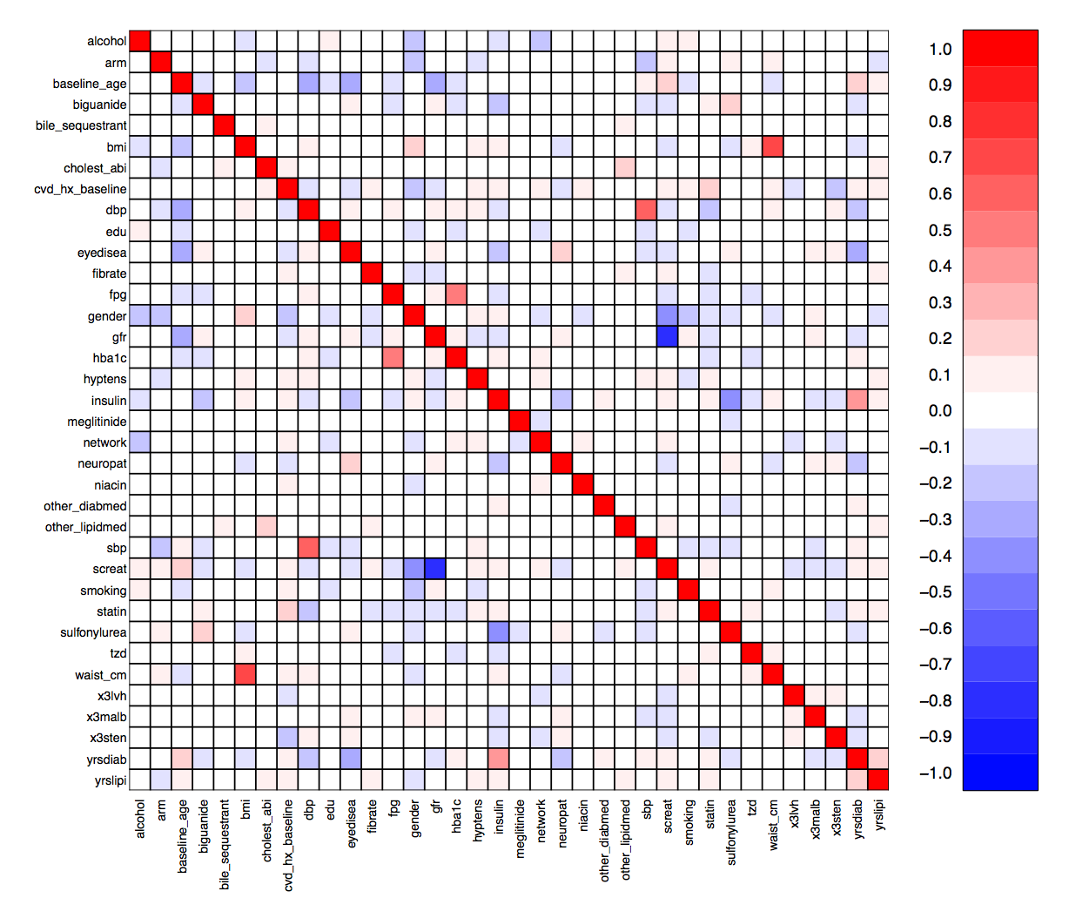
Genetic Associations with Baseline Lipids
Covariate correlation matrix. Screat, dbp and waist_cm were removed from the lists of covariates due to correlations with gfr, sbp and bmi, respectively.

Slide 34
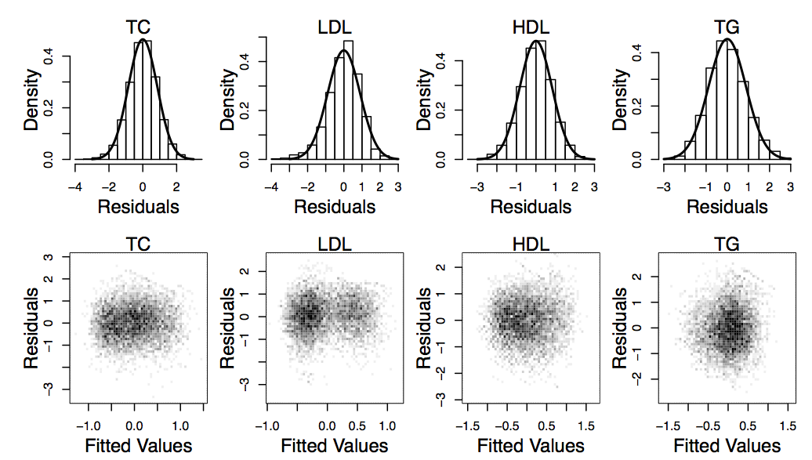
Genetic Associations with Baseline Lipids
Residuals from linear regressions of the phenotypes against the pruned covariates.

Slide 35
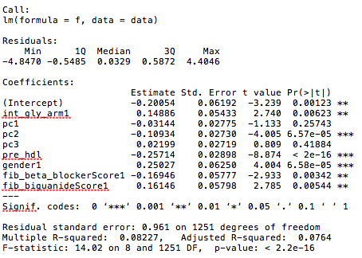
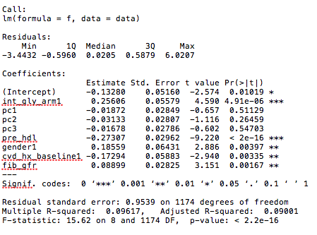
Fibrate-HDL
N=1261
Fibrate
Placebo
N=1183

Slide 36
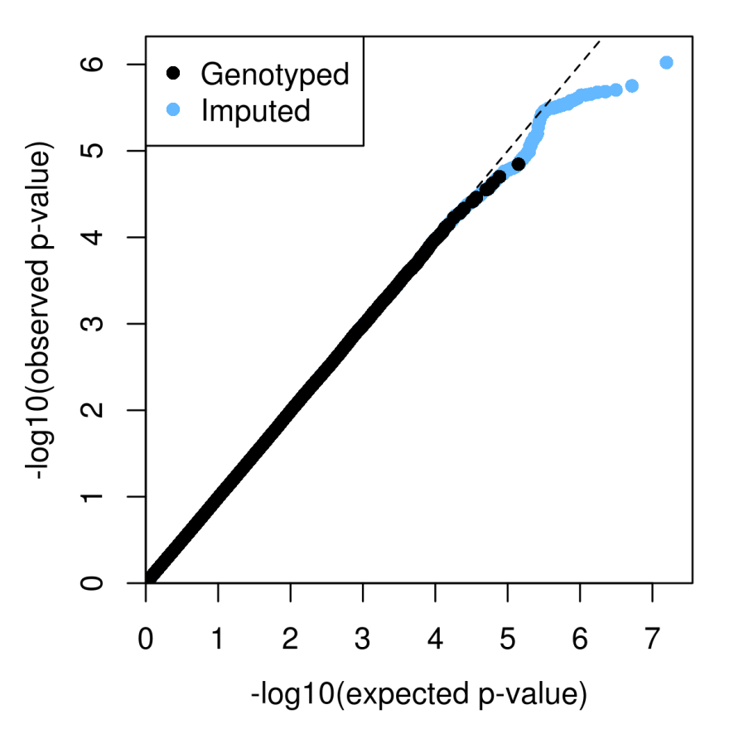
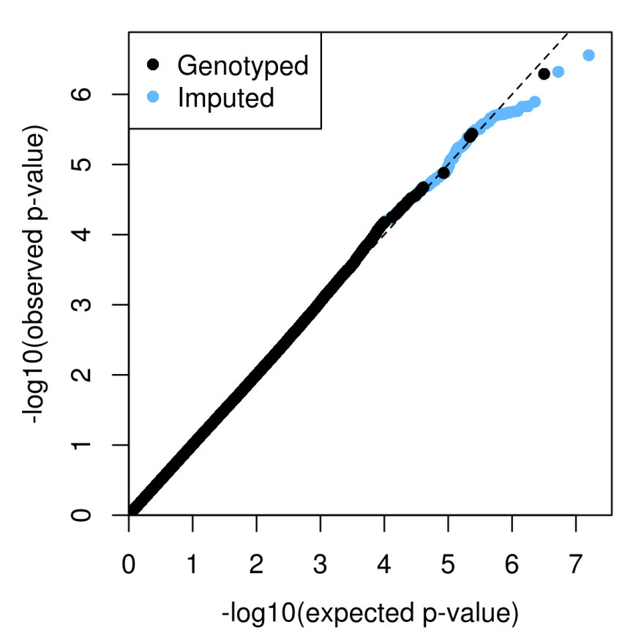
Fibrate-HDL
Fibrate
Placebo
N=1261
N=1183

Slide 37
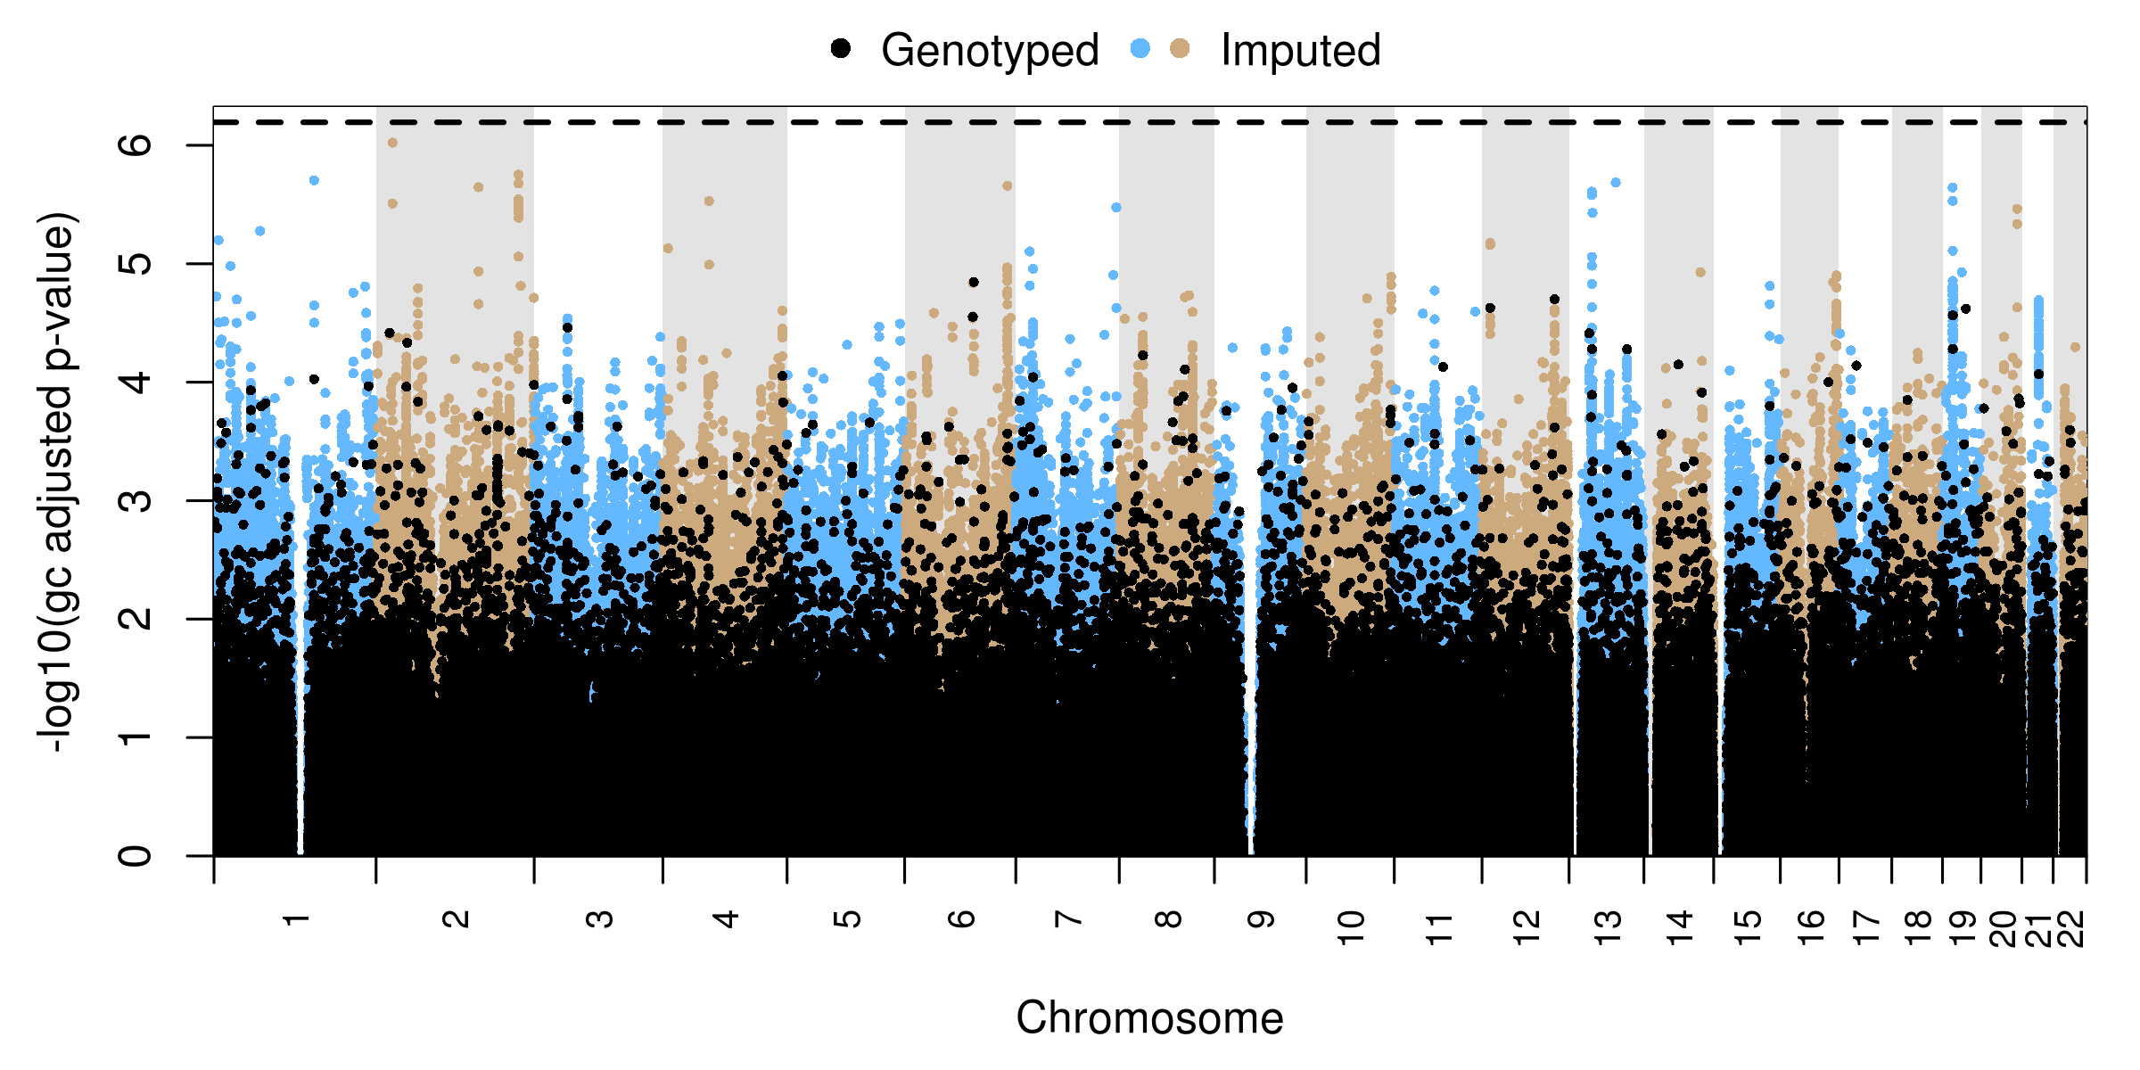
Fibrate-HDL
N=1261
LOC101928059, DENND4B
LOH12CR1, LOH12CR2
LINC00457
CAMTA1
ARPC2, LOC101928487
DPP6
CSN1S2AP
NBEA
CYP4F22
AFAP1
ZDHHC14
CYP4F12

Slide 38
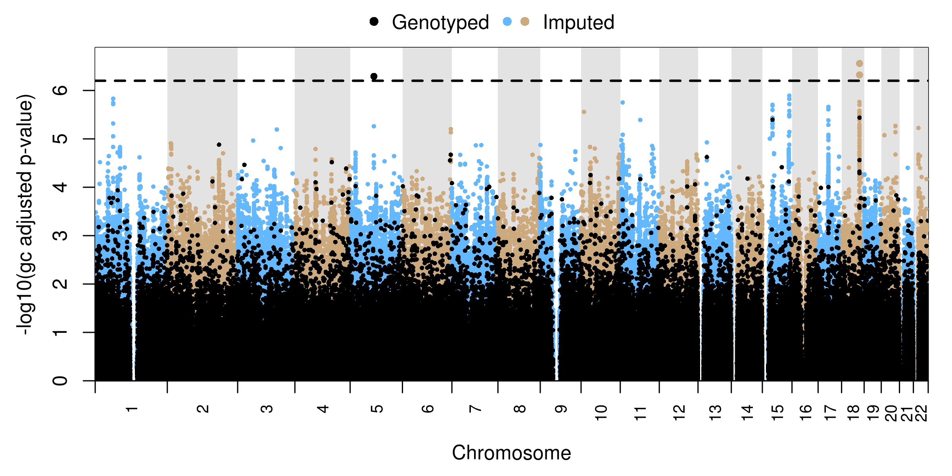
Placebo-HDL
N=1183
LOC284294
STK33
SV2B
ACACA
AQR
RPS6KA2

Slide 39
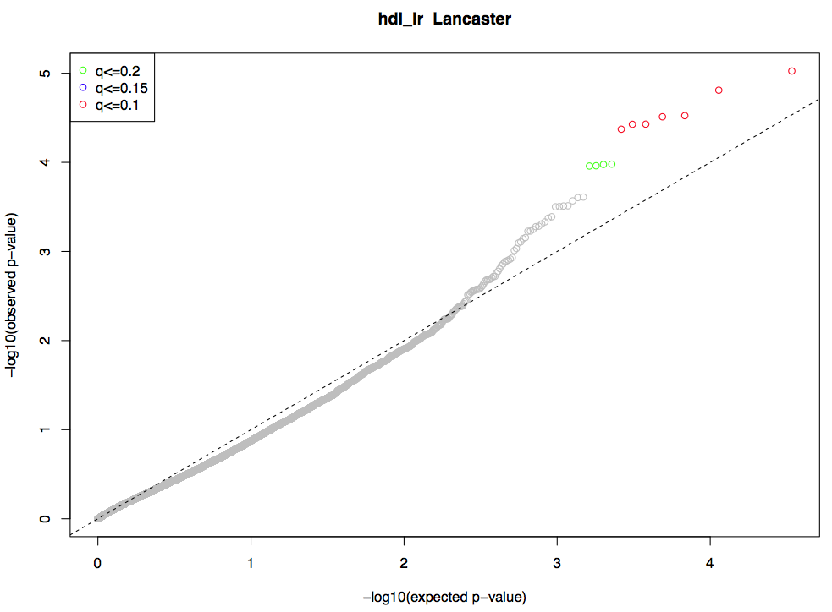
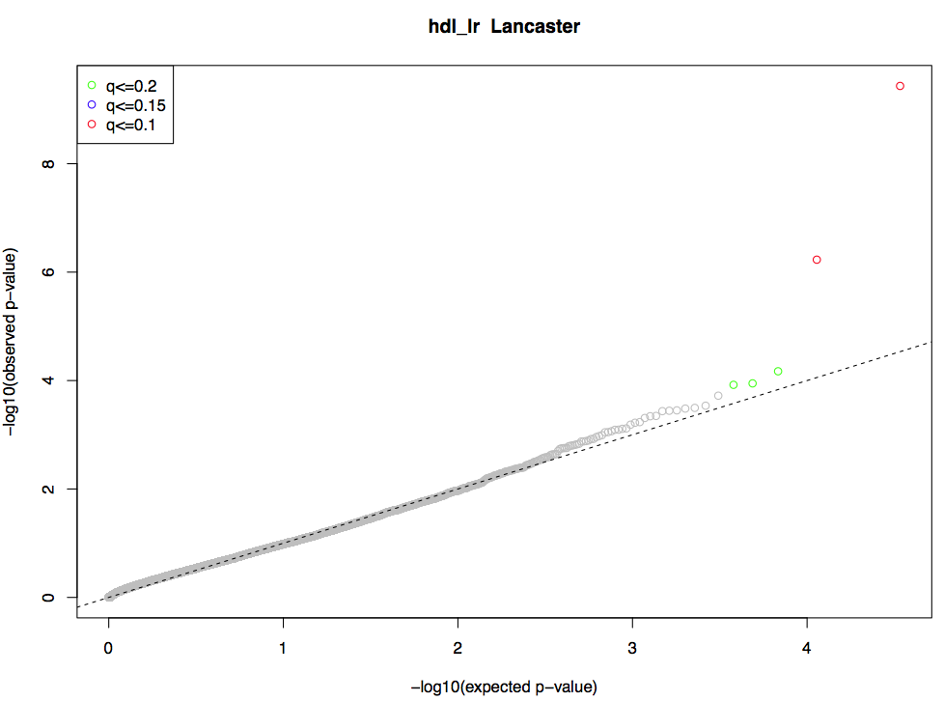
Rare Variant Analysis-HDL
PTGER4
IMPACT
SYMPK
LRRC20
LURAP1
RHOQ
CHRNE
DMRT1
SMAD6
MTHFD2
Fibrate-all races
MRPL18
TMEM9B
NUF2
MB21D2
ITIH1
Placebo-all races
NUDT8

Slide 40
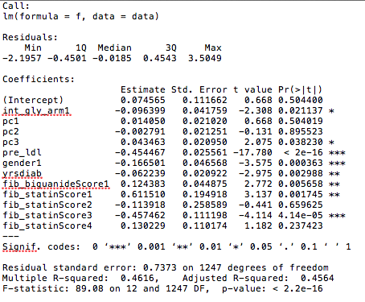
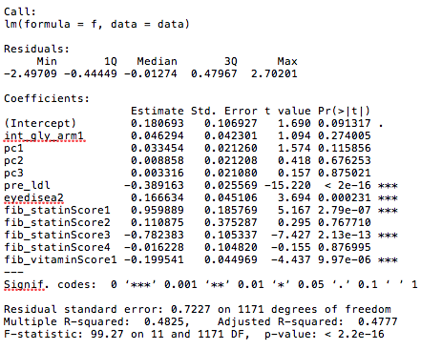
Fibrate-LDL
Fibrate
N=1261
Placebo
N=1183

Slide 41
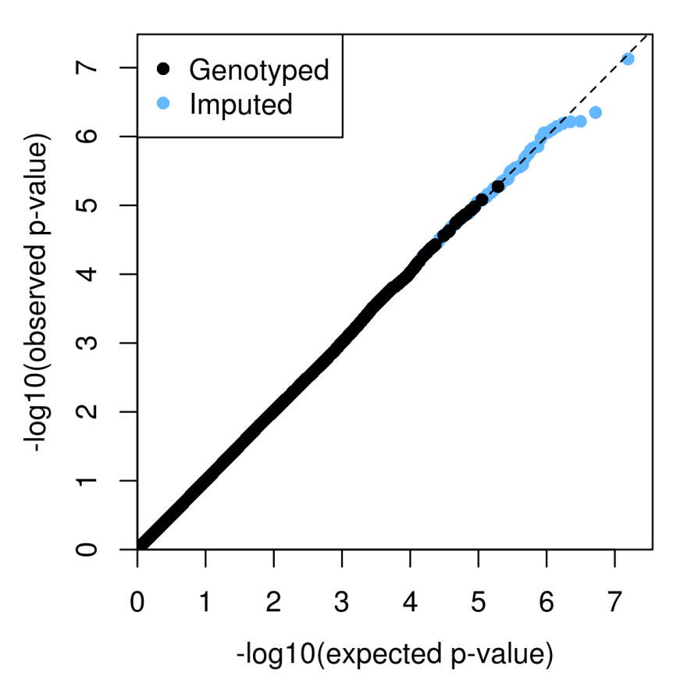
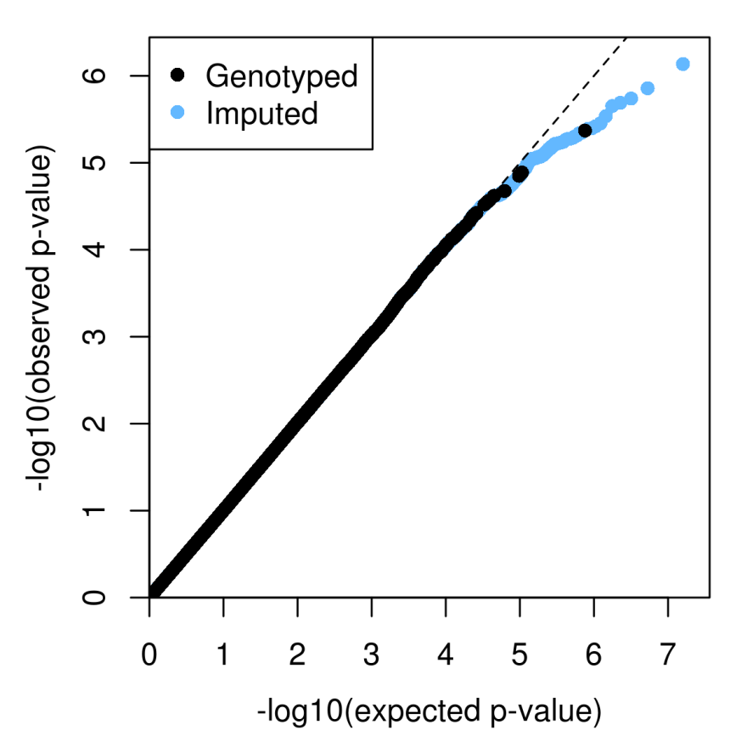
Fibrate-LDL
Fibrate
Placebo
N=1261
N=1183

Slide 42
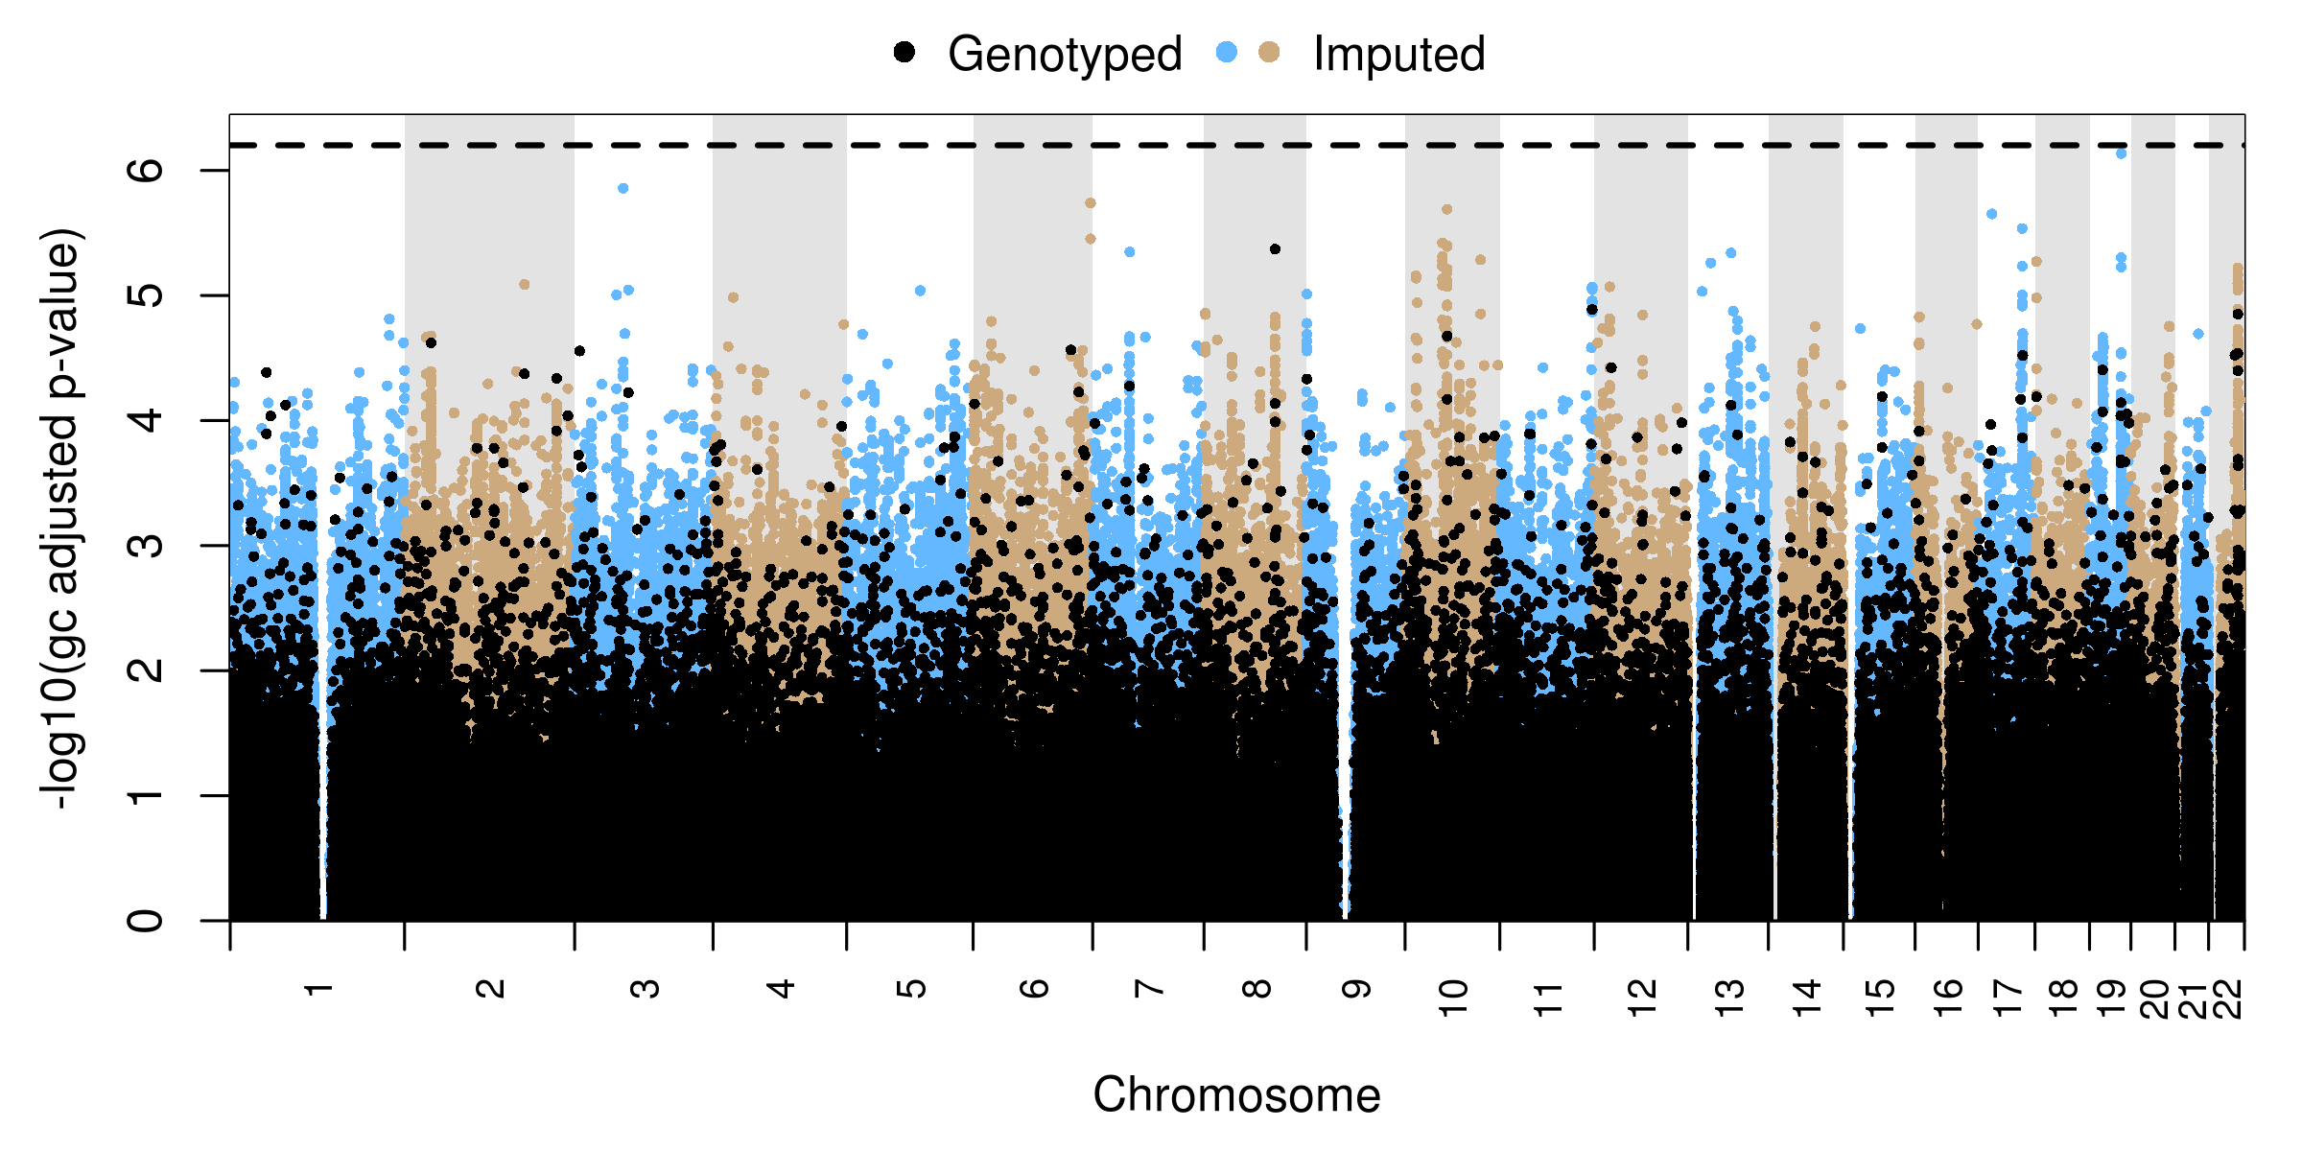
Placebo-LDL
N=1183
TOMM40

Slide 43
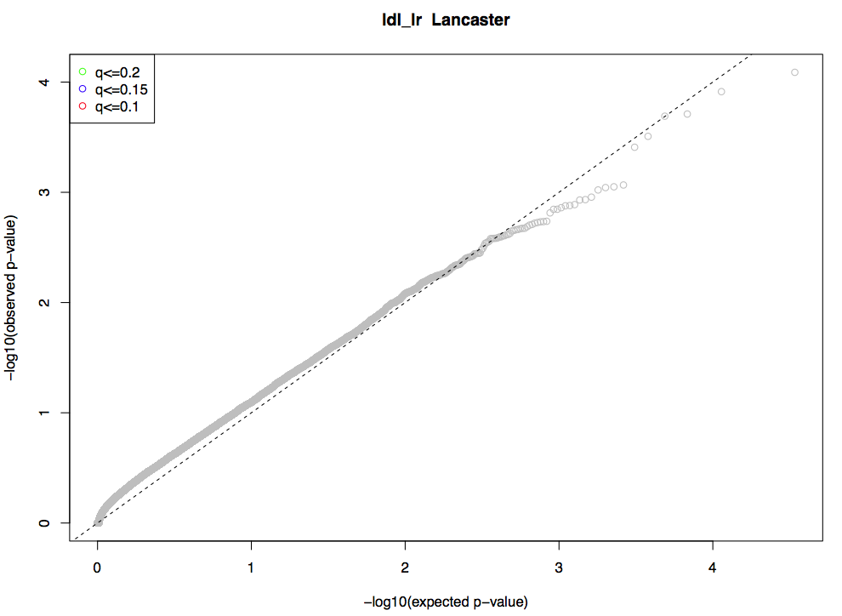
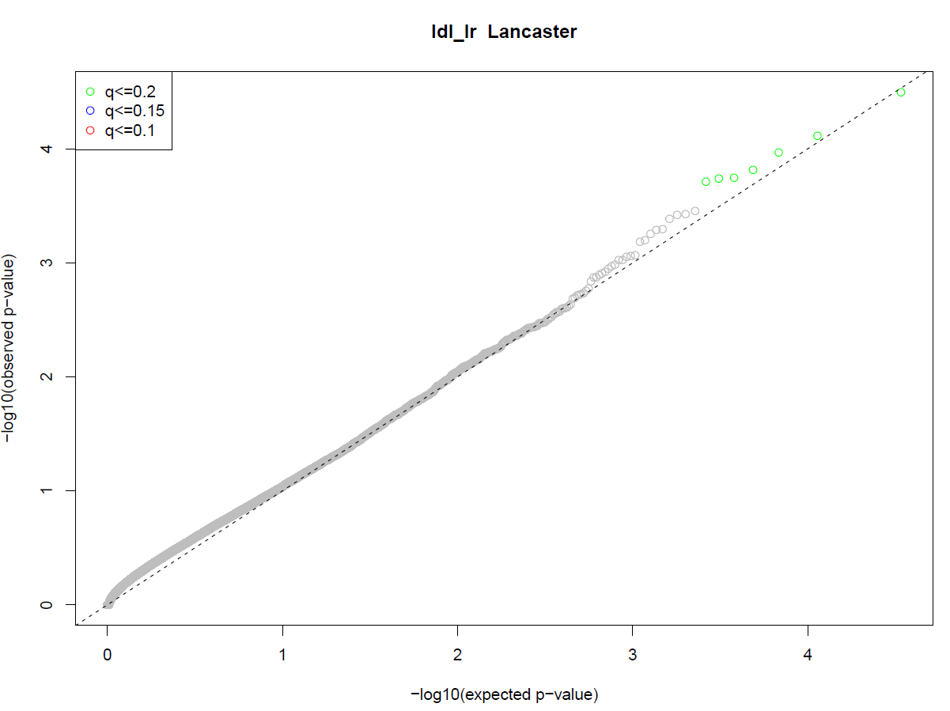
Rare Variant Analysis-LDL
Fibrate-all races
ASIC5
POM121LS
E2F6
MUC3A
OR5P2
HSPB8
HMX1
Placebo-all races

Slide 44
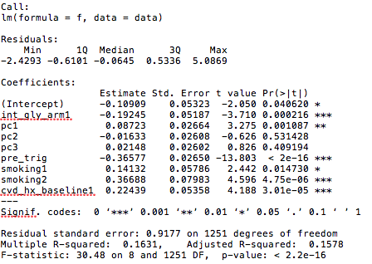
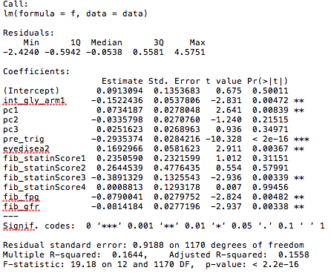
Fibrate-Triglycerides
Fibrate
N=1261
Placebo
N=1183

Slide 45
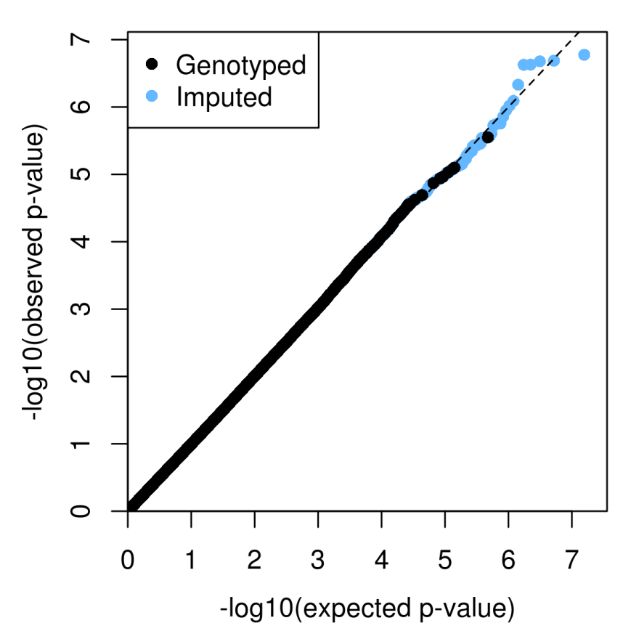
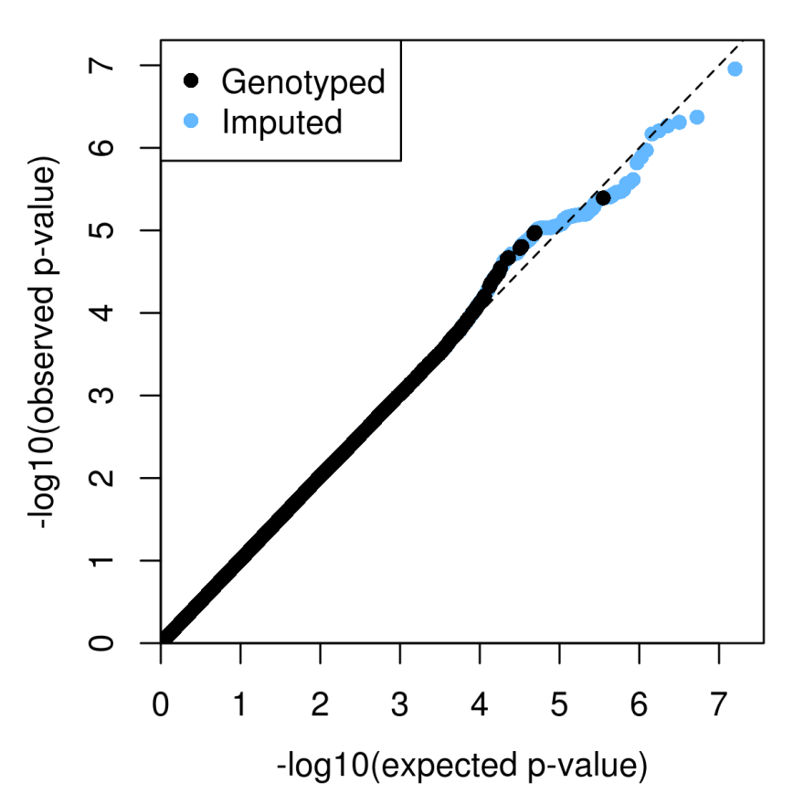
Fibrate-Triglycerides
Fibrate
Placebo
N=1261
N=1183

Slide 46
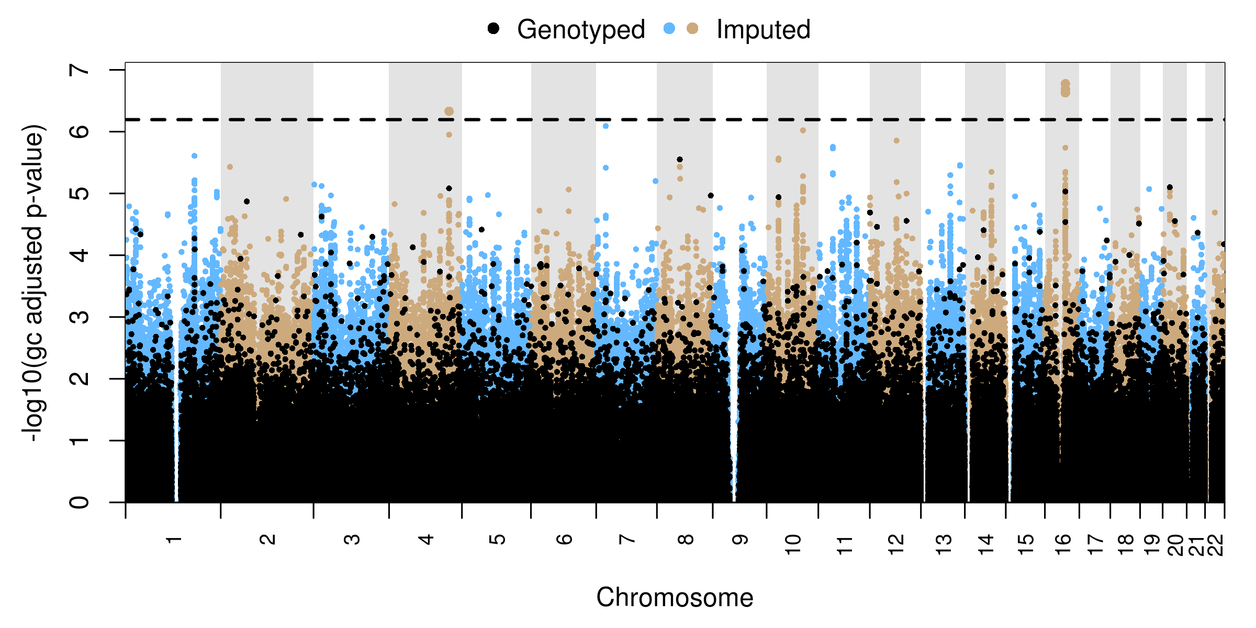
Fibrate-Triglycerides
N=1261
GALNT16
RPGRIP1L, FTO
XPR1
TOX
CEP55, FFAR4
PGAM1P5
ATAD2B
BEST3
ITGBL1

Slide 47
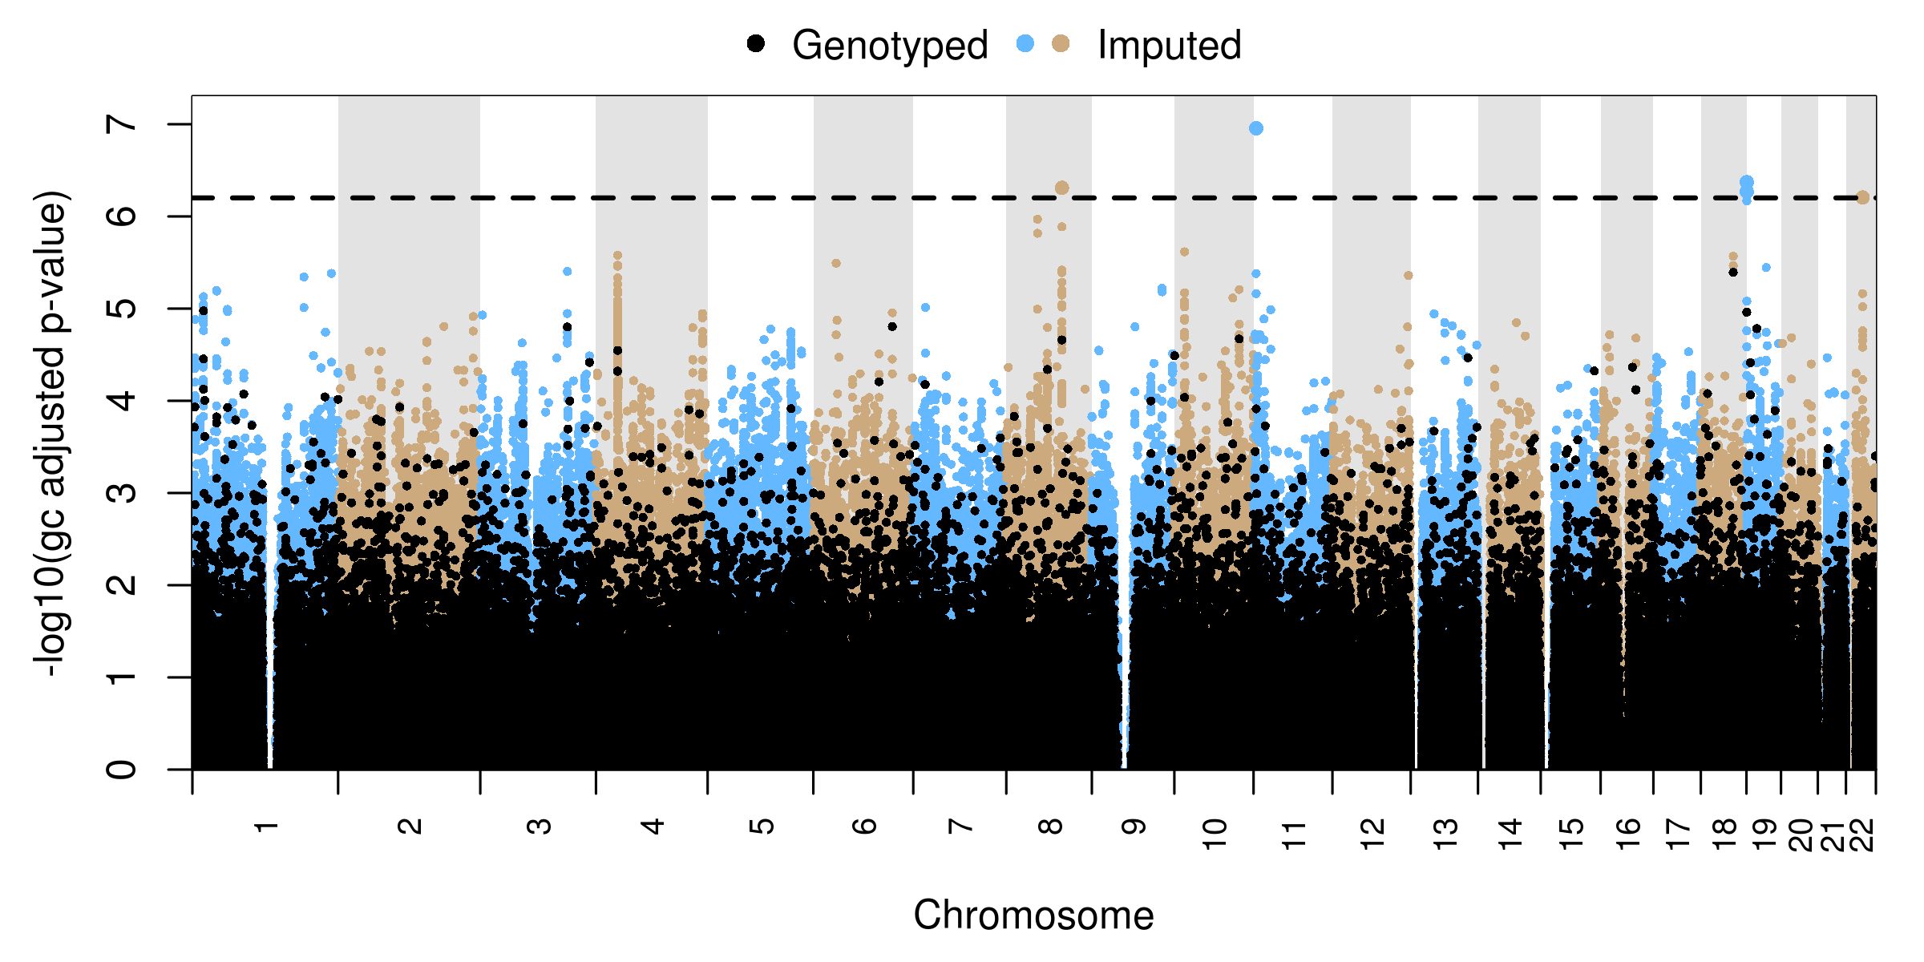
Placebo-Triglycerides
N=1183
HCN2
TTC28

Slide 48
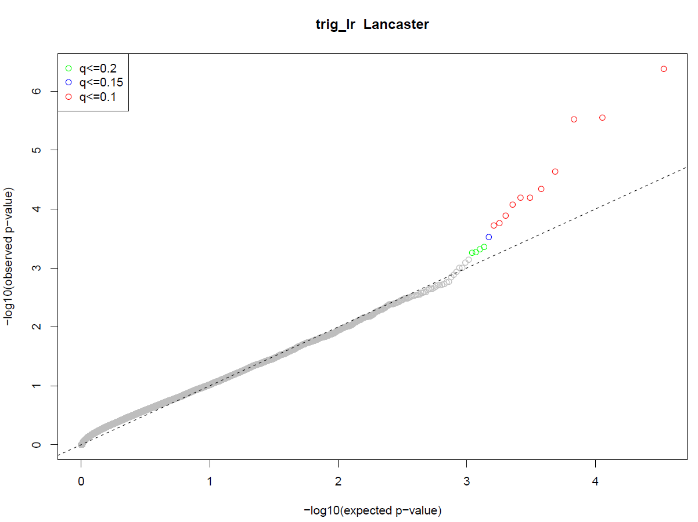
Rare Variant Analysis-Triglycerides
TMEM210
DCUN1D4
DUSP3
HES2
RAB27B
LOC101928772
EVA1C
NHLRC1
LOC101927763
MICU1
IDE
CREG2
Fibrate-all races
CDH6
THG1L
SNRNP40
ANKRD1
ATG16L1
HHIPL1
DHH
ZBTB5
HHIPL1
CX3CL1
LOC101928218
C16ORF70
SMIM13
RNF111
CAMK2D
C8orf82
Placebo-all races
MND1
SPAG9

Slide 49
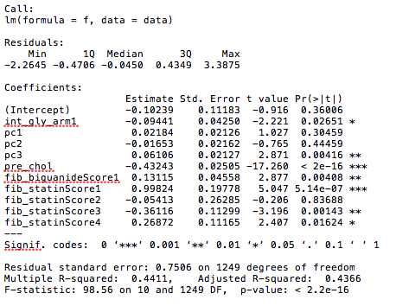
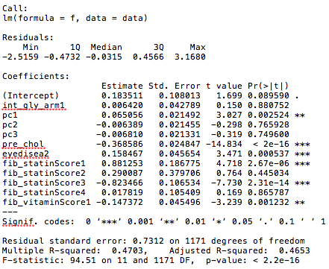
Fibrate-Cholesterol
Fibrate
N=1261
Placebo
N=1183

Slide 50
Fibrate-Cholesterol
Fibrate
Placebo
N=1261
N=1183

Slide 51
Fibrate-Cholesterol
N=1261
PRRX1
FGF14
MRPL12
SLC25A10
FBXL7
OSTF1, NMRK1
MIR3185, HOXB13, PRAC2
IL12RB2
OFCC1
ZNF775
ZNF101
LINC00539,MIPEPP3
SERPINA13P
GMIP, ATP13A1

Slide 52
Placebo-Cholesterol
N=1183
DDX46

Slide 53
Rare Variant Analysis-Cholesterol
TMEM210
PAQR8
ZNF469
RBM15B
Fibrate-all races
ASIC5
FAM110B
NMU
NKAIN4
KRTAP10-1
ALDH1A2
MUC3A
Placebo-all races

Slide 54
Fibrate-HDL
Black
N=137
White
N=779

Slide 55
Fibrate-HDL
Black
White
N=137
N=779

Slide 56
Fibrate-HDL
N=137
Black
MSH3
CELSR1
LOC102723892, CARD11
KMT2C
SORBS1
LOC101927369, CCL3
LOC101927640
LOC101928077
STX8
CARD10

Slide 57
Fibrate-HDL
N=779
White
ASTN2

Slide 58
Rare Variant Analysis by Race-HDL
HARS2
HSD17B13
RAE1
PTPN3
White-Fibrate
Black-Fibrate

Slide 59
Fibrate-LDL
Black
N=137
White
N=779

Slide 60
Fibrate-LDL
Black
White
N=137
N=779

Slide 61
Rare Variant Analysis by Race-LDL
White-Fibrate
Black-Fibrate

Slide 62
Fibrate-Triglycerides
Black
N=137
White
N=779

Slide 63
Fibrate-Triglycerides
Black
White
N=137
N=779

Slide 64
Fibrate-Triglycerides
N=137
Black
BLOC1S5-TXNDC5, EEF1E1-BLOC1S5, BLOC1S5
BCL9
LINC01182
CCDC149
SNHG17, LOC101928356
LOC101927145, ADGRL3-AS1
LRFN2
ADAMTS9, ROBO2
PARVB
ARHGAP26
LINGO2
LOC100507073
GLIS3
BPIFA1
ZYG11B
LINC00624
HECW2
SYT14

Slide 65
Fibrate-Triglycerides
N=779
White
RPGRIP1L
CSMD3

Slide 66
Rare Variant Analysis by Race-Triglycerides
HSD17B13
HARS2
MARCH3
White-Fibrate
POGZ
OCSTAMP
Black-Fibrate

Slide 67
Fibrate-Cholesterol
Black
N=137
White
N=779

Slide 68
Fibrate-Cholesterol
Black
White
N=137
N=779

Slide 69
Fibrate-Cholesterol
N=137
Black
NLGN1, PEX5L
CLN8
BICC1
NRXN1
SCGN
RBM19
SMAD3
LRRFIP1

Slide 70
Fibrate-Cholesterol
N=779
White
PBX4

Slide 71
Rare Variant Analysis by Race-Cholesterol
COL14A1
DNAJB9
AKR7A3
C9orf92
White-Fibrate
Black-Fibrate

