Slide 1
About OMICS Group
OMICS Group International is an amalgamation of Open Access publications and worldwide international science conferences and events. Established in the year 2007 with the sole aim of making the information on Sciences and technology ‘Open Access’, OMICS Group publishes 400 online open access scholarly journals in all aspects of Science, Engineering, Management and Technology journals. OMICS Group has been instrumental in taking the knowledge on Science & technology to the doorsteps of ordinary men and women. Research Scholars, Students, Libraries, Educational Institutions, Research centers and the industry are main stakeholders that benefitted greatly from this knowledge dissemination. OMICS Group also organizes 300 International conferences annually across the globe, where knowledge transfer takes place through debates, round table discussions, poster presentations, workshops, symposia and exhibitions.

Slide 2
About OMICS Group Conferences
OMICS Group International is a pioneer and leading science event organizer, which publishes around 400 open access journals and conducts over 300 Medical, Clinical, Engineering, Life Sciences, Phrama scientific conferences all over the globe annually with the support of more than 1000 scientific associations and 30,000 editorial board members and 3.5 million followers to its credit.
OMICS Group has organized 500 conferences, workshops and national symposiums across the major cities including San Francisco, Las Vegas, San Antonio, Omaha, Orlando, Raleigh, Santa Clara, Chicago, Philadelphia, Baltimore, United Kingdom, Valencia, Dubai, Beijing, Hyderabad, Bengaluru and Mumbai.

Slide 3
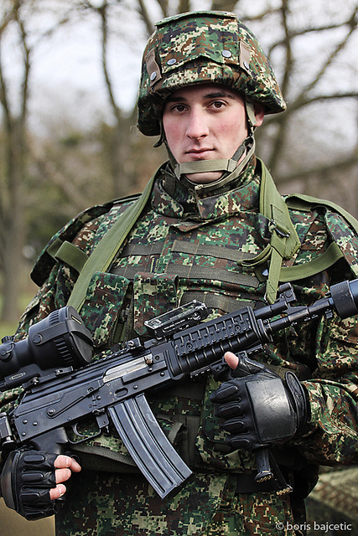
Should PTSD suffering patients be blamed for the combat related crimes in former Yugoslavia
Prof. Branislav Filipović, Belgrade, Serbia
3rd International Conference on
Forensic Research and Technology
October 06-08, 2014 San Antonio, USA

Slide 4
University of Belgrade, Faculty of Medicine

Slide 5
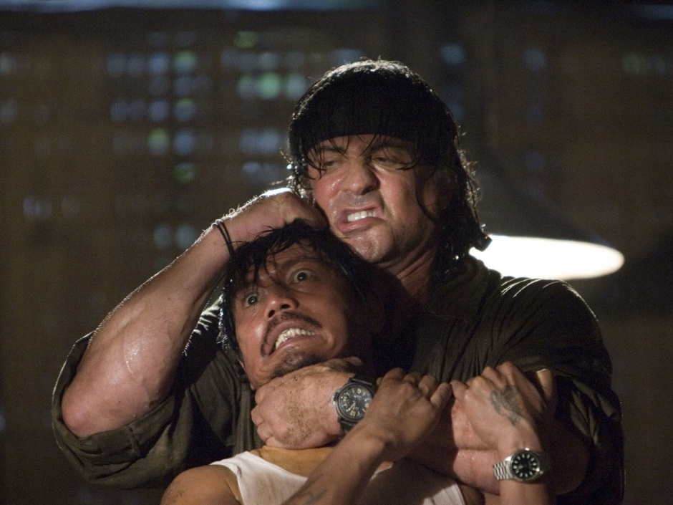
What is PTSD? Do we really know?
According to DSM V moved from Anxety to “Trauma and stress related disorders”
We all get a sterotype throgh the films
“Rambo” is the worst stereotype made on the base of PTSD, but this is the explanation why the majority of people, even very educated, imagine a war veteran as Sylvester Stallone.

Slide 6
Diagnostic criteria Now divided in several groups
Criterion A: Traumatic event
Trauma survivors must have been exposed to actual or threatened:
death
serious injury
sexual violence
The exposure can be:
direct
witnessed
indirect, by hearing of a relative or close friend who has experienced the event—indirectly experienced death must be accidental or violent
repeated or extreme indirect exposure to qualifying events, usually by professionals—non-professional exposure by media does not count
Many professionals who work in trauma differentiate between “big T-traumas,” the ones listed above, and “little-t traumas.” Little-t traumas can include complicated grief, divorce, non-professional media exposure to trauma, or childhood emotional abuse, and clinicians recognize that these can result in post-traumatic stress, even if they don’t qualify for the PTSD diagnosis.
There is no longer a requirement that someone had to have an intense emotional response at the time of the event. This requirement excluded many veterans and sexual assault survivors in the past.

Slide 7
Criterion B: Intrusion or Re-experiencing
These symptoms envelope ways that someone re-experiences the event. This could look like:
Intrusive thoughts or memories
Nightmares related to the traumatic event
Flashbacks, feeling like the event is happening again
Psychological and physical reactivity to reminders of the traumatic event, such as an anniversary
Criterion C: Avoidant symptoms
Avoidant symptoms describe ways that someone may try to avoid any memory of the event, and must include one of the following:
Avoiding thoughts or feelings connected to the traumatic event
Avoiding people or situations connected to the traumatic event

Slide 8
Criterion D: Negative alterations in mood or cognitions
This criterion is new, but captures many symptoms that have long been observed by PTSD sufferers and clinicians. Basically, there is a decline in someone’s mood or though patterns, which can include:
Memory problems that are exclusive to the event
Negative thoughts or beliefs about one’s self or the world
Distorted sense of blame for one’s self or others, related to the event
Being stuck in severe emotions related to the trauma (e.g. horror, shame, sadness)
Severely reduced interest in pre-trauma activities
Feeling detached, isolated or disconnected from other people
Criterion E: Increased arousal symptoms
Increased arousal symptoms are used to describe the ways that the brain remains “on edge,” wary and watchful of further threats. Symptoms include the following:
Difficulty concentrating
Irritability, increased temper or anger
Difficulty falling or staying asleep
Hypervigilance
Being easily startled

Slide 9
Criteria F, G and H
These criteria all describe the severity of the symptoms listed above. Basically, they have to have lasted at least a month, seriously affect one’s ability to function and can’t be due to substance use, medical illness or anything except the event itself.
Subtype: Dissociation
Dissociation has now been set apart from the symptom clusters, and now its presence can be specified. While there are several types of dissociation, only two are included in the DSM:
Depersonalization, or feeling disconnected from oneself
Derealization,

Slide 10
PTSD and Criminal Behavior
So, can PTSD cause criminal behavior? Yes and no. There is no doubt that PTSD can cause a person to make bad choices that lead to antisocial behaviors. Increased use of alcohol or drugs can lead to driving while intoxicated, domestic violence, and petty theft to support their drug or alcohol use. Increased physiological arousal, which causes the service member to always be on-guard, can lead to violent behavior that is out of proportion to a perceived threat. There are even cases in which combat veterans with PTSD have been found not guilty of murder when they were put in a situation, which reminded them of a previous stressful combat experience, and they felt they were defending themselves against an enemy combatant. Bret Moore, www.psychologytoday.com/blog/the-camouflage-couch/201008/criminal-behavior-is-not-symptom-ptsd

Slide 11
Material and Methods

Slide 12
Demographic characteristics
150 males accused for war crime
Aged 26 – 54 (41.32 ± 10.33)
Education:
28 elementary school
119 high school (24 started university bud did not gradute)
3 university
Marital status
Married with children 75
Married without children 10
Divorced 27
Living with the partner 18
Single 20

Slide 13
Diagnostics
Structured interview
Minnesota Multiple Personality Inventory – 2.
CAPS IV for PTSD
International personality disorder examination (IPDE) ICD-10 module (Loranger, Janga, Sartorius)
DSM V and ICD – 10 criteria have been used in diagnosis settlement.

Slide 14
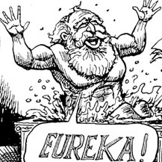
Results

Slide 15
128 of them, suffered from the severe personality disorder, mostly dissocial (antisocial), but also emotionally instable borderline and narcistic, regarding DSM IV criteria. According to DSM V all belonged to the emotionally unstable cluster.
They usually committed a crime that was documented by a photo or a video recording, as a kind of the trophy collecting proof.

Slide 16
RESULTS cont’d
Twelve of them were psychotic, whose crimes were committed without selection, e.g., three houses in a row, in one village, in the phase known as “narrowing of the conscience”, triggered by the war happenings. Two of them were had a delusional order from God to kill people from the different religion.
Ten people committed a combat crime as the revenche for the prior loss of the family members.
Eight of them showed no specific psychiatric pathology, but they were ordered to kill mostly the prisoners of war by a senior officer.

Slide 17
Only two suffered from pronounced PTSD, who were firstly captured from the opposite side, and then released under the mediation of the Red Cross. Both were driven by an unexplainable impulse to protect themselves from another imprisoning by the opponent side, killed the imprisoned soldiers in the enemy uniforms.

Slide 18
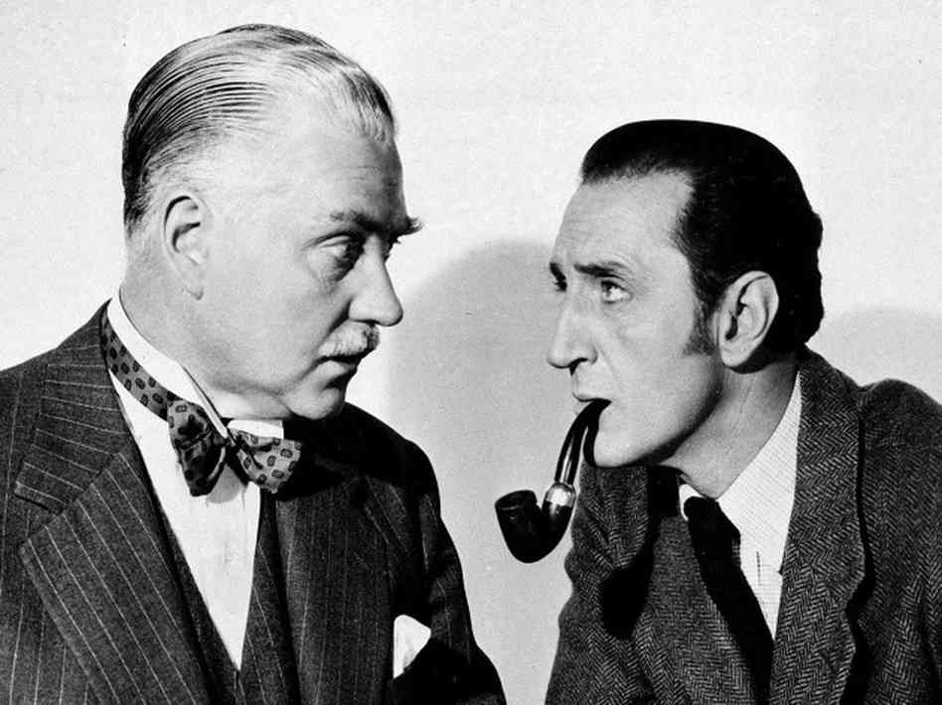
Conclusion
Elementary, my dear Watson!

Slide 19
Definitely, PTSD suffering war veterans seldom commit war crimes, and, according to our experience, combat crimes were performed by a person suffering from serious personality disorder.
Possibly, the criminal behavior, if expressed, in PTSD patients happens later
Eventually, PTSD can be a lame excuse for the war crimes

Slide 20
On the other hand, physicians should be more careful in selections for army service suitability
Special attention should be paid on personality disorder during the recruitment of new soldiers.
All of the active officers and professional soldiers also have to be screened on any kind of psychiatric disorder.

Slide 21
Let Us Meet Again
We welcome you all to our future conferences of OMICS Group International
Please Visit: www.omicsgroup.com
www.conferenceseries.com

