Slide 1
About OMICS Group
OMICS Group International is an amalgamation of Open Access publications and worldwide international science conferences and events. Established in the year 2007 with the sole aim of making the information on Sciences and technology ‘Open Access’, OMICS Group publishes 400 online open access scholarly journals in all aspects of Science, Engineering, Management and Technology journals. OMICS Group has been instrumental in taking the knowledge on Science & technology to the doorsteps of ordinary men and women. Research Scholars, Students, Libraries, Educational Institutions, Research centers and the industry are main stakeholders that benefitted greatly from this knowledge dissemination. OMICS Group also organizes 300 International conferences annually across the globe, where knowledge transfer takes place through debates, round table discussions, poster presentations, workshops, symposia and exhibitions.

Slide 2
About OMICS Group Conferences
OMICS Group International is a pioneer and leading science event organizer, which publishes around 400 open access journals and conducts over 300 Medical, Clinical, Engineering, Life Sciences, Pharma scientific conferences all over the globe annually with the support of more than 1000 scientific associations and 30,000 editorial board members and 3.5 million followers to its credit.
OMICS Group has organized 500 conferences, workshops and national symposiums across the major cities including San Francisco, Las Vegas, San Antonio, Omaha, Orlando, Raleigh, Santa Clara, Chicago, Philadelphia, Baltimore, United Kingdom, Valencia, Dubai, Beijing, Hyderabad, Bengaluru and Mumbai.

Slide 3


The development of an oligonucleotide, label-free electrochemical impedance based point-of-care technology
Aldin Malkoc
Arizona State University, USA
Jeffrey T. La Belle, Ph. D Michael Caplan, Ph. D

Slide 4
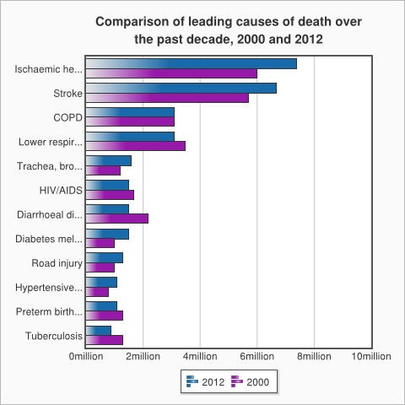
Background: Bacterial Infectious
Disease (BID) Statistics
BIDs are responsible for at least 4.6 million deaths in the world
Annual Costs
– 100 billion dollars annual worldwide
“WHO (2008) The Burden of Tuberculosis: Economic Burden. Geneva, Switzerland: World Health Organization.” “The top 10 causes of death. (n.d.). WHO. Retrieved July 13, 2014,”
“Gallup JL, Sachs JD (2000) The Economic Burden of Malaria. Cambridge, MA, USA: Center for International Development at Harvard University”

Slide 5
Current SOTA (State of the Art) BID Sensors
SOTA Sensor | Pros | Cons | Price
Plate Culture | Simplest setup for bacterial detection | Takes 3-5 days with low sensitivity. | >10$
GRAM Stain | Identifies gram negative or positive microbes | Insensitivity of Gram smear | >20$
PCR-gel Electrophoresis | Multiplication of DNA rather quickly, simple set- up | Long time, False Positives 9-57% | >50$
Fermentation Test | Will produce high accuracy result | Takes few days to receive result | >100$
Molecular Beacon | High signal to noise ratio and high specificity | Post analysis due to mutations | >500$
http://www.biomerieux-diagnostics.com/servlet/srt/bio/clinical-diagnostics/dynPage?open=CNL_CLN_PRD&doc=CNL_PRD_CPL_G_PRD_CLN_11&pubparams.sform=4&lang=en http://www.vintessential.com.au/resources/articles/malolactic-fermentation-monitoring.html

Slide 6
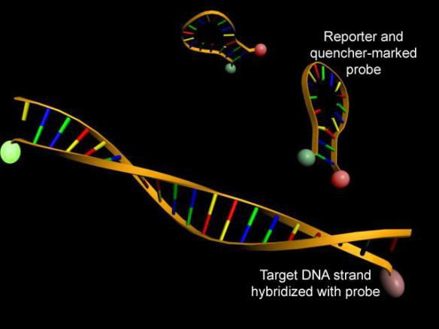
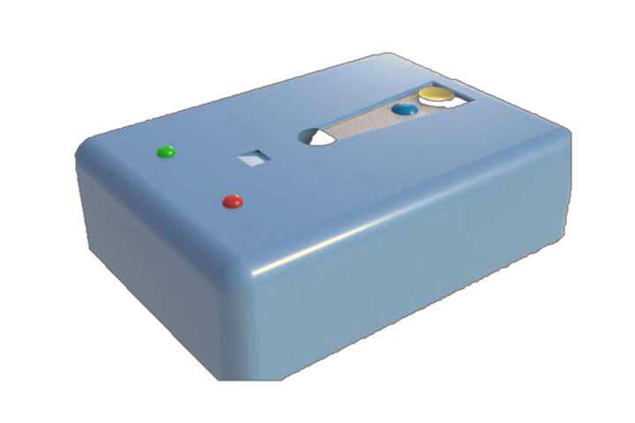
What to Measure for in BIDs
DNA Strand
Why Nucleotide
  Earlier/Accurate
detection
Goal
  EIS and Molecular Beacon
Ideal Method
  Low cost
  High specificity and
sensitivity
  Quick response time
•

Slide 7



























































































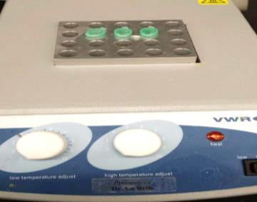
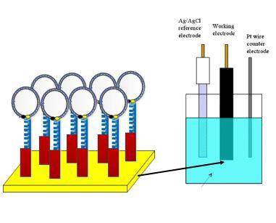


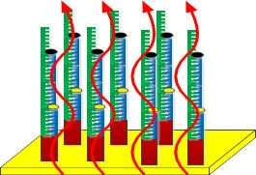
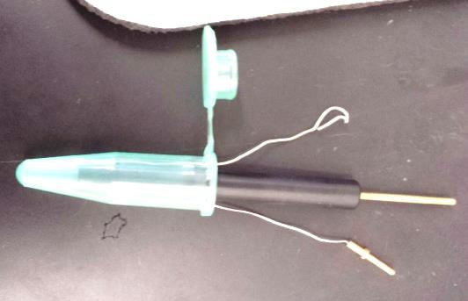




Experimental Setup
Using TP combined with EIS immobilization chemistry for detection
– Nucleotide-nucleotide interactions
EIS
–
Three electrode set-up
Hot Plate
Target Sequence
_{WT:} AT TAT TAC T TT ACT ATA T TAGCTT TTCCGCCA T C TAAAA TT CTA T T
– Optimal binding temperature
_{SNP:}AT TAT TAC T TT ACT ATA T TA TCTT TTCCGCCA T C TAAAA TT CTA T T
Tentacle probe functionalized gold disk electrode
Hot Plate
BID binds to tentacle probe

Slide 8
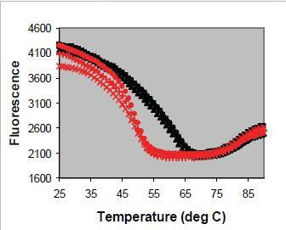
Data Collected
Lower Limit Detection
Replication of Data
Electrochemical Technique | Pros | Cons | LLD (M)
Electrochemical Impedance Spectroscopy (EIS) [5] | Detection range is 10⁻⁹-10⁻¹⁵ M. The technique takes 90 seconds and does not require a label. | Requires immobilization of protein recognition elements. | ₁₀-9 _{– 10}-15
EIS with Tentacle Probe | ANOVA shows a P- value = 1.93E-06 WT and SNP are have significantly different impedance | Requires immobilization of protein recognition elements. | 20*10⁻⁹
Impedance (Ohm)
1.2
1
0.8
0.6
0.4
0.2
0
Figure at Left. A Temperature gradient of using a molecular beacon.
Immobilized to Gold surface.
0
20 40 60
Temperature (deg C)
80
Satterfield, B. C., M. R. Caplan, and J. A. A. West. "Tentacle probe sandwich assay in porous polymer monolith improves specificity, sensitivity and kinetics."Nucleic Acids Research 36.19 (2008): e129-e129. Print.
[5] Bhavasar, 2009

Slide 9
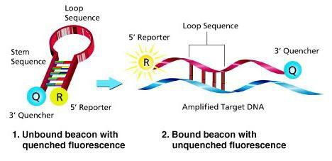
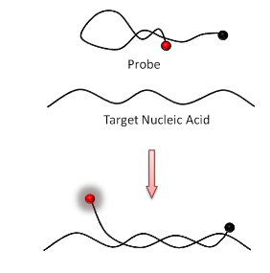
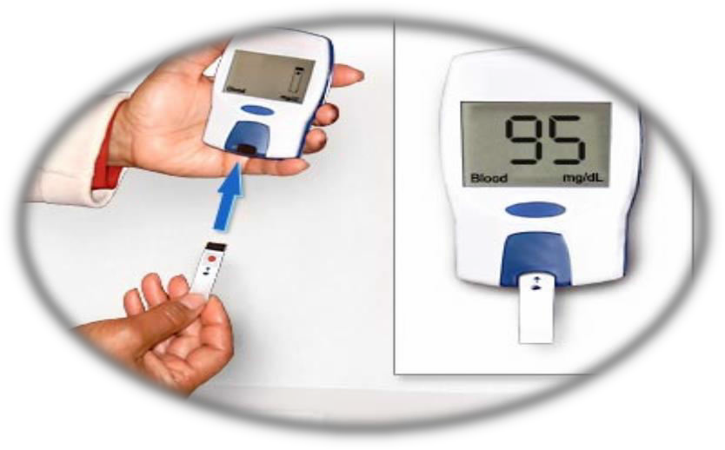
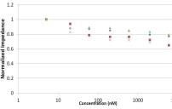
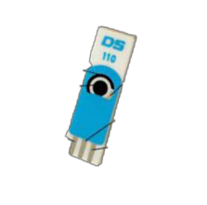
Future Work & Conclusion
Rapid Probe
Rapid probe (RP)
– Replace TP with molecular beacon that is truly cost efficient.
Human blood testing
– Complex Solution
Multiplexing
– Detection for multiple BID
from one sample
Real time testing
– Point-of-care EIS/RP device
‘Co-Diagnostics. (n.d.). Co-Diagnostics. Retrieved July 16, 2014, from http://www.codiagnostics.com’ ‘http://www.ysinhhocphantu.com/training/ky-thuat-real-time-pcr/8/’ ‘http://www.walgreens.com/marketing/library/contents.jsp?docid=100220&doctype=13’

Slide 10

Thank You
Questions?
Funding from
ASU Fulton Undergraduate Research Initiative
Labelle’s Army

Slide 11
Extra Slides

Slide 12
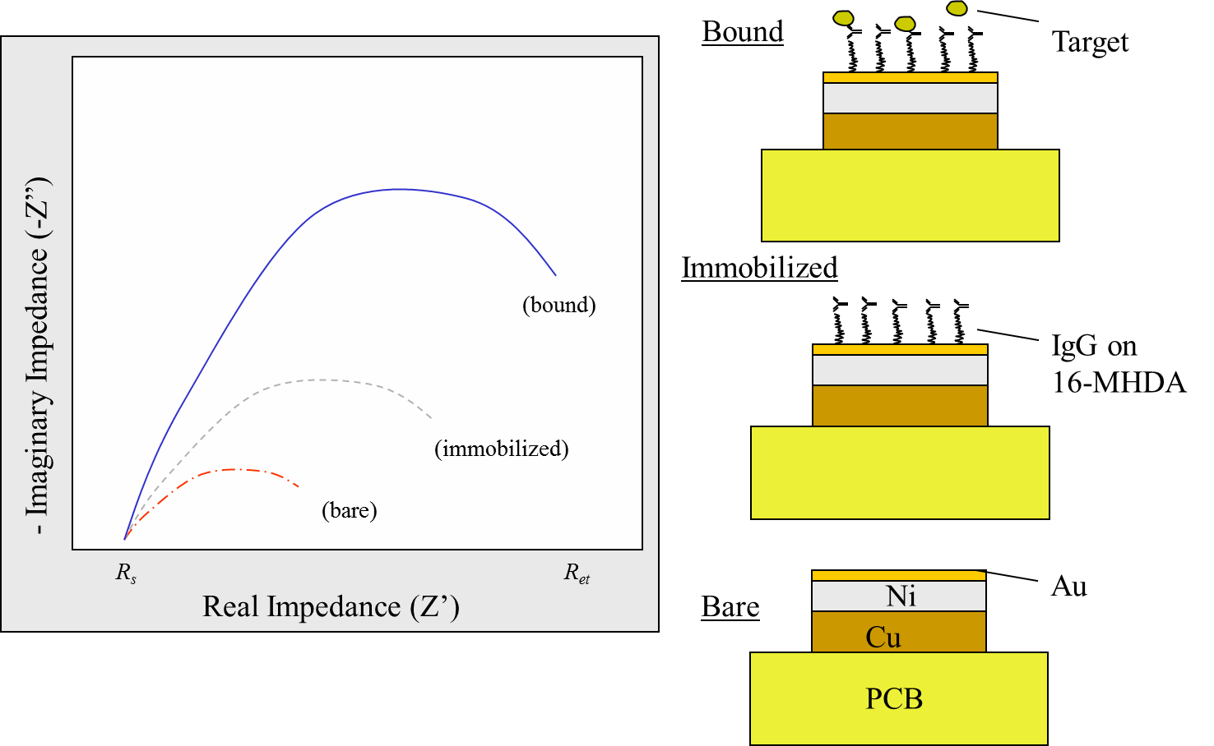
Immobilization

Slide 13
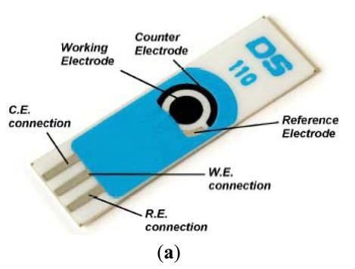
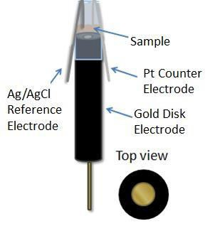
Strip Electrodes

Slide 14
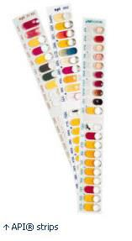
bioMerieux
Metabolic analysis
Identifies gram negative or positive microbes
Load and culture the cupules and inoculate for 24-48 hrs
A distinct pattern (20 codes) reduces into a 7 digit code you give to the company that identifies the bacteria (genus and species ID)
http://www.biomerieux-diagnostics.com/servlet/srt/bio/clinical-
diagnostics/dynPage?open=CNL_CLN_PRD&doc=CNL_PRD_CPL_G_PRD_CLN_11&pubparams.sform=4&lang=en

Slide 15
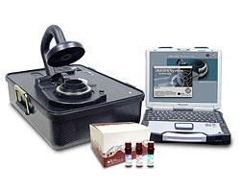
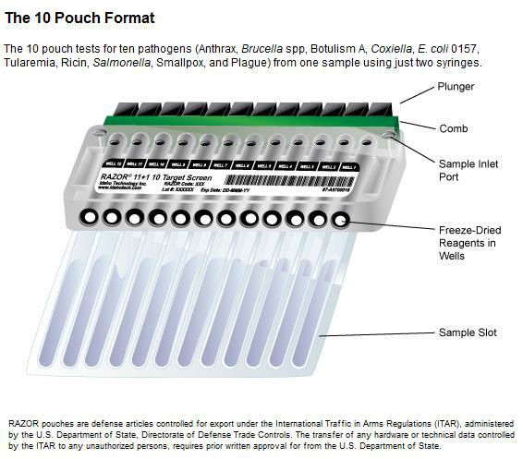
JBAIDS
Joint Biological Agent Identification and Diagnostic System (JBAIDS) Plague Detection kit
Yersinia pestis
Idaho Technology, Inc. Salt Lake City, UT
Anthrax, Brucella spp, Botulism A, Coxiella, E. coli 0157, Tularemia, Ricin, Salmonella, Smallpox, and Plague
Real time PCR

Slide 16
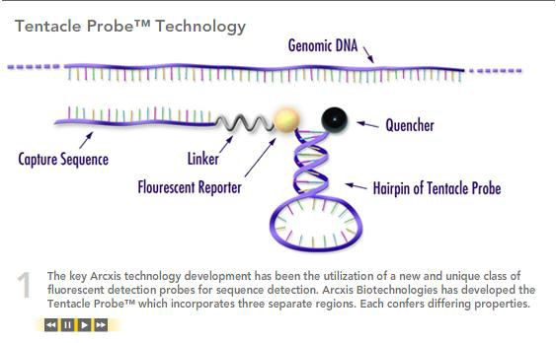

Solutions – Tentacle Probe
TM
Tentacle Probe
Capture Region
Detection Region
High Specificity
High Sensitivity
With or with out PCR
Arcxis Biotechnology,

Slide 17
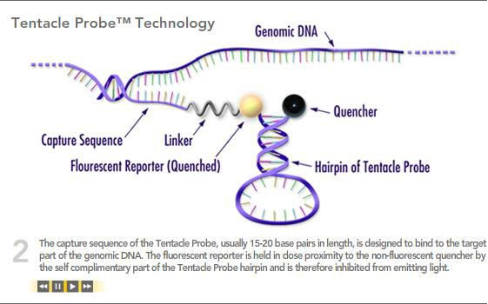
Solutions – Tentacle Probe
TM
Tentacle Probe
Capture Region
Detection Region
High Specificity
High Sensitivity
With or with out PCR
Arcxis Biotechnology,

Slide 18
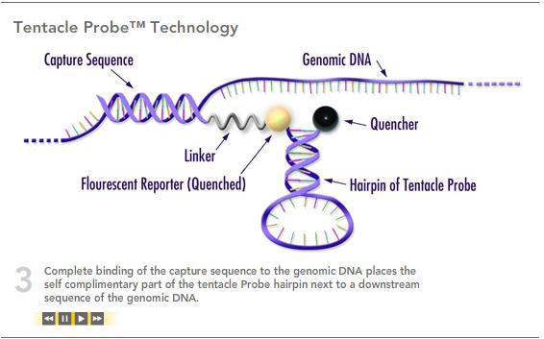
Solutions – Tentacle Probe
TM
Tentacle Probe
Capture Region
Detection Region
High Specificity
High Sensitivity
With or with out PCR
Arcxis Biotechnology,

Slide 19
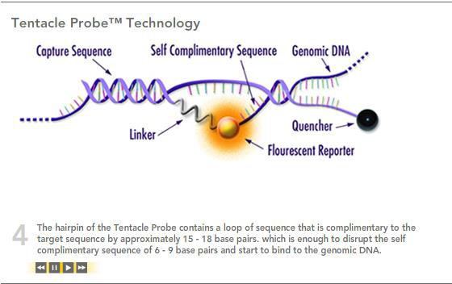
Solutions – Tentacle Probe
TM
Tentacle Probe
R
Capture Region
Detection Region
High Specificity
High Sensitivity
With or with out PC
Arcxis Biotechnology,

Slide 20
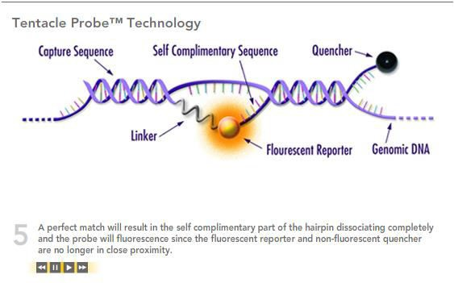
Solutions – Tentacle Probe
TM
Tentacle Probe
Capture Region
Detection Region
High Specificity
High Sensitivity
With or with out PCR
Arcxis Biotechnology,

Slide 21
Solutions cont..
Synthesized oligonucleotide
  Capture – PEG – Hairpin
  18 Complementary BP – PEG – CALfluor 560- 29 Complementary BP –BHQ1
B. anthracis – B.cereus
  1 BP polymorphism NO FALSE POS
Y. pestis – Y. psudotuberculosis
  25 deleted bases NO FALSE POS

Slide 22
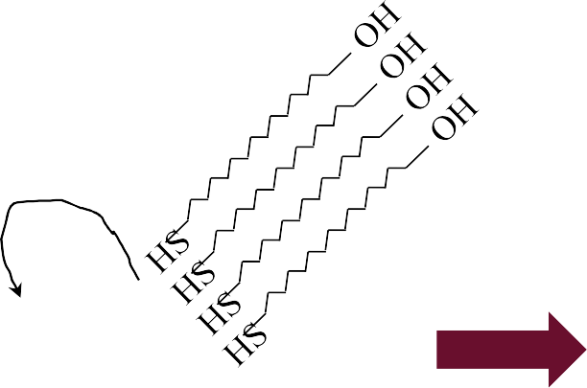
Immobilization of Tentacle ProbeTM
OH
OH OH
OH OH OH
OH OH
OH
OH OH OH
S
S S
S S S
GDE
EDC
EDC EDC
EDC EDC EDC
NHS
NHS
NHS
NHS NHS NHS
GDE
IL12
IL12 IL12
IL12 IL12
IL12
S
S S
S S S
S
S S
S S S
S
S S
S S S
GDE
GDE
GDE

Slide 23
Table 1
Table 1 – list of descriptions, pros and cons for common electrochemical
techniques
Description Pros Cons
Electrochemical Technique
[1]
A method in which one voltage is applied to the solution system and current over time is measured. This is very popular and well- developed to measure blood glucose levels.
Intrinsically has continuous time abilities and chosen voltage. This technique is well known.
Amperometric i-t (AMP-it) [2]
The detection range is 10⁻ ⁴-10⁻⁶ M.
[3]
Square Wave Voltammetry (SWV) [4]
Essentially, a more sensitive CV using differential voltage sweeping, but does only oxidation or only reduction, as it sweeps voltage in one direction.
A more sensitive determination of oxidation or reduction voltages of the sample.
Can only sweep voltage in one direction and detection range is 10⁻⁶-10⁻ ⁹ M.
[5]
] Wang, 2006 [2] Bishop 2010 [3] Ye, 2008 [4] Cai 2009 [5] Bhavasar, 2009

Slide 24
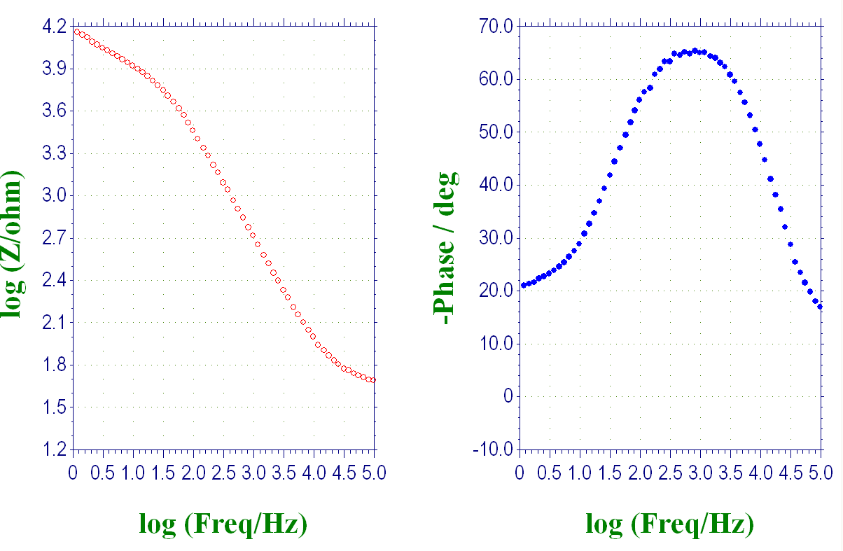
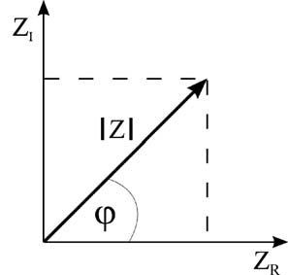


Electrochemical Impedance Spectroscopy (EIS) Background
Graphically
Nyquist Plot
(imaginary impedance)
(real impedance)
Lisdat et al, Bioanal. Chem, 2008
Mathematically
Z_{R} = Z cos(ϕ)
(real impedance)
Z_{i} = Z sin(ϕ)
(imaginary impedance)
Z ( jω) = ^{U ( jω)} = Z (ω) + jZ (ω)
I ( jω)
r i

Slide 25


Background: EIS Equivalent Circuit Models
Nyquist Plot
Circuit Model
Decreasing ω
Randles Circuit
-Im(Z)
^{R}ct
R_{s}
R_{s}
Re(Z)
^{R}s ^{+ R}ct
C_{d}
Warburg
Circuit
^{R}ct
Z
-Im(Z)
Kinetic
Diffusion
R_{s}
R_{s}
Re(Z)
R_{s} + R_{ct}
C
d
Verma, Applied Project Defense. June 2011

Slide 26
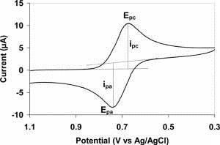
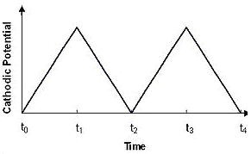


Electrochemical Techniques
Cyclic Voltammetry (CV)
Output
Input
Useful for other techniques: SWV
Formal Potential: Average of Reduction and Oxidation Peak Voltages
Amp i*t EIS
La Belle, E. Chem. 101. 2011.

Slide 27
Let Us Meet Again
We welcome you all to our future conferences of OMICS Group International
Please Visit:
www.omicsgroup.com
www.conferenceseries.com
www.pharmaceuticalconferences.com

