Slide 1
FOOD SAFETY IN INDIA: CURRENT STATUS
Dr. N. N. Zade
Director of Extension Education and Trainings,
Maharashtra Animal & Fishery Sciences University, Nagpur

Slide 2
Food
"Food" means a raw, cooked, or processed edible substance, ice, beverage, or ingredient used or intended for use or for sale in whole or in part for human consumption, or chewing gum.
(Food and Drug Administration
1999 Food Code)

Slide 3
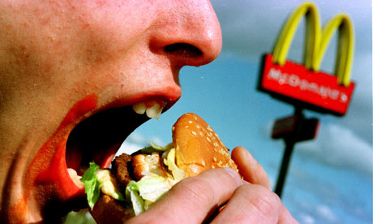

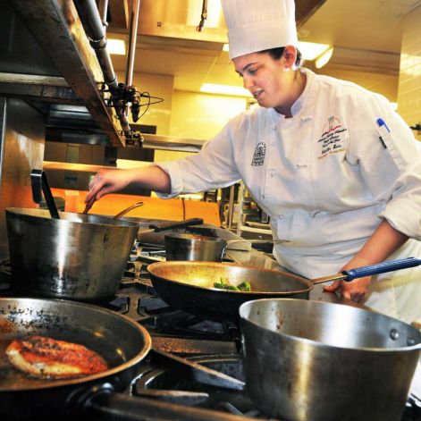
Food
Eating food is a risky process
Innate Immunity and traditional culinary practices are major protective factors

Slide 4
Food Safety
A suitable product which when consumed orally either by a human or an animal does not cause health risk to consumer.
OR
Assurance that food will not cause harm to the consumer when it is prepared and/ or eaten according to its intended use.

Slide 5

Food Safety: Why?????
Changing food habits
Increased processing and handling
Changing processes, products
Globalization of food trade

Slide 6
Food safety a global concern
Acute diarrhoeal illness is very common worldwide and estimated to account for 1.8 million childhood deaths annually, predominantly in developing countries
(World Health Organization, 2005)

Slide 7
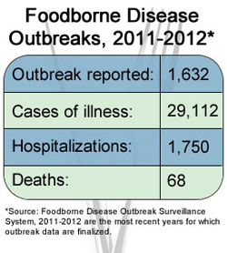
Food safety a global concern
CDC, USA

Slide 8
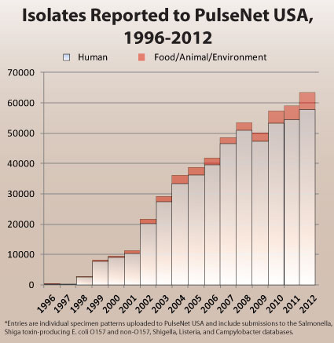
Food safety a global concern

Slide 9
Climate change and food safety
Eco system changes lead to more pests, less predators, more vectors for microbes
Unseasonal rains – humidity and fungal growth
Flooding – water contamination- soil contamination- unsafe food
Higher Ocean temperatures- algal blooms- harbour Vibrios in spore like forms- Novel strains' eg O139 Bengal
Changes in aquatic life and formation of marine biotoxins in sea foods due to production of phytotoxins by harmful algae

Slide 10

Global food safety issues
Allergens
Plant diseases
Mycotoxins
Food born bacteria
Sanitation /quality
GMO
Drug residues

Slide 11
Food Industry
India is the world's second largest producer of food next to China
India is one of the worlds major food producers but accounts for less than 1.5 per cent of international food trade.
This indicates vast scope for both investors and exporters.
Food exports in 1998 stood at US $5.8 billion whereas the world total was US $438 billion.

Slide 12
Food Industry
The Indian food industries sales turnover is Rs 140,000 crore (1 crore = 10 million) annually as at the start of year 2000.
The industry has the highest number of plants approved by the US Food and Drug Administration (FDA) outside the USA.

Slide 13
Pre FSSAI Scenario
Multiple food laws
Varied quality/safety standards
Rigid and non responsive standards
Poor information dissemination to consumers

Slide 14
Pre FSSAI Scenario
Nine different laws and eight different ministries governing the food sector
Laws framed by different Ministries/Depts. With different perspective and enforcement approach
Overlapping laws with different quality standards & labelling requirements

Slide 15
Acts and laws
The Prevention of Food Adulteration Act, 1954
Fruits and Vegetable Products (Control) Order- FPO 1955"
Meat Food Products Order (MFPO)1973
Vegetable Oil Products (Control) Order, 1947
Edible Oils Packaging (Regulation) Order, 1988,
Solvent Extracted Oil, De-oiled Meal and Edible Flour (Control) Order, 1967
Milk and Milk Products Order, 1992

Slide 16

FSSA
F
S
S
A
The PFA Act, 1954
EOP Order 1988
Solvent Extracted Oil, De-oiled Meal and Edible Flour (Control) Order, 1967
FPO 1995
MMPO 1992
MFPO 1973
VOP Order 1947
FOOD SAFETY AND STANDARD ACT 2006

Slide 17
Chronology
Food Safety and Standards Act ,2006 - passed by Indian Parliament and notified on 24th August, 2006
Authority Established- in Sept, 2008
FSS Regulations Notified -3rd August, 2011
All Food Business Operators in India to get Licensed/Registered with Food Safety Authority
New Act operationalised- 5th August,2011

Slide 18
Scope of FSSA
The Act covers activities throughout the food distribution chain, from primary production through distribution to retail and catering.
The Act gives the Government powers to make regulations on matters of food safety.
The Food Safety & Standards Authority of India is the principal Government Authority responsible for preparing specific regulations under the Act.

Slide 19
Stake Holders
Food Safety
Research institutes/ laboratories
Industry
Govt. Agencies
Regulators
Consumer organizations
Farmers organizations

Slide 20
Objectives of FSSA
1
To consolidate multiple laws and establish single point reference system
2
To establish Food Safety and Standards Authority
3
To regulate the manufacture, storage, distribution, sale and import of food products
4
To ensure availability of safe and wholesome food for human consumption

Slide 21
A leap forward
Single authority
Safety
Monitoring and surveillance
Full time officers
Laboratories in public and private sectors involved

Slide 22
A leap forward
Multilevel, multi dept. control to single line of command
Single reference point
Integrated response
Decentralization of licensing
High degree of consumer confidence
Transparent regulatory mechanism

Slide 23
A leap forward
Investor friendly mechanism
Adequate information dissemination
Speedy disposal of cases
Consistency between domestic and international food laws

Slide 24
Salient features
Involvement of stake holders in decision making
  The apex body has wider representation of food technologists, scientists, State Govt., farmers, Retailers, Consumer organizations, food industry
Science based standards
  Science based Standards that distinguish substandard and unsafe food
  Risk Assessment and Management integral to standards setting and enforcement

Slide 25
Salient features
Improved regulatory structure
  New enforcement structure
  Multi level, multi departmental control shift to a single line of control
  Large network of laboratories
  Regulation of food imported in the country

Slide 26
Salient features
Improved monitoring system
  Active and Passive Surveillance
  Annual Audit
  Good food traceability and recall plan

Slide 27
Salient features
Improved justice delivery
  Different procedure to deal with Civil and criminal penalties
  Provision for Adjudication and fast track disposal of cases
  Constitution of Tribunals

Slide 28
Salient features
Promotion of innovations
  Provisions for Functional and Novel Foods , dietary supplements, nutraceuticals etc.)
Consumer empowerment
  Safeguard consumers’ expectations of substance, quality in a non misleading presentation
  Consumers can take samples and get it analysed

Slide 29
Salient features
Accountability
  Provision for penalty against officer (Upto 1 lakh)
  In all cases prior notice to FBO
Private public participation in enforcement
  Accreditation of Private agencies/individuals for audit/inspections
  Accreditation of private Laboratories

Slide 30
Mechanism of regulation
CEO, FSSAI
Commissioner
of food safety states
Registration authority
Licensing authority
Central licensing authority
FSSAI headquarter monitoring
Zonal Director and other officers
Designated officer
Licensing authority
Municipal corporation
Nagar Nigam
Gram panchayat
Food safety officer

Slide 31
Implementation
Registration required for the Food Business Operator, who is a
manufactures or sells any article of food himself or a petty retailer, hawker, itinerant vendor or temporary stall holder; or
such food business including small scale or cottage or tiny food businesses with an annual turnover not exceeding Rs 12 lakhs and or whose-
  Production capacity of food (other than milk and milk products and meat and meat products) does not exceed 100 kg/ltr per day or
  Production or procurement or collection of milk is up to 100 litres of milk per day or
  Slaughtering capacity is 2 large animals or 10 small animals or 50 poultry birds per day or less than that

Slide 32
Implementation
Central License required for the Food Business Operator, who:
Dairy units including milk chilling units process more than 50 thousand litres of liquid milk/day or 2500 MT of milk solid per annum.
Vegetable oil processing units having installed capacity more than 2 MT per day.
All slaughter houses equipped to slaughter more than 50 large animals or 150 or more small animals or 1000 or more poultry birds per day
Meat processing units equipped to handle or process more than 500 kg of meat per day or 150 MT per annum
All food processing units other than mentioned above having installed capacity more than 2 MT/day.

Slide 33
Implementation
100 % Export Oriented Units
All Importers importing food items for commercial use.
All Food Business Operators manufacturing any article of Food which does not fall under any of the food categories prescribed under these regulations or deviates in any way from the prescribed specification for additives therein.
Retail chains operating in three or more states.
Food catering services in establishments and units under Central government Agencies like Railways, Air and airport, Seaport, Defence etc.

Slide 34
Issues in implementation
Volume
Food Business Operators
State licensing
Medium scale
State licensing
Small Scale
Petty Food Business Operators
Central Licensing
Big Scale

Slide 35
Issues in implementation
HR requirement
HR requirement
Laboratory professionals
Auditors
FBOs
Regulators

Slide 36
Progress So Far
Constitution of Authority, scientific Committee, and 8 Expert Panels
Notification of Rules and 6 Regulations
Transparency in online registration
Accreditation of 61 private labs
Accreditation of 12 Food Safety Management System agencies

Slide 37
Progress So Far
89 Individual for Inspection/ Auditing
Food Imports brought under FSS Act- about 75 % of total food imports in country.
Surveillance survey- Milk
Sampling of food products and prosecution going on in states
Action has been taken against false claims/ advertisements

Slide 38
Challenges Ahead
Setting of Food Safety Standards
Risk based Assessment
Effective Food Born Disease Surveillance System
Traceability, Recall and Emergency response system
Inform, Educate and Communicate to the consumers
Food Safety Management Systems
Capacity Building
Research and Development

Slide 39



