Slide 1

Recycling wastewater yields multiple benefits
Dr Birguy Lamizana, UNEP
World Congress & Expo on Recycling, July 20-22,
Barcelona, Spain

Slide 2
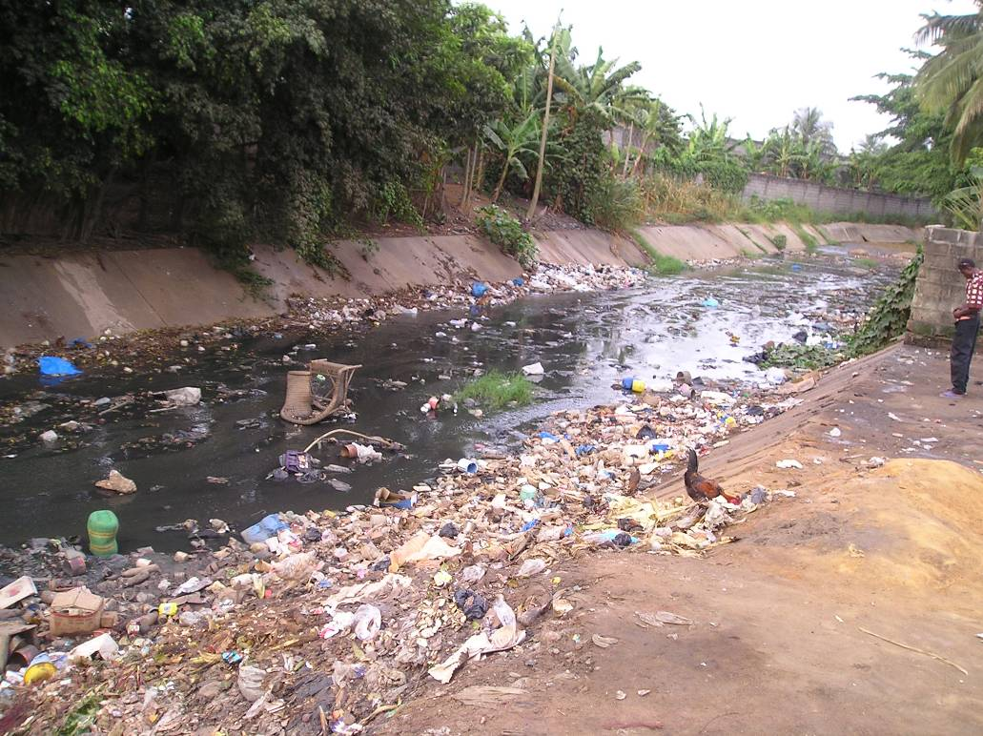
New approach, turning waste into wealth
Worldwide, the new environmental paradigm is to eliminate the concept of throwing away waste and replace it with the concept of considering waste as a resource
Focus on “Reduce, Reuse, Recycle” paradigm
Considers both solid waste and wastewater
Solid waste
Wastewater
Feacal sludge

Slide 3
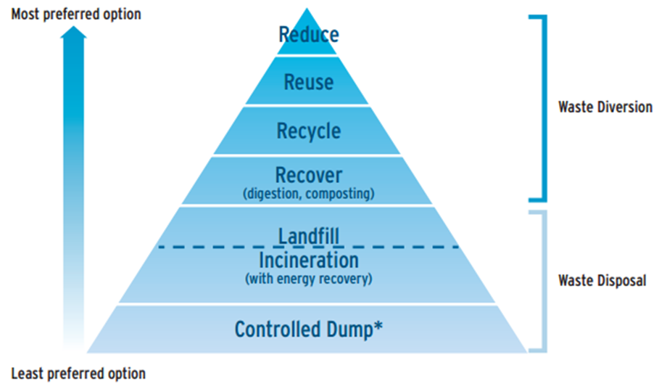
Waste management options
Reduce: reduce the amount
Reuse : someone’s waste used else
Recycle: use in another way or process
Recover: handle, keep, clean, transform, improve, return to the economy
Many other R's:….. repair, rethink …
Repair: take old and little defected things and repair them
Rethink: environmentally sound management of waste

Slide 4


Closing the loop....
This approach has fifth fold outcome:
  Reduce the contamination load on water bodies
  Reduce water scarcity
  Reduce CO2 emission
  Recycle fertilizers in food production
  Produce renewable energy

Slide 5
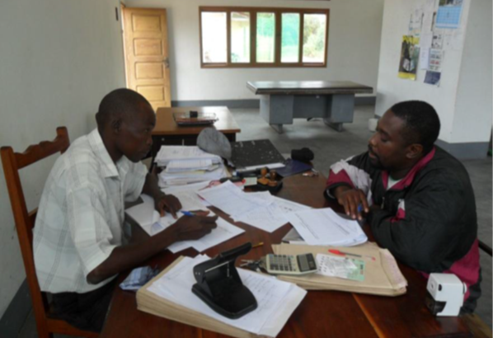
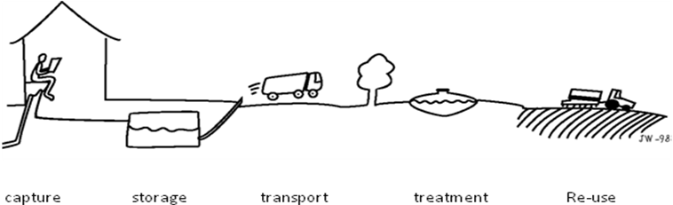
Looking through the sustainability lens
Institutional
Social
Financial
Technical
Considering the institutional aspect..
Environment
Health
Capturing topics such as:
Planning process
Stakeholder engagement and ownership
Policy and regulatory framework
Capacity and resources
Certification and quality ensurance
Monitoring
Examples:
South Africa
Brazil
Philippines
Burkina Faso
Sweden
…
SYSTEM APPROACH
Drawing by Jan Wijkmark

Slide 6
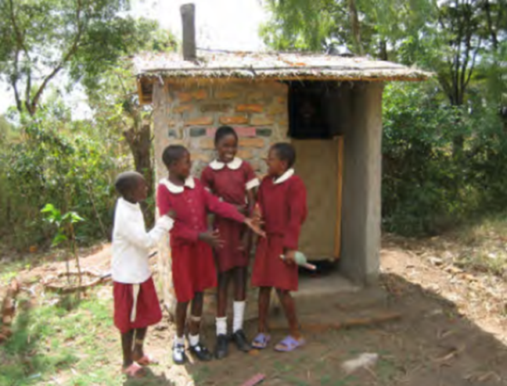
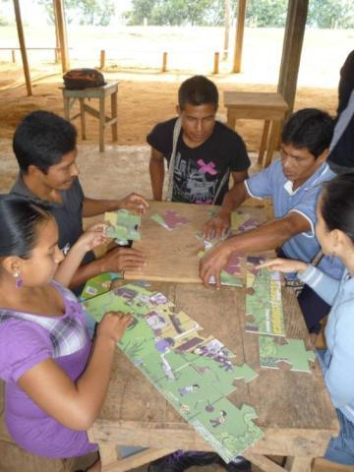
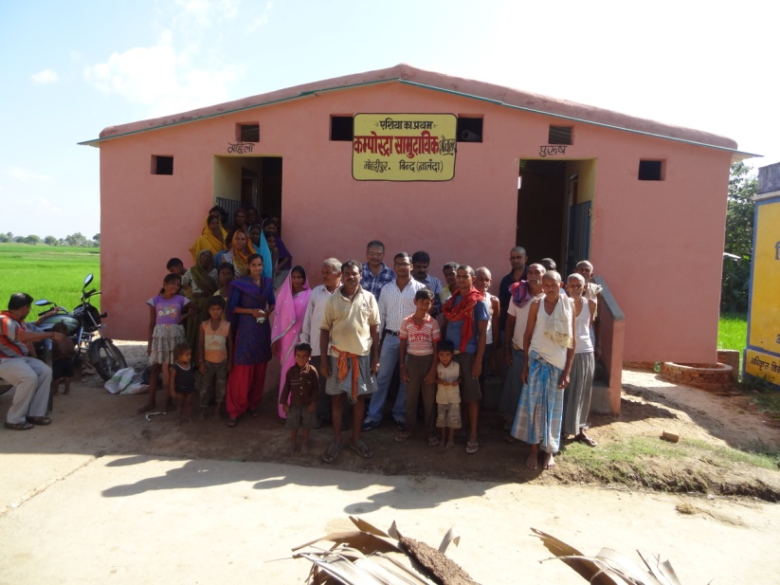
Social
Institutional
Social
Capturing topics such as:
Capacity development (e.g. awareness, local capacity)
Participation (e.g. intervention models, community organisation)
Gender and equity
Cultural acceptance
Socio-economic context (e.g. capacity and willingness to pay)
Financial
Technical
Health
Environment

Slide 7
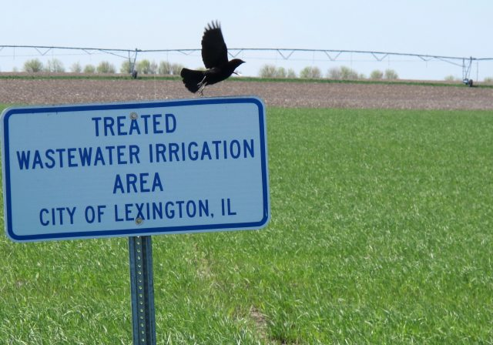
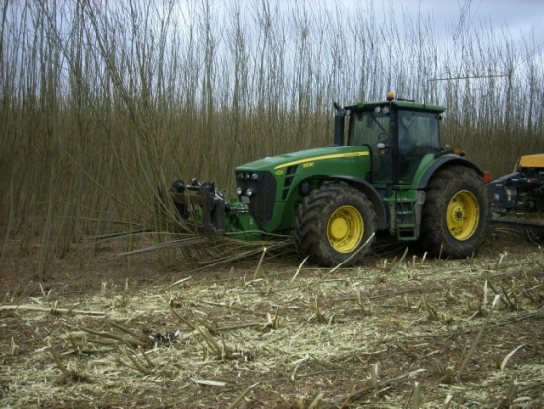
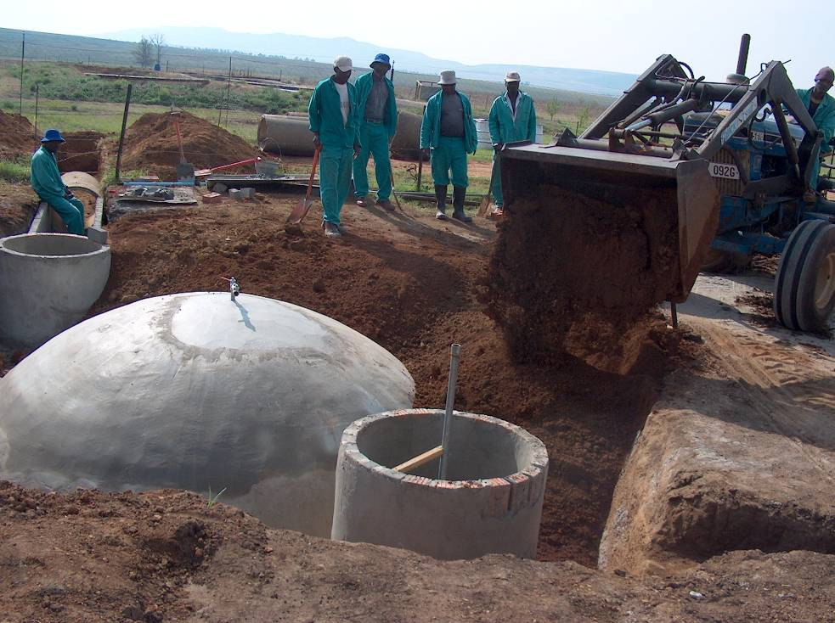
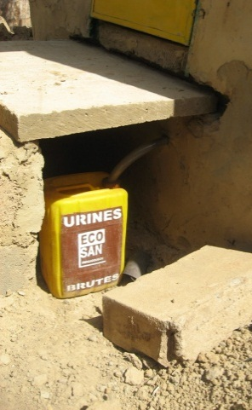
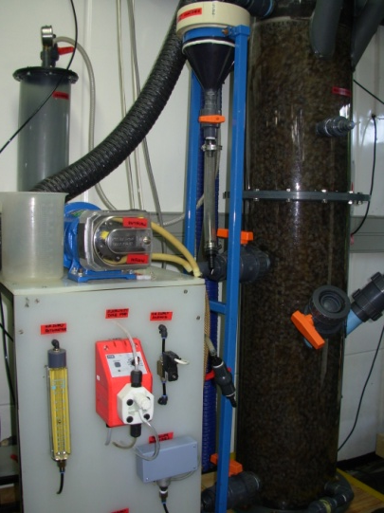
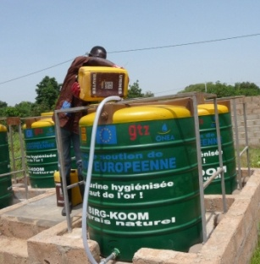
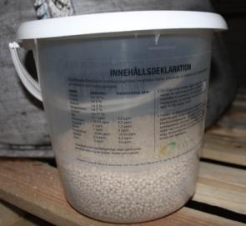
Technical
Institutional
Social
Diverse set of solutions for resource utilization
Financial
Technical
Health
Environment

Slide 8
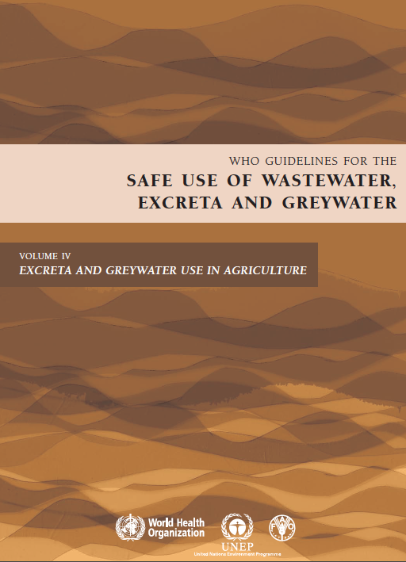
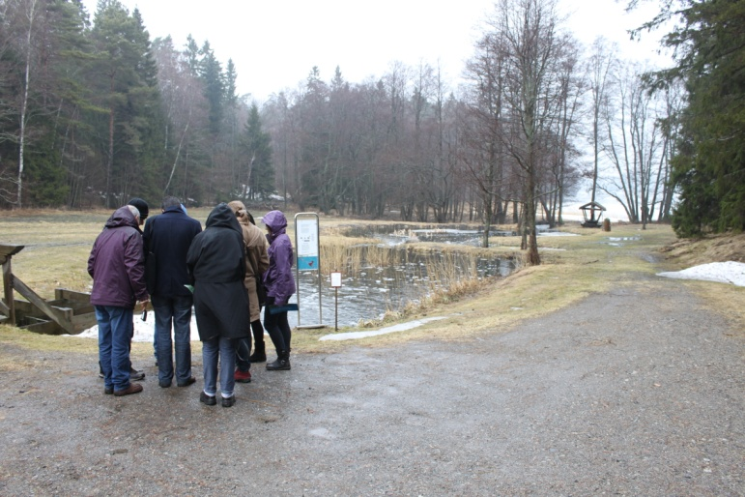
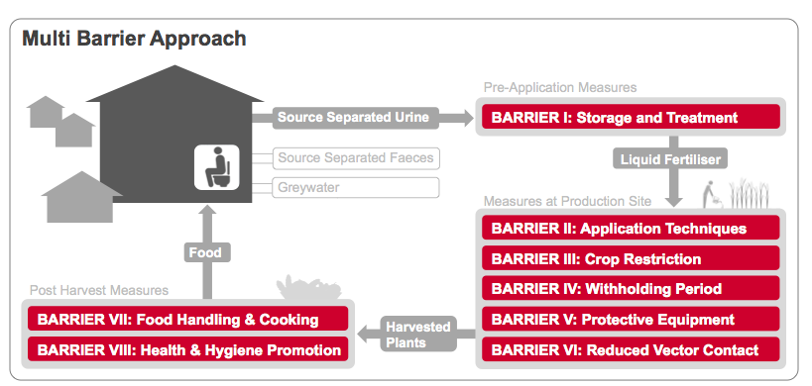
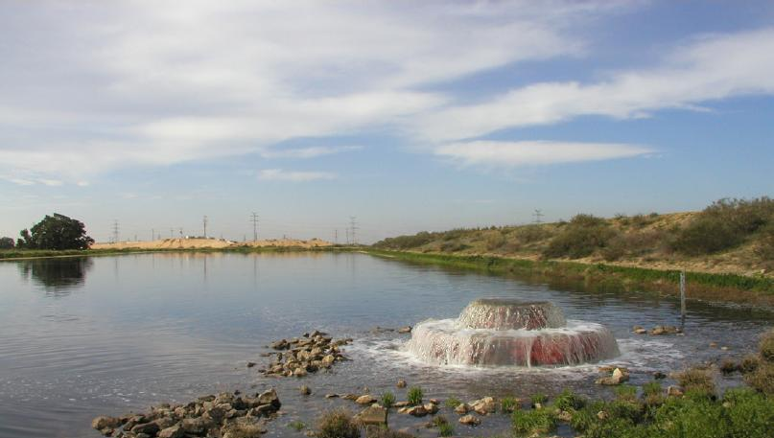
Health
Environment
Institutional
Social
Institutional
Social
Capturing topics such as:
Environmental protection
Protecting and enhancing ES
Natural treatment capacity
Ground water recharge
Creation of new habitats (e.g. constructed wetlands)
Potential cases: Namibia, Egypt, Philippines, Sweden,…
Financial
Technical
Financial
Technical
Environment
Health
Environment
Health
Capturing :
Integrated WASH approach
Reuse guidelines
Sanitation Safety Planning
Potential cases: Jordan
Recharge pond. Source: LOFTUS (2011)

Slide 9
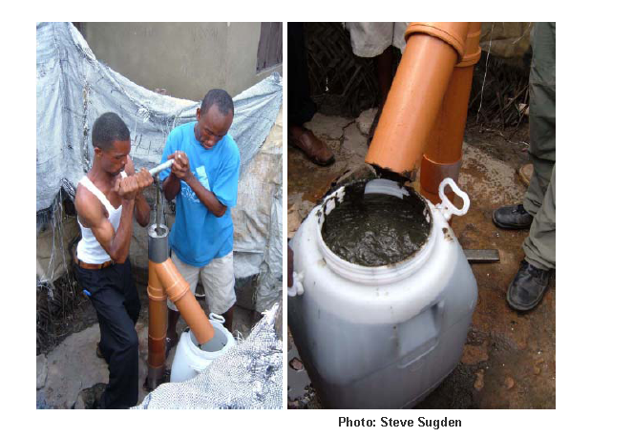
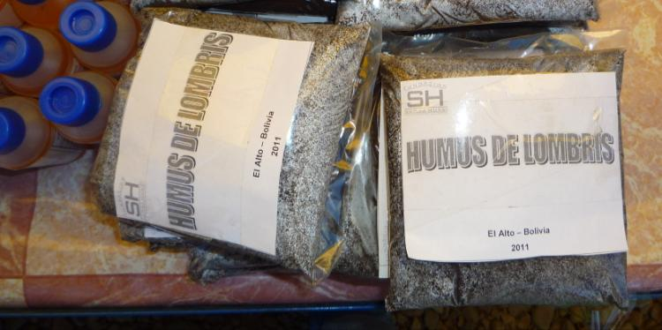
Financial
Institutional
Social
Capturing topics such as:
Financial models
Cost-Benefit Analyses
(e.g. costs for doing nothing – in health impacts and environmental degradation)
Sanitation as a Business
Financial
Technical
Health
Environment
Potential cases:
Jamaica
South Africa
India
…

Slide 10
Using the EcoSan approach………..
Waste segregation and possible utilization options. (UNESCO/IHP & GTZ, 2006)

Slide 11


Shifting focus from waste removal to resource recovery
RESOURCE MANAGEMENT OPTIONS
Water recycling
Potable water
Flush water
Industrial
TECHNICAL SYSTEM OPTIONS
Decentralized or centralized
Waterborne excreta management
Non-waterborne excreta management
Separate greywater management
Sludge management
On- or offsite treatment
Wastewater treatment options
Excreta and sludge treatment options
RESOURCES FROM EXCRETA AND WASTEWATER
Water and nutrient reuse
Agricultural irrigation
Forestry irrigation
Aquaculture
POTENTIAL MULTIPLE BENEFITS
water, nutrients, organic matter, and energy
Health protection
Environmental protection
Livelihoods
Water security
Food security
Energy security
Nutrient reuse
Solid fertilizer
Liquid fertilizer
Energy generation
Biogas generation
Biomass production
Ecosystem services
Groundwater recharge
Wetland biotope
Other outputs, e.g.
Protein feed
Building material

Slide 12
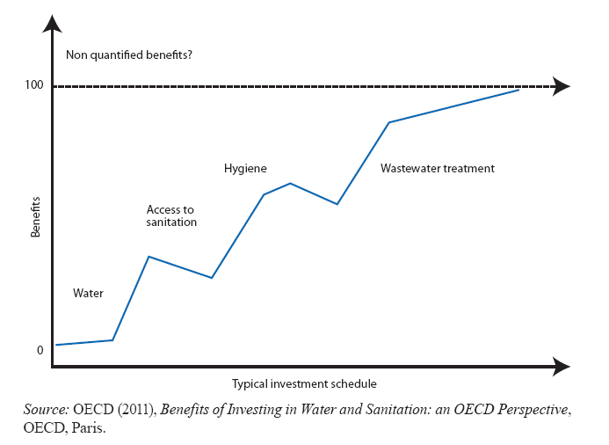
Benefits of investing in water and sanitation

Slide 13
Benefits for local communities & Society
Wastewater
Provides a source of income to farmers
Alternative fertiliser and irrigation source from domestic WW
Recycling of local water and nutrient sources
Reduction of energy consumption requirements for the production of artificial fertilizer
Opportunities to reduce costs for conventional WW treatment (investment, operation, disposal)
Supporting compliance with environmental legislation
Biomass
Increase in soil organic matter content and soil fertility
Increased income from improved biomass yields due to irrigation and fertilization
Opportunities to produce renewable biomass for local heat and power generation
Supporting local economy by establishing local biomass supply chains
It contribute to reducing dependency upon fossil fuels
Getting green areas

Slide 14
Benefits for other sectors?
Energy sector: both wastewater (sludge) and the biomass can be an efficient and renewable source of energy,
Water sector:
  Reducing freshwater withdrawal
  Contributing to groundwater recharge
  Improving water quality
Economy:
  the implementation of this integrated agro-forestry land-use system, particularly on larger scale, can furthermore create income and job opportunities for many people at a local level.
Food security:
  Aquaculture
  livestock
  Crops
Health sector:
  Reducing WW related diseases
Forest

Slide 15
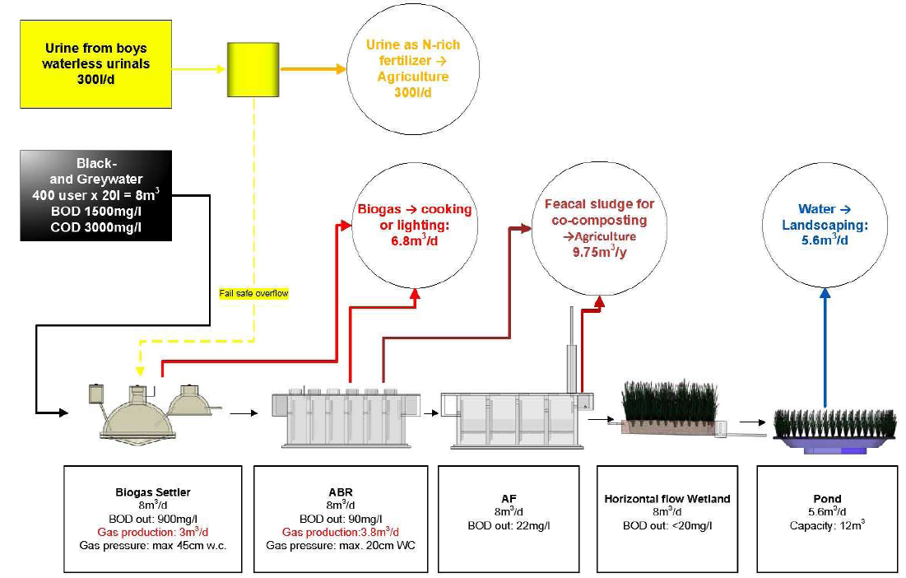

Decentralized Wastewater Management at Adarsh College - India
Decentralized Wastewater Management at Adarsh College – India- Ecosan approach
Anaerobic Baffled Reator
Anaerobic Filter

Slide 16
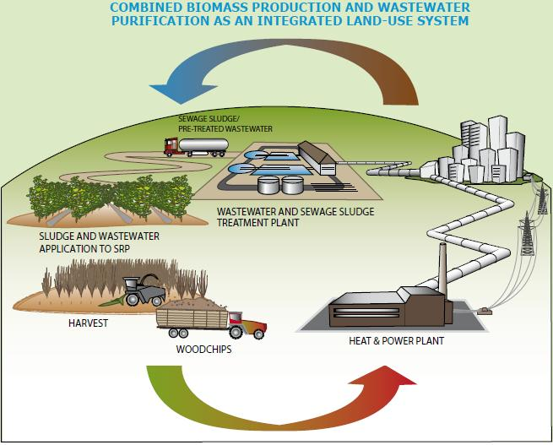
Schematic of the short rotation plantation. Source: EUBIA (n.y.)

Slide 17
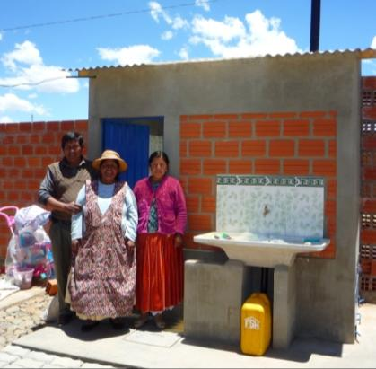
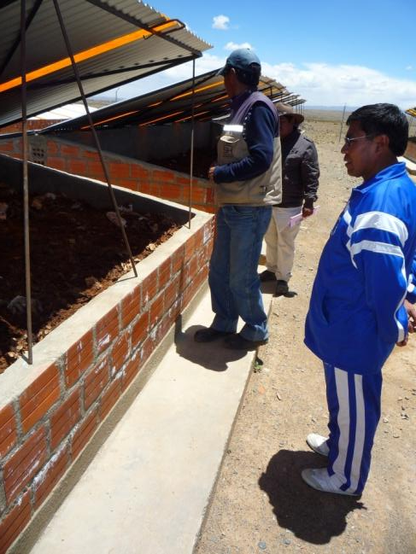
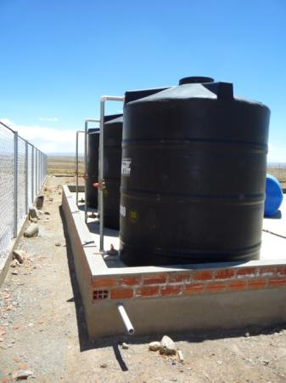
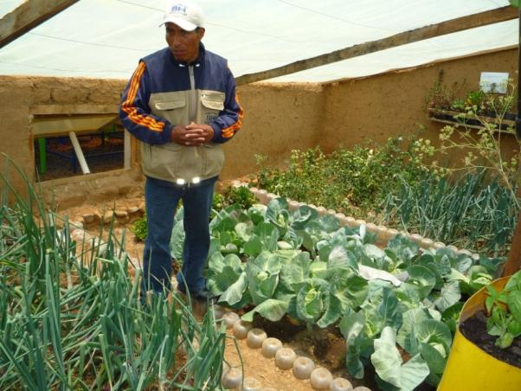
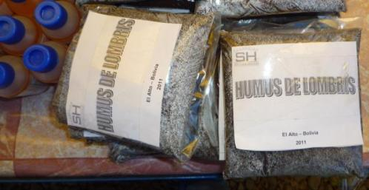


Non-waterborne excreta management:
Urine diverting dry toilets
Central collection and treatment
Reuse in crop
El Alto, Bolivia

Slide 18

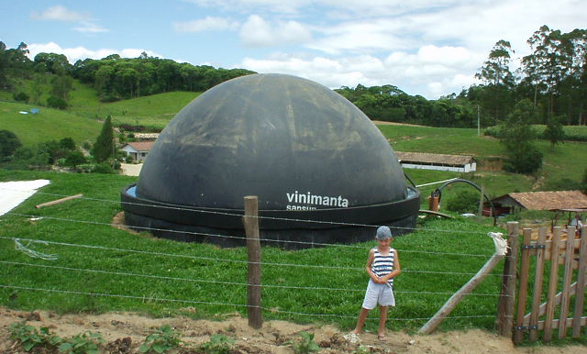
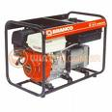

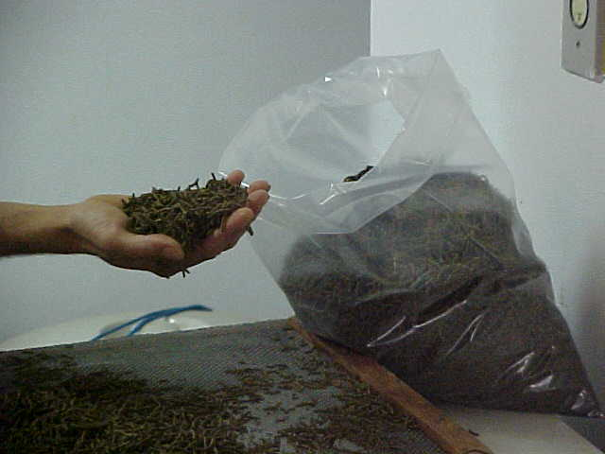
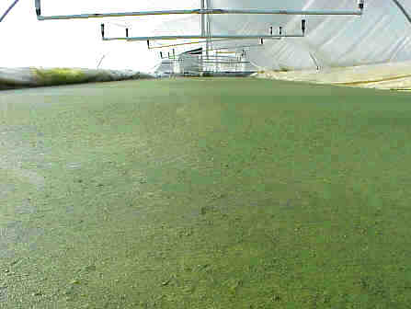
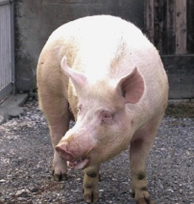
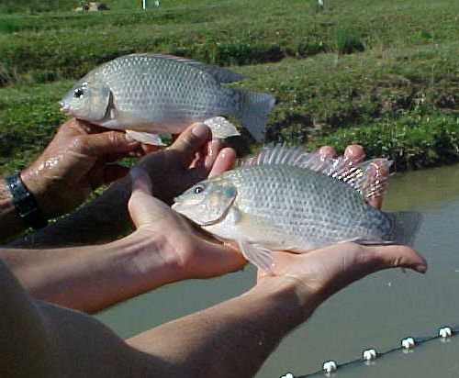
Electricity generator by Biogas
CH₄
Methane Combustion= CO₂
Swine waste
Food
CO₂
Duckweeds Lagoon

Slide 19
Niger: use of duckweed (Lemna spp.)in WW treatment and fodder production
to clean water in stabilisation providing high quality of effluent,
harvesting of duckweed for use as:
  a feed for on-site aquaculture
  animal feed) provides additional income generation for the system.
use of treated water for irrigating additional plants such as Moringa and Leptadenia adds to the financial stability of the agro sanitary system.
Water hyacinth (already there!) within the Niger River could also offer other perspectives

Slide 20
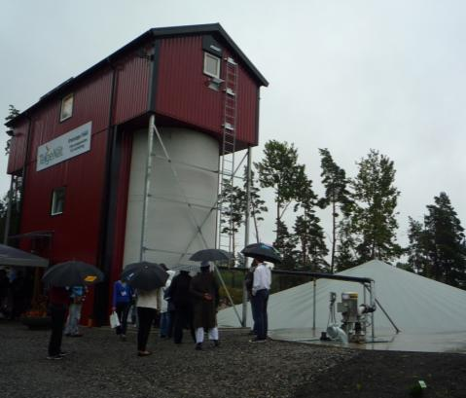

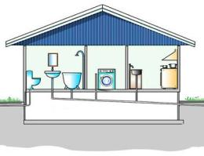
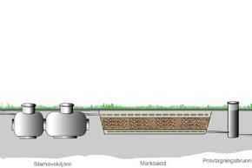
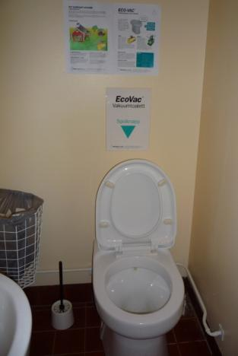
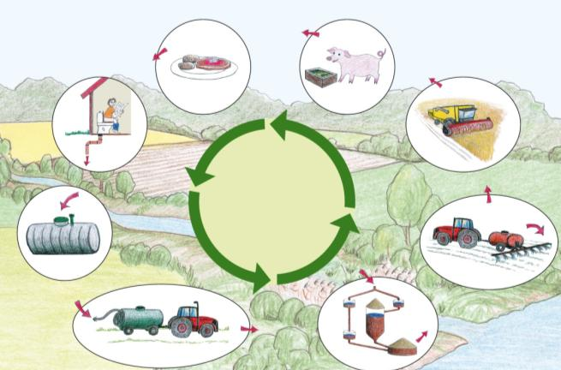
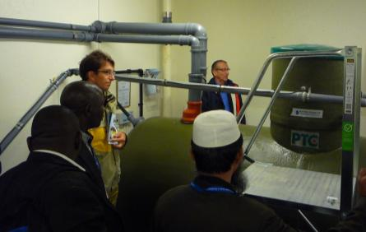
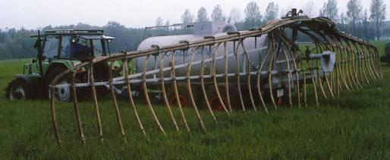

Decentralized wastewater management:
Low-flush vacuum toilets – Wet-composting and urea treatment – Reuse in (energy) crop
Södertälje Municipality, Sweden

Slide 21
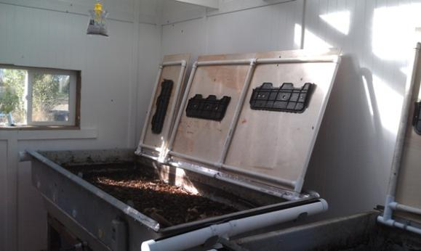
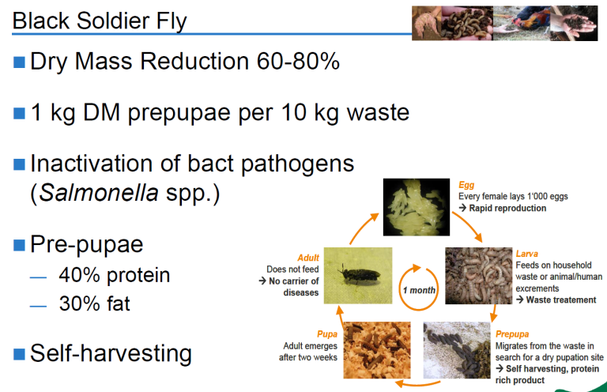
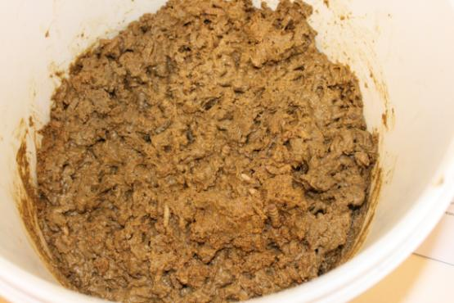
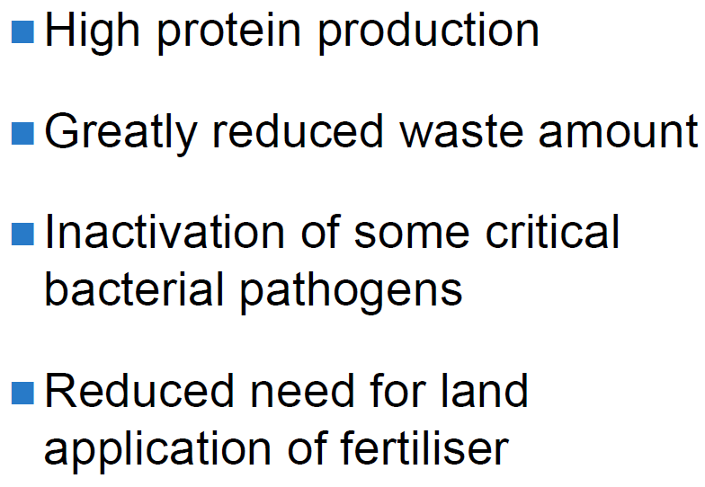

Protein production from waste products:
www.dipterra.com
Potentials for wastewater sludge and excreta management
Projects in Uganda, South Africa, USA, Sweden..

Slide 22
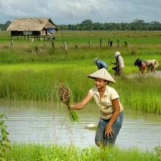
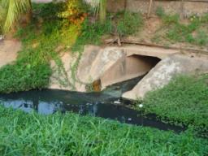
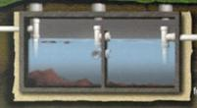
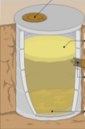
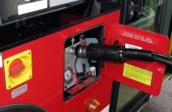
Making wealth from waste-Resource based management
Concept example from Vientiane, Laos
Used as fertilizer after treatment/processing
Urban channels
Septic Tank
Discharge
Biosolid
Food Security
Water Security
Harvested plants
Sludge
Wastewater
Urine
Food and Fibre
Biogas
Organic solid waste
Energy Security
Energy
Fuel or electricity
Urban centre

Slide 23



Example - Llobregat River Basin
Barcelona city
1,619,337 inhabitants
Area: 4,948 km²
Length: 156.5 km

Slide 24

Example - Llobregat River Basin

Slide 25

Example - Llobregat River Basin

Slide 26

Example - Llobregat River Basin
 | El Prat de Llobregat WWTP (hm³/yr) | Sant Feliu de Llobregat WWTP (hm³/yr)
Agriculture | 13.09 | 7.36
River stream flow | 10.37 | -
Wetlands | 6.31 | -
Seawater barrier | 0.91 | -
Municipalities | - | 0.11
Recreation | - | 0.37
Industry | 5.48 | -
Total | 36.2 | 7.84

Slide 27

Example - Llobregat River Basin
El Prat de Llobregat area | 5 245 000 EUR/yr for 13 hm³/yr
Sant Feliu de Llobregat area | 1 607 000 EUR/yr for 7.3 hm³/yr
Total annual cost | 6 852 000 EUR/yr for 20.3 hm³/yr
Average unit cost of water release | 0.34 EUR/m³

Slide 28

Example - Llobregat River Basin
 | Sant Feliu area (EUR/yr) | El Prat area (EUR/yr) | Total (EUR/yr)
Pumping costs | - 62 672 | -321 177 | - 383 849
Fertilizing costs | -10 419 | - 30 017 | - 40 436
Sales revenue | - 388 139 | 0 | - 388 139
Conveying reclaimed water | 208 390 | 120 066 | 328 456
Change of farmers´ income | 252 840 (20%) | 231 127 (5%) | 483 967 (25%)

Slide 29

Example - Llobregat River Basin

Slide 30


Example - Llobregat River Basin

Slide 31
THANK YOU FOR YOUR ATTENTION
Dr Birguy Lamizana
Birguy.lamizana@unep.org
www.unep.org/gpa

