Slide 1
Dietary xylanase addition and nutrient digestibility, rumen fermentation and duodenal fiber digestion in sheep
UNIVERSIDAD AUTÓNOMA DEL ESTADO DE MÉXICO
Facultad de Medicina Veterinaria y Zootecnia
A. Z. M. Salem
Professor – Researcher
asalem70@yahoo.com asalem70@hotmail.com
International Conference on Livestock Nutrition, August 11-12, 2015, Frankfurt, Germany

Slide 2
Project
Organization: International Atomic Energy Agency (IAEA), joint FAO/IAEA, division of Nuclear Techniques in Food and Agriculture
Project No.: MEX 16307.
Project period : 2010-2015
Proposal title: Influence of Exogenous Enzymes on the Nutritive Value of Some Mexican Fibrous Forage in Ruminants
Participants:
Dr. A. Z. M. Salem (Chief Scientific Investigator)

Slide 3
PROJECT MAIN OBJECTIVE
Improve the nutritive value of fibrous feeds using the exogenous enzymes as feed additives
7th Annual International Symposium on Agriculture, 14-17 July 2014, Athens, Greece

Slide 4
Introduction
Improving feed utilization in ruminant nutrition
Fibrolytic enzymes
Use additives
Live yeast
Phytogenic extracts

Slide 5
Fibrolytic enzymes
Commercial enzyme products, either from fungal or bacterial sources, have been widely used in livestock feeding
Feeding ﬁbre-degrading enzymes has been shown to improve feed utilization and animal performance but the mode of action has remained unclear

Slide 6
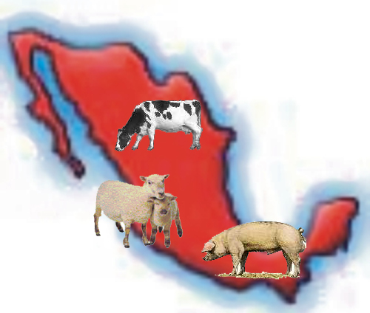
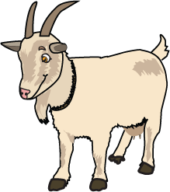
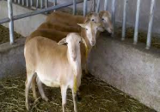
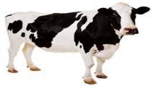
ENZYMES IN RUMINATES FEEDING
Enhancing attachment and colonization to the plant cell wall by ruminal microorganism
Enhance fibre fermentation and digestibility
Enhance ruminal microorganism’s activities
Reduced digesta viscosity
Influence gut permeability, and modulate immune function
Modify the balance of intestinal microorganisms, adhere to intestinal mucosa and prevent pathogen adherence or activation
IMPROVING THE ANIMAL PERFORMANCE

Slide 7
Mode of action
Hydrolysis of dietary ﬁbre before ingestion
Synergistic enhancement with endogenous microbial enzymes in the rumen
Altering ruminal fermentation
Enhanced ruminal microorganisms attachment and colonization to the plant cell wall

Slide 8
Factors implicated in enzyme efficiency
Differences in enzyme activity
Application rate and composition
Animal physiological Stage
Time of enzyme delivery
Ruminal activity
Enzymes stability

Slide 9
Objetive
Determine the effects of adding different levels of Xylanase enzyme on feed intake, ruminal fermentation, nutrient digestibility, duodenal NDF and ADF digestibility sheep fed a basal diet with 30% corn stover.

Slide 10
Material and methods

Slide 11
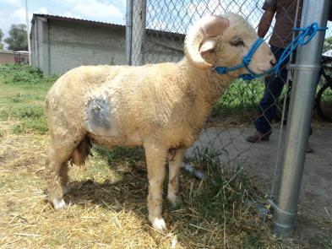
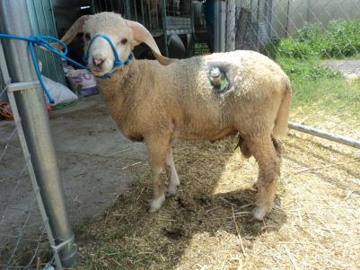
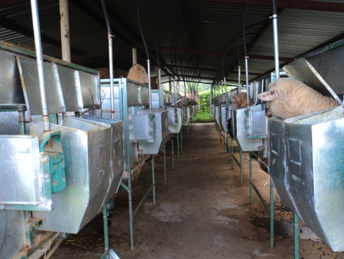
Animals
Four males Rambouillet sheep, weighing 39±1.8 kg
With permanent cannulas in the rumen and duodenum

Slide 12
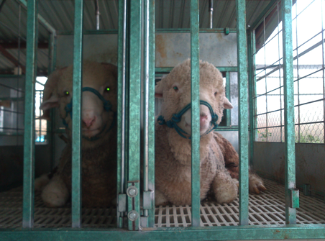
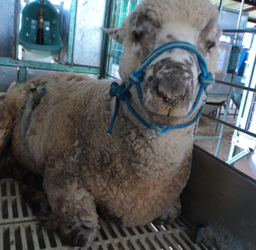
The sheep were housed in individual cages equipped with high automatic water valve steel bowls and fed a basal diet composed of 30% corn stover ad libitum for 84 days

Slide 13
Ingredients and chemical composition of the basal diet fed to the Rambouillet sheep (g/kg DM).
Ingredient | g/kg DM
Corn stover | 300
Ground sorghum grain | 520
Soybean meal | 60
Molasses | 80
Urea | 40
The basal diet was balanced for minerals and vitamins and formulated to cover the nutrient requirements of sheep according to NRC (1985) recommendations plus a 10% margin.
Sheep were randomly assigned to four treatments i.e. four doses of xylanase (XY; Xylanase® plus, Dyadic® PLUS, Dyadic international, Inc., Jupiter, FL, USA) at 0 (XY0), 1 (XY1), 3 (XY3), and 6 (XY6) µL /g DM of the basal diet in 4×4 Latin square design
The experimental periods consisted of 21 days with days 1-15 considered as the adaptation period to the experimental diets, and days 16 to 21 as the sample collection period

Slide 14
Parameters
Enzyme activity
Nutrient digestibility
The duodenal ADF and NDF digestibilities were determined on days16 and 17. About 500 mL of duodenal fluid was taken from each sheep 4 h after morning feeding

Slide 15
Rumen fluid was collected directly through the rumen cannula from the ventral sac of each sheep at 3, 6 and 9 h after morning feeding. The rumen samples (approx. 50 mL/ sheep) were immediately ﬁltered through four layers of cheesecloth, strained and stored in 45-mL glass bottles.

Slide 16
Ruminal methane (CH₄) production (L/d) was calculated according to the equation of Shibata et al. (1993) as:
CH₄ (L/d) = - 17.766 + 42.793 X - 0.849 X²;
where X = DMI (kg/d)
Microbial protein production (g/d) was calculated according to AFRC et al. (1984) as:
Microbial protein production (g/d) = 32 g /kg OM digested in the rumen

Slide 17
Results

Slide 18
p=
0.066 L, 0.508 Q
Fig. 1. Daily dry matter intake of a basal diet with different doses of xylanase (µL /g DM of the basal diet) and fed to the Rambouillet sheep (n=4)

Slide 19
p=
0.066 L, 0.508 Q
Fig. 2. Daily organic matter intake of a basal diet with different doses of xylanase (µL /g DM of the basal diet) and fed to the Rambouillet sheep (n=4)

Slide 20
p=
0.066 L, 0.508 Q
Fig. 3. Daily crude protein intake of a basal diet with different doses of xylanase (µL /g DM of the basal diet) and fed to the Rambouillet sheep (n=4)

Slide 21
p=
0.066 L, 0.508 Q
Fig. 4. Daily NDF intake of a basal diet with different doses of xylanase (µL /g DM of the basal diet) and fed to the Rambouillet sheep (n=4)

Slide 22
p=
0.066 L, 0.508 Q
Fig. 5. Daily ADF intake of a basal diet with different doses of xylanase (µL /g DM of the basal diet) and fed to the Rambouillet sheep (n=4)

Slide 23
p=
0.021 L, 0.014 Q
Fig. 6. Dry matter digestibility of a basal diet with different doses of xylanase (µL /g DM of the basal diet) and fed to the Rambouillet sheep (n=4)

Slide 24
p=
0.018 L, 0.014 Q
Fig. 7. Organic matter digestibility of a basal diet with different doses of xylanase (µL /g DM of the basal diet) and fed to the Rambouillet sheep (n=4)

Slide 25
p=
0.069 L, 0.015 Q
Fig. 8. Crude protrein digestibility of a basal diet with different doses of xylanase (µL /g DM of the basal diet) and fed to the Rambouillet sheep (n=4)

Slide 26
p=
0.008 L, 0.078 Q
Fig. 9. NDF digestibility of a basal diet with different doses of xylanase (µL /g DM of the basal diet) and fed to the Rambouillet sheep (n=4)

Slide 27
p=
0.031 L, 0.243 Q
Fig. 10. ADF digestibility of a basal diet with different doses of xylanase (µL /g DM of the basal diet) and fed to the Rambouillet sheep (n=4)

Slide 28
p=
0.122 L, 0.078 Q
Fig. 11. Duodenum NDF digestibility of a basal diet with different doses of xylanase (µL /g DM of the basal diet) and fed to the Rambouillet sheep (n=4)

Slide 29
p=
0.024 L, 0.050 Q
Fig. 12. Duodenum ADF digestibility of a basal diet with different doses of xylanase (µL /g DM of the basal diet) and fed to the Rambouillet sheep (n=4)

Slide 30
p=
0.198 L, 0.385 Q
p=
0.041 L, 0.051 Q
p=
0.039 L, 0.236 Q
Fig. 16. pH of rumen fermentation of Rambouillet sheep fed on a basal diet with different doses of xylanase (XY, µL /g DM of the basal diet) (n=4)

Slide 31
p=
0.933 L, 0.690 Q
p=
0.028 L, 0.929 Q
p=
0.604 L, 0.650 Q
Fig. 17. Ammonia-N of rumen fermentation of Rambouillet sheep fed on a basal diet with different doses of xylanase (XY, µL /g DM of the basal diet) (n=4)

Slide 32
p=
0.889 L, 0.058 Q
p=
0.105 L, 0.330 Q
p=
0.763 L, 0.948 Q
Fig. 18. Acetic acid of rumen fermentation of Rambouillet sheep fed on a basal diet with different doses of xylanase (XY, µL /g DM of the basal diet) (n=4)

Slide 33
p=
0.379 L, 0.026 Q
p=
0.530 L, 0.213 Q
p=
0.672 L, 0.037 Q
Fig. 19. Propionic acid of rumen fermentation of Rambouillet sheep fed on a basal diet with different doses of xylanase (XY, µL /g DM of the basal diet) (n=4)

Slide 34
p=
0.584 L, 0.871 Q
p=
0.426 L, 0.571 Q
p=
0.842 L, 0.372 Q
Fig. 16. Butiric acid of rumen fermentation of Rambouillet sheep fed on a basal diet with different doses of xylanase (XY, µL /g DM of the basal diet) (n=4)

Slide 35
p=
0.066 L, 0.015 Q
Fig. 21. Methane of rumen fermentation of Rambouillet sheep fed on a basal diet with different doses of xylanase (XY, µL /g DM of the basal diet) (n=4)

Slide 36
p=
0.506 L, 0.048 Q
Fig. 16. Microbial PC of rumen fermentation of Rambouillet sheep fed on a basal diet with different doses of xylanase (XY, µL /g DM of the basal diet) (n=4)

Slide 37
Conclusion
The levels of 3 and 6 µL xylanase/g DM of the basal diet had the highest nutrient digestibility and ruminal fermentation parameters. However, 6 µL xylanase/g DM of the basal diet of Rambouillet sheep elevated ruminal ammonia-N and individual VFA compared to the other levels.

