Slide 1


Effect of processing on in vitro bioaccessibility of phenolics, flavonoids and antioxidant activity of vegetables with/without yoghurt
Assoc. Prof. Dr. Esra ÇAPANOĞLU GÜVEN
Department of Food Engineering
Istanbul Technical University

Slide 2
Introduction
The best sources of antioxidants: Fruits & vegetables
Protective effects due to bioactive antioxidant compounds
Consumed fresh or processed into a variety of food products
Shelf-life, availability, new products, nutrition, quality
Health-promoting properties
Antioxidants
Processing

Slide 3
Introduction
Nature and conditions of the processes applied
Effect of processing on antioxidants
Variety/origin of the food material used
Biochemical properties of the antioxidant

Slide 4
Dietary antioxidants
Oxidative stress
Free oxygen radicals
Oxidative stress
Health disorders, ageing
Antioxidants in fruits and vegetables
Stabilize reactive oxygen species
Protect cellular lipids, proteins, and DNA
Antioxidants

Slide 5
Dietary antioxidants
Carotenoids
Food sources
↓ Risk
α-carotene, β-carotene, lutein, lycopene
tomato, carrot, spinach, chilli (red), kale, lettuce
cancer (lung and stomach) , CVD, eye diseases
Flavonoids
Food sources
↓ Risk
quercetin, hesperedin, naringenin, catechin, cyanidin, genistein
onions, apples, berries, tea, red wine, parsley, thyme, citrus, tea, apples, cherries, grapes, legumes
cancer , CVD, gastric and duodenal ulcers, allergies, infection
Vitamins
Food sources
↓ Risk
vitamin C, vitamin E,
vitamin A
orange, tomato, vegetable oils, nuts, carrot, tomato, green leafy vegetables
cancer, CVD, cataract development

Slide 6
Changes in antioxidant profile during food processing
High potential to affect the nutritional properties and biological activity of the end product
Both positive and negative effects
Thermal Treatments
Non-thermal Treatments
Blanching
Evaporation
Pasteurization
Canning
Drying
Boiling
Washing
Selection
Cutting
Homogenization
Packaging
Transportation
Storage

Slide 7
Changes in bioavailability
Bioavailability: “the proportion of a nutrient that is digested, absorbed, and metabolized through normal pathways”
Physiological effect is influenced by the active bioavailable dose
Food processing affects bioaccessibility and bioavailability (change in the chemical form of the compounds)
Lack of information on the effect of processing on bioavailability

Slide 8
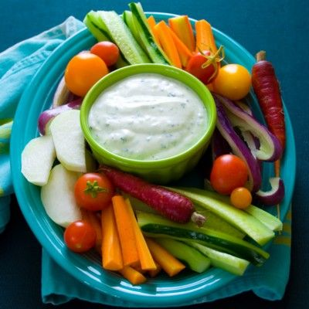
Vegetables and yoghurt
Home processed vegetables and yoghurt are commonly consumed together in Turkish diet.

Slide 9
Objectives
Determine the effects of food processing on total phenolics and antioxidant capacity
Investigate the effect of codigestion of commonly consumed vegetables and yoghurt in Turkey

Slide 10
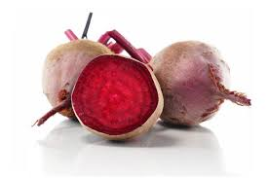
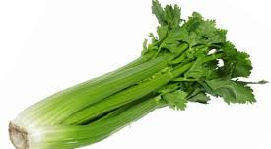
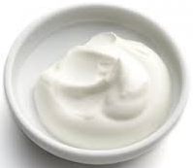
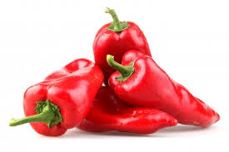
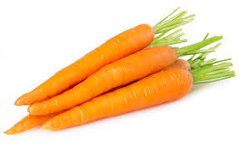
Materials
Red beetroot
Celery
Carrot
Red capia pepper

Slide 11
Processed materials
Raw
Sliced
Boiled
Roasted
~100°C
7 min
~200°C
7 min

Slide 12
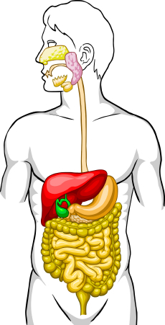
Methods

Slide 13
Methods
Chemical extraction
Total phenolic & total flavonoid contents
HPLC analysis
Total antioxidant capacity
  ABTS
  DPPH
  FRAP
  CUPRAC

Slide 14
Results and discussion
TP and TF results of raw materials
The results were given as; TP: mg GAE/100 g fresh sample; TF: mg rutin/100 g fresh sample

Slide 15
Results and discussion
AOX results of raw materials
All results were given as: µmol TEAC/100 g fresh sample

Slide 16
Processing effect

Slide 17
Results and discussion
a
b
b
b
a
a
ab
a
b
b
a
a
a
a
a
a
The results were given as; TP: mg GAE/100 g fresh sample; TF: mg rutin/100 g fresh sample; ABTSand FRAP: µmol TEAC/100 g fresh sample

Slide 18
Results and discussion
Total phenolic and flavonoid results
a
a
b
c
b
bc
c
c
The results were given as; TP: mg GAE/100 g fresh sample; TF: mg rutin/100 g fresh sample

Slide 19
Results and discussion
Total phenolic and flavonoid results
a
b
b
b
a
a
c
c
The results were given as; TP: mg GAE/100 g fresh sample; TF: mg rutin/100 g fresh sample

Slide 20
Results and discussion
AOX Analyses
a
ab
b
a
b
a
a
b
b
b
ab
a
b
b
ab
ab
All results were given as: µmol TEAC/100 g fresh sample

Slide 21
Results and discussion
Total phenolic and flavonoid results
a
ab
ab
a
b
a
b
c
The results were given as; TP: mg GAE/100 g fresh sample; TF: mg rutin/100 g fresh sample

Slide 22
Results and discussion
AOX Analyses
ab
a
b
b
a
a
b
a
a
b
c
a
b
d
c
c
All results were given as: µmol TEAC/100 g fresh sample

Slide 23
Results and discussion
HPLC Analysis
quercetin
Raw
luteolin derivatives
Roasted

Slide 24
Results and discussion
In vitro gastrointestinal digestion
Processing➔ High recovery

Slide 25
Effect of yoghurt addition

Slide 26
Results and discussion
%Recovery/Expected
The results were given as; TP: mg GAE/100 g sample; TF: mg rutin/100 g sample; DPPH, CUPRAC, ABTS and FRAP: µmol TEAC/100 g sample

Slide 27
Results and discussion
%Recovery/Expected
The results were given as; TP: mg GAE/100 g sample; TF: mg rutin/100 g sample; DPPH, CUPRAC, ABTS and FRAP: µmol TEAC/100 g sample

Slide 28
Results and discussion
%Recovery/Expected
The results were given as; TP: mg GAE/100 g sample; TF: mg rutin/100 g sample; DPPH, CUPRAC, ABTS and FRAP: µmol TEAC/100 g sample

Slide 29
Results and discussion
%Recovery/Expected
The results were given as; TP: mg GAE/100 g sample; TF: mg rutin/100 g sample; DPPH, CUPRAC, ABTS and FRAP: µmol TEAC/100 g sample

Slide 30
Conclusion
Effect of processing varies according to the type of the fruit/vegetable, variety, etc.
Roasting may have a positive impact on bioactives and AOX capacity of vegetables
Yoghurt addition may increase AOX capacity of vegetables
Yoghurt addition may also enhance the bioavailability of processed vegetables

Slide 31
Thank You!

