Slide 1
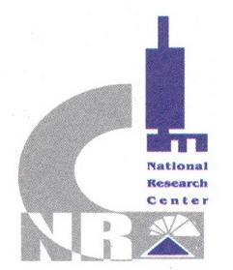


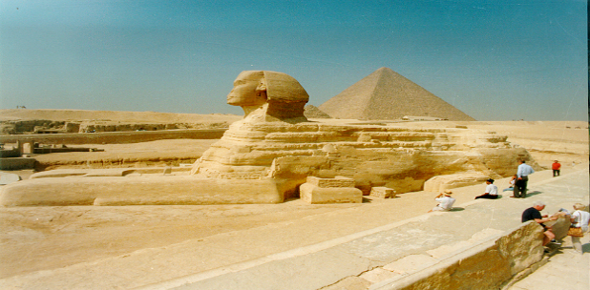
بسم الله الرحمن الرحيم
IN THE NAME OF GOD
Bee products as immunopotentiation
Ahmed Hegazi
National Research Centre,
Egypt

Slide 2
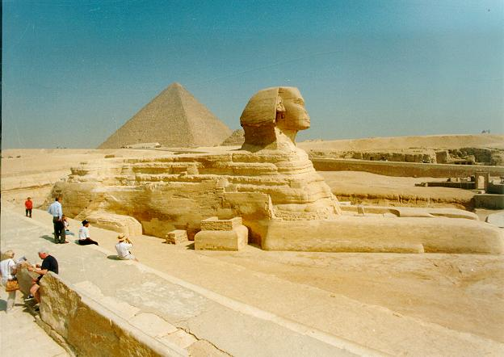

Bee products as immunopotentiation
Special thanks to Scientific Committee of the
4th International Conference and Exhibition on Immunology
September 28-30, 2015
Houston, Texas, USA

Slide 3

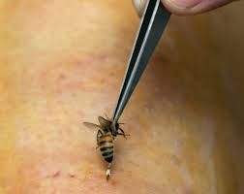
Bee products as immunopotentiation

Slide 4
The Immune System
Through a series of steps called the immune response, the immune system attacks organisms and substances that invade body systems and cause disease.
Surface barriers
  skin, lungs, stomach, tears, saliva, flora
Components of the Immune System:
  White Blood Cells circulate via blood and lymph.
  Lymph tissue
  Organs: thymus, spleen, bone marrow

Slide 5
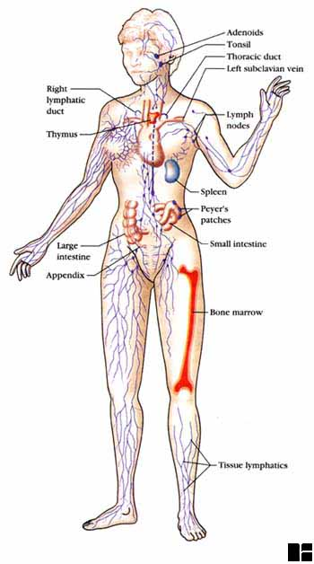

Slide 6

Introduction
Bee products as immunopotentiation
Apitherapy open a good area of researches to overcome many irritable disease problems which many patients are suffering from it, beside the horrible side effects of chemical drugs.

Slide 7
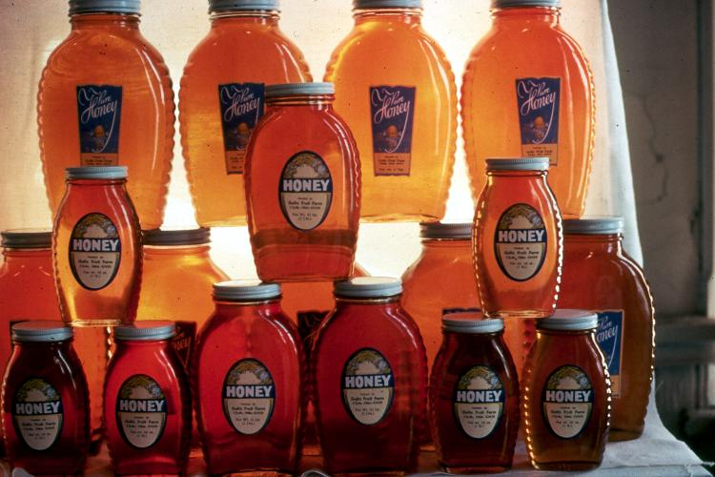
Obviously, honey bees are important for honey production…

Slide 8
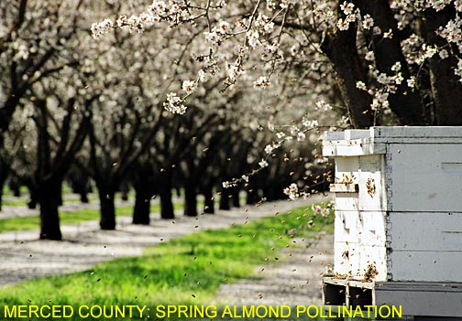
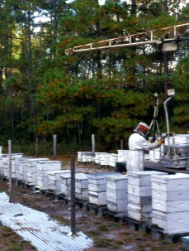
Crop pollination
…but they are even more important for crop pollination. Beehives are often contracted to be placed temporarily into fields and orchards to help pollinate crops. Over 100 different crops reply on honey bee pollination, accounting for $20 billion per year in added agricultural produce. African bees are much less amenable to transport and movement in agricultural contexts, which could ultimately increase the price of produce.

Slide 9
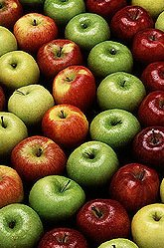
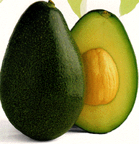
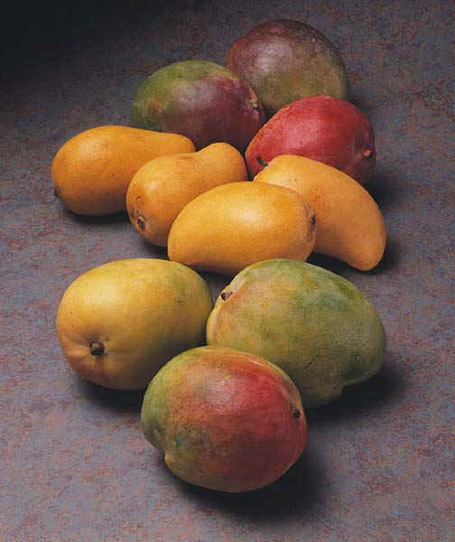
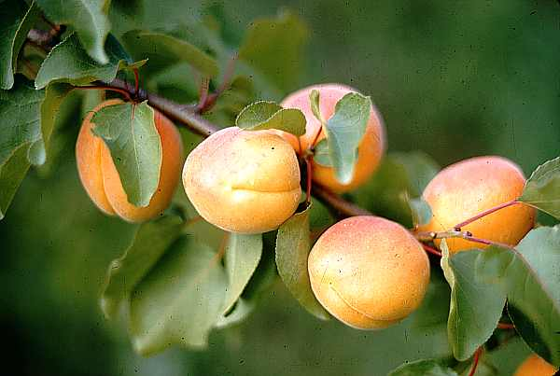
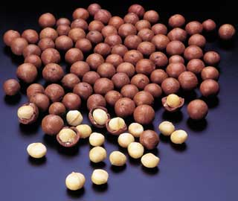
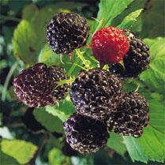
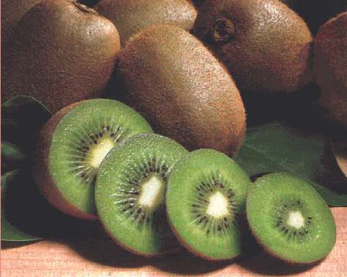
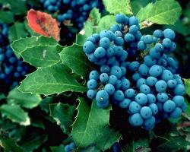
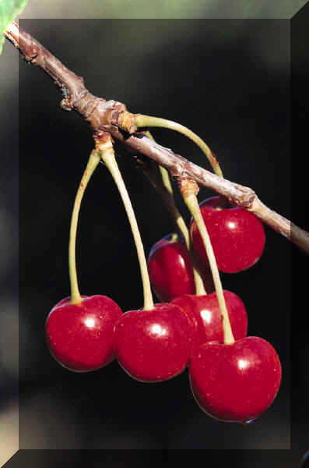
Fruits and Nuts

Slide 10
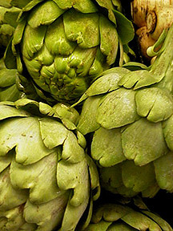
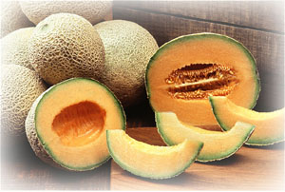
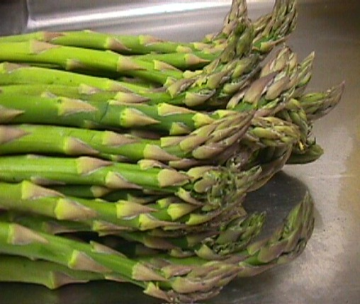
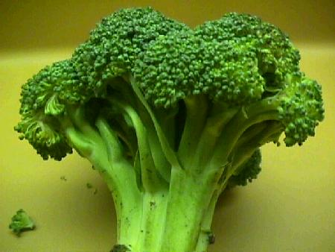
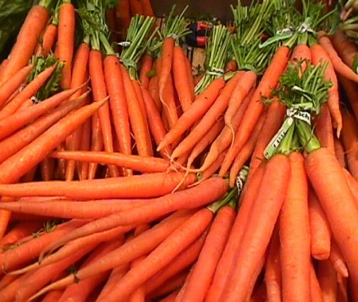
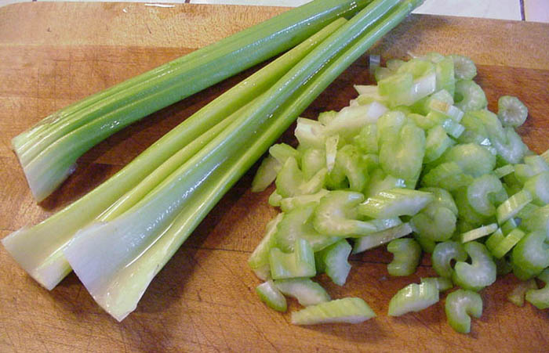
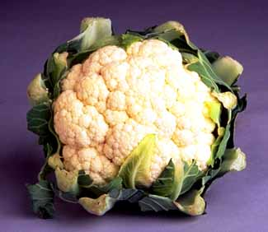
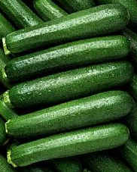
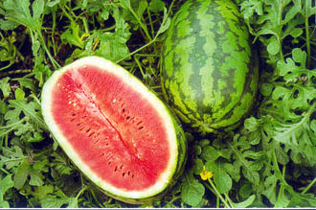
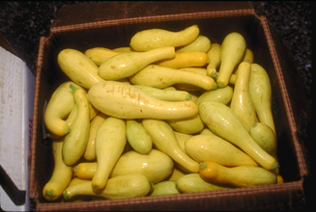
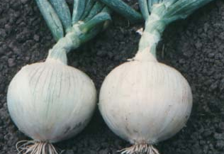
Vegetables and Melons

Slide 11
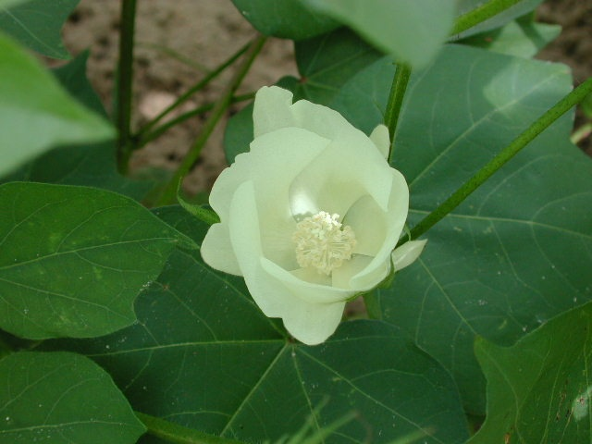

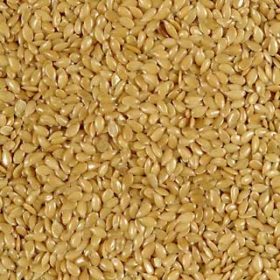

Field Crops

Slide 12
APITHERAPY
is the Complementary and Alternative Medicine promoting the use of bee products
Apitoxin or bee venom
Hive air
Comb beeswax
Drone larvae
Whole bees enteras
Honey
Bee bread
Pollen
Royal jelly
Propolis

Slide 13
WHAT IS APITHERAPY
“Apitherapy” is, simply said, the use of bee products to prevent, heal or recover somebody from one or more diseases/conditions.
The origin of this word is Api" comes from the bee's latin name: Apis mellifica
"therapy" comes from the Greek word "therapeuein" which means a method to treat the human beings or animals against different diseases.

Slide 14
APITHERAPY
Medical importance of bee products
For nutrition ,
Health
Life quality
Improvement
Prevention and treatment of diseases,
Cosmetics .

Slide 15
Apitherapy
All bee products have medicinal properties.
Their cost is pennies.
Easy obtened, storage, processing, and application.
Many diseases can be healed and prevented.
Apitherapy is available for poorest countries
Available for everyone
Synergic with antibiotics and other medications.

Slide 16
Apitherapy
Immunostimulant.
Anticancer.
Wound healers.
Antiviral, antifungal, wide-spectrum antibacterial.
No undesirable secondary effects.
No doctor’s prescription is needed.
They are the best medication world over

Slide 17
Apitherapy and beehives are an immediate answer to the need for
vitamins,
proteins,
antibiotics,
oral rehydratants,
anaesthetics,
antiseptics,
topical healers for wounds and burns,
tissue preservatives,
immunostimulants,
and other healing resources.

Slide 18
WHAT IS APITHERAPY
Apitherapy is not just a simple, therapeutically method;
it is already a different type of medicine.
We can even call it "APIMEDICINE".

Slide 19

History
From historical point of view the honey bees evolved roughly more than 100 - 160 million years.

Slide 20

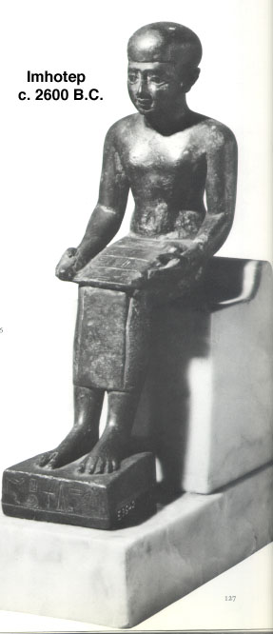



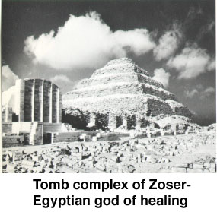
Imhotep, a physician who became a deified god

Slide 21
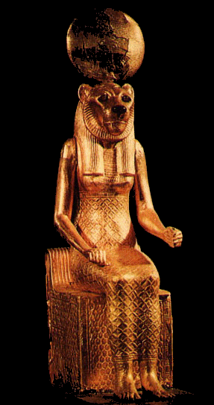
Ancient Egyptian Medicine
The Egyptians explained medicine as the work of the gods, caused by the presence of evil spirits or their poisons, and cleansing the body was the way to rid the body of their influence.
Incantations, prayers to the gods - above all to Sekhmet
Sekhmet Netjert (Goddess) of Healing

Slide 22
Bee products as immunopotentiation
History
The Holy Bible, in the old and New Testament points to the bees and their products for more than 40 times as urged eating honey, as gifts to inhabitants of countries faraway, as a good food either alone or with other food materials in the human diet.

Slide 23
Bee products as immunopotentiation
History
Where the Holy Koran has a long Surah (chapter) with the name of bees (No. 16, Surah Al Nahl). The God Says “ God inspired bees to live in mountains, trees and that they construct. Ten eat from fruits and follow the ways of the God. Hence comes out of their bellies, syrup of different hues, in which there are cure for people. In this there is a proof of those who think deeply”.
قال الله تعالى" بسم الله الرحمن الرحيم وأوحى ربك إلى النحل أن أتخذى من الجبال بيوتا ومن الشجر ومما يعرشون ثم كلى من كل الثمرات فأسلكى سبل ربك ذللا يخرج من بطونها شراب مختلف ألوانه فيه شفاء للناس إن فى ذلك لآية لقوم يتفكرون " ( النحل : 68 و 69 )

Slide 24

Bee products as immunopotentiation
History
  In the Holy Hadeth The prophet Mohammed mentioned 23 Hadeth. He described the Moamens like bees and he prefer honey as a food.

Slide 25
Bee products as immunopotentiation
History
  He was took honey as a gift from King of Egypt. Also he recommended that peoples not killed bees because they have a great role in the agriculture, medicine and nutrition

Slide 26

Bee products as immunopotentiation
History
Apitherapy has a great attention allover the world.
This prompted me to organize an International Symposium on Apitherapy where more than one thousand scientists were attended from 22 countries
These symposiums discussed 54 scientific papers in all aspects of apitherapy.

Slide 27
Bee products as immunopotentiation
History
The modern knowledge about the composition of every product gave the way for more demand of using such products in medicine

Slide 28
Hive Products
Honey
  Variable yields – 40 to 100 lbs/hive
  Depends on amount of rainfall, temperature, hive strength
Beeswax
  Small yield from honey comb cappings
Pollen
  Gathering pollen can weaken hive

Slide 29
Hive Products
Propolis
  Tree sap collected by bees
  Used by bees to patch small holes/cracks in hive that might harbor bacteria or pests

Slide 30
Honey

Slide 31
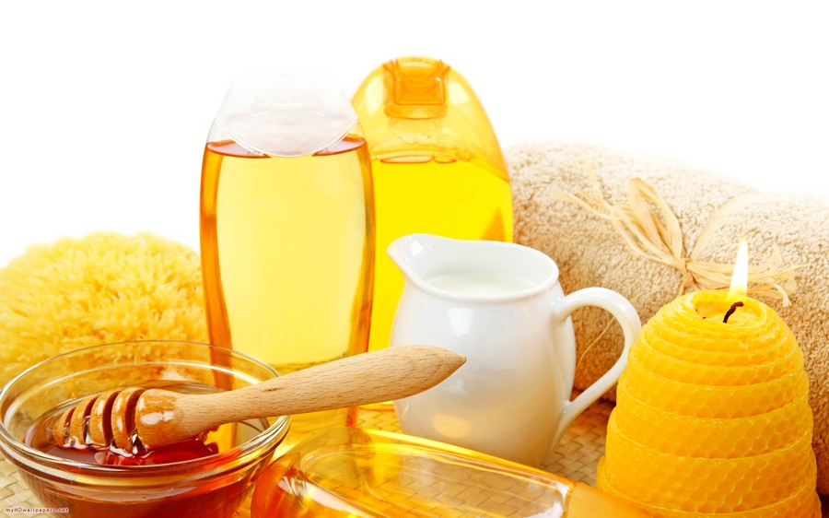
Bee products as immunopotentiation Honey
Honey is composed of various sugars, flavonoids, phenolic acids, enzymes, amino acids, proteins, and miscellaneous compounds
Its composition varies according to floral sources and origin

Slide 32
Bee products as immunopotentiation Honey
Honey is one of the oldest medicines.
Its use is recorded in Egyptian papyri dated from 1900 to 1250 B.C.
It is also mentioned in the Holy Qu'ran
used many of the Egyptian prescriptions.
Honey found that "cleans sores and ulcers of the lips,
heals carbuncles and running sores

Slide 33
Healthiest Benefits of Sweet Honey
Honey is a delicious natural liquid produced by honey bees after the hard efforts.
Honey bees gathering the nectar from flowers through a process of evaporation and regurgitation.
It is an oldest sweetener on the earth that has surprising healing powers.
There is no doubt that natural honey is a power house of health benefits that fight against the many health problems.

Slide 34
honey have many powerful qualities of antibacterial and antifungal properties.
Honey is very famous around the world as a natural remedy and also used this sweet in the preparation of medicines.
Honey is one of the best natural remedy that boost-up the immunity strength, improve the energy level and enhance the physical stamina.

Slide 35
Bee products as immunopotentiation Honey
It is believed that consuming honey regularly prevents the risk of developing many diseases and help to make you live longer.
Most of the peoples are not aware with the composition of honey, this natural liquid contain glucose, fructose and minerals such as potassium, magnesium, iron, phosphate etc.

Slide 36
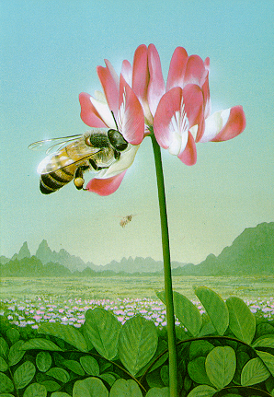
Bee products as immunopotentiation Honey
gives the best energy to the whole body
Cleanses the digestive tract
Stimulates the immune system
Cures skin wounds
Relaxes over-contracted muscles.

Slide 37
Bee products as immunopotentiation Honey
honey used for many different purposes:
as a laxative,
as a cure for diarrhea
Antimicrobial activity
Anti fungal
for coughs and throat maladies,
to agglutinate wounds

Slide 38
Bee products as immunopotentiation Honey
for eye diseases.
Stomach upset
treat dyspepsia and stomach ulcers
treatment for gastro-intestinal infections
Honey help to replace lost electrolytes and provide an energy source
Honey had activity against a range of dermatophytes, i.e. fungi causing skin infections such as ringworm

Slide 39
Bee products as immunopotentiation Honey
anti-inflammatory
antimicrobial
antimutagenic
antioxidant
antitumor effects.

Slide 40
The % of different constitute of honey
% | Constituents
16-20 | Water
52.9 | Fructose
20.4 | Glucose
1-3 | Scurose
4 | 0ther sugrs
0.3 | Protein
0.04 | Nitrogen
0.2 | Minerals
3.46 | Others

Slide 41
immunopotentiation
Honey
Honey induces apoptosis in various types of cancer cells via depolarization of mitochondrial membrane.
Honey elevates caspase 3 activation level and poly (ADP-ribose) polymerase (PARP) cleavage in human colon cancer cell lines which is attributed to its high
Honey generates ROS (reactive oxygen species) resulting in the activation of p53 and p53 in turn modulates the expression of pro- and antiapoptotic proteins like Bax and Bcl-2tryptophan and phenolic content

Slide 42

Prevent the risk Muscle fatigue
Muscle fatigue problem is normally associated with the athletes which can affect their performance level. Consuming sweet honey improves the stamina of athletes and also prevents the risk of muscle fatigue. The combination of glucose and fructose in sweet honey boost-up the energy level of the longer time.

Slide 43

Helps you to Better Sleep
Honey has sleep-inducing properties which help you to sleep well.

Slide 44

Treat the indigestion problem
Indigestion is a common problem that associated with the unhealthy lifestyle and poor dieting.
Consuming sweet honey helps in prevention of indigestion and gas problem.
So always add this sweetener in your diet to diminish the risk of indigestion and gas problem.

Slide 45
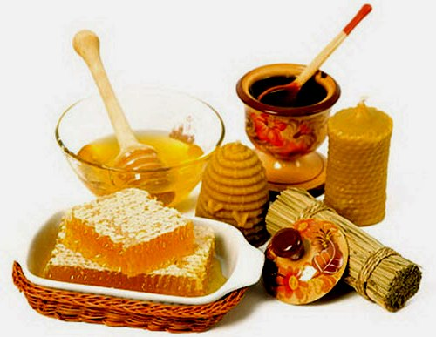
Enhance immunity strength and regulate blood sugar Level
Sweet honey is acts as an immunity booster due to the presence of phytonutrients that stimulate antibody production.
Peoples are always believed that sweet is not good for diabetic patients but honey is a natural sweetener that helps in the blood sugar regulation.
Unprocessed honey has the ability to control the blood sugar level, so it is very healthy for diabetic patients.

Slide 46
Honey and Its Anti-Inflammatory and Immunomodulatory Activities
Honey exhibits anti-inflammatory response.
Phenolic compounds in honey are responsible for anti-inflammatory activity
The mechanism involves the suppression of the proinflammatory activities of COX-2 and/or inducible nitric oxide synthase (iNOS) through these phenolic compounds or flavonoids.

Slide 47
Bee products as immunopotentiation Honey
Manuka, Pasture, Nigerian Jungle, and are found to increase production of
IL-1β,
IL-6,
TNF-α .
This immunomodulatory activity

Slide 48
Bee products as immunopotentiation Honey
Honey stimulates antibodies, B and T lymphocytes, neutrophils, monocytes, eosinophils, and natural killer cells (NK-cells) production during primary and secondary immune responses in tissue culture.

Slide 49
Bee products as immunopotentiation Honey
It has been shown that honey stimulates macrophages, T-cells, and B-cells to provoke antitumor effect
Immunoprotective activity of honey is often linked to anticancer action

Slide 50
Bee products as immunopotentiation Honey
honey may stimulate the immune system via these fermentable sugars .
A sugar, nigerooligosaccharides (NOS), present in honey has been found to have immunopotentiating activity .
Nonsugar components of honey may also be responsible for immunomodulation .

Slide 51
Bee products as immunopotentiation Honey
The possible mechanisms of honey are due to its apoptotic
antiproliferative
antitumor necrosis factor (anti-TNF)
antioxidant
anti-inflammatory
estrogenic
immunomodulatory activities.

Slide 52
Pollen

Slide 53
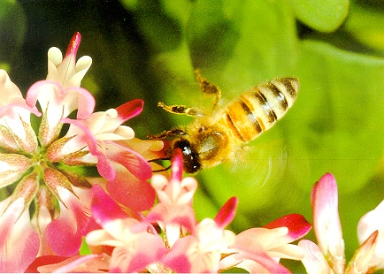
Bee products as immunopotentiation
Bee pollen
BEE POLLEN improves:
the functions of the liver
gives more strength to the heart
gives all necessary amino acids to the nervous system.

Slide 54
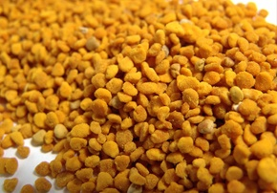
Bee products as immunopotentiation
Bee pollen
Improve the quality, quantity and circulation of the blood;
Improve the functioning of the adrenal glands, kidneys, liver, heart, and thymus,
thus helping the entire nervous system and body

Slide 55
Bee products as immunopotentiation
Bee pollen
Bee pollen is a mixture of the pollens picked up by bees as they fly from one flower to another.
Bee pollen is a popular folk remedy for many conditions, including PMS and enlarged prostate.
It’s also used as an energy tonic.

Slide 56
Bee pollen is true gift from Mother Nature.
It contains many essential nutrients.
The Greeks called it the “nectar of the gods.”
Bee pollen contains up to 35 percent complete protein,
22 amino acids,
B vitamins,
27 mineral salts, trace elements and several enzymes. NSP Bee Pollen is naturally dried to preserve vital enzymes.
Bee products as immunopotentiation
Bee pollen

Slide 57
Bee products as immunopotentiation
Bee pollen
bee pollen might reduce some side effects of radiation therapy for cancer.
chronic prostatitis or enlarged prostate.
Another study found that a product containing bee pollen (and several other ingredients) seemed to reduce PMS symptoms.

Slide 58
Bee products as immunopotentiation
Bee pollen
Boosting natural energy and combating chronic fatigue
Flagging spirits
Aiding healing
Regenerating the body and muscles
Preventing allergies
Lowering bad cholesterol
Decreasing fatty deposits in the body
With bee pollen, weight loss can also be achieved
Preventing infections and disease
Increasing your life span
Giving you youthful and healthy skin
Strengthening the immune system
Detoxifying the body
Increased vitality and energy
Balance the hormones in your body
Providing mental clarity

Slide 59
Who is Bee Pollen Best For?
Anyone under stress
Athletes and sports people
Anyone who has a weak immune system
Those recovering from illness
Those with long term health conditions
Anyone struggling with fatigue
Those who are trying to lose or maintain their weight
Those who want to boost their fertility

Slide 60
Bee venom

Slide 61
Bee products as immunopotentiation
Bee venom
BEE VENOM :
Help patients having MS as well as auto immune diseases very much.
Diminishes the inflammatory reactions in the affected areas

Slide 62
Bee products as immunopotentiation
Bee venom
Improves the blood circulation in the nervous system, and in the whole body.
Increases the natural production of cortisol in the adrenal glands
Gives more energy and stamina.

Slide 63

Bee products as immunopotentiation
Bee venom
There are 78 different components in the bee venom.
But not all these components are consistently present in every bee’s venom.

Slide 64
Bee products as immunopotentiation Bee venom
There are six primary components which are through to provide the major therapeutic benefits of bee venom therapy (BVT).

Slide 65
Bee products as immunopotentiation
Bee venom
Bee venom is made up of at least 18 pharmacological active compounds.
Melittin
Adolapin
Apamin
Phospholipase A1
Phospholipase A2

Slide 66
Bee products as immunopotentiation Bee venom
Hyaluronidase
Histamine
Mast Cell Degranulating Peptide (MCD)
Dopamine
Norepinephrine
Compound X

Slide 67
Bee products as immunopotentiation Bee venom
Acid phosphatase
Secapin
Leukotrienes
These compounds identified by(Schmidt, 1992)

Slide 68
Bee products as immunopotentiation
Bee venom
Immune system
Immune augmentation
Systemic lupus erythromatosis
AIDS
T cell suppression
B- enhancement

Slide 69
Bee products as immunopotentiation
Bee venom
Bee venom contains a number of powerful anti-inflammatory substances, including adolapin and melittin.
It is to be a hundred times more powerful than hydrocortisone,
melittin stimulates the body production of cortisol, a natural steroid that also acts as an anti-inflammatory.

Slide 70
In adaptive immune response
The effect of IL-10+ NK cells on Ag-specific T cell proliferation has been examined in bee venom major allergen
phospholipase A2- and purified protein derivative of Mycobecterium bovis-induced T cell proliferation.

Slide 71
Bee products as immunopotentiation
Bee venom
Moon et al., (2007) investigated the anti-inflammatory effect of BV and its major component, melittin (MEL), on lipopolysaccharide (LPS)-stimulated BV2 microglia.
Their findings indicate that BV and MEL exert anti-inflammatory effects by suppressing the transcription of cyclooxygenase (COX)-2 genes
and proinflammatory cytokines, such as interleukin (IL)-1 beta, IL-6 and tumor necrosis factor (TNF)-alpha.

Slide 72
Bee venom (BV)
These results demonstrate that BV and MEL possess a potent suppressive effect on proinflammatory responses of BV2 microglia
Also suggest that these compounds may offer substantial therapeutic potential for treatment of neurodegenerative diseases that are accompanied by microglial activation.

Slide 73
Bee venom (BV)
Mellitin had no effect on IL-1beta- or TNF-alpha-induced MMP1 or MMP3 production and did not decrease LPS-induced secretion of MMP1.
Among the serum proinflammatory cytokines, the production of TNF-alpha in the BV group was suppressed compared to the control group but IL-1beta was not suppressed.

Slide 74
Bee venom (BV)
in vivo bee venom treatment affects the production of IL-1 by macrophages directly ,
(Hadjipetrou-Kourounakis and Yiangou1988).

Slide 75
Bee venom (BV)
Korean bee venom (KBV) has anti-inflammatory properties that inhibit NOS and TNF-α expression.
KBV could be useful in inhibiting the production of inflammatory cytokine and NO production in neurodegenerative diseases (Han et al., 2007).

Slide 76
Bee venom (BV)
Hegazi et al., (2013) found that Propolis and bee venom are effective in treatment of psoriasis, with minimal tolerable side effects, when used either separately or in combination.
significant reduction in both PASI score and serum level of IL-1β was observed in all groups of patients.

Slide 77
Bee venom (BV)
Correlation between percentage reduction of PASI score and that of IL-1 β showed a strong positive correlation in group I received bee venom.

Slide 78
Bee venom (BV)
Continuous exposure of non-allergic beekeepers to high doses of bee venom antigens induces diminished T cell-related cutaneous late-phase swelling to bee stings in parallel with suppressed allergen-specific T cell proliferation and T helper type 1 (Th1) and Th2 cytokine secretion.

Slide 79
Bee venom (BV)
Meiler et al., (2008) found after multiple bee stings, venom antigen-specific Th1 and Th2 cells show a switch toward interleukin (IL) 10-secreting type 1 T regulatory (Tr1) cells.
T cell regulation continues as long as antigen exposure persists and returns to initial levels within 2 to 3 mo after bee stings.
.

Slide 80
Bee venom (BV)
Histamine receptor 2 up-regulated on specific Th2 cells displays a dual effect by directly suppressing allergen-stimulated T cells and increasing IL-10 production

Slide 81
Bee venom (BV)
Kim et al., (2008) found that bee venom. injected i.p at doses of more than 20 microl/100g mouse once a day for 14 days
inhibited the ability of inguinal lymph node cells to produce
    T cell cytokines interleukin-1 beta, -2, -6,
    tumor necrosis factor-alpha
    and interferon-gamma.

Slide 82
Bee venom (BV)
sensitization against bee venom was strongly enhanced during treatment with antihistamines.
Clemastine increased IgE production while decreasing IgG2a production against bee venom.

Slide 83
Bee venom (BV)
This T-helper type 2 shift of the humoral response appeared to be caused by reduced IFN-gamma and enhanced IL-4 secretion from allergen-specific T cells.
They also found reduced TNF-alpha, IL-6 and major histocompatibility complex class-II expression by macrophages.
In sensitized mice, the efficiency of allergen-specific immunotherapy was reduced by clemastine treatment.

Slide 84
Royal jelly

Slide 85
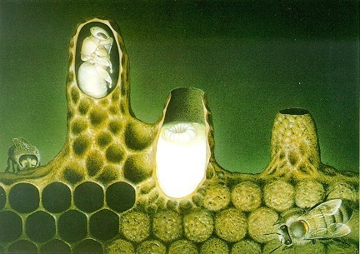
Bee products as immunopotentiation
ROYAL JELLY
ROYAL JELLY
Improve the quality of the cellular regeneration
To fight against auto-immune diseases
Increase longevity
It is the perfect food of Mother Nature

Slide 86
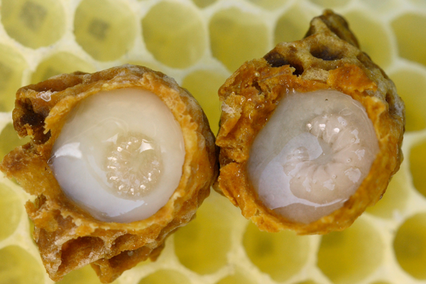
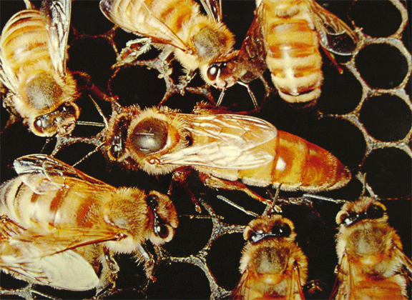
Royal Jelly

Slide 87
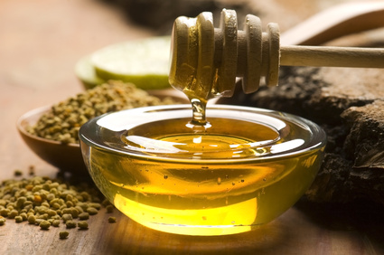
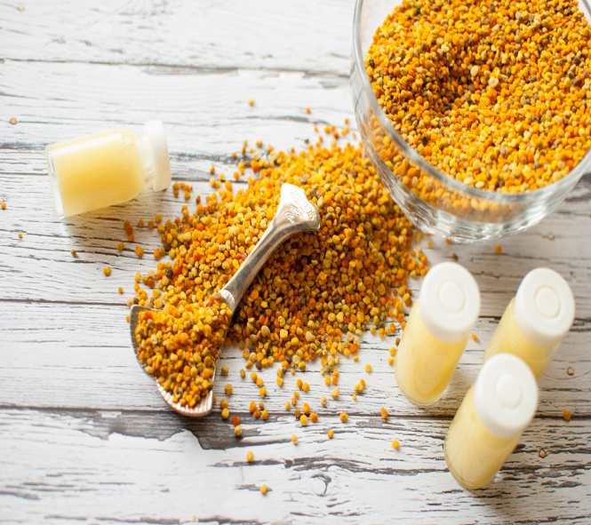
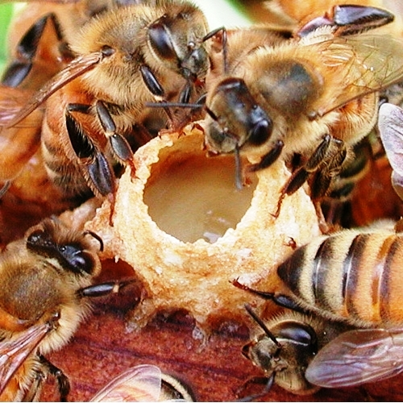
What is Royal Jelly
Royal jelly is a thick, milky substance,
with a composition similar to pollen,
made by the worker bees to feed the eggs
and the queen bee.

Slide 88

Inflammation
Antioxidant Power
Royal Jelly
Advantages
Skin Healing
Immune Modulator

Slide 89
Royal Jelly
royal jelly honeys are found to increase production of
IL-1β,
IL-6,
TNF-α .
This immunomodulatory

Slide 90
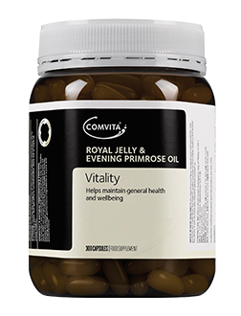
Royal jelly contains complex B vitamins, amino acids, fatty acids, minerals, enzymes, natural antibiotic properties, and antibacterial properties.
Royal jelly is known for its anti- aging, cholesterol-lowering,
anti-inflammatory, wound healing, antibiotic components
and antibacterial agents.

Slide 91
Royal Jelly
Royal jelly (RJ) proteins (apalbumin-1 and apalbumin-2) in honey have antitumor properties.
These proteins stimulate macrophages to release cytokines TNF-α, interleukin-1(IL-1) and interlueken-6 (IL-6)

Slide 92
Royal Jelly
Pasture, jelly bush, and Manuka honeys (at concentrations of 1% w/v) stimulate monocytes to release tumor necrosis factor-alpha and interleukin- (IL-) 1β and IL-6
The possible mechanism involves the binding of TNF-R to TNF-α and adaptor protein such as TNFR associated death domain protein (TRADD), TNF receptor associated factor (TRAF), and receptor-interacting protein (RIP) to regulate apoptosis and inflammation through these cytokines

Slide 93
Royal Jelly
This TNF-α release can play a pivotal role as a key cytokine to regulate important cellular processes such as apoptosis, cell proliferation, and inflammation

Slide 94
Propolis

Slide 95
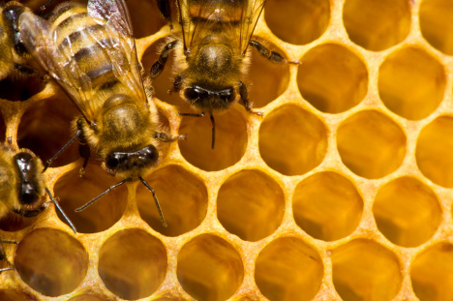
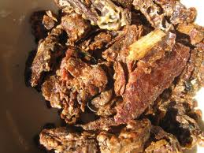
What is Propolis?
It is a powerful defence system produced by nature.
Natural anti-oxidant play a measure role in it.

Slide 96
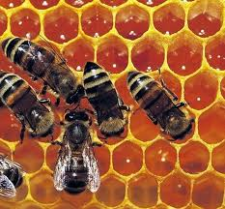
How Propolis is made?
A mixture of resin and sap is used to produce Propolis
Buds of conifer and poplar trees +beeswax + other bee secretions = Propolis

Slide 97
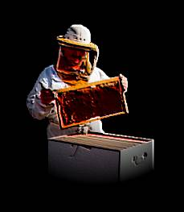
Bee products as immunopotentiation PROPOLIS
  Propolis, or "bee glue," is a well-known substance that beekeepers find in their hives.

Slide 98
Propolis
Essentially the “glue” in bee hives.
Made of plant resin.
Preserves warmth in hive and keeps out microbes.
Has various antimicrobial properties.
Used for healing and part of “apitherapy”.
Interesting uses including violin varnish.
Used since the Ancient Greeks and Romans discovered it.

Slide 99
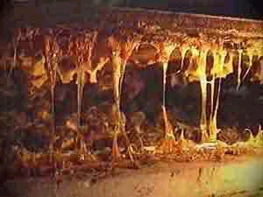
Propolis in the Hive
(Kulincevica & Gacica, 1991)

Slide 100
Major Components
Caffeic acid phenethyl ether or CAPE.
Phenolics
Terpenes
Hydrocarbons
Acids
Flavonoids

Slide 101
Uses of Propolis
Dentistry procedures
Treating Herpes simplex virus type 1 and 2
Parasitic infections
Burns
Canker sores
Colds (Prevention and treatment)
Dental pain and plaque
Gingivitis
Fungal infections
Legg- calve-Perthes disease
Rheumatic diseases
Stomach ulcers
Vaginitis
Propolis is used by many.
Some pharmaceutical giant companies have special R&D for Propolis.

Slide 102
Properties of Propolis in General
Stimulates antibody production.
Inhibits viral entry into CD4 lymphocytes, especially against HIV-1.
Increases effectiveness of antiviral drugs such as the reverse transcriptase inhibitor, zidovudine.
Treats opportunistic infections that plague AIDS patients.
Decreases lymphocyte proliferation when exposed to mitogens such as ConA.
Increases production of IFN-γ and activates macrophages.

Slide 103
Interesting Properties of CAPE
Inhibits Nuclear Transcription Factor Kappa B or NF-κB, which drives T-cell proliferation and effector functions.
Anti-inflammatory activity.
Treats arthritis and inflammatory bowel disease.
Inhibits IL-2 which also drives T-cell proliferation.

Slide 104
Bee products as immunopotentiation PROPOLIS
PROPOLIS : Acts as
Very good immune-modulator.
It stimulates the activity of the thymus
It has anti-viral
anti-inflammatory
Regenerative
Anti-toxic properties
It strengthens the cellular membranes of the body
Antioxidant

Slide 105
Increased Antibody Production
Propolis was shown to increase antibody production in rats immunized with bovine serum albumin.
Acted as adjuvant.
Enhanced the activity of macrophages.

Slide 106

Increased Antibody Production
(Sforcin, Orsi, & Bankova, 2005)

Slide 107
Inhibition of NF-κB
CAPE inhibited NF-κB binding to macrophages and decreased cytokine production.
Tumor necrosis factor alpha, TNF-α, which stimulates macrophages to kill tumor cells was used to see if NF- κB would bind.
Anti-inflammatory activity.
Macrophages underwent apoptosis in patients with IBD leading to healing of the injuries to the colon.

Slide 108

Inhibition of NF-κB
(Fitzpatrick, Wang, & Le, 2001)

Slide 109

CAPE Induces Apoptosis in Macrophages in Patients with IBD
(Fitzpatrick, Wang, & Le, 2001)

Slide 110

CAPE Reduces Injury to the Colon
(Fitzpatrick, Wang, & Le, 2001)

Slide 111
Inhibition of IL-2
CAPE inhibited IL-2 leading to anti-inflammatory activity.
T-cell proliferation was inhibited in samples with Con-A, a mitogen, added.

Slide 112
Anti-viral Activity
Viral entry of HIV-1 was inhibited in CD4 lymphocytes.
Effectiveness of the reverse transcriptase inhibitor, zidovudine, was increased.
Virus was kept from proliferating.

Slide 113

Propolis Decreased Viral Expression in CD4 Cells
(Gekker, Hu, Spivak, Lokensgard, & Peterson, 2005)

Slide 114

Propolis Increases Effectiveness of Anti-viral Drugs
(Gekker et. al, 2005)

Slide 115
Treatment for AIDS Patients
Propolis treats opportunistic fungal infections such as thrush and leukoplakia.
Kept infections from coming back and alleviated symptoms.
Increased the immune response.

Slide 116

Increased Production of IFN-$γ$
Propolis increased IFN-γ production leading to the antigen being presented on cells and the immune response starting to clear it faster.
Mitogen infected cells did not show proliferation that would normally happen.
Kept mitogen from working.

Slide 117
Bee products as immunopotentiation PROPOLIS
It was also clear that propolis extract caused an increase in the weight of lymphoid organs of chicks.
Furthermore, propolis extract treated group was the highest in the (NDV) antibodies titer (4.9, 6.4 and 7.7) when compared with control group (2.7, 2.2 and 1.9) on 14, 21 and 28 days respectively.

Slide 118
Dietary flavonoids are known to affect the proliferation, differentiation, and apoptosis of cancer cells and may play an important role in cancer
chemoprevention, especially for cancers of the gastrointestinal tract, because of their direct contact with food.

Slide 119
  CAPE inhibition of cell proliferation and apoptosis are alternative responses to oxidative stress
  the particular response may depend on cellular redox status at a given time

Slide 120
                Kimoto et al. 1998 reported that artepilin C
                (a component of propolis) has cytostatic and cytotoxic effects on various malignant tumor cells in vitro and in vivo
                It activates the immune system, especially by increasing the number of macrophages and their phagocytic activity as well as the number of lymphocytes, and has direct antitumor activity

Slide 121
Bee products act upon both innate and adaptive immune response

Slide 122
Bee products act upon both innate and adaptive immune response
At different levels, in the human innate response, these compounds suppress
    DNA synthesis,
    decrease proinflammatory cytokine synthesis (IL-2, IL-12 and IL-4),
    inactivate both the classical and alternative complement pathway,
    decrease superoxide anion production in neutrophils.

Slide 123
In adaptive immune response
propolis and honey induce the increase of antibody production by plasma cells,
enhance the secretion of TGF-β after the activation of T regulatory cells,
inhibit Con A-stimulated cell proliferation in mice (Cova, 2013).

Slide 124
In adaptive immune response
The effect of IL-10+ NK cells on Ag-specific T cell proliferation has been examined in bee venom major allergen, phospholipase A2- and purified protein derivative of Mycobecterium bovis-induced T cell proliferation.

Slide 125
In adaptive immune response
IL-10+ NK cells significantly suppressed both allergen/Ag-induced T cell proliferation and secretion of IL-13 and IFN-gamma, particularly due to secreted IL-10 as demonstrated by blocking of the IL-10 receptor.

Slide 126
In adaptive immune response
These results demonstrate that a distinct small fraction of NK cells display regulatory functions in humans.

Slide 127
Conclusion
From the over mentioned date it could concluded that:
Bee products is safe
non toxic
no cumulative activity
Immunopotentiation

Slide 128









Slide 129


Bee products as immunopotentiation

Slide 130
Bee products as immunopotentiation
Ahmed G. Hegazi
National Research Center, Egypt
Thank you

Slide 131

Prof. Dr. Ahmed Hegazi
Professor of Microbiology and Immunology
National Research Center, Dokki, Giza, Egypt
President of Egyptian Environmental Society for uses and production of bee products
Secretary of Egyptian Society of Apitherapy
Secretary General of African Federation of Apiculture Associations
Member of Apitherapy Commission , APIMONDIA
E mail: ahmed@ahmedhegazi.com
and ahmedhegazi128@gmail.com
www,ahmedhegazi.com
Tel H: + 202 37749222
Fax H: + 202 37749222
Fax W: + 202 33370931
GMS: + 201 01440063

