Slide 1

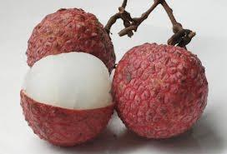
Antioxidant effect of Litchi fruit pericarp extract in sheep meat nuggets
Arun Kr Das
Eastern Regional Station,
ICAR-Indian Veterinary Research Institute
37 Belgachia Road, Kolkata-700037

Slide 2

Introduction
Oxidation of lipid and auto-oxidation -major causes of quality deterioration and reduced shelf life of meat products.
Changes in meat quality parameters such as colour, flavour, odour, texture and even nutritional value
Meat mincing, cooking and other processing prior to refrigerated storage disrupt muscle cell membranes facilitating the interaction of unsaturated lipids with pro-oxidant substances such as non-haem iron, accelerating lipid oxidation leading to rapid quality deterioration and development of rancidity.
Initially lipid oxidation in meat products results cardboard flavour and progresses with development of painty, rancid and oxidized flavour.
Degree of lipid unsaturation, muscle type, animal diet, additives such as salt, cooking method, manner of storage and pH of the muscle

Slide 3
Introduction
The rate and extent of oxidative deterioration can be reduced through various means like
    curing,
    vacuum packaging,
    modified atmosphere packaging
    and most importantly adding synthetic or natural antioxidants.
Synthetic antioxidants such as butylated hydroxytoluene (BHT) and butylated hydroxy anisole (BHA) have been used extensively, recent studies have implicated them to have toxic effects.
An alternate to prevent lipid peroxidation in muscle foods during processing and storage- to use natural antioxidants
Fruits and vegetables are rich sources of antioxidants and can serve as a source of natural antioxidants for meat products

Slide 4
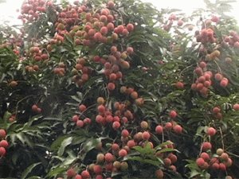
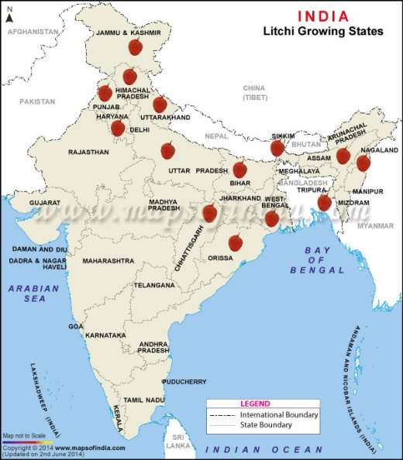
Litchi fruit pericarp-a valuable agri-by-product
Litchi (Litchi chinensis Sonn.) is a tropical and subtropical fruit native to China, and now widely cultivated throughout the World.
Litchi or Lychee, a fruit with a rough brown shell and sweet white flesh around a large shining brown seed.
Well received by consumers- due to its delicious taste and possible health benefits.

Slide 5
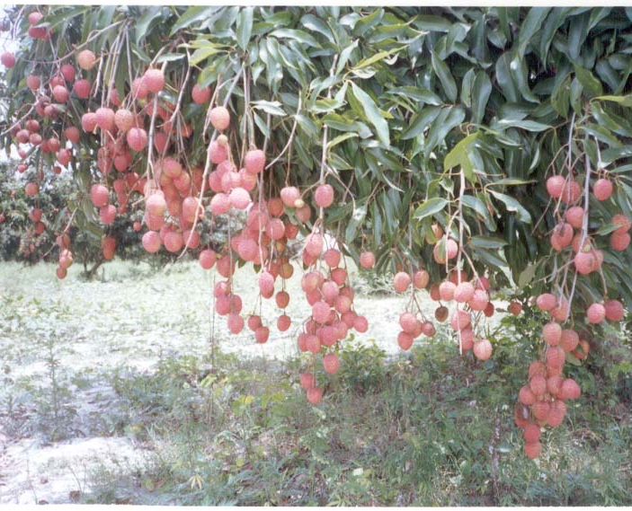
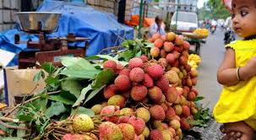
Litchi fruit pericarp-a valuable agri-by-product
Litchi fruit pericarp (LFP) accounts for approximately 15% by weight of the whole fresh fruit and contains significant amounts of phenolics which are usually discarded as a waste in the process.
The phenolics of LFP have been confirmed to have antioxidant, anticancer, immunomodulatory activities.
LFP has been considered a new source of pharmaceuticals and food industry.
No literature regarding its use as natural antioxidant in muscle food system.

Slide 6
Objective
To assess the phenolic compounds and antioxidant potential of water extract of litchi fruit pericarp powder.
To study its use in muscle food products as a source of natural antioxidants to prolong quality and stability.
To compare its antioxidant potential with BHT in sheep meat nuggets.

Slide 7
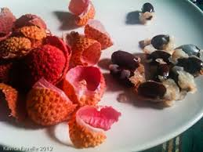
Methodology
Dressed and deboned sheep meat and stored frozen at − 18 °C till further use.
Fresh Litchi fruit pericarp was collected and dried after fine chopping in an oven at 50°C.
After drying, fine powder of Litchi fruit pericarp was prepared using home mixer.
Ten grams of litchi pericarp powder was added in 100 ml boiled distilled water and left for 1 h followed by filtration through Whatmann No 1 filter paper to get extract

Slide 8
Analytical procedures
Litchi pericarp powder analysis
  Estimation of total phenolics
  Radical Scavenging activity using DPPH assay
  Ferric reducing antioxidant power assay
Sheep meat nuggets for quality and acceptability
  pH and cooking yield
  TBARS number
  Sensory analysis of goat meat patties

Slide 9
Formulation for sheep meat nuggets prepared with litchi pericarp extract and BHT
Ingredients (%) | Control | LPE (1%) | LPE (1.5%) | BHT ( 100)
Meat | 71.1 | 70.1 | 69.5 | 70.0
Salt | 1.8 | 1.8 | 1.8 | 1.8
Ice flakes | 10 | 10 | 10 | 10
Refined oil | 8 | 8 | 8 | 8
Condiments | 4 | 4 | 4 | 4
Polyphosphate | 0.3 | 0.3 | 0.3 | 0.3
Dry spice mix | 1.8 | 1.8 | 1.8 | 1.8
Na nitrite (ppm) | 150 | 150 | 150 | 150
Wheat flour | 3 | 3 | 3 | 3
LPE (1%) | 0.00 | 1.00 | 1.5 | -
BHT (100ppm) | - | - | - | 100
Control: Sheep meat nuggets; LEP (1%)-Sheep meat nuggets with 1% LPE; LEP (1.5%): Sheep meat nuggets with 1.5% LPE; BHT100: Sheep meat nuggets with 100ppm BHT

Slide 10
Total phenolics (mg gallic acid equivalent) in different concentrations of litchi pericarp powder and BHT
Phenolics constitutes - one of the major groups of compounds acting as primary antioxidants or free radical terminators.
Determination of total phenolics is one of important parameters to estimate the amount of antioxidants
Concentration dependent total phenolics in Litchi pericarb powder extract.
a
b
b
c

Slide 11
Radical scavenging activity (%) of litchi pericarb powder extract and BHT
The DPPH radical has been widely used to test the free radical scavenging ability of various natural products and has been accepted as a model compound for free radicals originating in lipids
The percent radical scavenging activity of LPE was increased significantly (P < 0.05) with the concentration
DPPH radical scavenging activity of 1.5 LPE was comparable to the activity of 100 ppm BHT.
The DPPH free radical scavenging by antioxidants is due to their hydrogen donating ability; the more the number of hydroxyl groups, the higher the possibility of free radical scavenging ability

Slide 12
Ferric reducing antioxidant power (A700) of different concentrations of litchi pericarb powder and BHT
Reducing properties are generally associated with the presence of reductones.
The antioxidative action of reductones is based on the breaking of free radical chains by the donation of hydrogen atom
Reducing power of 1.5% LPE was even significantly higher (P < 0.05) as compared to 100 ppm BHT
The reducing power of a compound is related to its electron-transfer ability; therefore, the reducing capacity of a compound may serve as a significant indicator of its potential antioxidant activity
a
b
b
c

Slide 13
Effect of LPE and BHT on pH, product yield and total phenolics of sheep meat nuggets.
Parameters | Control | LPE (1%) | LPE (1.5%) | BHT ( 100)
pH | 6.21±0.03 | 6.20±0.02 | 6.22±0.02 | 6.19±0.02
Cooking yield (%) | 93.62±0.48 | 93.29±0.36 | 94.12±0.43 | 93.75±0.39
Total phenolics (GAE)mg/g | 0.05±0.01^{c} | 0.13±0.01^{b} | 0.17±0.01ª | 0.16±0.01ª

Slide 14
Effect of LPE and BHT on sensory attributes of sheep meat nuggets.
Sensory attributes | Control | LPE (1%) | LPE (1.5%) | BHT ( 100)
Appearance | 7.23 ± 0.05 | 7.22 ± 0.06 | 7.18 ± 0.06 | 7.12 ± 0.04
Flavour | 7.06 ± 0.6 | 7.05 ± 0.08 | 7.03 ± 0.06 | 6.94 ± 0.07
Texture | 7.15 ± 0.08 | 7.03 ± 0.07 | 7.01 ± 0.06 | 7.02 ± 0.06
Juiciness | 7.07 ± 0.07 | 7.13 ± 0.04 | 7.15 ± 0.05 | 7.17 ± 0.05
Overall acceptability | 7.18 ± 0.05 | 7.08 ± 0.06 | 7.11 ± 0.06 | 7.05 ± 0.07

Slide 15
Effect of LPE and BHT on TBARS values of sheep meat nuggets during refrigerated storage
Total phenolics, radical scavenging activity and reducing powder estimation indicate that LFP powder has good antioxidant potential.
So its efficiency in controlling lipid oxidation of sheep meat nuggets was evaluated during refrigerated storage against control nuggets and BHT nuggets.
TBARS values of all the products increased significantly with the advancement of storage period
TBARS number (mg malonaldehyde/kg)

Slide 16
Conclusion
Bestowed with phenolic compounds which have excellent free radical scavenging activity and reducing power.
Extracts at 1 and 1.5% level significantly increases the phenolic contents in sheep meat nuggets and can act as a source of natural antioxidants.
No adverse effect on sensory attributes of the final products.
Extract significantly reduces the lipid peroxidation similar to the 100 ppm BHT thus improving the product quality and stability.

Slide 17
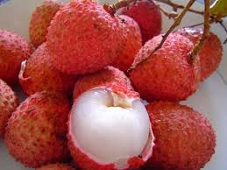

Enjoy the delicious Litchi and benefits of pericarp as natural antioxidant

