Slide 1

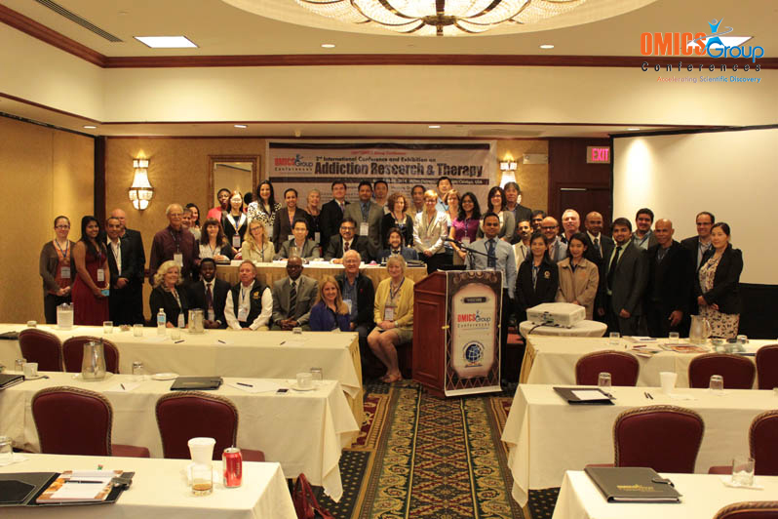
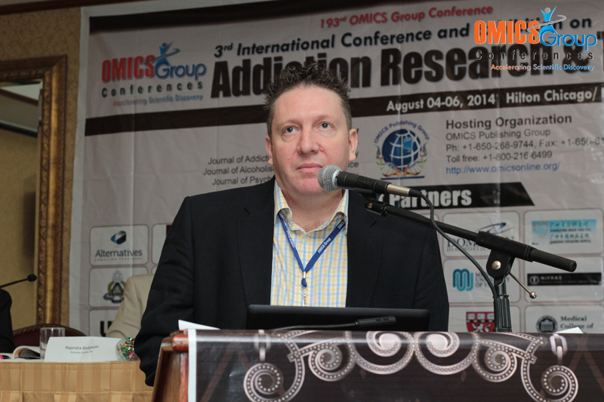
Addiction Therapy-2014
Chicago, USA
August 4 - 6, 2014
Martin Peters

Slide 2
iNTEGRATED treatment model
From Theory to Practice

Slide 3
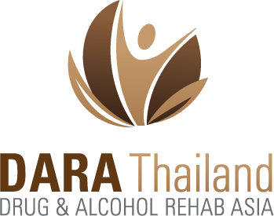

By Martin Peters
BA (Hons), Dip HE, DIP, RN
Treatment Program Director - DARA Thailand

Slide 4
Different Models of Addiction Treatment
Disease Model
  The ‘disease model’ views substance addiction as a lifelong illness that requires complete abstinence
Harm Reduction Model
  Espouses the belief that people with previous alcohol problems can maintain minimal substance use and drink/drug socially in a controlled manner

Slide 5
Changes in Treatment Approaches and Attitudes
Approaches to working with alcohol and drug abusing clients have changed drastically over the last thirty years
Until the 1980’s the usual way of treating unmotivated or ambivalent clients was through confrontational methods, which included the intentional coordination of a crisis
Such approaches are not common today as they relate to high drop out rates and poor outcomes

Slide 6
Changes in Treatment Approaches and Attitudes
In line with recent evidence, researchers have advised alcohol and drug clinicians to adopt “a non-confrontational approach”
  Motivational Interviewing, in a study was found to be more effective in addressing alcohol abuse than confrontational counseling (Miller, Benefield & Tonigan, 1993)
Carl Rogers had proposed way back in 1951 that
  Treatment approach that integrates an empathic client-centered counseling style (e.g. Rogers, 1951)

Slide 7
Motivational Interviewing
Miller & Rollnick explain that the “building blocks” of MI include ‘rolling with resistance’, giving feedback, removing barriers, providing choices, practicing empathy, clarifying goals and actively helping.
Developing discrepancy and eliciting change talk are also important. Other principles include being positive and reassuring, avoiding pressuring tactics and supporting self-efficacy

Slide 8
Cycle of Change
Precontemplation
PROGRESS
Contemplation
Preparation
Action
Maintenance
RELAPSE

Slide 9
Cycle of Change
Several comprehensive studies or meta-analyses have proved the efficacy of MI
  It indicated strong empirical support for its use in improving client participation in treatment and reducing alcohol or drug use (Burke, Arkowitz & Menchola, 2003; Noonan & Moyers, 1997)

Slide 10
Cognitive Behavior Therapy
Cognitive-behavioral therapy (CBT) was pioneered in the late 1950s as an alternative to psychodynamic therapy. It is a general term for a classification of therapies that emphasize the role of thinking in how we feel and what we do.
There are a variety of approaches (e.g., Rational Emotive Behavior Therapy, Dialectic Behavioral Therapy) but most are based on the assumption that our thoughts cause our feelings and behaviors, not external things like people, situations, and events.

Slide 11
ABC-DF Diagram
Situation
Thoughts
Physical Reactions
Moods/Feelings
Behaviour

Slide 12
ABC-DF Diagram
A vast proportion of clients seeking treatment for alcohol or drug use also have mental health issues and psycho, emotional trauma. With such clients CBT was also found to be superior to MI and 12-step approaches
However a challenge we experience that, it may not be feasible for all alcohol and drug clinicians to receive adequate training in order to utilize CBT with the level of expertise that would ensure positive results.

Slide 13
12 Steps Facilitation TSF
Twelve Step Facilitation Therapy (TSF) is a brief, structured, and manual-driven approach to facilitating early recovery from alcohol abuse, alcoholism, and other drug abuse and addiction problems.
The intervention is based on the behavioral, spiritual, and cognitive principles of 12-step fellowships such as Alcoholics Anonymous (AA) and Narcotics Anonymous (NA).

Slide 14
TSF
Therapy focuses on two general goals:
  acceptance of the need for abstinence from alcohol and other drug use and
  surrender or the willingness to participate actively in 12-step fellowships as a means of sustaining sobriety.

Slide 15
Non Mainstream Alternative Treatment Methods
Mindfulness – Meditation, Yoga
Physical Therapy
Massage
Acupuncture
Recovery Related Activities – Regular Excursions outside facility

Slide 16
An Integrated Approach to Addiction Treatment
An integrated approach to working with clients is recommended that considers multiple contributing factors including emotional, biological, behavioural, cognitive, and social dimensions.
Such ‘theoretical integrationism’ is the basis for the Integrated Treatment Approach by DARA. These syncretistic approaches seek to overcome the inadequacies and partiality of single theories through combining treatment methods from multiple modalities into a new coherent system.

Slide 17
INTEGRATED Treatment Method
Practice and Practical
Implication
Work and development of an Integrated Treatment Method was started and soon implemented in DARA
  Two Treatment Centers in Thailand
    Koh Chang “Integrated Behavioral Therapy™”
      CBT
      Schema
      TA
      DBT
      TSF
      Yoga, Mindfulness
      PT, Massage Therapy, Acupuncture

Slide 18
integrated Treatment Method
Practice and Practical
Implication
    Chathaburi “Steps to Recovery™”
      CBT
      TA
      TSF
      Yoga, Mindfulness
      PT, Massage Therapy, Acupuncture
3 years providing interventions on ITM in both center.
  Higher Completion Rates
  Scale of satisfaction from clients has been consistently high

Slide 19
INTEGRATED Treatment Method
Practice and Practical
Implication
In the recent 12 month period from June 2013 to June 2014,
350 Clients received treatment of this model
  90% Discharge as Successful Completion of Treatment.
    With a lean stay of 28 days. Average is 60 Days in treatment.
  8% Discharge due to; Against Clinical Advice, Incomplete Treatment
  2% Discharge to either Administrative Discharge ie transfer to another level of care/facility or Non-Compliance.

Slide 20
Credits
  (Washton & Zweben, 2006)
(Valliant, 1996, cited Emmenkamp & Vedel, 2006)
(Bratter, 1975, cited in Glidden-Tracey, 2005; Johnson, 1973
(Miller & Rollnick, 2002)
(Hilarski, 2005, p.2)
(Miller & Rollnick, 2002; Washton & Zweben, 2006).
(Miller, Benefield & Tonigan, 1993; Project MATCH, 1997; Stephens, Roffman & Curtin, 2000)
(Fisher & Bently, 1996; Jerrell & Ridgely, 1995).

Slide 21
Thank You
For inquiries about this presentation or our programs, please email me at
martin@alcoholrehab.com
To learn more about DARA Thailand, please visit
www.dararehab.com

