Slide 1
Effect of Core Stability Exercises on Trunk Muscles' Endurance and Dynamic Balance in Healthy Adults
Neama H. Mohamed

Slide 2
INTRODUCTION
Many models of the spine consider stability in terms of the ability of the spine to withstand compressive forces and resist buckling.

Slide 3
INTRODUCTION
Panjabi’s model of spinal stability (1992):
Passive subsystem
(Spinal column)
Active subsystem
(Muscles and ligaments)
Neural control subsystem (Neural control)
Panjabi’s
Model Of
Spinal
Stability
Stabilizing
System

Slide 4
INTRODUCTION (cont)
The major source of spinal stability comes from the second component of Panjabi's model because the passively supported spine collapses under 90 N of load.
This system must activate the correct muscles at the right time by the right amount to protect the spine from injury and also allow the desired movement (Barr et al., 2005).

Slide 5
INTRODUCTION (cont)
Bergmark (1989) developed a model to summarize the role of the core muscles and their contribution to spinal stability.
    Global muscles
    local muscles

Slide 6
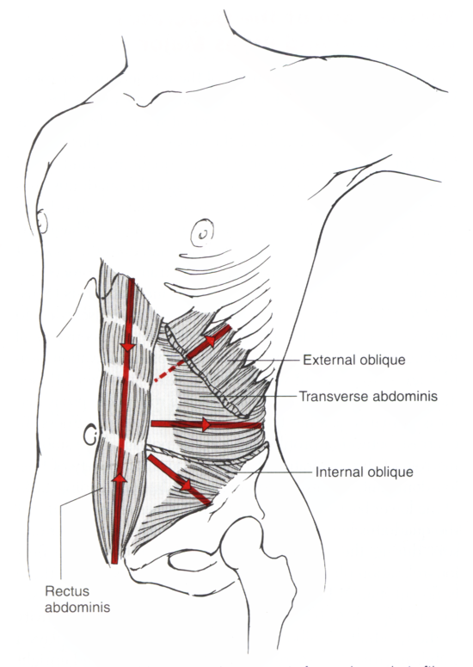
External oblique
Rectus abdominis
Internal oblique

Slide 7
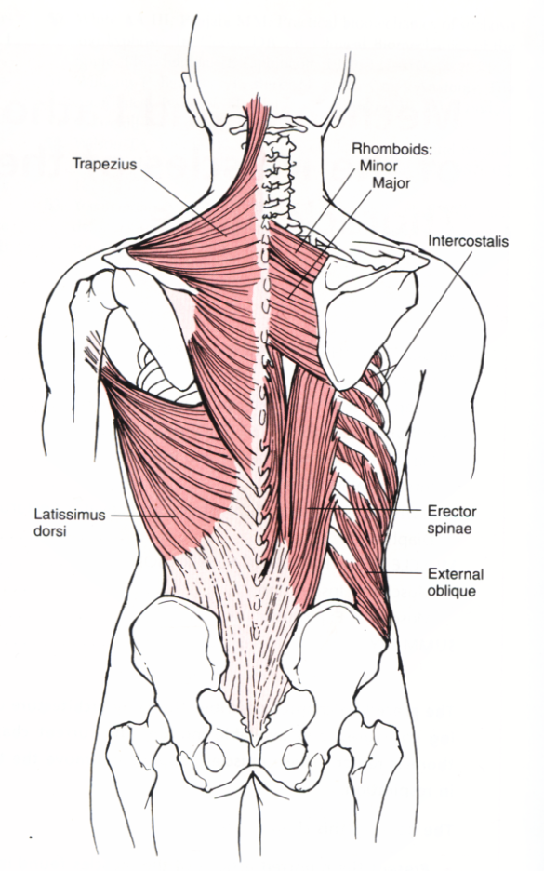
Erector spinae
Latissimus dorsi

Slide 8
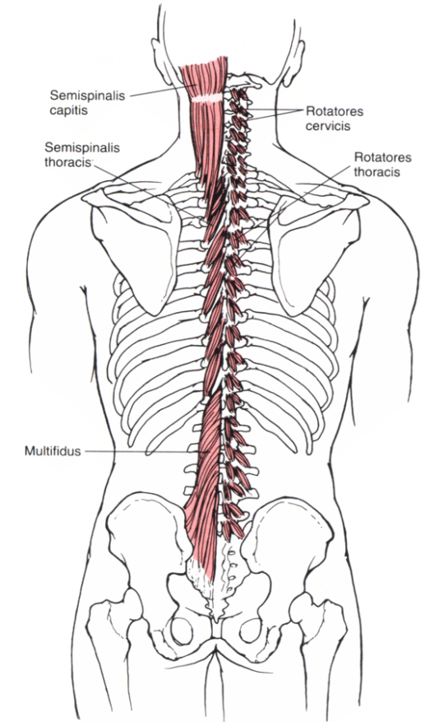
Rotators
Transversus abdominis
multifidi

Slide 9
INTRODUCTION (cont)
Contribution of Local vs. Global system in spinal stability
  Local
  Global
short segmental muscles
proprioceptors
& kinesthetic sensors
Increase intra- abdominal pressure
acting together

Slide 10
INTRODUCTION (cont)
Core stability can be defined as:
The ability to maintain neutral spine using the abdominal, back, and hip muscles as a stabilizers rather than prime movers.

Slide 11
INTRODUCTION (cont)
Components of core stability:
Endurance
Balance
Coordination
Strength
Core
stability

Slide 12
INTRODUCTION (cont)
Core stability and trunk muscles’ strength and coordination:
Strength
Coordination
Spinal stability

Slide 13
INTRODUCTION (cont)
Core stability and trunk muscles’ strength and coordination:
sufficient stability of the lumbar spine is achieved in most persons with very modest levels of coactivation of the paraspinal and abdominal muscles.
So, maintaining stability when performing tasks of daily living is not achieved by sufficient muscle strength but rather by sufficient endurance

Slide 14
INTRODUCTION (cont)
Core stability and trunk muscle endurance:
Poor endurance
Motor control error
Back injury

Slide 15
INTRODUCTION (cont)
Core stability and dynamic balance:
Dynamic balance is an integral component of core stability.
The core functions to maintain dynamic balance during activities which helps avoid serious distortion patterns.

Slide 16
INTRODUCTION (cont)
With the evidence supporting the importance of trunk muscle endurance and dynamic balance for improving core stability.
It is important to emphasize on improving core muscle endurance and dynamic balance to improve health and reduce the risk of injury.

Slide 17
INTRODUCTION (cont)
Purposes of the study:
To investigate the effect of core stability exercise program on the work fatigue and total work of the trunk extensors and flexors.
To investigate the effect of core stability exercise program on the antero-posterior, medio-lateral, and over all stability indices.

Slide 18
Materials
and
Methods

Slide 19
MATERIALS & METHODS
PARTICPANTS
  Thirty five healthy college students participated in this study. They were randomly assigned to two groups; Experimental (A) and control (B)
Experimental | Control
Twenty participants (10 male & 10 female) Age 20.7 ± 2.37 Weight 66.6 ± 12.1 Height 166.7 ± 7.8 | Fifteen participants (6 male & 9 female) Age 20.3 ± 0.61 Weight 68.6 ± 12.2 Height 164.3 ± 7.6

Slide 20
MATERIALS & METHODS
Inclusion and exclusion criteria:
Inclusion criteria | Exclusion criteria
Good abdominal muscle strength. Normal flexibility of the lower back muscles | Previous core stability exercise program experience. Low back episodes during the previous year prior to participating in the study. Tightness in hip flexors and extensors. Any deformity.

Slide 21
MATERIALS & METHODS (cont)
Instrumentations:
The Biodex Isokinetic Dynamometer
Assessment of the trunk muscles’ endurance

Slide 22
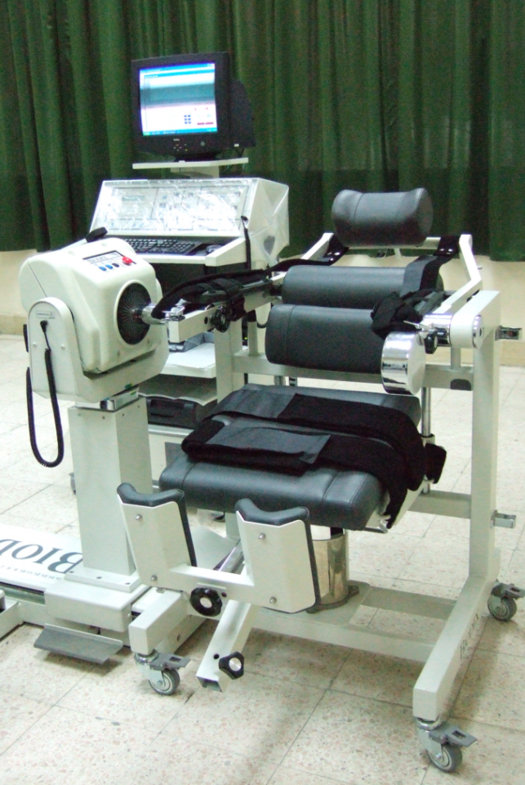
MATERIALS & METHODS (cont)
The Biodex Isokinetic Dynamometer
Testing chair
Computer system
Control panel
Dynamometer
Adjustable straps
The Biodex Isokinetic
System III

Slide 23
MATERIALS & METHODS (cont)
Instrumentations:
The Biodex Balance system
Assessment of dynamic balance

Slide 24
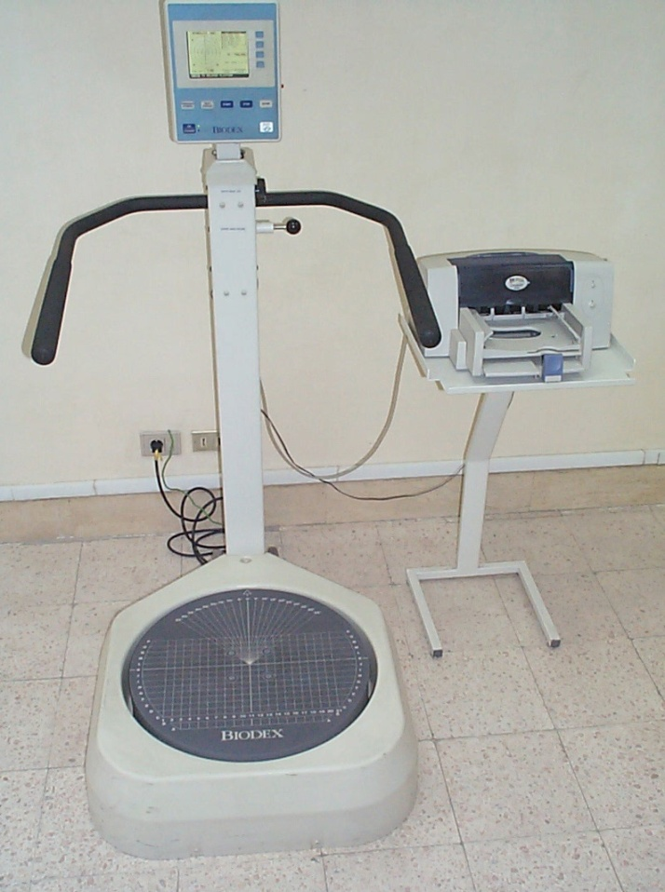
MATERIALS & METHODS (cont)
The Biodex Balance system
Display screen
Support handle rails
Printer
Platform

Slide 25
MATERIALS & METHODS (cont)
Procedures
Trunk muscles’ endurance testing
Dynamic balance testing

Slide 26
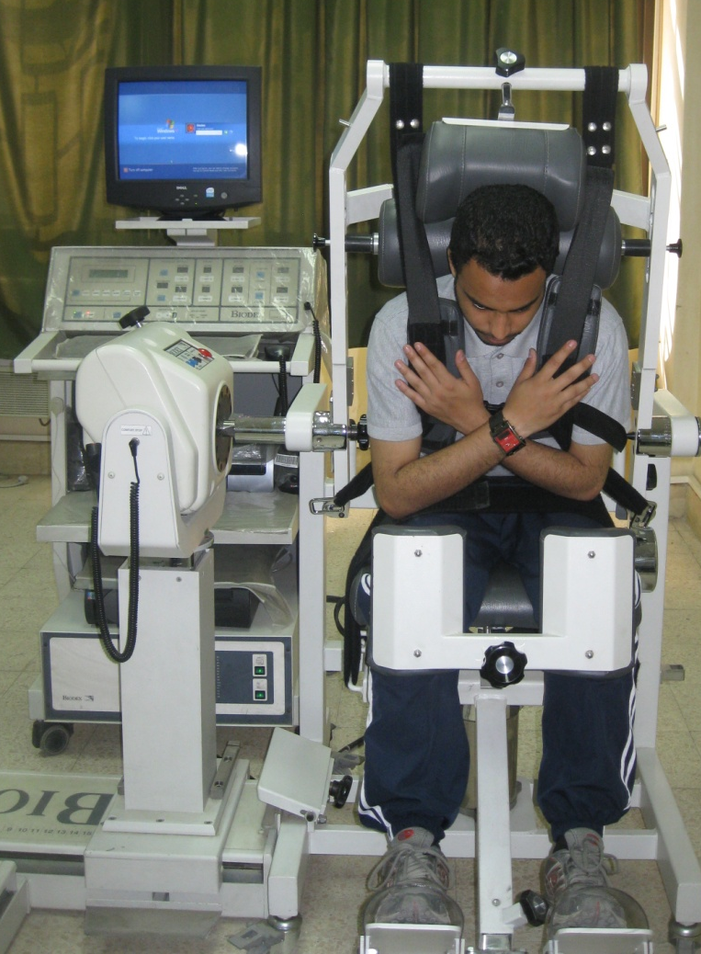
MATERIALS & METHODS (cont)
1- Isokinetic muscle endurance testing
      Twenty sets of flexion and extension.
      trunk ROM (70°).
      Angular velocity (180°/sec).
      Concentric contraction mode.

Slide 27
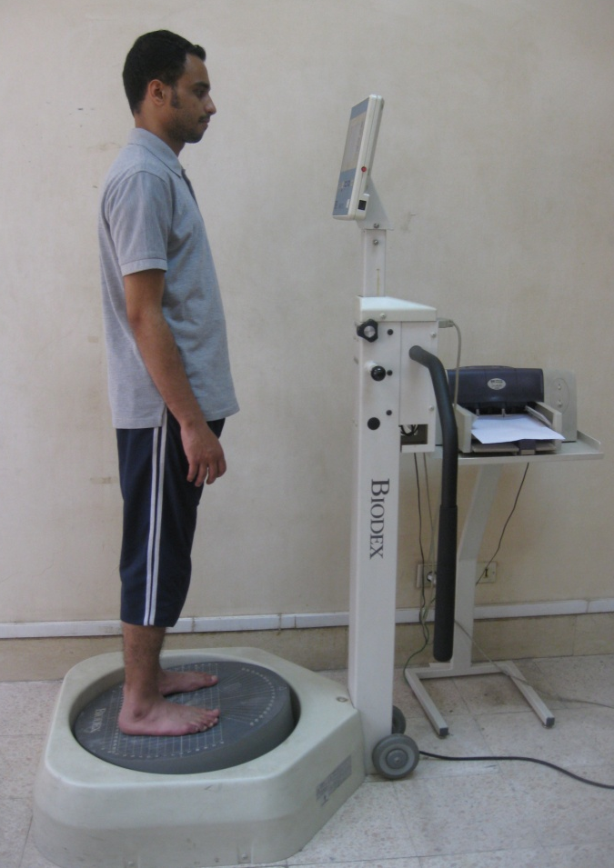
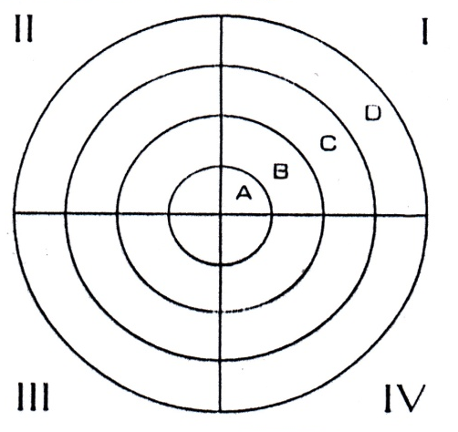
MATERIALS & METHODS (cont)
2- Dynamic balance testing procedures
Center

Slide 28
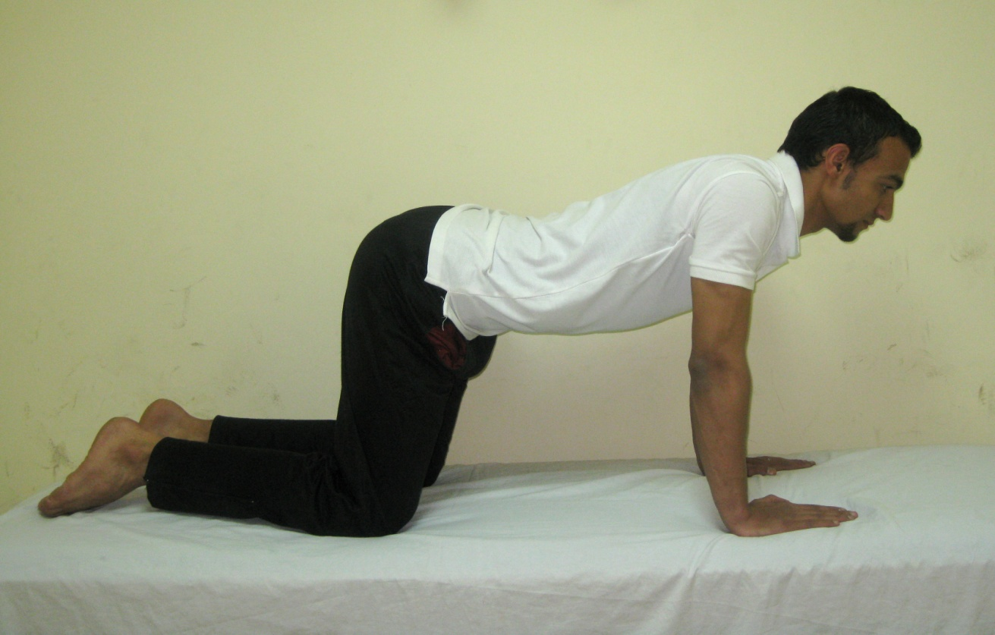
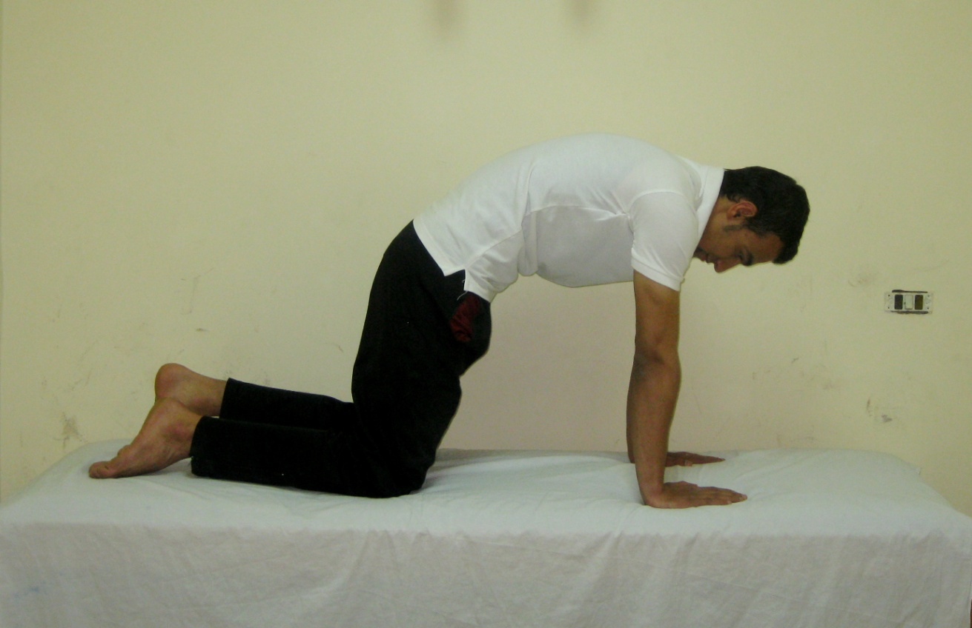
MATERIALS & METHODS (cont)
Intervention
The core stability exercise program (McGill, 2007):
Warm up exercise:

Slide 29
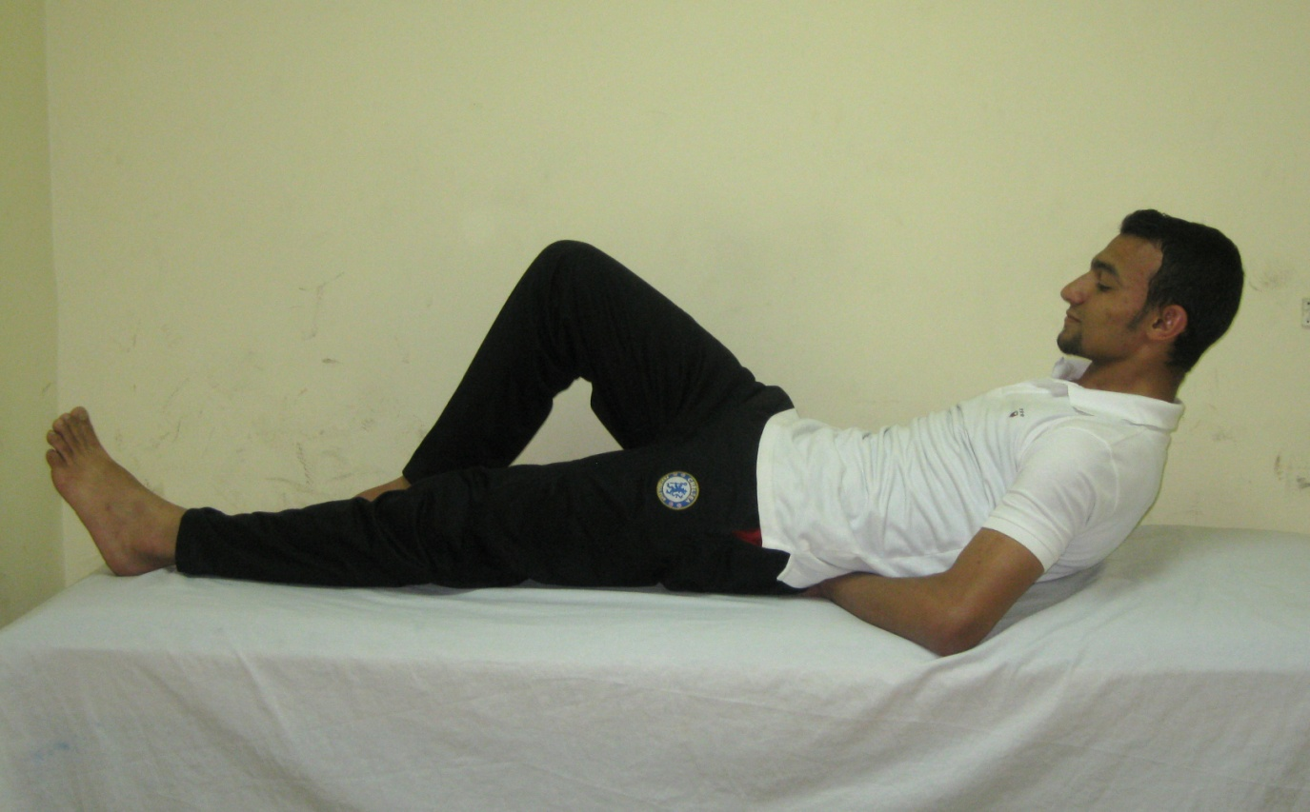
MATERIALS & METHODS (cont)
Curl up exercise:

Slide 30
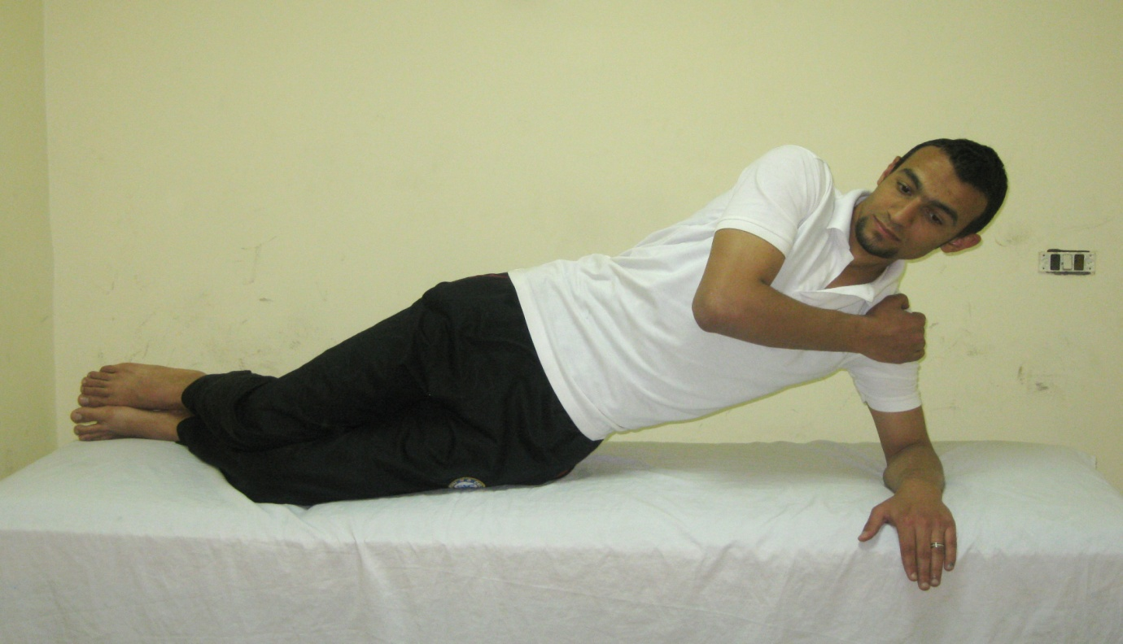
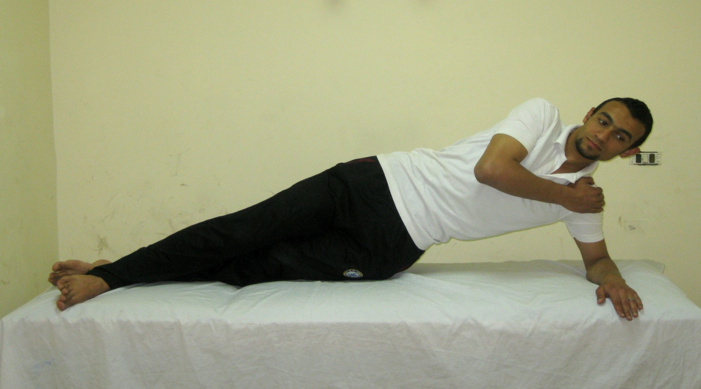
MATERIALS & METHODS (cont)
Side bridge exercise:

Slide 31
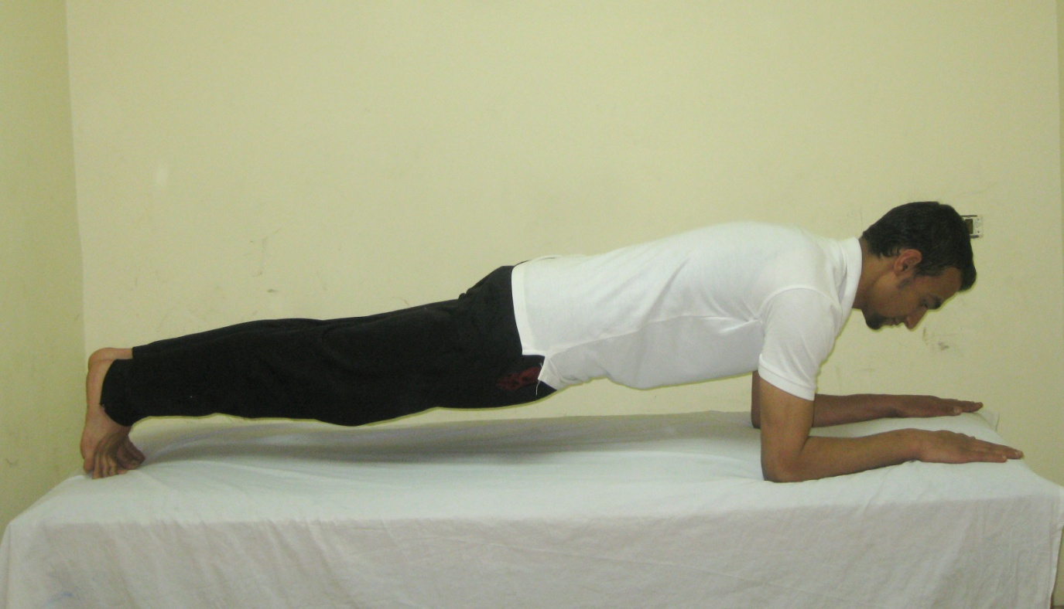
MATERIALS & METHODS (cont)
Prone bridge exercise:

Slide 32
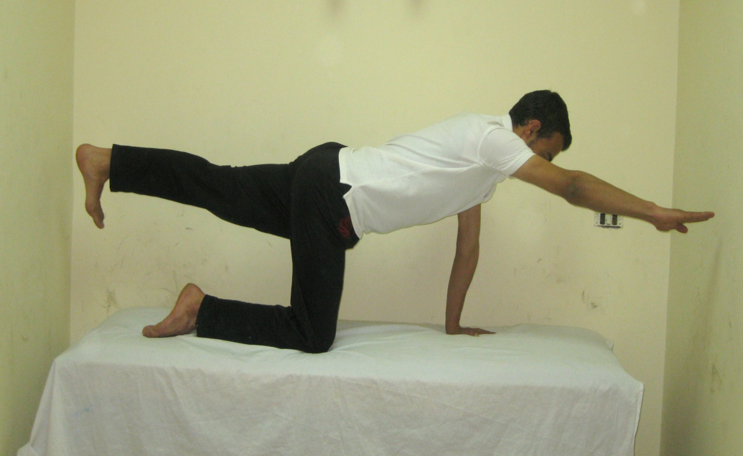
MATERIALS & METHODS (cont)
Bird dog exercise:

Slide 33
MATERIALS & METHODS (cont)
Data and statistical analysis
Dependent variables
Independent variables
Tested group
Experimental Control
Isokinetic parameters
(endurance parameters)
Total work and work fatigue
Time factor
Pre test Post test
Balance parameters
AP, ML, and OSI

Slide 34
MATERIALS & METHODS (cont)
Data analysis
    2x2 Mixed Design (MANOVA)
    2x2 Mixed Design (MANOVA)
Experimental/control
“pre”/”post” tests
Trunk flexors’/extensors’ work fatigue
Experimental/control
“pre”/”post” tests
Trunk flexors’/extensors’
Total work

Slide 35
MATERIALS & METHODS (cont)
Data analysis
    Mann- Whitney tests
    Wilcoxon singed rank tests
      The initial alpha level for parametric and non parametric analysis was set at 0.01
Experimental/control
AP, ML, and OSI.
“pre”/”post” tests
AP, ML, and OSI.

Slide 36
Results

Slide 37
RESULTS

Slide 38
RESULTS

Slide 39
RESULTS

Slide 40
RESULTS

Slide 41
RESULTS

Slide 42
RESULTS

Slide 43
RESULTS

Slide 44

Discussion

Slide 45
DISCUSSION (cont)
The significant improvement in the work fatigue and total work of the trunk extensors and flexors in the “post” condition in the experimental group might be attributed to:
The core stability exercise
program which lasted
for 6 weeks.

Slide 46
DISCUSSION (cont)
The significant increase in the total work of the trunk flexors compared to the total work of the trunk extensors in the experimental group in the “post” condition might be attributed to
The number of exercises that addressed the abdominal muscles at the expense of the back ones.
Curl-up
Side-bridge
Prone-bridge
Abdominals
Back muscles
Bird-dog

Slide 47
DISCUSSION (cont)
This improvement in the trunk muscles’ endurance in the experimental group may result From
Physiological adaptations in muscles induced with training.
This adaptation can range from muscle hypertrophy to fiber type conversions.
Factors affecting the extent of these adaptations are the frequency, length and mode of training.

Slide 48
DISCUSSION (cont)
The selected exercises in the current study were isometric to ensure sufficient activation of the deep and superficial trunk muscles.
The frequency and dose of the exercises were deemed sufficient to demonstrate improvement in trunk muscles’ endurance.
The core stability exercise program used in this study performed for 6 weeks. These exercises were performed thrice per week. The participant began with one set of 15 repetitions once a day for 3 days per week in the first 2 weeks. Then, 2 sets, each of 15 repetitions, were performed a day for 3 days per week in the following 2 weeks. Finally, 3 sets, each of 15 repetitions, were performed a day for three days in the last 2 weeks.

Slide 49
DISCUSSION (cont)
The insignificant difference between the “pre” and “post” conditions for the work fatigue and the total work of the trunk extensors and flexors in the control group is because:
the control group received no
treatment program.

Slide 50
DISCUSSION (cont)
The significant decreases in the AP, ML, and OSI in the “post” condition in the experimental group might be attributed to:
the core stability exercise
program which lasted
for 6 weeks

Slide 51
DISCUSSION (cont)
This improvement in the AP, ML and OSI in the experimental group may result From
trunk muscle strengthening.
balance is specific for every skill and is improved through repetition of static position or dynamic movement.

Slide 52
DISCUSSION (cont)
The insignificant difference between the “pre” and “post” conditions for the AP and the OSI in the control group is because:
the control group received
no treatment program

Slide 53
DISCUSSION (cont)
The slight decrease in the MLSI in the “post” condition in the control group might be attributed to:
the test retest effect

Slide 54
Conclusion
With trunk muscle endurance and dynamic balance being improved, it may be concluded that core stability exercises are effective in improving spinal stability.

Slide 55
Recommendations
Investigate larger sample size.
Investigate the effects of core stability exercise programs in patients with chronic low back pain.

Slide 56


