Slide 1
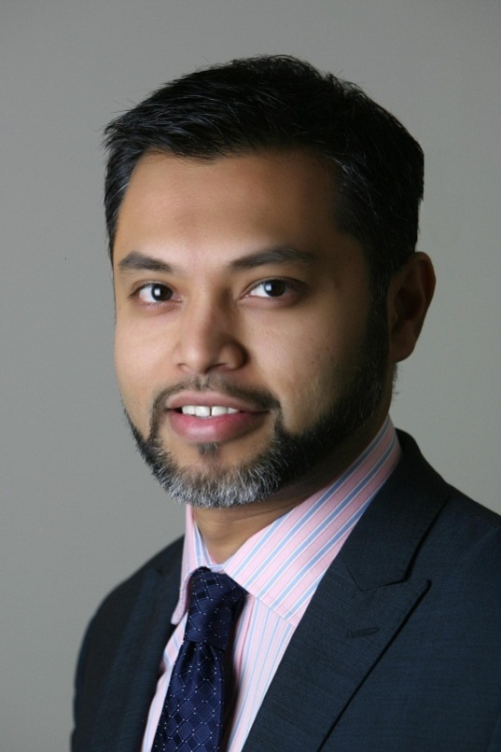
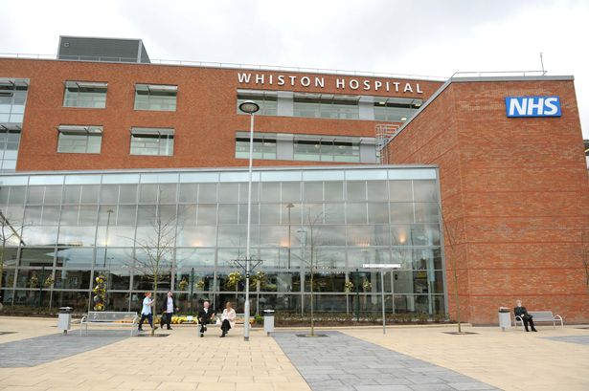
Fahad G. Attar Consultant Orthopaedic Surgeon Specialist in Lower Limb Arthroplasty & Knee Reconstruction Surgery
St Helens and Knowsley University Hospitals NHS Trust
Merseyside
UK

Slide 2
Little bit about myself…
Specialist interest in Hip & Knee Replacement surgery and Knee reconstruction surgery
Graduated from Liverpool University, UK
Trauma & Orthopaedic training in the Midlands, Leicester, UK
Fellowships – Nuffield Orthopaedic Centre, Oxford, UK
Sunnybrook hospital, Toronto, Canada
Wrightington Hospital, UK
Currently work at St. Helens and Knowsley University Hospitals NHS Trust, Merseyside, UK and affiliated with the University of Liverpool

Slide 3
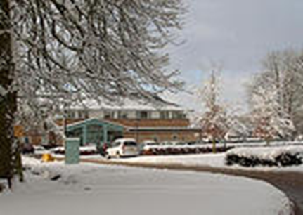
Private practice at:
BMI The Alexandra Hospital,
​Mill Ln,
Cheadle,
Manchester,
Cheshire SK8 2PX
UK
Spire Cheshire Hospital,
﻿​Fir Tree Close,
Warrington, WA4 4LU
UK
52-54 Alderley Road,
Wilmslow,
Cheshire SK9 1NY
UK
www.kneespecialistmanchester.co.uk

Slide 4
Subspecialist interests and expertise:
Lower limb arthroplasty
Partial knee replacements
Joint preservation surgery
Knee sports injuries and ligament reconstructions
Anterior knee pain and patello-femoral instability
Patient specific knee replacements

Slide 5
Positions held:
Research and Audit lead for Trauma and Orthopaedics at St. Helens and Knowsley University hospital NHS Trust, Merseyside, UK
ATLS Instructor, Royal College of Surgeons of England
Reviewer for The Knee Journal
UKIETR Member (UK International Emergency Trauma Register)
Examiner for The University of Liverpool Medical school, UK
Examiner and Tutor for FRCS revision course, Wrightington and Liverpool, UK

Slide 6
Affiliations:
- British Orthopaedic Association - Royal College of Surgeons of Edinburgh - Canadian Orthopaedic Association
- University of Liverpool - British Association for Surgery of the Knee
- World Orthopaedic Concern
- ICRS (International Cartilage Repair Society)
- ISAKOS (International Society of Arthroscopy, Knee Surgery and Orthopaedic Sports Medicine)
- SICOT (International Society of Orthopaedics and Traumatology)

Slide 7
Research interests and current on going studies:
Patient satisfaction and outcomes following TKR, UKR and PFJ replacements
Patient related outcome measures following joint preservation surgery – meniscal transplants, HTO, OATS and knee resurfacing surgery
Starting and part of a multi-centre NiHR UK trial on outcomes following patient specific, ConforMIS, iDuo bicompartmental knee replacements

Slide 8
Patient outcome measures and long term results of:
- tibial de-rotation osteotomy for external tibial torsion
- Patella distalisation for isolated patella alta
- Patella medialisation for increased TT-TG offset
-Trochleoplasty for trochleo dysplasia
-MPFL reconstruction for isolated MPFL rupture
Designing a validated scoring system specifically for patello-femoral pain and instability

Slide 9
Publications: a full list of paper and abstract publications and presentations at international meetings are available on my website
Original papers:
‘Simultaneous peri-articular femoral osteotomy and total knee arthroplasty for treatment of osteoarthritis associated with a severe valgus deformity of >45⁰’ F G Attar, M Drexler, N Reischl, D J Ng, J C Cameron. MOJ Orthopaedics and Rheumatology, July 2014 (accepted for publication)
‘Total knee arthroplasty in patients with excessive external tibial torsion > 45⁰ and patella instability – Surgical technique and long term follow up’ M. Drexler, T. Dwyer, M. Marmor, N. Reischl, F.G. Attar, J.C.Cameron. 2012 Nov 8. pii: S0883-5403(12)00581-5. doi: 10.1016/j.arth.2012.08.012. [Epub ahead of print]
‘Radiological Outcomes following simultaneous 1st and 5th metatarsal osteotomies’ M. Hadi, F. Attar, R. Shariff, G.S. Attar Journal of Orthopaedics, Trauma and Rehabilitation, Volume 16, Issue 2 , Pages 59-61, December 2012
‘Hip Conversion: Don’t Promise Too Much’ M. Drexler, N. Reischl, T. Dwyer, F.G. Attar, D.J. Ng, H. Cameron. Seminars in Arthroplasty, Volume 23, Issue 3, Pages 176-178, September 2012.

Slide 10
‘Comparison of cement pressurisation in flanged and unflanged acetabular cups’ F. Attar, R. Bhattacharya, S. Green, A. Port. Journal of Orthopaedic Surgery and Research, 2012, 7:5
‘Foot pressure comparison between hallux rigidus patients with normal asymptomatic matched individuals using pedobarograph: our early results’ M. Hadi, A. Alani, F. Attar, A. Adedepo, Journal of Orthopaedics, Trauma and Rehabilitation, Volume 16, Issue 1 , Pages 13-15, June 2012
‘The effect of Total Knee Arthroplasty on body mass index – a prospective study’ R. Shariff, F.G. Attar, M. Manickham, A. Wainwright, M. McNicholas. Journal Of Orthopaedics, Trauma and Rehabilitation, Volume 15, Issue 2, December 2011
‘How good are orthopaedic surgeons at assessing ECGs?’R. Shariff, S.G. Attar, F.G. Attar. Journal Of Orthopaedics, Trauma and Rehabilitation, Volume 14, Issue 2, December 2010
‘Does chevron osteotomy affect the blood supply to the first metatarsal head?’, R Shariff, F. Attar, S. Vinjamuri, R. Siddiqi, G. Attar, Acta Orthop. Belg. 2009, 75, 234-238.

Slide 11
‘Survival analysis at 15 years of cemented Press-Fit Condylar Total Knee Arthroplasty’ Fahad G. Attar, Fu-Meng Khaw, Lorna M.G. Kirk, Paul J. Gregg, The Journal of Arthroplasty, Volume 23, Issue 3, Pages 331-488, April 2008.
‘Perioperative changes in the microcirculation in feet following foot and ankle surgery’, F. Attar, D. Machin, D. Selvan, R. Shariff, N.P. Geary. The Journal of Foot and Ankle Surgery, Volume 46, Number 4, July/August 2007.
‘Comparison of the caliper method and two dimensional computer software to measure polyethylene wear after total hip arthroplasty’, V. Kumar, F. Attar, P. Savvidis, J. Anderson. European Journal of orthopaedic surgery and traumatology, Volume 16, Number 3/September, 2006.

Slide 12
Books:
‘Succeeding in the FRCS T&O Part 1 Exam: MCQ Revision Questions in Trauma and Orthopaedics’, Fahad G. Attar & Talal Ibrahim. London, BPP Learning Media, 2011
Abstracts:
‘Comparing predictability of survival between ISS and NISS’, M.U. Saleem, N. Yousaf, F. Attar and R. Deshmukh. Injury Extra, Volume 38, Issue 4, April 2007, Pages 110-11.
‘Correlating different parameters and scoring systems with the probability of survival in trauma patients’, N. Yousaf, M.U. Saleem, B. Sheraz, F. Attar and R. Deshmukh. Injury Extra, Volume 38, Issue 4, April 2007, Pages 109-110.
‘Ottawa guidelines for ankle and foot injuries’, Dr. M. N. Hadi, Mr. F. G. Attar. International Journal of Disaster Medicine, 2006; 4:3.
‘Compare and predict probability of survival between ISS and NISS’, Dr. U. Saleem, Dr. N. Yousuf, Mr. F. G. Attar, Mr. R. Deshmukh. International Journal of Disaster Medicine, 2006; 4:3.
‘Foot pressure study using the pedobarograph : Comparison of normal subjects with Hallux Rigidus and metatarsalgia', Mr. F. Attar, Mr. V. Kumar, Mr. G. Akra, Mr. K. Rome, Mr. A. Adedapo. J Bone Joint Surg Br Orthopaedic Proceedings, 2006 88-B: 275-276.

Slide 13
‘Assessment of polyethylene wear in total hip arthroplasty: A comparative study of computer software versus Livermore method’, Mr. V. Kumar, Mr. F. Attar, Mr. P. Savvidis, Mr. J. Anderson. J Bone Joint Surg Br Orthopaedic Proceedings, 2006 88-B: 276.
‘The relationship between the Injury Severity Score and the Revised Trauma Score with the probability of survival for our trauma patients and how this compares with the predicted relationship’, Mr. F. Attar, Mr. P. Simms. Injury Extra (online).
‘Probability of survival in trauma patients: is there a need for change in the variables used for calculation? Mr. F. Attar, Mr. P. Simms. Injury Extra (online).
‘Perioperative assessment of microcirculation in feet’, Mr. F. Attar, Dr. R. Shariff, Dr. D. Selvan, Dr. D. Machin, Mr. N. Geary. J Bone Joint Surg Br Proceedings, Sep 2005; 87-B: 373.
‘Assess the correlation between the expected outcome and the actual outcome of trauma patients using the ISS scoring system’, Mr. F. Attar, Mr. P. Simms. European Journal of Trauma Supplement, 30 (1): pg 68; May 2004.
‘Assessing documentation of vital observations in management of trauma victims’, Mr. F. Attar, Mr. P. Simms. European Journal of Trauma Supplement, 30 (1): pg 69; May 2004.

Slide 14
www.kneespecialistmanchester.co.uk
Thank you
For further information and details please visit website below

