Slide 1
Occupational Health and Safety Conference 2014

Slide 2

Introduction

Slide 3


Introduction to study
Occupation Disrupted?- Exploring the Narratives of Irish Farmers following a Farm Accident
Laura Reilly
Manigandan Chockalingam

Slide 4
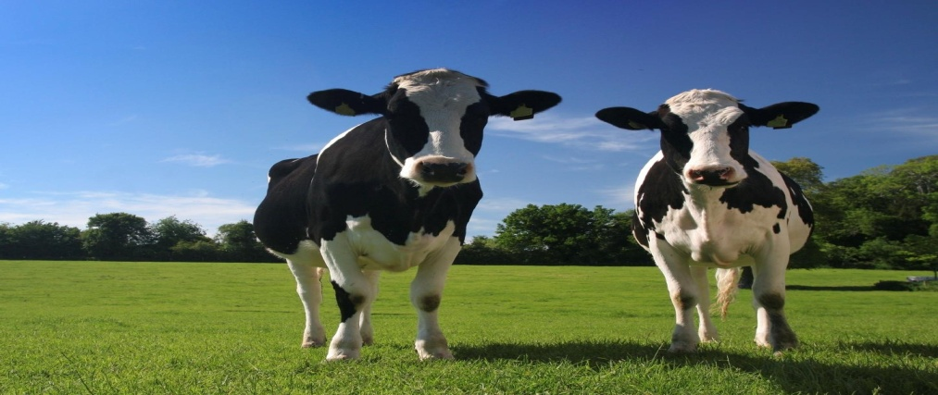
Research Question
“What is the impact of a farming accident and
subsequent disability on one’s perceived
occupational identity, occupational competence
and their occupational environment?”

Slide 5

Rationale for Study
Formidable Challenge
Limited Research
Provide information
(Finnegan 2007; Hissong & Wilhite, 2008; Hissong, Jorge & Wilhite, 2008; Pickett, Day & Dosman, 2008; Hissong & Wilhite, 2010; Molyeaux-Smith, Townsend & Guernsey, 2003; Angoules, 2012; Health & Safety Authority, 2013)

Slide 6

Literature REVIEW

Slide 7
Literature Review
Phenomenon of Farm accidents
Dearth of Knowledge
Rehabilitation and Farm accidents
Reed & Claunch, 1998; Young, Strasser & Murphy, 2004; Whelan, 2009

Slide 8
Methodology

Slide 9
Research Design
Qualitative
Phenomenology
Strengths
Weaknesses
(Krefting, 1991 ; Baker, 1994 ;Denzin & Lincoln, 1998; Merriam, 1998; Hammell, Carpenter& Dyck, 2000; Reis & Judd, 2000; Teijlingen & Hundley, 2001; Hammell, 2001; Donalek, 2004; Mallinson et al, 2004 ;Wilding & Whiteford, 2005; Holloway, 2005; Finlay, 1999)

Slide 10
Participant Selection
Inclusion & exclusion criteria
Recruitment- Irish Farmers Association (IFA) & Teagasc
Purposive sampling
Maximum variation
(Coyne, 1997; Robson, 2002; Ritchie, Lewis & Elam, 2003)

Slide 11
Measurement Device
Occupational Performance History Interview-II
Congruent with aims of study
Interview questions only
(Kielhofner & Henry, 1988 ; Kielhofner & Mallinson, 1995; Fossey, 1996; Kielhofner & Henry, 1998 ;Kielhofner, Mallinson, Forsyth & Lai, 2001; Kielhofner, 2002; Mallinson et al, 2004; Apte, Kielhofner, Paul-Ward & Braveman, 2005; Reis & Judd, 2000)

Slide 12
Data collection
Single individual interview
Semi structured format
Place of residence
Ethical precautions- consent, confidentiality
(Mallinson et al, 2004; Miles & Gilbert, 2005)

Slide 13
Data Analysis
Thematic analysis
Transcription & coding
Collective themes
(Daly, Kelleher & Gliksman, 1997; Barbour, 1998; Cook, 2001; Finlay & Gough, 2003; Shenton, 2004 ;Fereday & Muir-Cochrane, 2006; Braun & Clarke, 2006; Green & Thorogood, 2008; Tufford & Newman, 2012)

Slide 14
Ensuring Trustworthiness
Shenton, 2004; Green & Thorogood, 2008; Finlay & McGough, 2003; Merriam, 1998; Tufford & Newman, 2012; Lincoln & Guba, 1985; Mallinson et al, 2004)
Conformability
Credibility
Dependability

Slide 15
Results

Slide 16
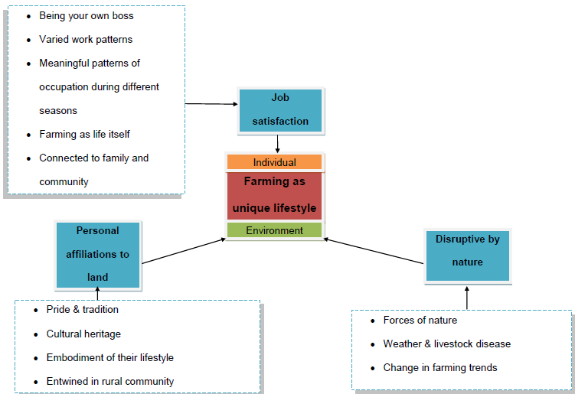
Results- Theme 1

Slide 17
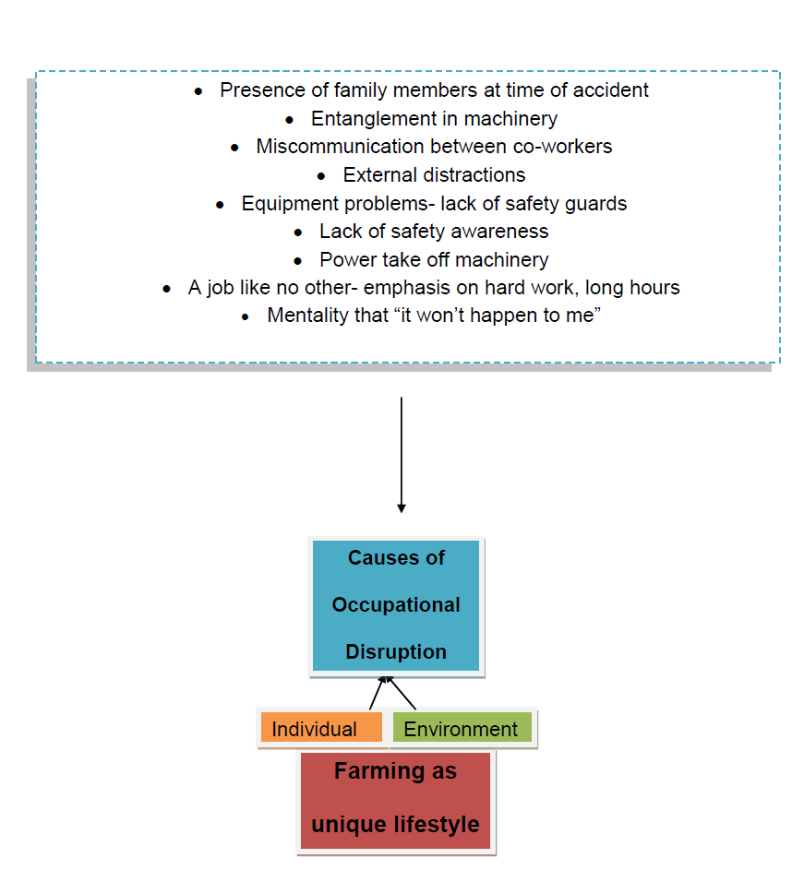
Results- Theme 1

Slide 18
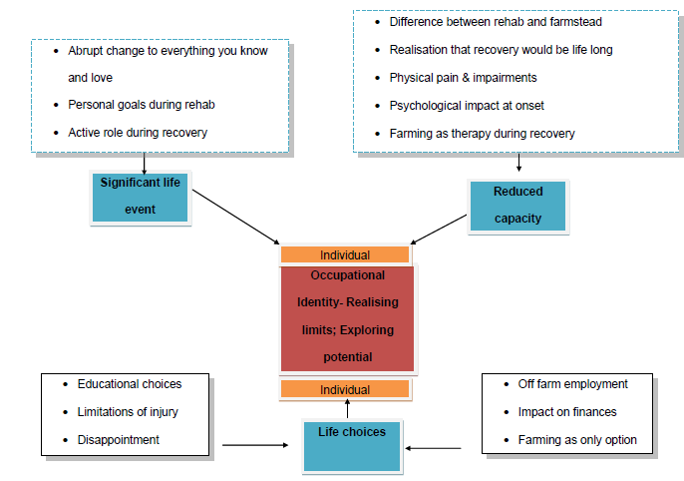
Results

Slide 19
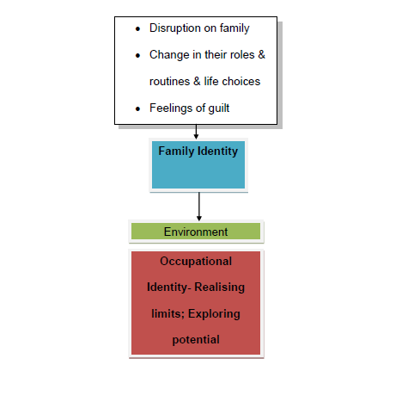
Results

Slide 20
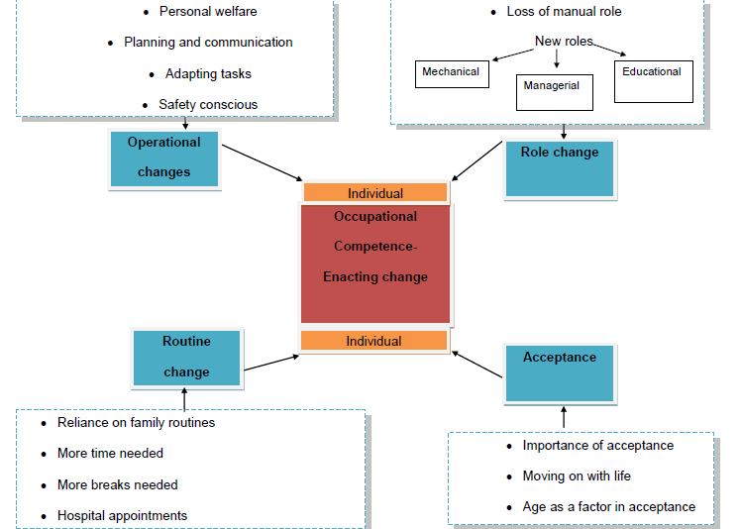
Results

Slide 21
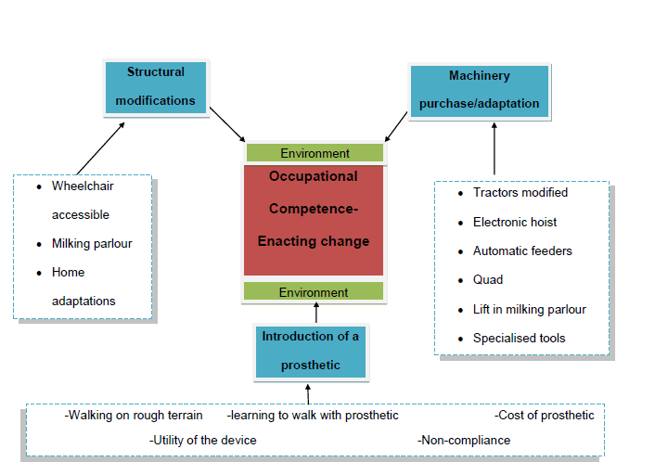

Slide 22
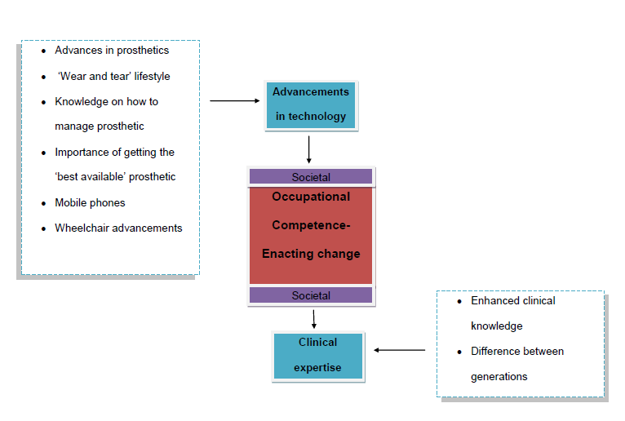

Slide 23
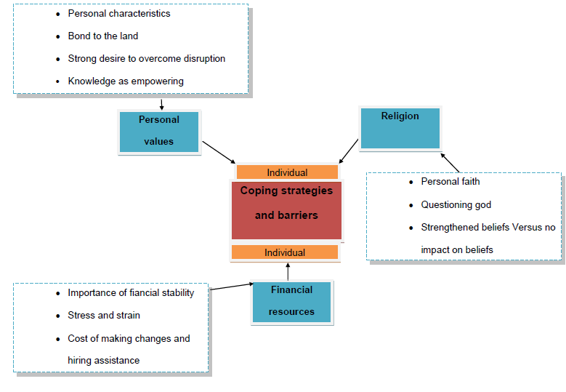

Slide 24
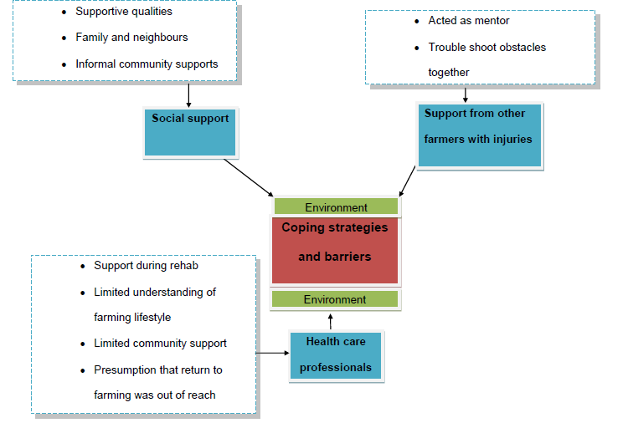
Results

Slide 25
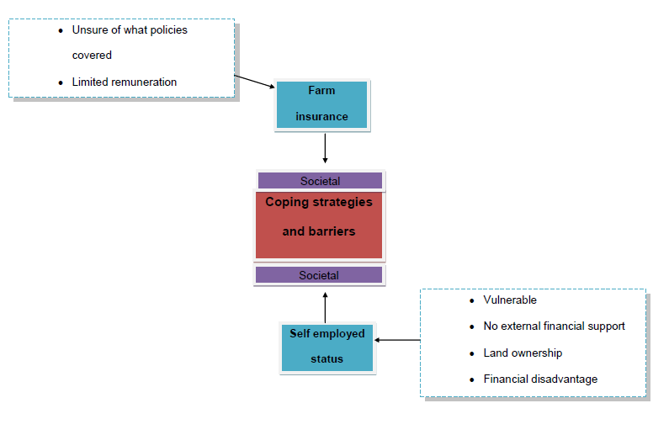

Slide 26
Photos of adaptations

Slide 27
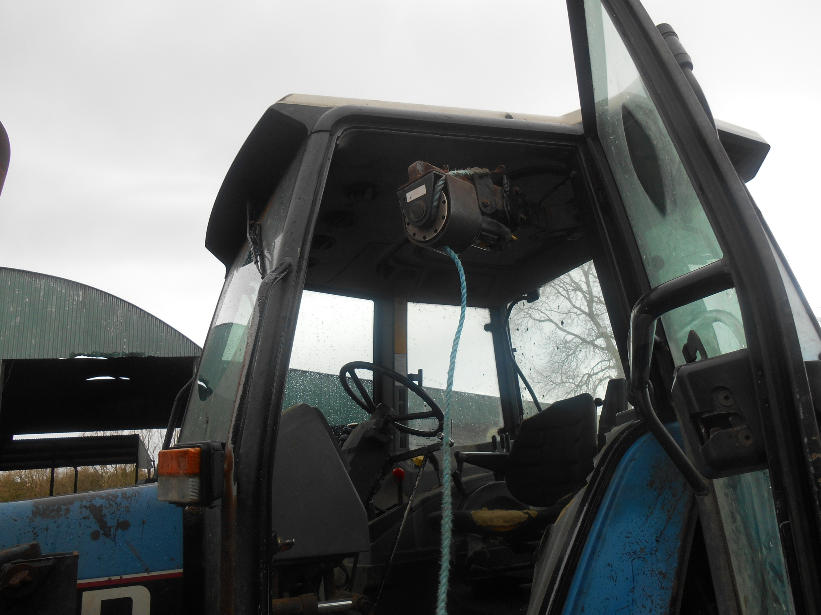
Electronic Hoist

Slide 28
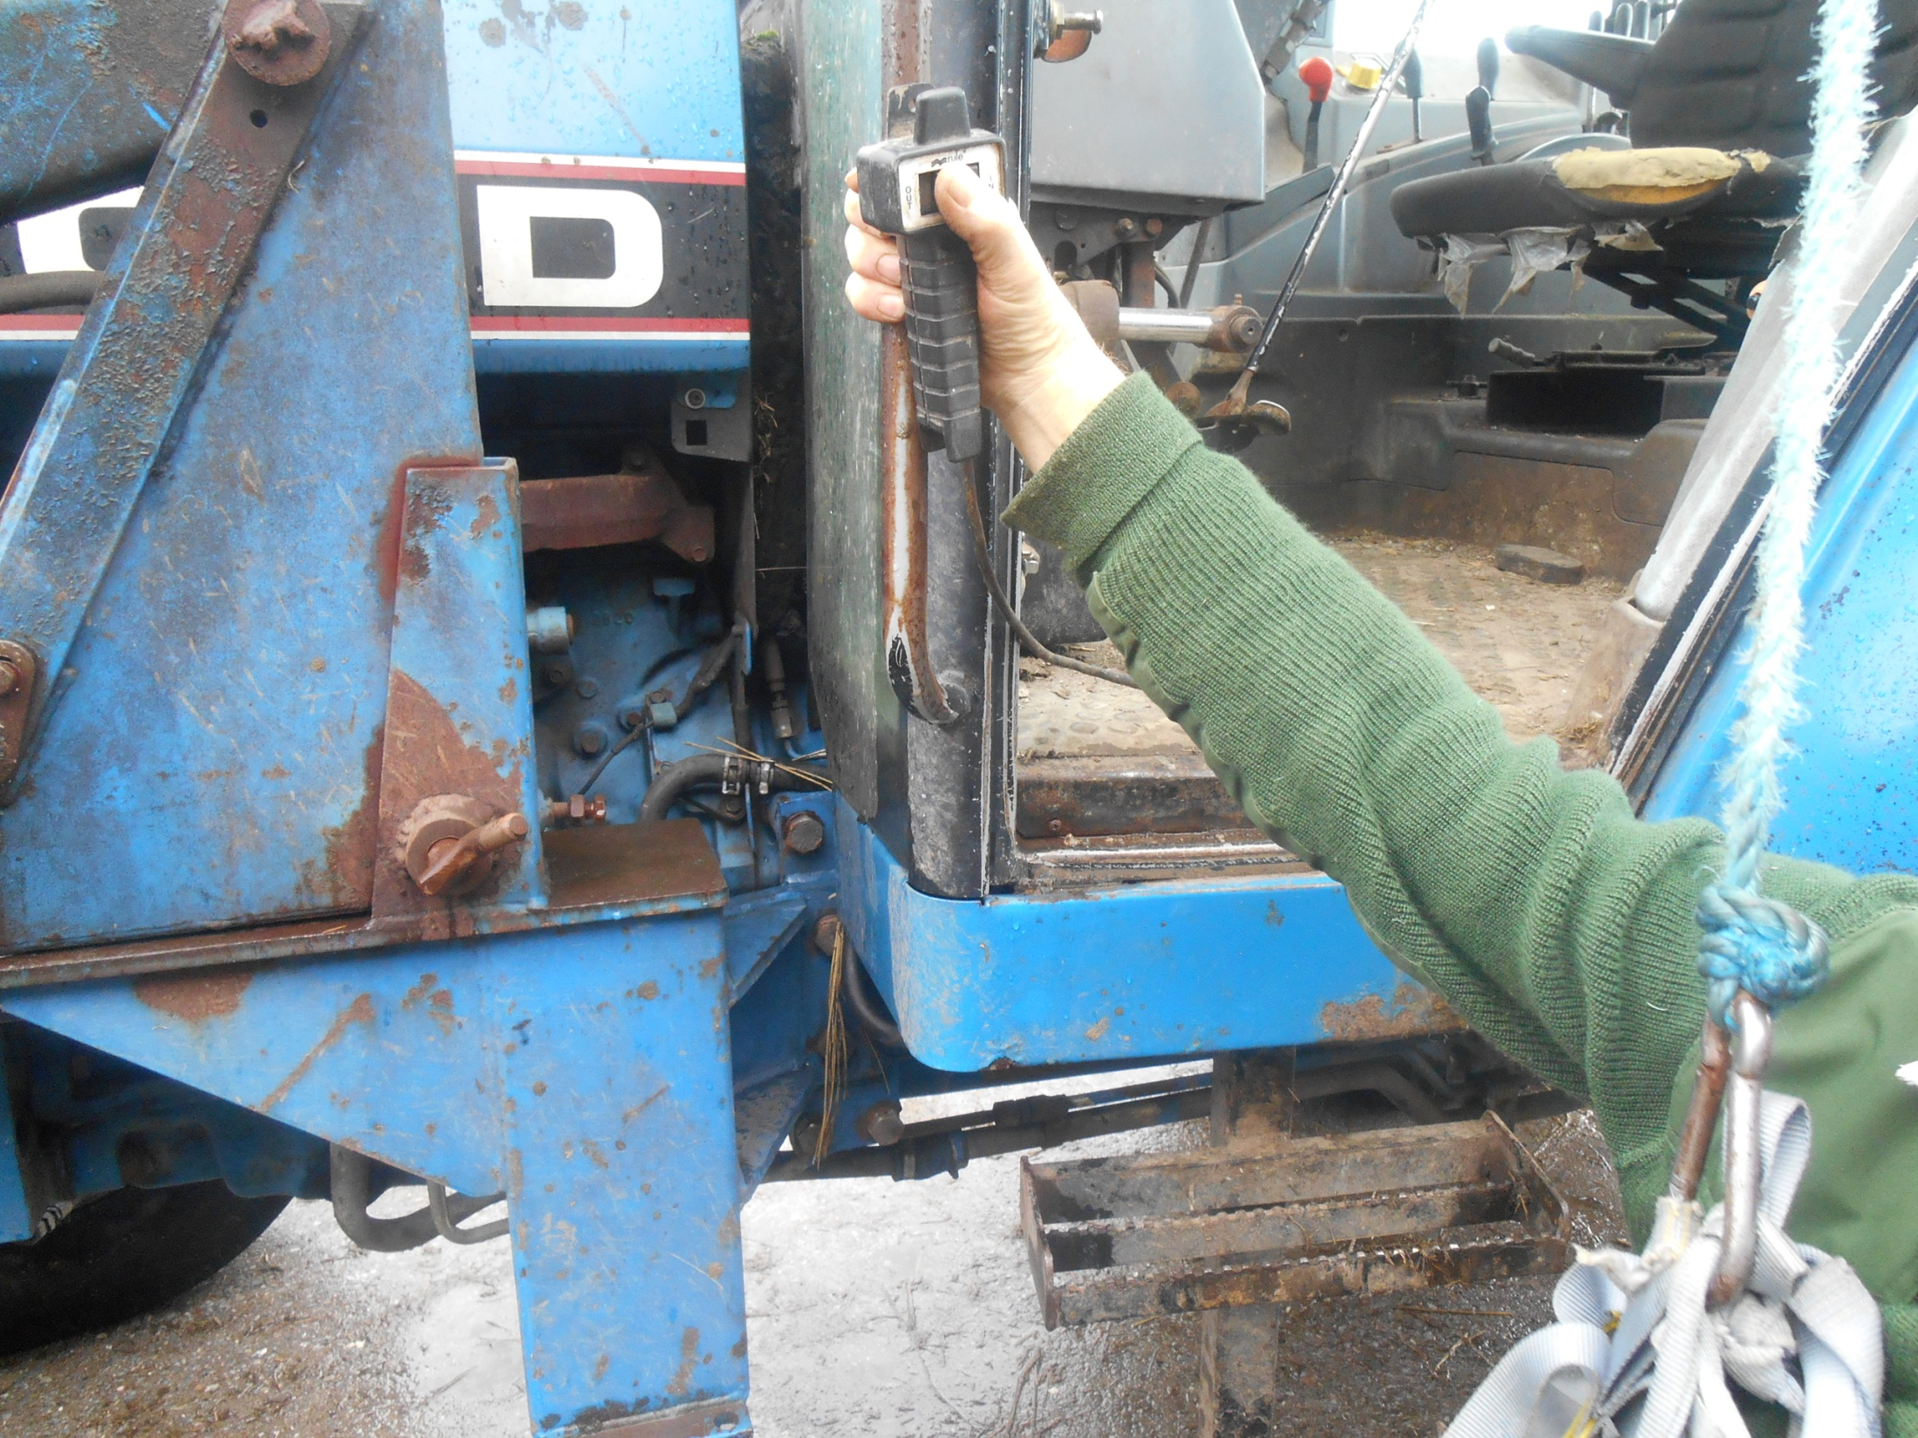
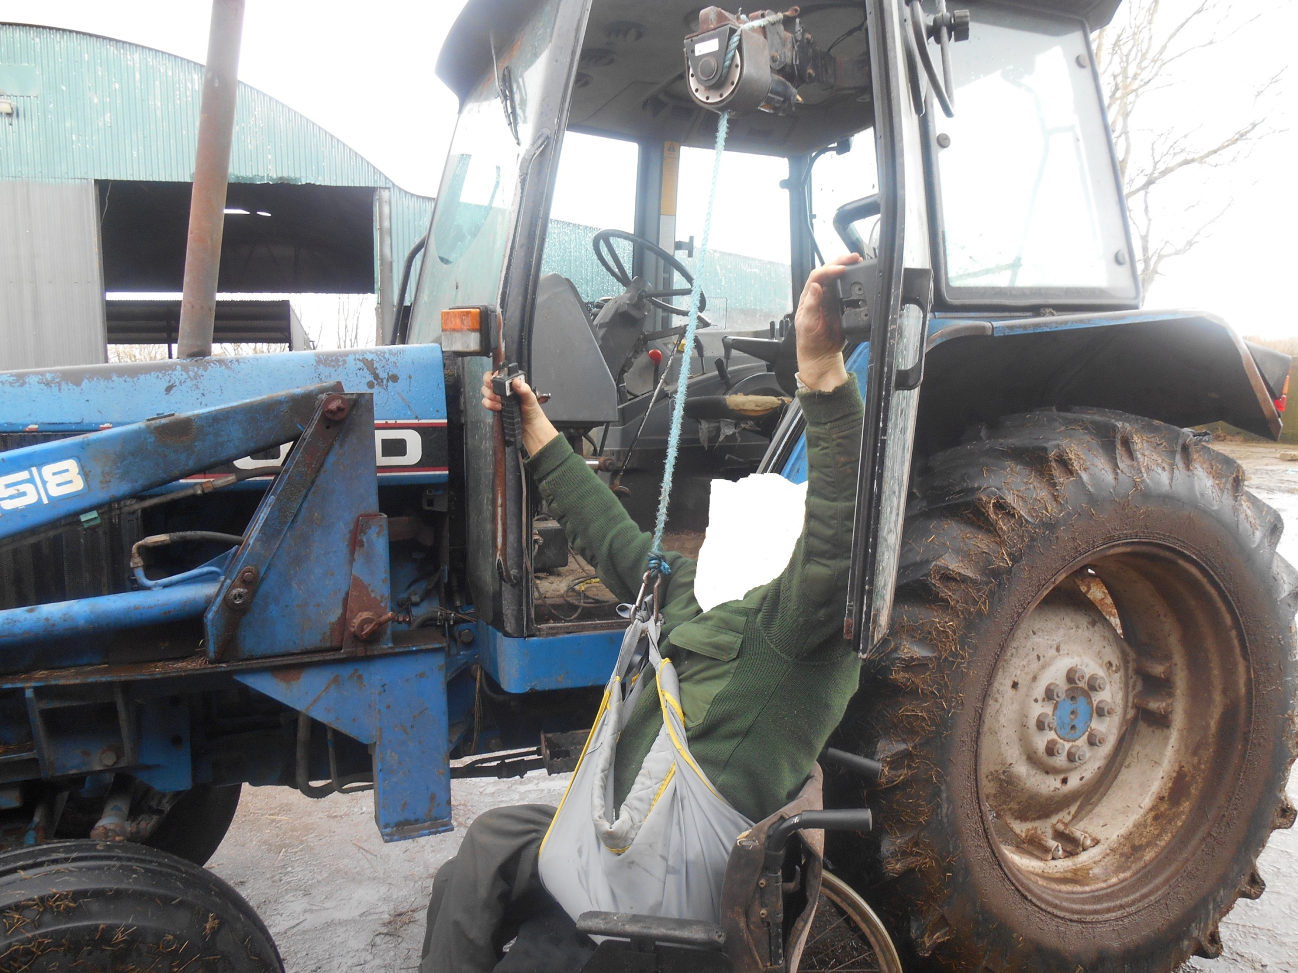
Wheelchair to Tractor Transfer

Slide 29
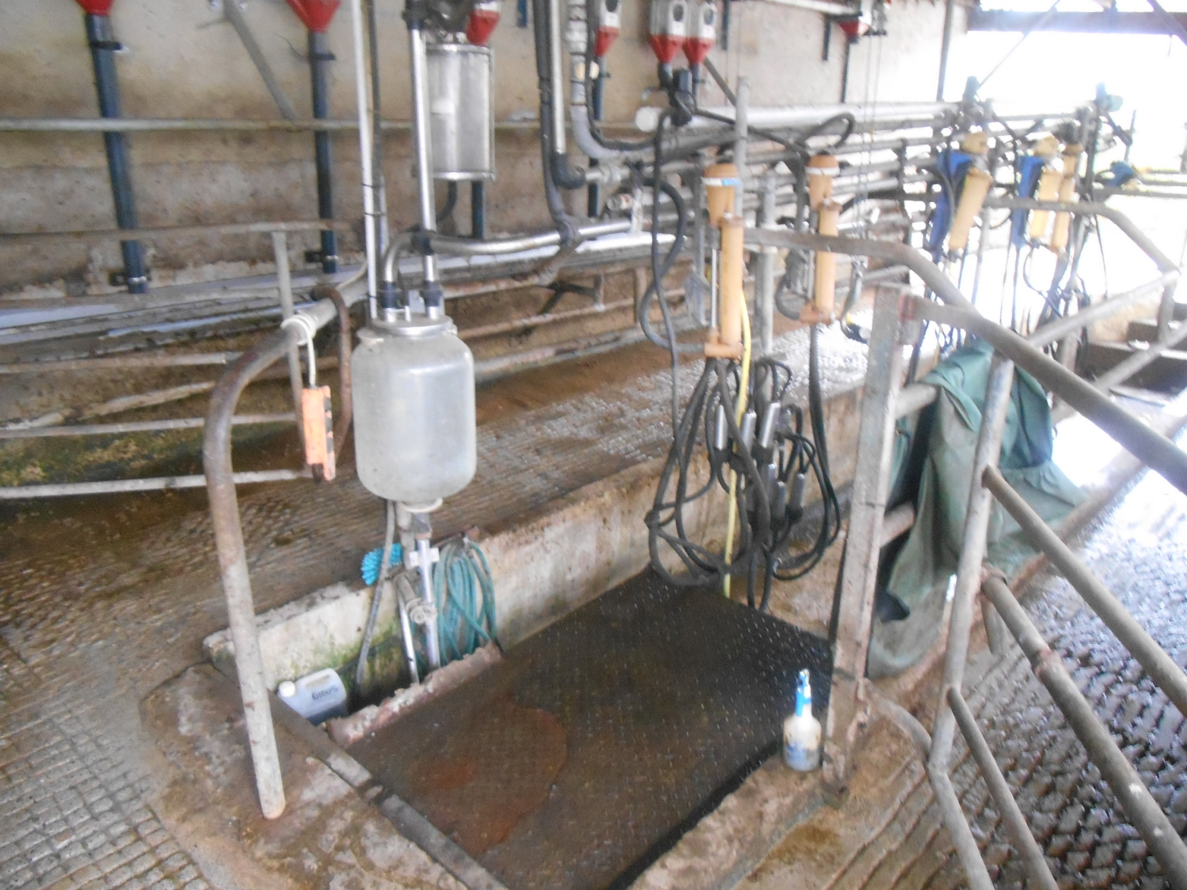
Lower walls
Electronic Lift

Slide 30
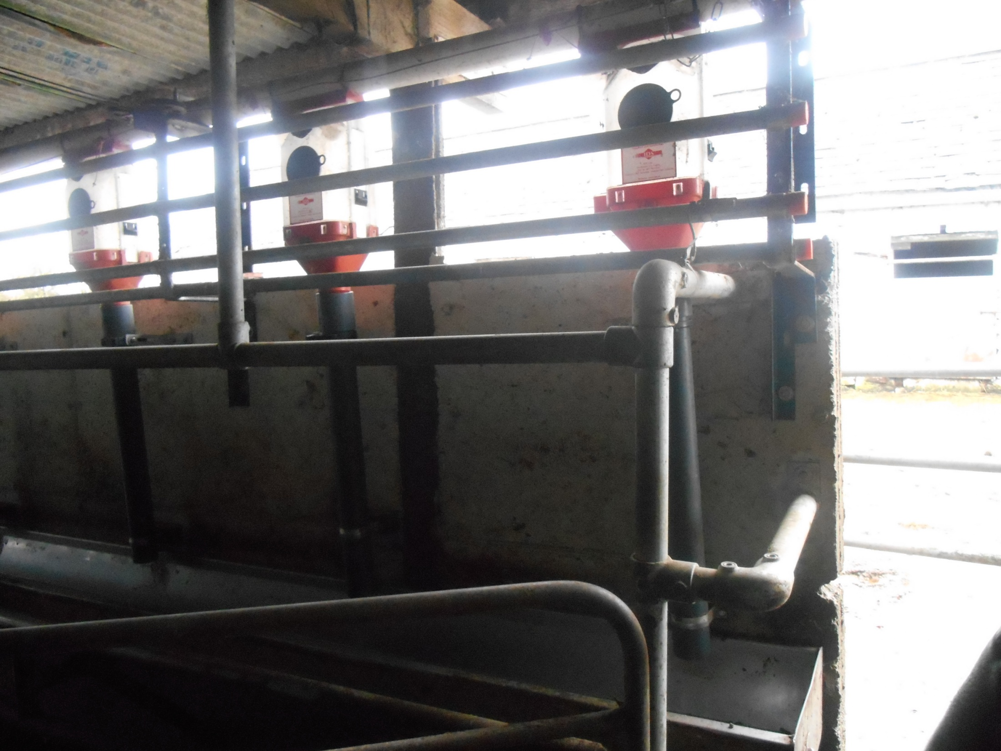
Automatic Feeders

Slide 31
discussion

Slide 32
Discussion
Social Model of disability
Community impact
Individual & Environmental Factors
Christiansen, 1999; Reed & Claunch,1998; Reed, 2004

Slide 33

Potential Limitations
Inexperience of primary researcher
Small sample of population affected

Slide 34

Implications
(Molyneaux-Smith, Townsend & Guernsey, 2003; Hissong & Wilhite, 2008; Hissong, Jorge & Wilhite, 2008; Hissong & Wilhite, 2010

Slide 35
Implications
Research
Practice
Policy
(Molyneaux-Smith, Townsend & Guernsey, 2003; Hissong & Wilhite, 2008; Hissong, Jorge & Wilhite, 2008; Hissong & Wilhite, 2010

Slide 36
Acknowledgements
Participants
Irish Farmers Association
Teagasc
Department of Occupational Therapy, NUIG

Slide 37
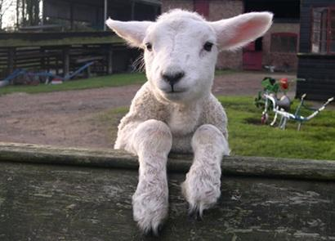
Thank you for listening

Slide 38
References
Angoules, A. (2012) ‘Agricultural Injuries: A global rural health problem’ Journal of Trauma and Treatment 1 (6) pp.1-2
Apte, A., Kielhofner, G., Paul-Ward, A. & Braveman, B (2005) ‘Therapists and clients perceptions of the Occupational Performance History Interview’ Occupational Therapy in Health Care 19 (1-2), pp.173-192
Baker, T.L. (1994), Doing Social Research (2nd Ed), New York: McGraw-Hill
Braun, V & Clarke, V (2006) ‘Using Thematic Analysis in Psychology’ Qualitative Research in Psychology, 3 (2) pp.77-101
Cook, JV (2001) Qualitative research in occupational therapy: strategies and experiences. Albany, NY: Delmar Thomson Learning

Slide 39
References
Cotton, G.S (2012) ‘Occupational Identity Disruption after TBI: an approach to Occupational Therapy evaluation and treatment’ Occupational Therapy in Health Care 26 (4) pp.270-282
Coyne, I.T (1997) ‘Sampling in qualitative research; Purposeful and theoretical sampling; merging or clear boundaries’ Journal of Advanced Nursing 26 pp.623-630
Daly, J., Kelleher, A. & Gliksman, M (1997) The Public Health Researcher: A methodological approach Australia: Oxford University Press
Denzin, N. K., & Lincoln, Y. S. (1998). Collecting and interpreting qualitative material.
Thousand Oaks, CA: Sage.
Donalek, J.G (2004) ‘Demystifying Nursing Research’ Urologic Nursing 24 pp.516-517
Fereday, J. & Muir-Cochrane, E (2006) ‘Demonstrating rigour using Thematic Analysis: A Hybrid Approach of inductive and deductive coding and theme development’, International Journal of Qualitative Methods, 5 (1), pp.1-11

Slide 40
References
Finnegan, A. (2007) An examination of the status of health and safety on Irish farms
Unpublished BA Thesis University College Dublin
Finlay, L. (1999) ‘Applying Phenomenology in research: problems, principles and practices’ British Journal of Occupational Therapy 62, pp.299-306
Fossey, E (1996) ‘Using the Occupational Performance History Interview: Therapists
reflections’ British Journal of Occupational Science, 59 (5) pp.223-228
Green, J. & Thorogood, N (2004) Qualitative methods for health research London: Sage
Hammell, K.W., Carpenter, C. & Dyck, I (2000) Using Qualitative Research: A practical Guide for physical and occupational therapists Oxford: Churchill Livingstone

Slide 41
References
Hammell, K.W (2001) ‘Using qualitative research to inform the client centred evidence- based practice of occupational Therapy’ British Journal of Occupational Therapy 64 (5) pp.228-234
Hissong, A. & Wilhite, C (2008). ‘Occupational therapy's role with farmers with disabilities
or disease: Understanding the cultural factor of farming as a way of life’ OT Practice,
13 (13) p.1-8
Hissong, A., Jorge, M. & Wilhite, C. (2008, June) Education of occupational and physical
therapy professionals in rehabilitation. National Institute of Farm Safety Proceedings.
sowing the Wind with Safety & Health.
Hissong, A.N & Wilhite, C (2010) 15th ‘World congress of World Federation of
Occupational Therapists’ The Farmer, The Farm, and Farming: More than seeds and
manure- Assisting farmers tell & own their story of everyday living secondary to Injury or
Disease 4th – 7th May, Santiago, Chile Pennsylvania: AgrAbility

Slide 42
References
Holloway, I (Ed) (2005) Qualitative Research in Healthcare Berkshire: Open University Press
Kielhofner, G., & Henry, A.D (1988) ‘Development and investigation of the occupational performance history interview’ The American Journal of Occupational Therapy 42 pp. 489-498
Kielhofner, G., & Mallinson, T (1995) ‘Gathering narrative data through interviews: empirical observations and suggested guidelines’ Scandinavian Journal of occupational therapy 2 pp.63-68
Kielhofner, G, Mallinson, T, Forsyth, K & Lai, J.S (2001) ‘Psychometric properties of the second version of the Occupational Performance History Interview (OPHI-II)’ The American Journal of Occupational Therapy 55 (3) pp. 260-267

Slide 43
References
Kielhofner, G. (2002) Model of Human Occupation: Theory and application, 3rd ed., London: Lippincott Williams & Wilkins
Krefting, L (1991) ‘Rigor in qualitative research: The assessment of Trustworthiness’ American Journal of occupational therapy 45 (3) pp.214-222
Lincoln, Y.S & Guba, G.G. (1985) Naturalistic Inquiry, Newbury Park, C.A.: Sage as cited in Ballinger, C (2004) ‘Writing up rigour: representing and evaluating good scholarship in qualitative research’ The British Journal of Occupational Therapy, 67 (12) pp. 540-546
Mallinson, T, Kielhofner, G, Crawford, C, Nowak, M, Rigby, M, Henry, A & Walens, D (2004) ‘A User’s Manual for The Occupational Performance History Interview (OPHI-II)-Version 2.1 Model of Human Occupation Clearinghouse, Department of Occupational Therapy, College of Applied Sciences, University of Illinois of Chicago

Slide 44
References
McNamara, J, Ruane, D, Whelan, S, & Connolly, L (2007) "Preliminary Investigation of the Incidence and Impact of Disability on Irish Farms" Journal of International Agricultural & Extension Education 14 (2); 21-35
Merriam, S.B. (1998) Qualitative research and case study applications in education, San Francisco: Jossey-Bass
Miles, J & Gilbert, P (Eds) (2005) A handbook of research methods for clinical & health psychology New York: Oxford
Molyneaux-Smith, L, Townsend, E & Guernsey, J.R (2011) ‘Occupation Disrupted: Impacts, Challenges & Coping Strategies for farmers with disabilities’ Journal of Occupational Science 10 (1) pp.14-20

Slide 45
References
Parry, J., Lindsey, R., Barnes, H. & Taylor, R. (2005) Farmers, Farm-workers and work related stress London: Health & Safety Executive
Phelan, S & Kinsella, E.A (2009) ‘Occupational identity: Engaging Socio-cultural perspectives’ Journal of Occupational Science 16 (12) pp. 85-91
Pickett, W, Day, L & Dosman, J (2008) ‘The Saskatchewan farm injury cohort: rationale & methodology’ Public Health reports 123 (5) pp.567-575
Reis, H.T & Judd, C.M (ed) (2000) Handbook of Research Methods in Social and Personality Psychology New York: Cambridge University Press
Ritchie, J., Lewis, J. & Elam, G (2003) ‘Designing and selecting samples’ In Ritchie, J & Lewis, J (Eds) Qualitative Research Practice: a guide for social science students and researchers Thousand Oaks, C.A: Sage pp. 77-108
Robson, C (2002) Real World Research , 2nd ed Oxford: Blackwell Publishing

Slide 46
References
Schwammle, D (1996) ‘Occupational Competence explored’ Canadian Journal of
Occupational Therapy 63 (5) pp.323-330
Shenton, A.K (2004) ‘Strategies for ensuring trustworthiness in qualitative research
projects’ Education for information 22 pp.63-75
The Health and Safety Authority (2013) Farm Safety Action Plan- 2013-2015 Dublin:
Health and safety Authority
Teijlingen, E.R.V & Hundley, V (2001) ‘The importance of pilot studies’ Social Research Update 35 PP.1-4

Slide 47
References
Tufford, L & Newman, P (2012) ‘Bracketing in qualitative research’ Qualitative social work 11 (1) pp.80-96
Whelan, S (2011) A Study on the impact of Disability among farm operators on the Farm Business and their requirement for support and services Unpublished Degree of Doctor Thesis. National University of Ireland, Dublin
Whelan, S., Ruane, D., McNamara, J., Kinsella, A., & McNamara, A. (2009) "Disability on Irish farms – a real concern" Journal of Agromedicine. Vol. 14 (2); 157-163
Whiteford, G (2000) ‘Occupational Deprivation: a global challenge in the new millennium’ British Journal of occupational therapy 63 (5) pp.200-204
Wilding, C. & Whiteford, G (2005) ‘Theoretical and Philosophical underpinnings of phenomenological research’ Occupational Therapy Journal of Research, 25 (3) pp.98-104

